Slide 1

Pore-Throat Type A
Water in
(imbibition)
Water out
Pore-Throat Type B
Residual oil (Snap-off)

Slide 2
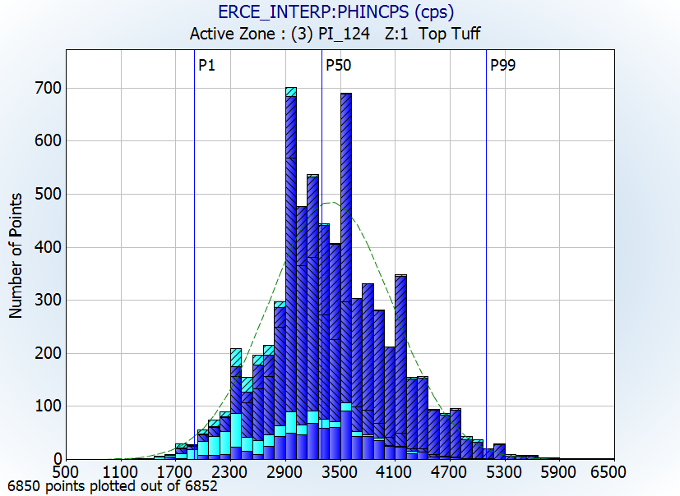
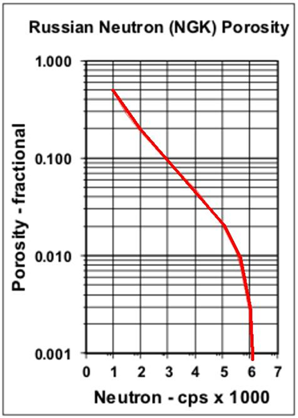
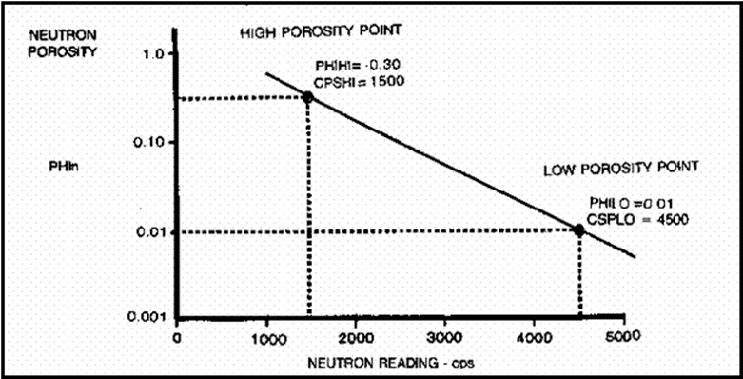
NEAR
Counts*
PHIN⁺
FAR
Counts*
Rescale

Slide 3
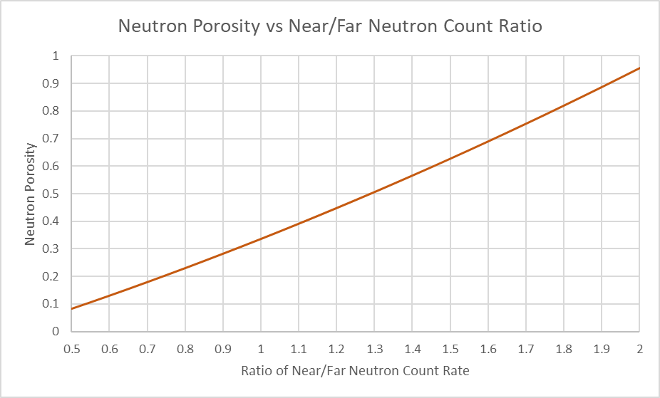
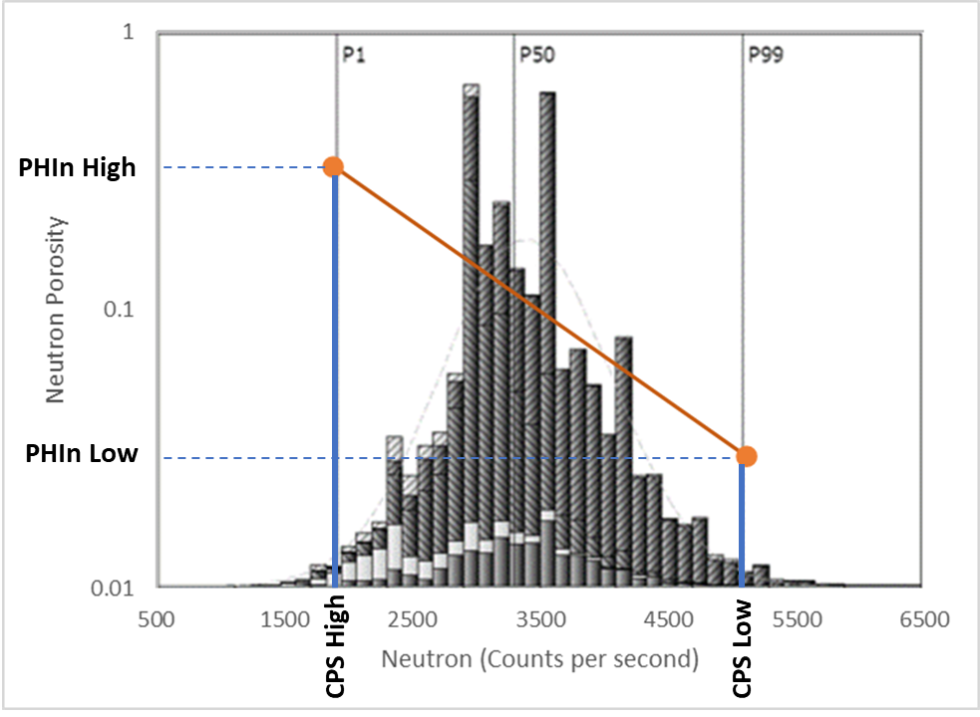
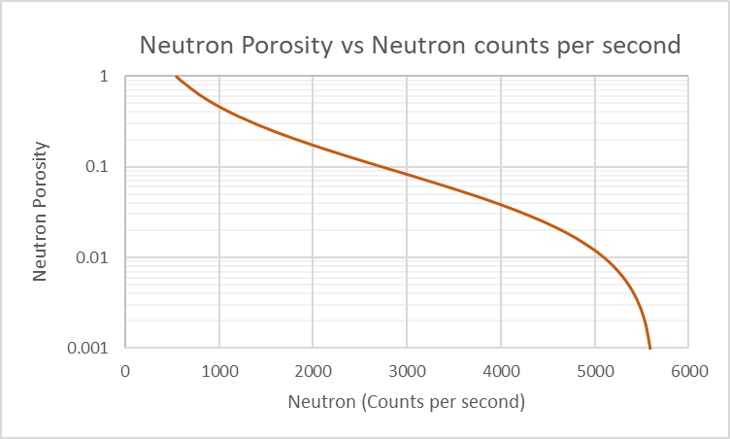

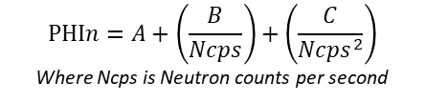

$$PHIn=A{(Nrat)}^{2}+ B\left(Nrat\right)\text{ − }\text{C}$$
Where Nrat is ratio of near to far counts
NEAR
Counts*
PHIn⁺
PHIT
$PHIn=0.0747{(Nrat)}^{2}$ + 0.3942$\left(Nrat\right)$ - 0.1325
from Carlstrom & Cluff (2003)
Frequency
FAR
Counts*
Compute PHIn
Convert to PHIT with High-Low method
$$PHIn=A+\left(\frac{B}{Ncps}\right)+\left(\frac{C}{{Ncps}^{2}}\right)$$
Where Ncps is Neutron counts per second

Slide 4
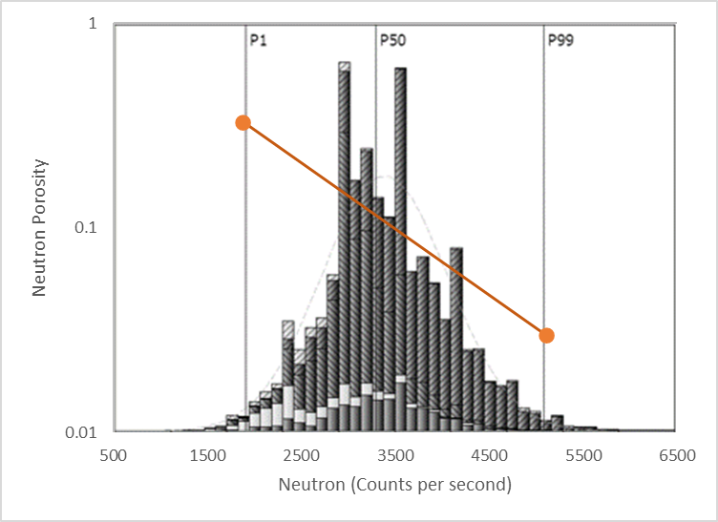
PHIn High
PHIn Low
CPS High
CPS Low

