Slide 1
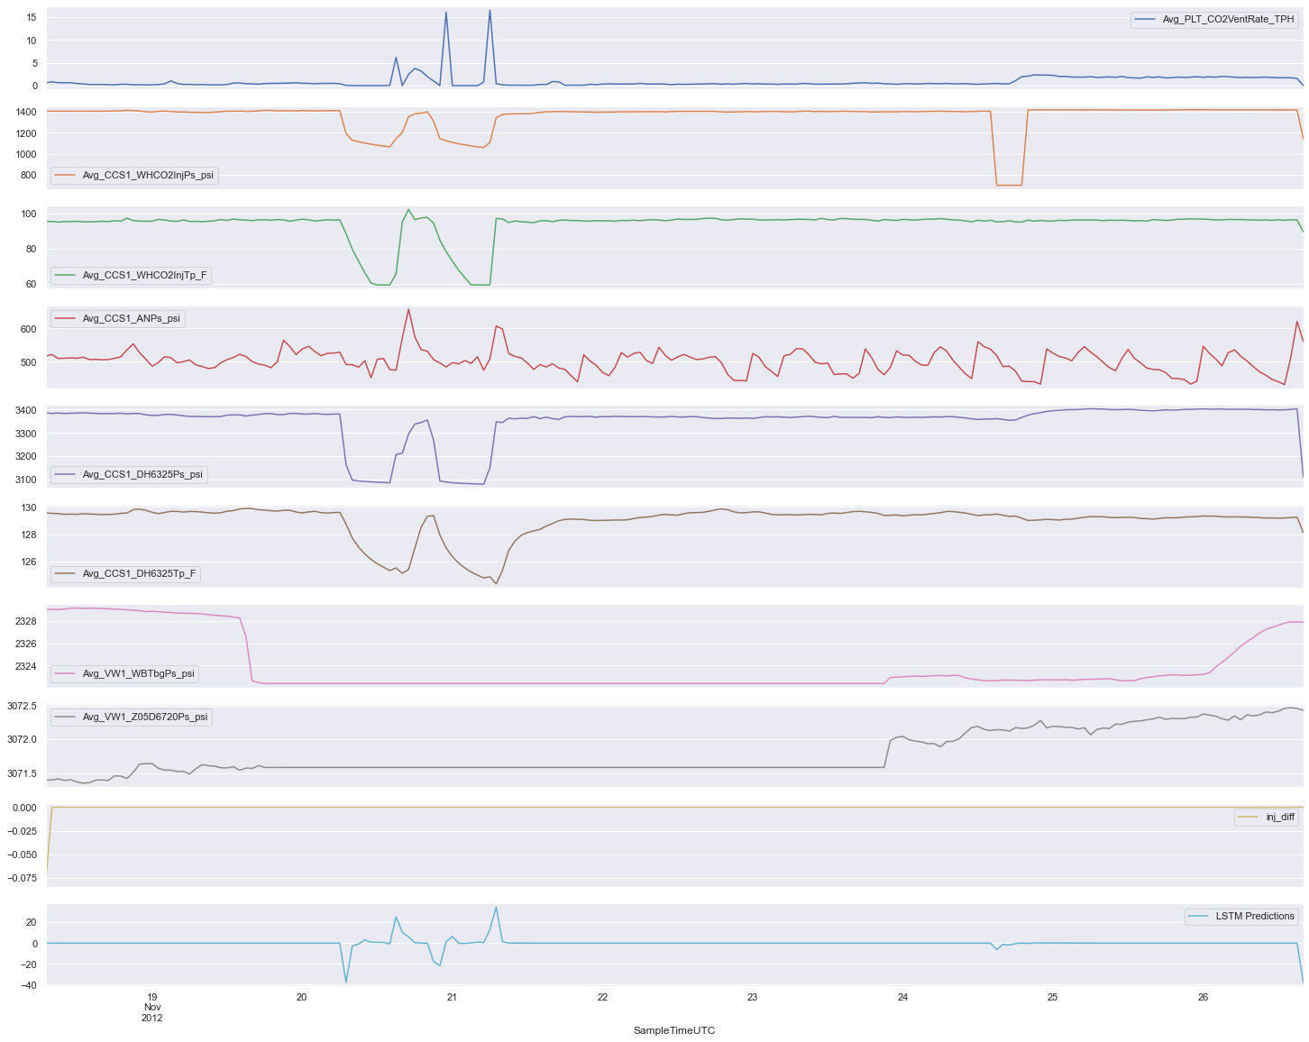
15
Avg_PLT_CO2VentRate_TPH
10
5
0
1400
1200
1000
Avg_CCS1_WHCO2InjPS_psi
800
100
80
Avg_CCS1_WHCO2InjTp_F
60
600
Avg_CCS1_ANPs_psi
500
3400
3300
3200
Avg_CCS1_DH6325Ps_psi
3100
130
128
126
Avg_CCS1_DH6325Tp_F
2328
Avg_VW1_WBTbgPs_psi
2326
2324
2322
3072.5
Avg_VW1_Z05D6720Ps_psi
3072.0
3071.5
0.000
inj_diff
-0.025
-0.050
-0.075
20
LSTM Prediction
0
-20
Sample Time UTC
-40
19 Nov
2012
20
21
22
23
24
25
26

