Slide 1
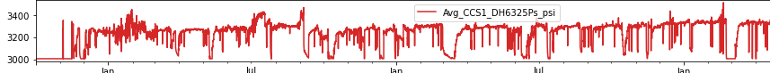
After Data Cleaning
Before Data Cleaning

Slide 3
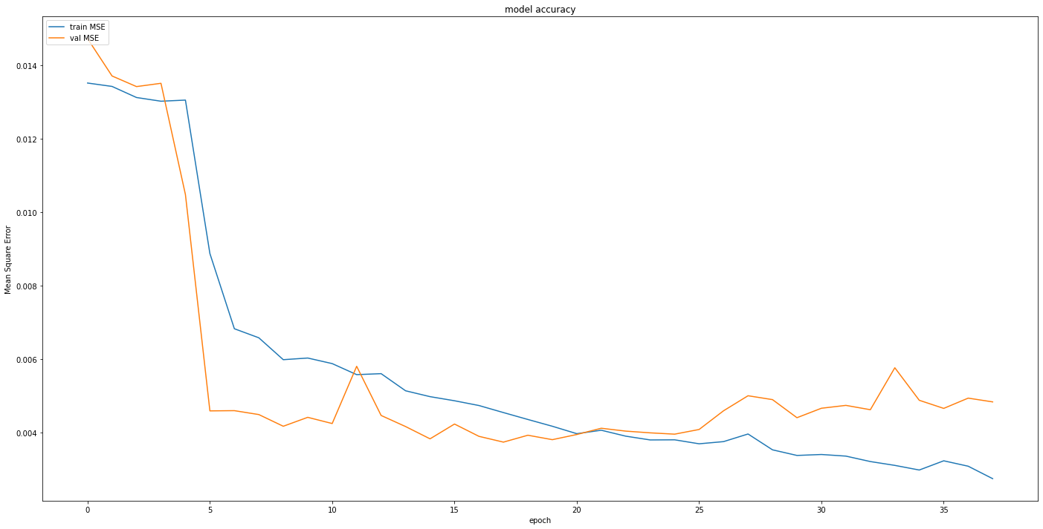
train MSE
val MSE
Model Accuracy
0.014
0.012
0.010
Mean Squared Error
0.008
0.006
0.004
0
5
10
15
Epoch
20
25
30
35

Slide 4
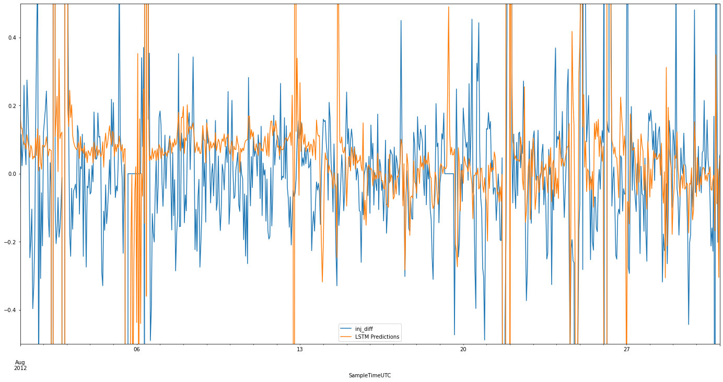
0.4
0.2
0.0
-0.2
-0.4
Inj Diff
LSTM Predictions
Aug 2012
6
13
Sample Time UTC
20
27

Slide 5
0.4
0.2
0.0
-0.2
-0.4
Inj Diff
LSTM Predictions
Aug 2012
6
Sample Time UTC
13

Slide 6
Inj Diff
LSTM Predictions
0.4
0.2
0.0
-0.2
-0.4
20
Sample Time UTC
27
Aug 2012

Slide 7
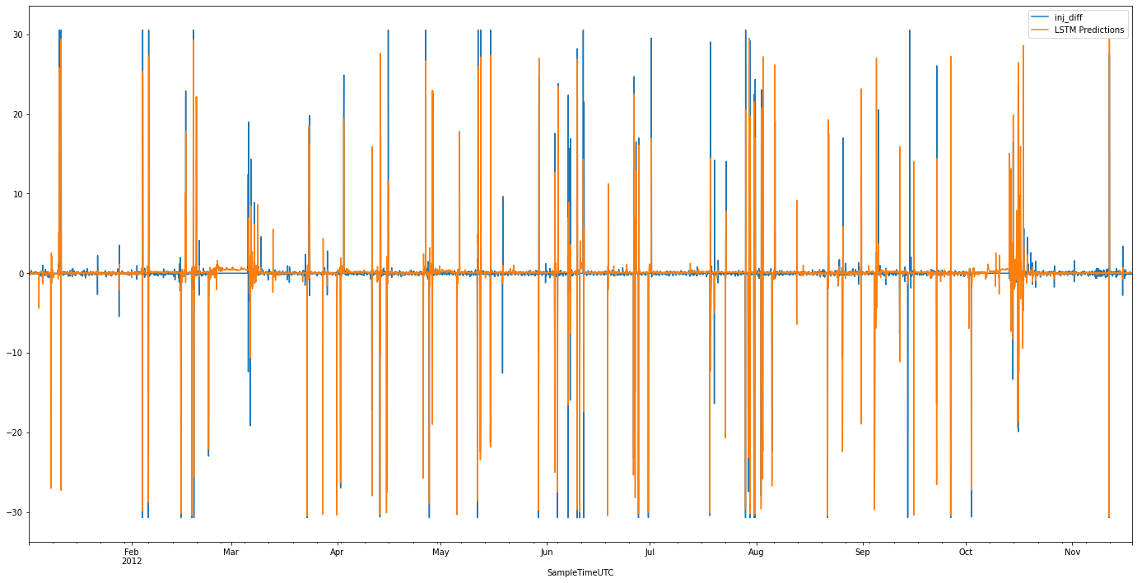
Inj Diff
LSTM Predictions
30
20
10
0
-10
-20
-30
Feb
2012
Mar
Apr
May
Jun
Jul
Aug
Sep
Oct
Nov
Sample Time UTC

