Slide 1
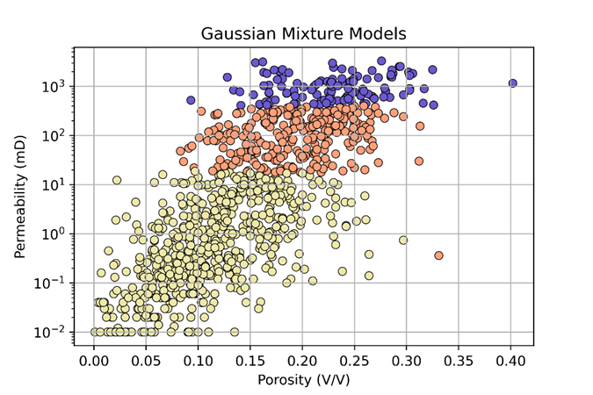
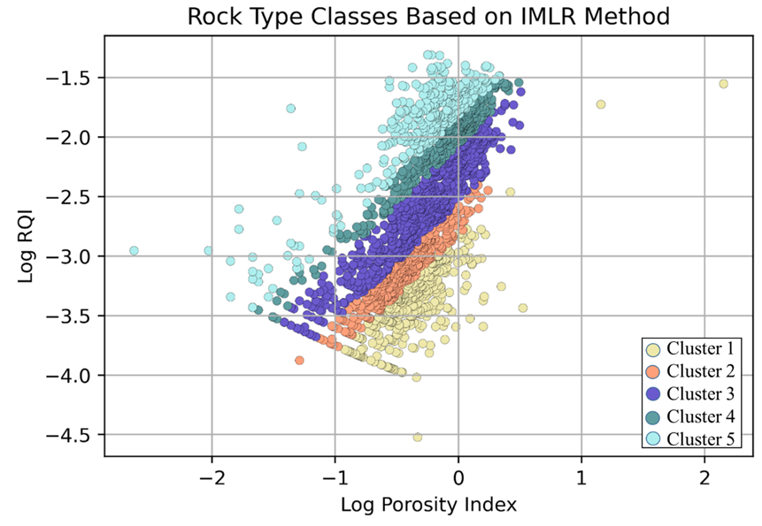

Evaluating Different Clustering Algorithms for Prediction of Rock Types and Permeability
We have trialed 5 unique UML methods trialed, with each showing different outcomes. Of the 5, Density-Based Spectral Clustering & Gaussian Mixture Models show results most closely matching empirical core measurements. This highlights that UML methods can potentially perform permeability prediction to reasonable degrees of accuracy.
Rock Typing is used in numerous ways, such as predicting permeability away from well control. This is typically done using porosity and permeability measurements taken from core samples.
Typically, it’s a manual process, potentially involving several subject matter experts. Yet, with advanced in unsupervised machine learning (UML), this approach can be simplified and accelerated*
Munish Kumar and Tan Wen Xuan, Singapore University of Social Sciences
*Graphic courtesy of vecteezy.com

