Slide 1

ANL488 Oral Presentation
Project Title: Prediction of the feasibility of potential CO2 storage locations
Low Kai boon Calvin
Student id: n1981115
Supervisor: Dr Munish KumaR

Slide 2
Agenda
Introduction to Carbon Capture and Storage (CSS)
Business Objective
Data Understanding
Data Preparation
Predictive Modelling
Results & Evaluation
Recommendations

Slide 3
Introduction to CSS
CSS is the act of reducing the amount of carbon dioxide in the atmosphere
Used in conjunction with emission-intensive industries
CSS technologies include:
solvent scrubbing and oxyfuel combustion used in man-made CSS facilities
Inject pressurized carbon dioxide into a stable geological feature
Advantages of CSS include:
CCS can easily retrofitted onto existing systems
decarbonisation of emission-intensive industries

Slide 4
Business Problem
There is an interest in developing CSS facilities to address global warming
However, the obstacles hindering the development of CSS facilities are:
The development of CSS facilities requires planning beforehand, expensive and complex
Several various factors to consider
Thus, there is encouragement for companies to take on CSS projects by:
Letting companies take the risks associated with CCS projects
Have a catalogue of information regarding the past, present and future CCS projects.
Objectives
Using publicly available data to build predictive models to determine the feasibility of CSS projects

Slide 5
About the Datasets Used
The two datasets I am going to use in my data analysis are:
CSS Dataset
Contains information including the facilities’ location, types of CSS technologies used, project cost and status and the amount of CO2 to be captured and stored
Has 305 rows of information
CSRC Dataset
Contains information regarding natural-occurring geological features, its location and the amount of CO2 that can be stored.
Has 852 rows of information

Slide 6
Data Cleaning & Transformation
Cleaning the CSS Dataset
Tidying up the headers
Remove redundant information
Standardise measurement and currency
Cleaning the CSRC Dataset
Remove redundant information
Transforming both datasets
Standardise headers and add information to both datasets for concatenation
Encoding to convert text variables to numerical variables

Slide 7
Data Modelling
Partition the dataset into training and testing dataset
Build two types of predictive models:
Decision Trees
Artificial Neural Network (ANN)
Evaluation of predictive models using confusion matrix

Slide 8
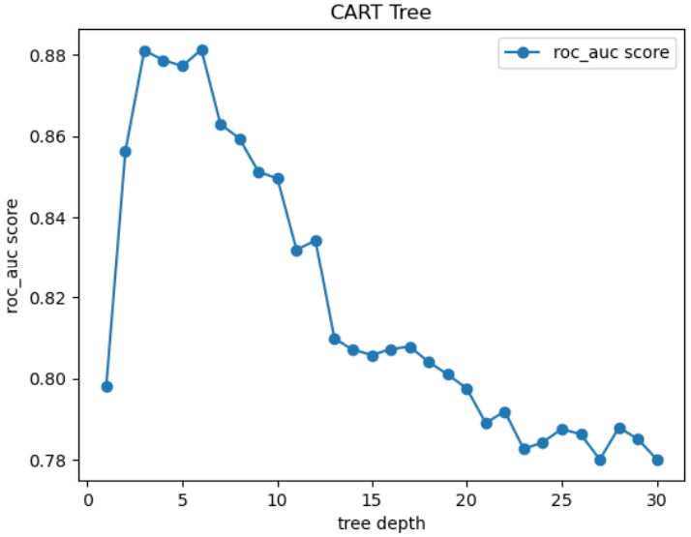
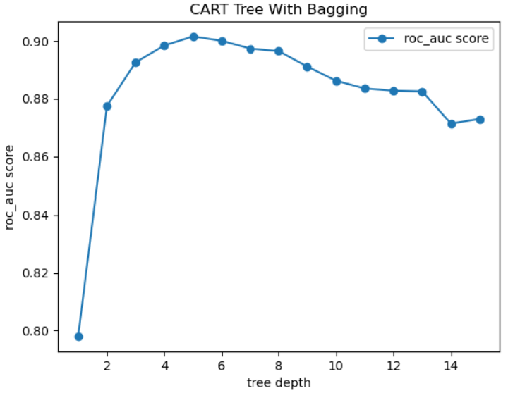
Decision Tree Pruning

Slide 9
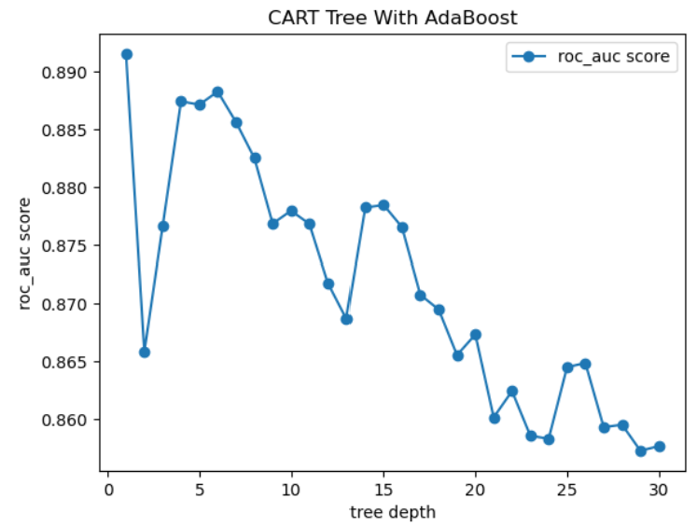
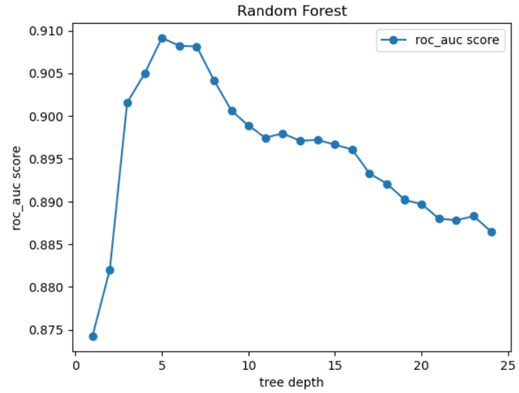
Decision Tree Pruning

Slide 10
ANN’s Hidden Layer Sizes
Use six hidden layer sizes:
(10,), (50,), (100,), (10, 10), (50, 50), (100, 100)
Construct ANN models with each of the hidden layer sizes
The ANN models with the highest accuracy rate will be chosen

Slide 11
Comparison of Accuracy Rates
Predictive model | Overall Accuracy Rate | Sensitivity | Specificity
CART Tree | 80.51% | 82.01% | 76.79%
CART Tree With Bagging | 79.49% | 82.73% | 71.43%
CART Tree With AdaBoost | 83.08% | 90.65% | 64.29%
Random Forest | 82.56% | 88.49% | 67.86%
ANN | 63.08% | 59.71% | 71.43%
ANN With Bagging | 62.05% | 58.99% | 69.64%

Slide 12
Random Forest Illustration
Storage And/Or Capture ≤ 0
0: 305
1: 471
Samples: 776
Capture Amount (Mt) ≤ 2872
0: 247
1: 457
Samples: 704
Capture Amount (Mt) ≤ 7211.
0: 58
1: 14
Total: 72
Amines ≤ 0
0: 114
1: 416
Total: 530
Plant ≤ 0
0: 133
1: 41
Total: 174
0: 0
1: 3
Total: 3
Project Cost (USD) ≤ 10500000256
0: 58
1: 11
Total: 69
MTR Polaris Membrane System ≤ 0
0: 114
1: 414
Total: 528
0: 2
1: 0
Total: 2
Petroleum ≤ 0
0: 122
1: 31
Total: 153
ION’s Solvent CO2 Capture Technology ≤ 0
0: 11
1: 10
Total: 21
Pre-Combustion ≤ 0
0: 58
1: 10
Total: 68
0: 0
1: 1
Total: 1
Petroleum ≤ 0
0: 114
1: 410
Total: 515
0: 0
1: 4
Total: 4
Capture Amount (Mt) ≤ 17170
0: 109
1: 20
Total: 209
Capture Amount (Mt) ≤ 11096
0: 13
1: 11
Total: 23
Pre-Combustion ≤ 0
0: 11
1: 7
Total: 18
0: 0
1: 3
Total: 3
Capture Amount (Mt) ≤ 216102
0: 32
1: 7
Total: 39
Cold Methanol (Rectisol) ≤ 0
0: 26
1: 3
Total: 29
0: 114
1: 144
Total: 256
0: 0
1: 266
Total: 266
0: 44
1: 19
Total: 63
0: 65
1: 1
Total: 66
0: 1
1: 7
Total: 8
0: 12
1: 4
Total: 16
0: 8
1: 4
Total: 12
0: 3
1:: 3
Total: 6
0: 19
1: 7
Total: 26
0: 13
1: 0
Total: 13
0: 25
1: 3
Total: 28
0: 1
1: 0
Total: 1

Slide 13
Recommendations
If the facility is a petroleum field, the capture amount should be no more than 11096
If the facility is a saline aquifer, the capture amount should be no more than 2872 metric tons
If the facility is a plant:
If it does not involve both capture and storage, the plant should capture no more than 2872 metric tons and use MTR Polaris™ Membrane System or Amines
If it does not involve both capture and storage, the plant captures more than 2872 metric tons and use ION’s Solvent CO2 Capture Technology
If it involves both capture and storage, the plant should capture no more than 7211 metric tons
If it involves both capture and storage, the plant captures more than 7211 metric tons, it should cost more than USD 10500000256.

Slide 14
Thank you

