Slide 1


China’s green finance insights from Chinese Literature: A text mining approach
Student Name: Lim Wen Qi
Student PI: E2081571
Supervisor: Dr. Munish Kumar

Slide 2

Agenda
Introduction, Motivations & Research Gaps
01
Objectives
02
Literature Review
03
Data Understanding & Preparation
04
Results & Evaluation
06
07
Data Preprocessing & Modelling
05
Recommendations

Slide 3
Introduction
China is a significant contributor towards climate change
Global contribution: 27% Carbon Dioxide Emissions and 33.3% Greenhouse Gas Emissions
Green finance identified for future sustainable and economic development in 2016
Rapid progression of China’s green finance market:
Established novel green financing system
Multiple green finance regulations implemented
Green bond market: 0% (2015) → 39% (2016)→ 57% (2022)
Notes:
China has been known to contribute significantly towards climate change. Up till 2022, it has contributed to 27% of global CO2 emissions and 33.3% of greenhouse gas emissions. Due to both the 2015 Paris Agreement and 2016 United Nations Sustainability Development Goals, China gained motivation to act on climate change. The country identified green finance in 2016 to tackle this issue. From then on, there has been rapid progression of China’s green finance market. After establishing a novel green finance system and implementing multiple green finance regulations, the market has grown to be the 2nd largest globally. Most prominently, its green bond market grew from 0% in 2015 to a 39% in 2016. At that time, the country became the largest green bond market in just 1 year.

Slide 4
Motivations & Research Gaps
Motivations
China plays an important role in preventing further climate change
E.U. and U.S. that started in 2007 vs China’s rapid growth in 1 year
Research Gaps
Existing bibliometric analysis mainly done on English literature
Bibliometric analysis done on Chinese literature:
English search terms --- Not comprehensive
English translation of journal titles --- Lost of meanings during translation
Notes:
So, why is it important to understand China’s trends? As mentioned earlier, China plays a large role in contributing towards climate change. As such, its developments are therefore crucial to prevent the worsening of climate change. Additionally, China’s rapid growth is also something to learn from. The European Union and United States began developing its green bond market since 2007. However, in just 1 year, China became the largest market in the world. This indicates that there are many aspects to be learnt from the nation’s success.
Upon further research, there are multiple research gaps that need to be addressed. Firstly, it was observed that most bibliometric analysis on China’s green finance market only consisted of those found in English databases, namely the Web of Science and Scopus databases. Even if bibliometric analysis were carried out on Chinese literature from Chinese databases, the authors used English search terms and English translations of the extracted journal titles. Firstly, in a Chinese database, most titles are written in Chinese and do not have translations. Therefore, searching in English renders the search incomprehensive. Secondly, translated journal titles indicate that there is likely to be a lost of meaning during translation. Therefore, these research gaps should be resolved.

Slide 5
Objectives
Aim: A bibliometric analysis on Chinese green finance literature obtained from Chinese databases using machine learning
Research Queries:
RQ1: How recently has research begun into green finance in China?
RQ2: What are the overall green finance insights gathered from Chinese literature?
RQ3: What are the trending topics in green finance from Chinese literature?
Notes:
This study attempts to resolve the research gaps as mentioned. The aim is to conduct a bibliometric analysis on Chinese green finance literature obtained from Chinese databases using machine learning. CNKI was chosen as it is the largest literary database in China. Due to the large number of queried journals expected, text mining will be conducted on the retrieved dataset. Guiding queries are as follows. RQ1 measures the recency of research in China. RQ2 seeks to understand the overall trends from all years of Chinese green finance literature and RQ3 identifies the trending topics in the past 3 years of research.

Slide 6
Literature Review
Global Perspective
Maria et al. (2023) --- climate finance from developed to developing nations
Li et al. (2022) --- Impact, performance and investment
China’s Perspective
Li et al. (2022) --- green finance, green credit and green bonds
Feng et al. (2023) --- green credit, green bonds and green investment
Zhang et al. (2019) --- climate finance, climate change and policy
Notes:
Existing literature has noted rather different focus areas globally and in China. Zhang et al. and Maria et al. have identified that global research areas are mainly towards the ecological and environmental impact direction. Li et al. has also identified that global research veers towards market performance and investment. However, the main topic of research remains the impact towards the environment. On the other hand, both Li et al. and Feng et al. have identified that China looks towards a more monetary aspect of green markets. These results will later be compared with those obtained from this study.

Slide 7


Data Preparation
1
Data Collection
2
3
Collation into Common Data Frame
Data Cleaning
Notes:
3 main steps were involved in obtaining and preparing the dataset for pre-processing and modeling. These include collection of the data, collation and data cleaning.

Slide 8
Data Preparation
Data Collection
Collation into Common Data Frame
Data Cleaning
27,958 APA Citations of Chinese journals
Gathered from CNKI database using 2 search queries and grouped into 4 excel files:
Fields | Search Queries
 | "可持续经济" (Sustainable Finance) | "绿色金融" (Green Finance)
“科技” (Science and Technology) | 3,678 articles | 4,374 articles
“社科” (Humanities and Social Sciences) | 9,879 articles | 10,027 articles
Notes:
Citation data was gathered for all relevant journals using 2 queries, ke chi xu jing ji, which stands for sustainable finance and ‘lv se jing rong’, which stands for green finance in Chinese. Both search terms were entered in Simplified Chinese. A total of 27 thousand 958 records were obtained from all search results. All records were collated into 4 excel files.

Slide 9
Data Preparation
Data Collection
Collation into Common Data Frame
Data Cleaning
Excel files were read as 4 dataframes and concatenated into a single dataframe
Pandas library methods “read_excel” and “concat” were applied
Cleaning steps
Dropping duplicates
Splitting dataframe based on different delimiters
2 relevant outliers were delt with separately
Dropping rows without author or year
Converting ‘Year’ column to numeric
Notes:
The excel files were read into a new Jupyter Notebook where Python codes were ran. The Pandas library was used to read the files and concatenate the resulting dataframes. As both search queries were rather similar, there is a high possibility that duplicate records will be queried. Removing these duplicates resulted in 19 thousand 673 rows remaining. Afterwards, the data was split to separate the citations into different categories, where 2 outlier records were delt with separately. Rows with neither author nor year were dropped, and the Year column was converted to numeric form.

Slide 10





Data Preprocessing & Modelling Pipeline
2 topic modelling models were used: BERTopic and Top2Vec
Both have similar pipelines:
1
2
3
4
5
Embedding
Dimensionality Reduction
Clustering
Vectorization / Tokenization
Topic Extraction
Notes:
2 topic modelling models were used to preprocess and model the data. Both involved embedding, dimensionality reduction, clustering, vectorization or tokenization and topic extraction.

Slide 11
Data Preprocessing & Modelling Pipeline
Embedding
Dimensionality Reduction
Clustering
Vectorization / Tokenization
Topic Extraction
BERTopic & Top2Vec
Embedding involves transforming text documents into numerical representations SBERT pre-trained sentence transformers were used Model: “paraphrase-multilingual-MiniLM-L12-v2” Model was trained on 50+ languages
Notes:
Firstly, Embedding was done for both Bertopic and Top2Vec models. As the input is documents of textual data, transforming these texts into numerical representations are useful in determining the similarity and dissimilarity of the documents. SBERT pre-trained sentence transformers were used. These sentence transformers make use of BERT’s transformer network to produce contextualized word embeddings and use a mean pooling layer to get a fixed dimensional output vector. (768 vector size) The model used was the “paraphrase-multilingual-MiniLM-L12-v2”, which had been trained on datasets of over 50 languages. This makes the model suitable for usage in this study.

Slide 12
Data Preprocessing & Modelling Pipeline
Embedding
Dimensionality Reduction
Clustering
Vectorization / Tokenization
Topic Extraction
BERTopic & Top2Vec
Dimensionality reduction crucial to improve clustering Reduces the dimensions of input embeddings UMAP was used UMAP uses graph layout algorithms to arrange data from a high to low-dimensional space Parameter tuning: N_neighbours = 30 N-components = 5 Min_dist = 0.20
Notes:
Secondly, Dimensionality reduction was conducted for BERTopic and Top2Vec. The transformed embeddings resulted in high dimensionality which results in clustering difficulties. As such, dimensions of the embeddings were reduced using UMAP. UMAP’s graph layout algorithm involves optimizing a low dimension graph representation from a high dimension representation. Using a fuzzy simplicial complex, UMAP ensures the balance between the local and global structure of the data. A custom umap model was formed through parameter tuning. N-neighbours was set as 30, a value higher than the default 15. This was altered because larger values indicated higher focus on global structure. N_components was set as 5, higher than the default of 2. As this dataset is rather small, more dimensions should be preserved to ensure more optimal clustering. Min_dist was set as 0.20, a value higher than a default of 0.1. This ensures looser packing of points to preserve the broader topological structure of the embeddings.

Slide 13
Data Preprocessing & Modelling Pipeline
Embedding
Dimensionality Reduction
Clustering
Vectorization / Tokenization
Topic Extraction
BERTopic & Top2Vec
Clustering embeddings into similar groups → extract topics HDBSCAN was used HDBSCAN works well with noise and irregular shaped clusters It calculates embedding densities, constructs a hierarchy and clusters based on minimum cluster size Parameter tuning: Min_cluster_size = 30
Notes:
Thirdly, Clustering is performed on both models. Clustering models form groups of similar embeddings, allowing for topic extraction. HDBSCAN was used due to its ability to work well with noise and irregularly shaped clusters. It calculates densities of all embeddings and forms a hierarchical structure to determine clusters larger than the minimum cluster size. Parameter tuning was also applied to this model, where the minimum cluster size was set to 30 instead of the default of 5. This value decreases the number of clusters formed, allowing for more meaningful cluster formation.

Slide 14
Data Preprocessing & Modelling Pipeline
Embedding
Dimensionality Reduction
Clustering
Vectorization / Tokenization
Topic Extraction
BERTopic | Top2Vec
Uses vectorization algorithms Sklearn feature extraction library --- Count Vectorizer Parameters Stopwords: Custom stopword list Tokenizer: Custom tokenizer using jieba | Uses tokenization algorithms Custom tokenizer function Custom jieba tokenizer with modifications for removal of custom stopword list Vectorization done by model
Notes:
Thirdly, vectorization was performed on the BERTopic model and tokenization was performed for the Top2Vec model. I will explain BERTopic’s model first.
BERTopic’s arguments require a numerical vector to be passed into its vectorization argument. As such, I used sklearn’s count vectorizer. For the stopword parameter, I used a custom stopword list that consisted of combining stopwordiso’s original Chinese stopword list with addition of varying keyword combinations from the search queries. For the tokenizer parameter, I created a custom tokenizer as sklearn’s tokenizer does not work effectively on multilingual models. I used jieba, a word segmentation library specific to Chinese textual data for the tokenization process.
On the other hand, Top2Vec uses a tokenization algorithm. This is because the model’s arguments require a list of list that contains tokens to be passed into the tokenizer argument. Similar to the tokenizer used in BERTopic, the jieba library was used to segment the Chinese titles and slight modifications were done to remove the stopwords as earlier mentioned. Vectorization is done by the model, where topic vectors are calculated by centroids of dense clusters.

Slide 15
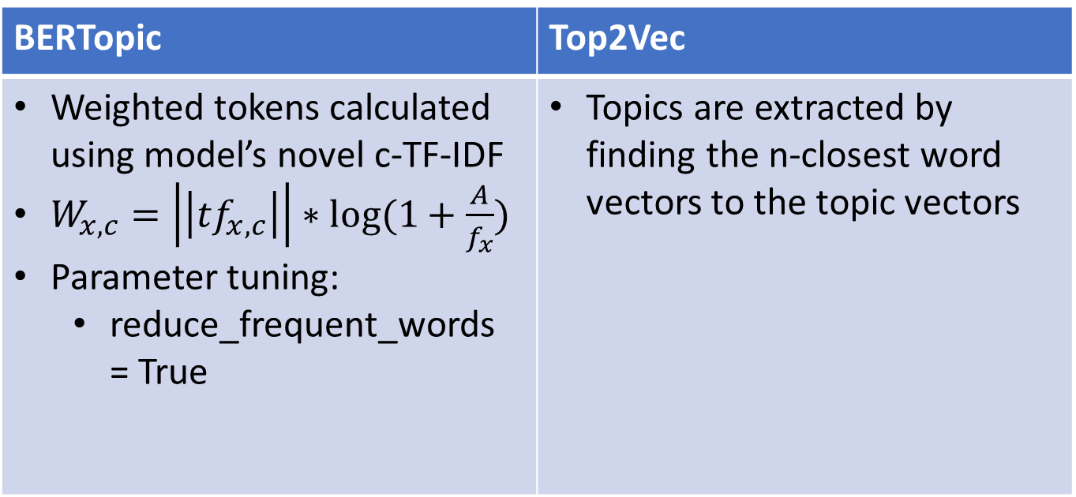
Data Preprocessing & Modelling Pipeline
Embedding
Dimensionality Reduction
Clustering
Vectorization / Tokenization
Topic Extraction
BERTopic | Top2Vec
Weighted tokens calculated using model’s novel c-TF-IDF $W_{x,c}=\left|\left|{tf}_{x,c}\right|\right|∗log⁡(1+\frac{A}{f_{x}})$ Parameter tuning: reduce_frequent_words = True | Topics are extracted by finding the n-closest word vectors to the topic vectors
Notes:
Lastly, BERTopic and Top2Vec uses different topic extraction methods. BERTopic calculates the tokens weights based on a modified term frequency inverse document frequency. Instead of calculating on the document level, c-TF-IDF calculates the frequency on a cluster level. It treats each cluster as a single document instead of a set of documents, which means that tf is calculated based on the frequency of each word in each cluster, and idf is the logarithm of the average number of words per cluster over the frequency of a word across all classes. Addition of plus one is to force the values to be positive. Parameter tuning was conducted on the c-TF-IDF model, where I set reduce frequent words to true. This results in the removal of words that are not indicated as stopwords but appear in every topic. Top2Vec extracts its topics by finding the n-closest word vector to the topic vectors. This step is done by the model and no parameter tuning is available as the parameters to extract the top 50 closest words are hard-coded in the model documentation.
Afterwards, the literature titles are fitted in both models and ran.

Slide 16
Results: How recently has research begun into green finance in China? (RQ1)
Earliest 5 studies on green finance:
Year | Translated Title
1991 | New order of Society --- Two differing views
1993 | Sustainable investing --- Challenges towards the economy
1994 | Sustainable development strategies are an objective requirement of Jiangsu’s economic and societal development
1994 | 《China’s 21st Century Agenda》 A preliminary study on Shanxi’s economic and social sustainable development strategy
1994 | The ecology industry and China’s sustainable economic development
Notes:
Now, I will elaborate on the results. Kindly take note that all results shown are English translations of Chinese text that are passed through a translation model from the huggingface model hub. Although its translations are fairly accurate to the best of my understanding, some meanings may be lost in translation. Please refer to the original paper for the Chinese outputs whenever necessary.
Firstly, I will answer research question 1. The earliest 5 studies were published in the 1990s, with the earliest in 1991. This indicates that research into green finance had started even before the green finance gained traction across the world. Except for 1991, most articles published focused mainly on a sustainable economy and societal development. It can be interpreted that this was due to the signing of the United Nations Framework Convention on Climate Change in 1992, which China was a part of.

Slide 17
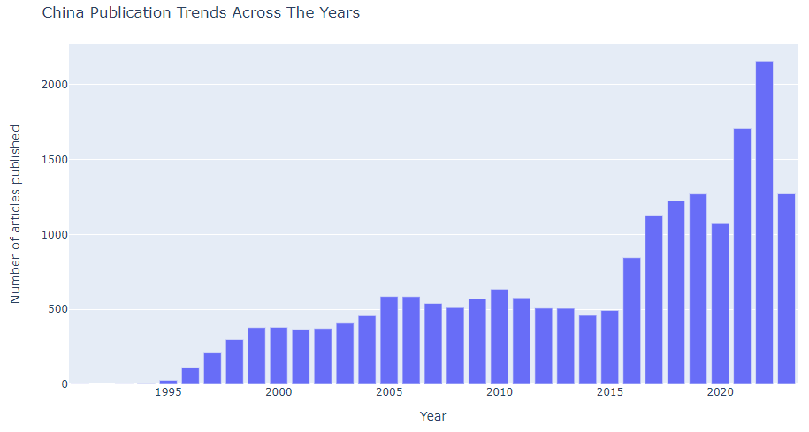
Results: How recently has research begun into green finance in China? (RQ1)
Notes:
It can also be observed that publication trends show a steady increase that peaks in 2016.

Slide 18
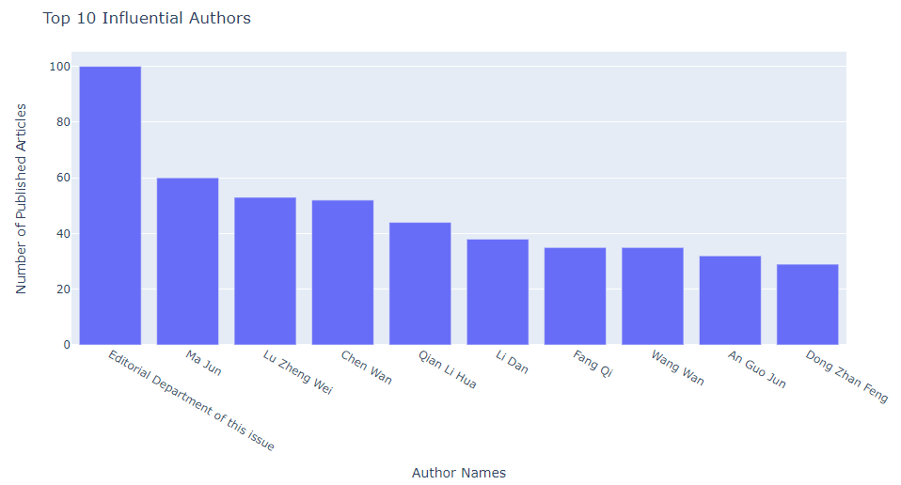
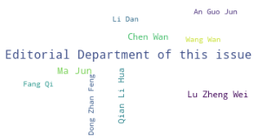
Results: How recently has research begun into green finance in China? (RQ1)
Top 10 most influential Authors
Notes:
To understand more about the literature gathered, we also need to understand the influential authors in the field. The highest number of published articles by one author is 100, where the top influential author is an editorial department. The most influential single author is Ma Jun, with 60 published articles to date.

Slide 19
Results: What are the overall green finance insights gathered from Chinese literature? (RQ2)
BERTopic model
Topics | Count | Top 10 tokens | Proposed Topic
0 | 1855 | `the test area', 'industrial structure', 'upgrading', 'financial system', 'quality', 'compatibility', 'technology', 'status and' empowerment' | Innovation and improvements
1 | 846 | 'water resources', 'water resources', 'water basin', 'water and soil conservation', 'water', 'safe', 'water-saving', 'use', 'water-saving', 'economic and social' | Water conservation
2 | 499 | 'population',’ private’, ‘national economy',’assumption',’foundation',’foundation',’macroeconomic',’assumption',’assumption', ‘assured',’ full' | Finance terminology
3 | 488 | 'construction', ‘concept', ‘travel’, ‘area’, 'manufacturing',' 'logistic',' 'gdp',' 'barrier',' 'packaging', 'green' | Manufacturing sector
4 | 377 | 'forestry’, ‘under forest’, ’afforestation’, ’forestland’, ’forest resources’, ‘forest’, ‘natural forest', ‘forestland', ‘work' | Forestry
5 | 343 | `China', ‘financial system', ‘beautiful', 'China Business Bank',' 'Beijing', 'China Postal',' ‘discussion', ‘vision',’ lead' | China’s foresight
Notes:
We will now look into the second research question. For clarification, the translated topics show multiple repetitions in topics. Just a note that their corresponding Chinese topics were of different tokens with similar meanings.
I will first cover the BERTopic results. The topic model generated 86 valid topics. It is interesting to note that there is a large focus shown on innovation and improvements. Highlighting of innovation and improvements were not shown to be of great importance in global and Chinese literary journals. However, this insight is prominent in China’s policy documents. It should also be noted that water conservation, manufacturing and forestry were topics of interest. This is similar to findings of global literature with an emphasis on climate change.

Slide 20
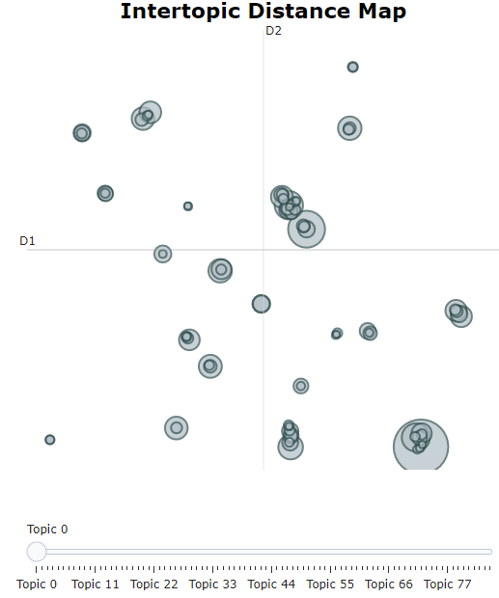
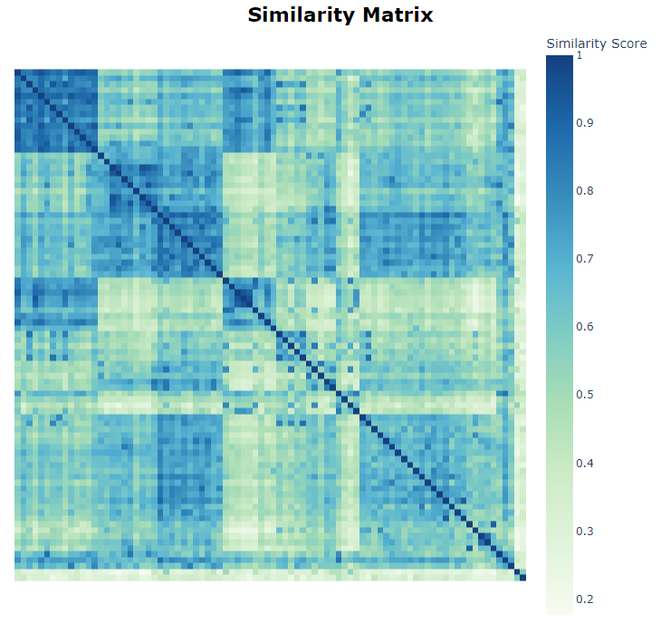
Results: What are the overall green finance insights gathered from Chinese literature? (RQ2)
BERTopic model
Notes:
The BERTopic model distribution was rather well conducted, with high topic diversity of 0.89. Similarly, this can be observed from the intertopic distribution map, where clusters are rather distinguished. The similarity matrix shows that some topics were rather similar, but it is still acceptable, with the matrix showing a pale blue shade. This is rather good compared to the many other iterations that resulted in the entire matrix colored dark blue.

Slide 21
Results: What are the overall green finance insights gathered from Chinese literature? (RQ2)
Top2Vec model
Topics | Count | Top 10 tokens | Proposed Topic
0 | 1045 | ‘China', 'Beijing', 'Shanghai', 'Changdong', 'Henan Province', 'National Economy',' 'Economic Belt',' 'Guangxi', 'Fukuchi',' 'Globalization' | China districts
1 | 1028 | `Banking Industry', 'Credit Policy', 'Banking Bank', 'Banking Bank', 'Financial Institutions', 'Financial Services', 'Credits', 'Financial System', 'Banking System', 'Banks' | Banking systems
2 | 831 | 'Water resources', 'water resources', 'water basin', 'environmental protection', 'ecological environment', 'sustainable environment', 'resource management', 'eco-agriculture', 'vision of development' | Water conservation
3 | 830 | `Henan Province', 'Cuangdong', 'Congxi', 'Fukuchi',' 'Gangxi',' "Zhejiang Province',' 'Fukuji Province', 'Vision of Development',' 'Hong Kong Macau' | China provinces
4 | 793 | 'Eco-agriculture', 'Agriculture', 'Vision of Development', 'Rural', 'Sustained Growth', 'Eco-Environment', 'Rural', 'Sustainability', 'Eco-development' | Eco-agriculture
5 | 782 | 'Eco-environment','eco-agriculture','eco-tourism','eco-environment','environmental protection',' sustainability’, 'environment’, 'forestry', 'vision of development' | Eco-environment
Notes:
Now I will cover the Top2Vec model. It is observed that there are multiple overlapping topics such as China districts and China provinces, eco-agriculture and eco-environment. With a low topic diversity score of 0.21, the topics generated are rather similar. As such, the model’s results are not very good and can be briefly looked over.

Slide 22
Results: What are the trending topics in green finance from Chinese literature? (RQ3)
BERTopic model
Topics | Count | Top 10 tokens | Proposed Topic
0 | 766 | 'Industrial structure', 'upgrading', 'test area', 'reform', 'coupling', 'technology innovation', 'quality', 'region', 'degree', 'standard' | Innovation and improvements
1 | 524 | `entity', 'structure', 'head of board', 'new', 'finance centre', 'open', 'visit', 'branch', 'modern', 'finance' | Financial bodies
2 | 493 | 'carbon', ‘carbon peak', ‘carbon', ‘bicarbon', ‘emission', ‘right',’ lower carbon', ‘target', ‘high carbon',’ opportunity' | Carbon Emissions
3 | 173 | 'Human capacity', 'resource management', 'sustainability', 'continuing growth', 'distribution', 'human resources', 'cycle', 'growth', 'geographical', 'continuing' | Human resources
4 | 164 | 'Renewed', 'Rural', 'Agriculture', 'Rural',' Push', 'Rural', 'Agriculture', 'Income',' Reality', 'Return to Poverty' | Agriculture
5 | 146 | 'Construction', 'Concept', 'Construction', 'Lease', 'Priority', 'New Opportunities',' Model Areas', 'Sector', 'Procuration',' 'Trade' | Construction
Notes:
Lastly, I will answer research question 3. The study seeks to understand trending topics in the last 3 years. I will first cover the BERTopic modeling output. It can be seen that innovation and improvements remain the most popular topic. This possibly hints that innovation is a topic that will remain for long. It is also interesting to note that new areas of interest are arising, namely human resource and construction. These topics were not in the top10 topics when the entire dataset is taken into account. Therefore, it indicates that it is a rather nascent trending topic.
Coherence: 0.376
Top div: 0.877

Slide 23
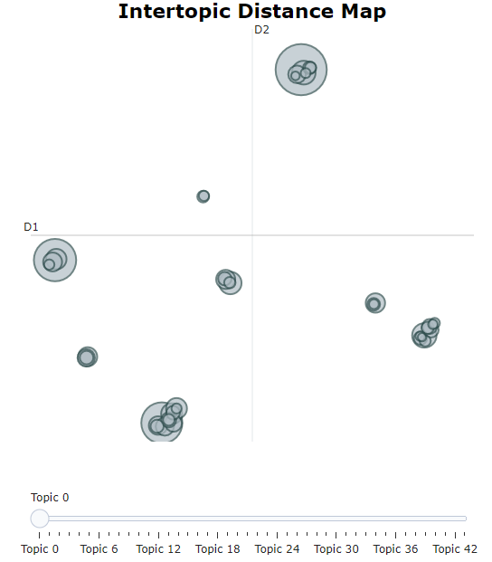
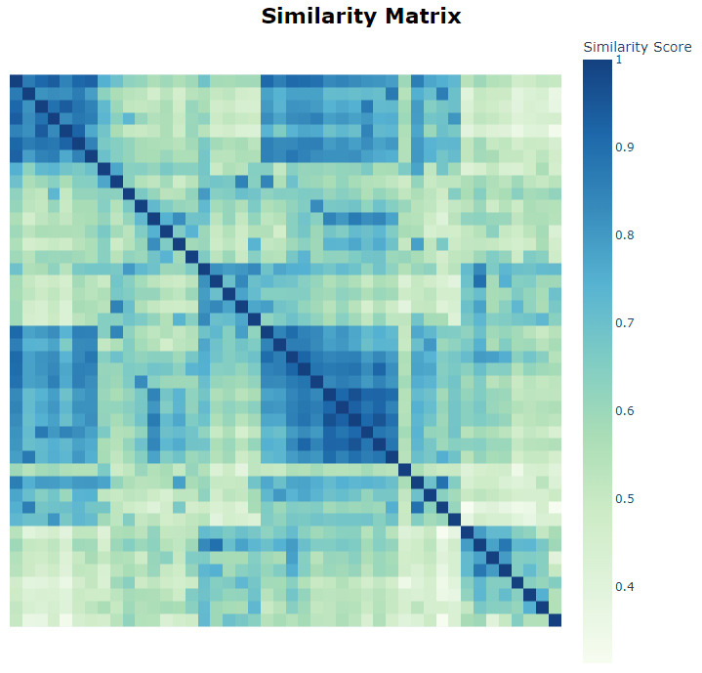
Results: What are the trending topics in green finance from Chinese literature? (RQ3)
BERTopic model
Notes:
The topic distribution performs rather well too. From the intertopic distance map, some clusters are spaced far apart, while others are close by. This indicates that there is enough topic diversity, where the topic diversity metrics is 0.877. The similarity matrix is also rather acceptable, with few topics shaded dark blue. These observations meant that the topics are rather well distributed.

Slide 24
Results: What are the trending topics in green finance from Chinese literature? (RQ3)
Top2Vec model
Topics | Count | Top 10 tokens | Proposed Topic
0 | 539 | 'Development', 'Status and', 'Our Strategy', 'Status', 'Innovation', 'promotion', 'policies', 'policies', 'industry' | Strategy and policy
1 | 525 | 'Technology Innovation', 'Innovation', 'Industry', 'Industry', 'Industry', 'Industry', 'Technology', 'Technology', 'Development', 'Strategy' | Technological innovation
2 | 461 | 'Bank Industry', 'Bank Bank', 'Financial Institutions', 'Financial System', 'Credit', 'Bank', 'Investment Financing', 'Financial Services', 'Financing',' Enterprises' | Financial Systems
3 | 316 | 'Rural','Rural','Development','Region','Agriculture','Eco-agriculture','Innovation','Promotion','Hong Kong’, 'Strategy' | Development in rural areas
4 | 266 | "Hong Kong Au", "China", "Industrial Structure", "Development", "District", "Industry", "Innovation", "Technology", "Innovation", "Investment", "Technology" and "Enterprise" | China’s innovations
5 | 252 | 'Eco-agriculture','Agriculture','Rural','Eco-Rural','Development',' Growth', 'Industry Structure',' Forestry',' Industry' | Agricultural
Notes:
I will now cover the Top2Vec results. The model generated 26 topics and shows that strategy, policy and rural developments are prioritized. This is roughly similar to the findings obtained from the bertopic model. However, the topic diversity is only 0.3 for this set of topics.

Slide 25
Recommendations
Future research can be done on trending topics identified:
Human resources
Greener Construction
Development in low-income rural areas
Bank Types
Commerce
Notes:
The recommendations are as follows : (From slide)

