Slide 1
ANL488: BUSINESS ANALYTICS APPLIED PROJECT
The reliability of renewable energy to replace oil and gas as our energy of choice
Presented by
Sam Cheng Jia Wei

Slide 2

ANL488: Business Analytics Applied Project
The reliability of renewable energy to replace oil and gas as our energy of choice
Problem Definition
Topic:
The reliability of renewable energy to replace oil and gas as our energy of choice.
What is Renewable Energy?
Renewable energy is energy derived from natural sources that replenishes itself at a higher rate than they are consumed (UN, 2023).
Hydropower (reservoir, run-of-river, pumped storage hydropower)
Solar (solar photovoltaics, concentrating solar power)
Wind (onshore and offshore wind)
Bioenergy
Geothermal
Business Objective:
Has renewable energy production increased over time?
How much energy is generated from renewable energy production?
Does the renewable energy production outweigh the cost of investment?

Slide 3
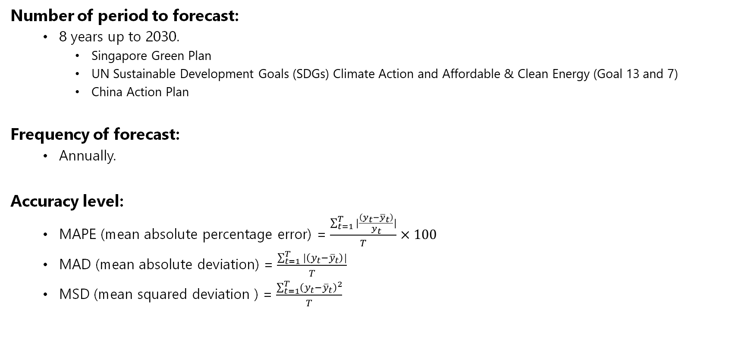
ANL488: Business Analytics Applied Project
The reliability of renewable energy to replace oil and gas as our energy of choice
Problem Definition
Number of period to forecast:
8 years up to 2030.
Singapore Green Plan
UN Sustainable Development Goals (SDGs) Climate Action and Affordable & Clean Energy (Goal 13 and 7)
China Action Plan
Frequency of forecast:
Annually.
Accuracy level:
MAPE (mean absolute percentage error) = $\frac{\sum_{t=1}^{T}{|\frac{\left(y_{t}−{\overline{y}}_{t}\right)}{y_{t}}|}}{T}×100$
MAD (mean absolute deviation) = $\frac{\sum_{t=1}^{T}{|\left(y_{t}−{\overline{y}}_{t}\right)|}}{T}$
MSD (mean squared deviation ) = $\frac{\sum_{t=1}^{T}{{\left(y_{t}−{\overline{y}}_{t}\right)}^{2}}}{T}$

Slide 4






ANL488: Business Analytics Applied Project
The reliability of renewable energy to replace oil and gas as our energy of choice
Forecasting Process (CRISP-DM)
Model Deployment
Model Validation
Model Selection/ Fitting
Data Analysis
Data Collection
Problem Definition

Slide 5

ANL488: Business Analytics Applied Project
The reliability of renewable energy to replace oil and gas as our energy of choice
Data Collection
Where the data is from?
The project is cited from Our World in Data, it has been collected aggregated, and documented by Hannah Ritchie, Pablo Rosado, Edouard Mathieu, Max Roser (2022).
The compiled dataset is compiled in GitHub and extracted for this project.
Data Format
Dataset of the 6 continents are merged to form West, Central and East.
Dataset is filtered to contain the necessary data:
Share of electricity generation that comes from fossil fuels, nuclear and renewables.
Electricity generation from coal, measured in terawatt-hours
fossil_share_elec | nuclear_share_elec | renewables_share_elec
hydro_electricity | solar_electricity | wind_electricity | other_renewable_electricity | fossil_electricity

Slide 6






ANL488: Business Analytics Applied Project
The reliability of renewable energy to replace oil and gas as our energy of choice
Data Collection
Merging continents together
West (North & South America)
Central (Europe & Africa)
East (Asia & Oceania)
The ratio of the world’s renewable energy as of 2022
Europe
North America
Asia
Africa
South America
Oceania
 | Hydropower | Solar | Wind | Biofuels & Others
North America (West) | 694.66 | 233.38 | 499.28 | 90.47 | 1517.79
South America (West) | 712.67 | 49.90 | 112.48 | 68.68 | 943.73
Europe (Central) | 697.70 | 233.21 | 523.77 | 219.97 | 1674.65
Africa (Central) | 156.72 | 18.18 | 23.89 | 8.69 | 207.48
Asia (East) | 1997.43 | 745.87 | 907.26 | 366.76 | 4017.32
Oceania (East) | 43.39 | 39.12 | 34.52 | 12.48 | 129.51
 | 4302.57 | 1319.66 | 2101.20 | 767.05

Slide 7
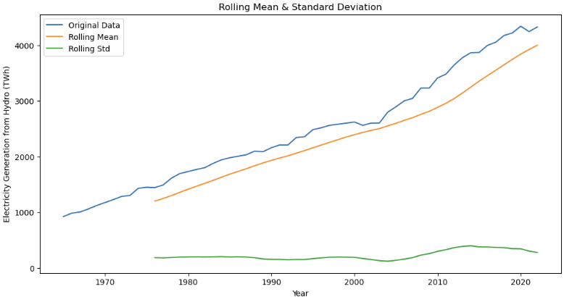
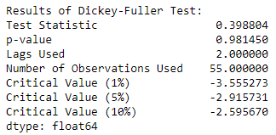
ANL488: Business Analytics Applied Project
The reliability of renewable energy to replace oil and gas as our energy of choice
Data Analysis
Augmented Dickey-Fuller Test (ADF)
The ADF test is used in this project’s time series analysis to determine whether the given time series dataset is stationary or not. If the p-value is less than 0.05, there is strong evidence that the graph is stationary.

Slide 8
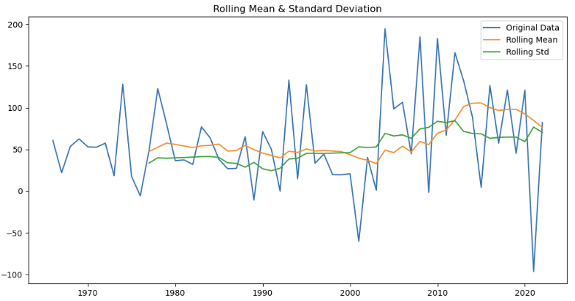
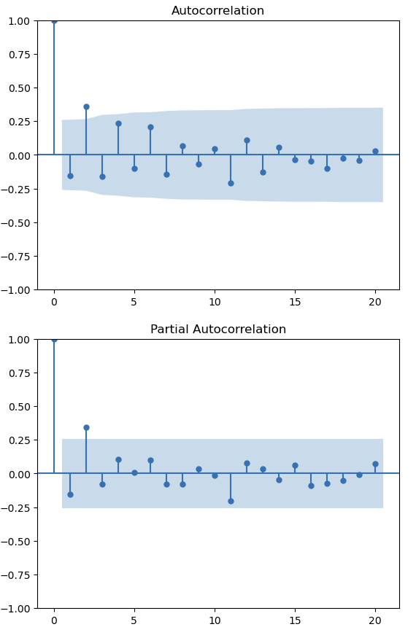
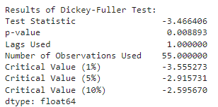
ANL488: Business Analytics Applied Project
The reliability of renewable energy to replace oil and gas as our energy of choice
Model Selection & Fitting

Slide 9
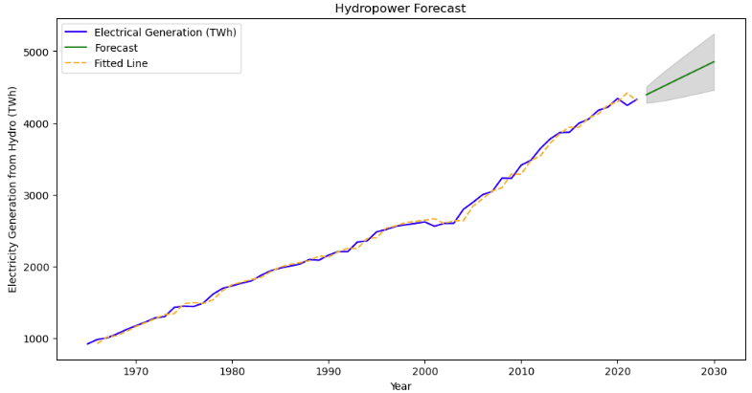
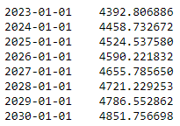

ANL488: Business Analytics Applied Project
The reliability of renewable energy to replace oil and gas as our energy of choice
Model Validation / Forecasting Model Deployment
Mean Absolute Percentage Error (MAPE)
MAPE is used to measure the accuracy of a forecasting model's predictions. MAPE quantifies how well a forecasting model's predictions match the actual values as a percentage of the actual values. A lower MAPE indicates a more accurate forecast.

Slide 10
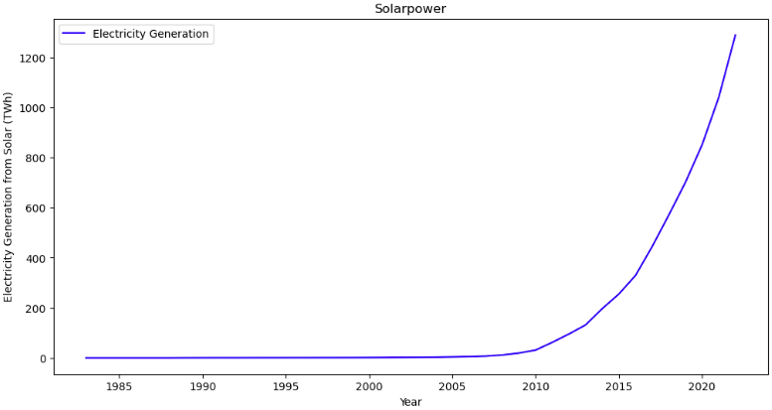
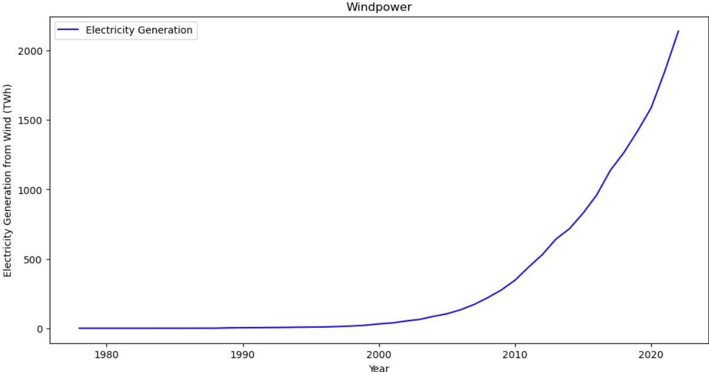
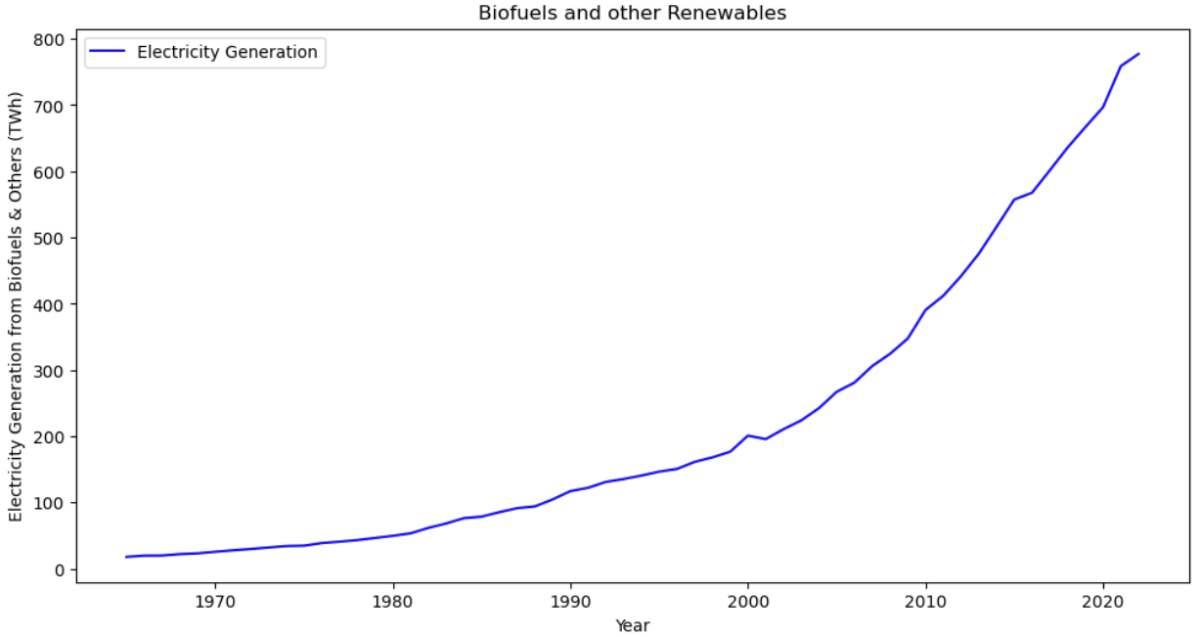
ANL488: Business Analytics Applied Project
The reliability of renewable energy to replace oil and gas as our energy of choice
Data Analysis
Solarpower
Holt-Winters Exponential Smoothing
Forecasts with Level, Trend and Seasonality.
Double Exponential Smoothing
Forecasts with Level and Trend only.
Windpower
Biofuels and other Renewables

Slide 11
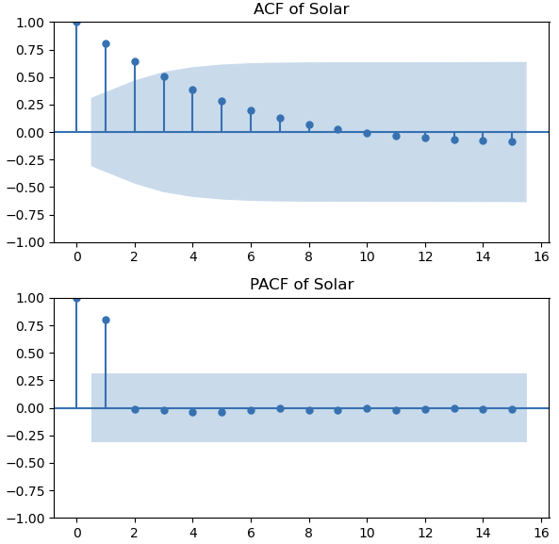
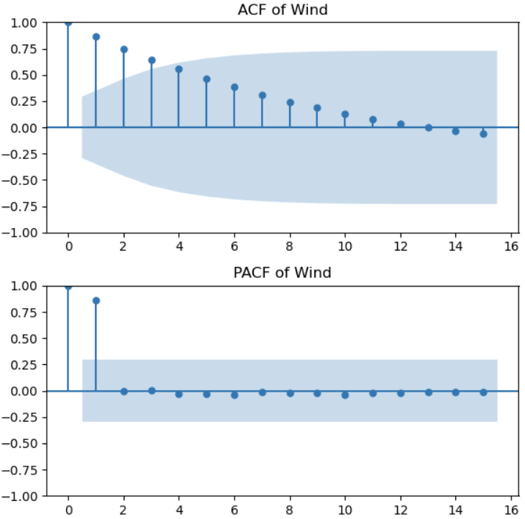
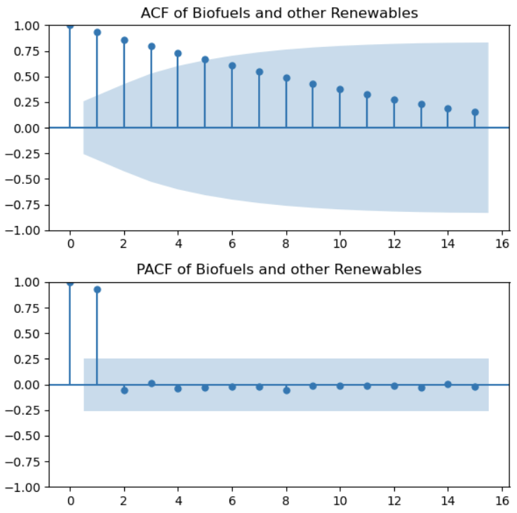
ANL488: Business Analytics Applied Project
The reliability of renewable energy to replace oil and gas as our energy of choice
Model Selection & Fitting
Solarpower
Windpower
Biofuels and other Renewables

Slide 12
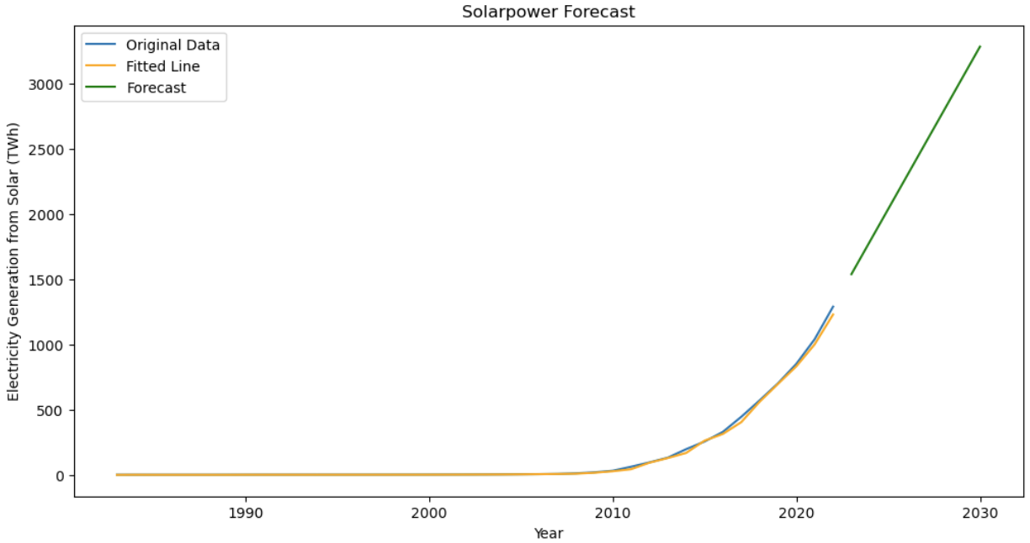
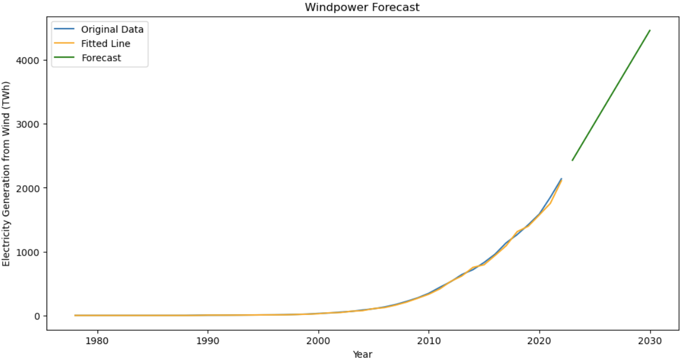
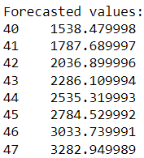
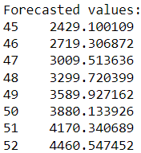
ANL488: Business Analytics Applied Project
The reliability of renewable energy to replace oil and gas as our energy of choice
Model Validation/ Forecasting Model Deployment
Solarpower
Windpower

Slide 13
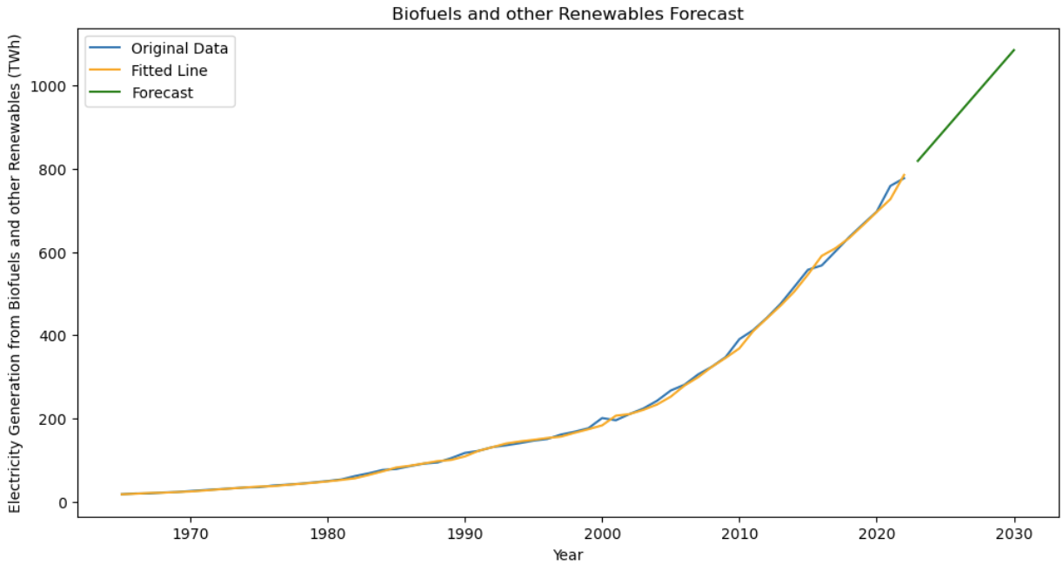
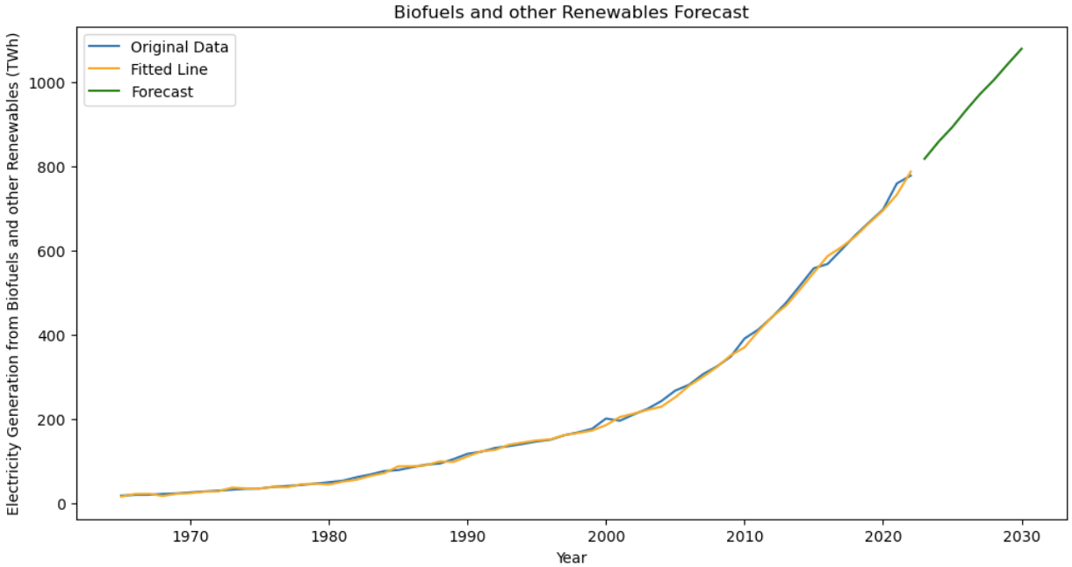

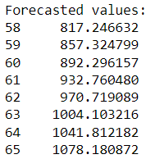
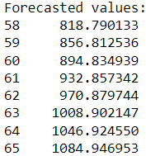


ANL488: Business Analytics Applied Project
The reliability of renewable energy to replace oil and gas as our energy of choice
Model Validation/ Forecasting Model Deployment
Without Seasonality
With Seasonality

Slide 14
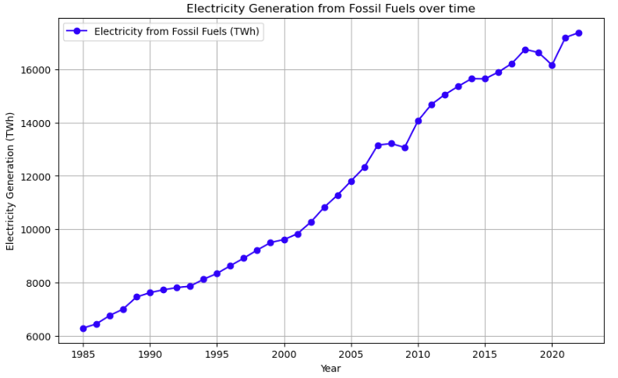
ANL488: Business Analytics Applied Project
The reliability of renewable energy to replace oil and gas as our energy of choice
Non-renewable energy
Has it caused fossil fuels to decrease? No.
Year | Electricity Generation (TWh)
1985 | 6285
2003 | 10822
2022 | 17385
~ +67%
~ +67%

Slide 15
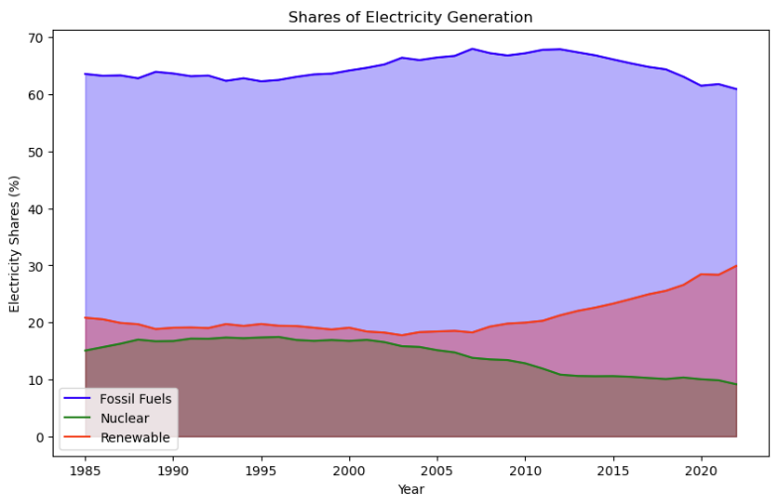
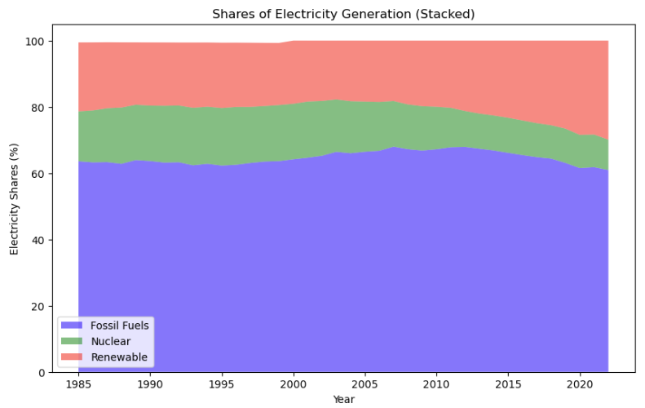
ANL488: Business Analytics Applied Project
The reliability of renewable energy to replace oil and gas as our energy of choice
Shares of Electricity Generation
Fossil Fuels: 60.94%
Nuclear: 9.15%
Renewable Energy: 29.91%

Slide 16
ANL488: Business Analytics Applied Project
The reliability of renewable energy to replace oil and gas as our energy of choice
Levelised Cost of Electricity (LCOE)
The global LCOE is determined by the total installed costs, lifetime capacity factor, Operation and Maintenance (O&M) costs, the economic lifetime of the project and the cost of capital (IRENA, 2022).
This table is recorded in USD per kilowatt hour (USD/kWh).
Hydro
Solar
Wind
Biofuels & Others
Fossil Fuels
2010 | 0.042 |  | 0.413 |  | 0.152 |  | 0.068 |  | 0.056
2022 | 0.062 |  | 0.084 |  | 0.057 |  | 0.059 |  | 0.069
+48%
-80%
-62%
-23%
+23%
Rising installation cost as remote plants, with poor infrastructure has higher logistical, civil engineering and grid connection costs.
Mean LCOE of concentrating solar power and solar photovoltaics.
Mean LCOE of onshore and offshore wind.
Larger turbines, longer blades, higher height.
Mean LCOE of Biofuels and Geothermal
By-products from agricultural or forestry processes

Slide 17
ANL488: Business Analytics Applied Project
The reliability of renewable energy to replace oil and gas as our energy of choice
References
Hannah Ritchie, Max Roser and Pablo Rosado (2022) - "Energy". Published online at OurWorldInData.org. Retrieved from: 'https://ourworldindata.org/energy' [Online Resource]
IRENA (2022), Renewable power generation costs in 2022, International Renewable Energy Agency, Abu Dhabi

