Slide 1


ANL488
USING MACHINE LEARNING TO UNCOVER INSIGHTS
RELATED TO SAFETY INCIDENTS
(MINING INDUSTRY)
Connie Tan @ Zann Tan
W2070962

Slide 2







Business Understanding
Data
Understanding
Modelling
Evaluation
Deployment
Question & Answers
Background
Previous Studies
Mining organization operating in Australia & Canada
Harsh work environments
2.3 fatalities per 100,000 workers in 2021
Safety research not widely studied
Focuses on either fatalities or injury
Association between injury severity and accident factors
Business Problem
Address the issue of fatalities and injuries in mines
Reduce exposure to hazards
Current Study
Incident Triggers
Body location
Incident Outcome
Injury Severity
Incident Drivers
Human
Environment
Mechanism of injury
Nature of injury
Agency of injury
Business Objectives
Enhance safety of miners in Australia & Canada
Achieve zero fatalities and injuries
Data Mining Goal
Predict factors causing fatalities and injuries in mines
Software used
Python and Tableau

Slide 3



Business Understanding
Data
Understanding
Modelling
Evaluation
Deployment
Question & Answers
Data Understanding
Incident Drivers
Agency of Injury
Incident Triggers
Mechanism of Injury
Incident Outcome
Body location
Nature of Injury
7 datasets provided were joined using unique key ID
61 variables with more than 2 million rows of data
Each variable contains more than 10 categories
Date range from 2000 to 2023
Additional data collected: Australia and Canada weather data
Environmental factor
New weather data
Human factors
‘safety_events.csv
‘site_location.csv
‘production_data.csv
‘labour_hours_worked.csv
‘employee_roster.
csv
‘person_workgroup.csv
‘emp_start_end_dates.csv

Slide 4
Business Understanding
Data
Understanding
Modelling
Evaluation
Deployment
Question & Answers
Data Preparation
Data Selection
Categorical Data
Chi-square test
11 statistically significant variables
1 statistically insignificant variable
Cramer’s V
Small Association – 4 variables
Medium Association – 3 variables
Large Association – 4 variables
Preliminary Checks
Irrelevant Columns
Data Cleaning
Invalid Data
Merging
Merge across files based on ID
New Columns
Derive new columns
Missing or Duplicate
Recategorize
Final dataset: 11 variables
Injury Severity Framework
Lost Time
Injury Classification
Injury Severity
Minor
Moderate
Serious

Slide 5
Business Understanding
Data
Understanding
Modelling
Evaluation
Deployment
Question & Answers
Modelling Data Preparation
Modelling
Performed One-Hot Encoding
Split dataset into 70% training & 30% testing
Fix random seed
Multi class target
Minor
Moderate
Serious
Imbalance target
Minor – 19%
Moderate – 67%
Serious – 14%
Decision Tree
Decision Tree with SMOTE / Boosting
Random Forest
Random Forest with Boosting
Support Vector Machine (OneVsRest Approach)
Neural Network
Logistic Regression
Model Evaluation Methods
Training and Testing Accuracy
Confusion Matrix; Precision/Recall
F1 Score
ROC Curve
Kappa Score

Slide 6
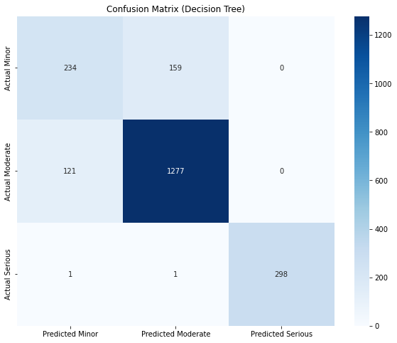
Business Understanding
Data
Understanding
Modelling
Evaluation
Deployment
Question & Answers
Champion Model
Decision Tree
No overfitting issues
Parameters to control overfitting
Max depth = 10
Minimum sample split = 100
Minimum samples in a leaf = 50
Target | Training Accuracy | Testing Accuracy | Hit Rate (Precision) | Accuracy (Recall) | F1-score | ROC Curve | Kappa Score
Minor | 86.59% | 86.51% | 0.66 | 0.60 | 0.62 | 0.90 | 0.72
Moderate |  |  | 0.89 | 0.91 | 0.90 | 0.93
Serious |  |  | 1.00 | 0.99 | 1.00 | 1.00

Slide 7
Business Understanding
Data
Understanding
Modelling
Evaluation
Deployment
Question & Answers
Decision Tree Rules
Moderate
Body Part
Multiple of unspecified locations
Lower Body
Upper Body
Daily Temp – Warm/ Cool / Hot
Agency of Injury
Other and unspecified agencies
Machinery and Equipment
Materials and substances
Nature of Injury - Other or unspecified
Mechanism of Injury
Direct Impact
Stress (Physical/Mental)
Minor
Mechanism of Injury - Direct Impact
Incident time
Morning
Afternoon
Midnight
Nature of Injury – Traumatic
Agency of Injury - Machinery and Equipment
Daily Temp
Hot
Warm

Slide 8
Business Understanding
Data
Understanding
Modelling
Evaluation
Deployment
Question & Answers
Deployment methods
Limitations
Based on the decision tree rules,
Develop a watch tracker comprising
Current weather conditions (hot, cold, warm)
Real time alerts about machine usage such as maintenance alerts
Carry out tool-box meetings before starting work
Emphasize on the importance of personal protective equipment
Ensure adequate lighting for miners working under poor lighting conditions
Ensure chemicals are stored in clear containers and properly labelled.
Insufficient data
Future Work
Gather more data comprising
Demographics
Work Experience
Size of organisation
Mine type
Employment type
Native languages
Safety indicators
Maintenance data

Slide 9

Business Understanding
Data
Understanding
Modelling
Evaluation
Deployment
Question & Answers
Question & Answers
THANK YOU ☺

