Slide 1

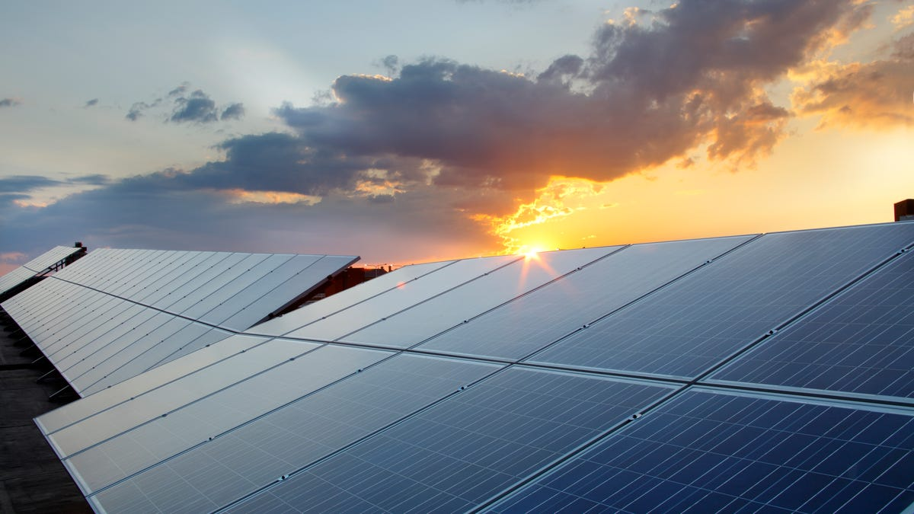
Comparison of SARIMA and LSTM models in forecasting solar irradiance
Chen Guo Hao Alvin
N1981071
Presentation date: 190922
ANL488 Presentation

Slide 2



Project background
Business problem
Singapore needs solar energy, but solar assets are challenged by intermittent generation
Business objective
De-risk investment on solar assets
Data mining objective
Identify the best model for forecasting annual solar irradiance using historical solar irradiance
ANL488 Presentation

Slide 3

Gaps in literature review
Out of scope
Area of focus
Numerical weather prediction models
(forecast period too short hence out of scope)
WRF
GFS
Linear models
SARIMA by Alsharif et al. (2019)
ARIMA
Triple Exponential Smoothing
Linear regression
Non-linear models
LSTM by Qing & Niu (2018)
ANN – Artificial neural network
WNN – Wavelet neural network
CNN – For satellite imagery
No direct comparison between linear and non-linear performance for irradiance
Hence we compare SARIMA (best linear) and LSTM (best non-linear)
ANL488 Presentation

Slide 4
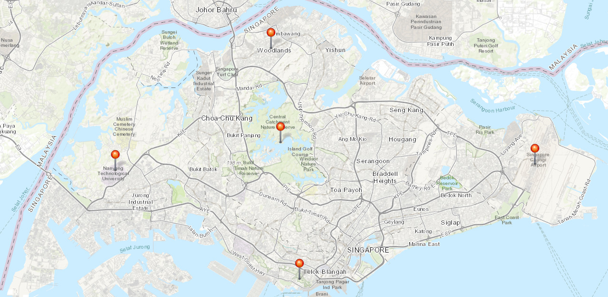
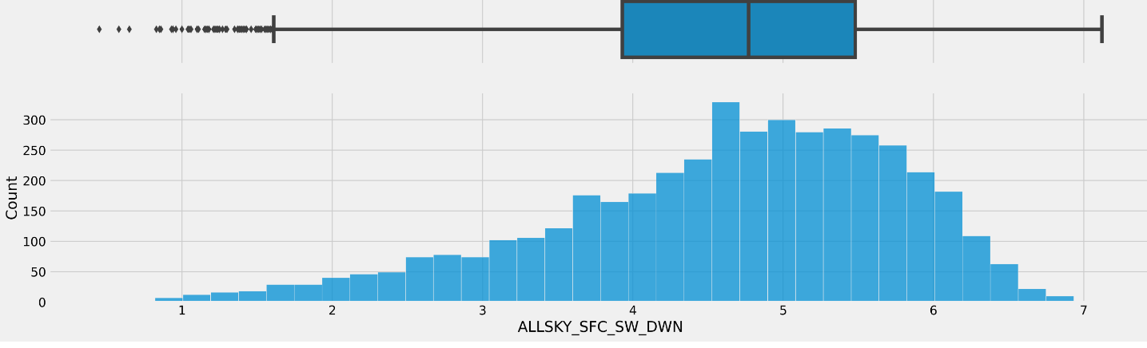
Data collection and understanding
Data source: NASA Power
Collected from 5 locations to cover Singapore
15 variables collected, 3 ordinal 12 continuous
From January 2010 to December 2021
Irradiance is left skewed
1.4373N, 103.778E
1.3683N, 103.8022E
1.3505N, 103.6811E
1.3603N, 103.9918E
1.2734N, 103.8178E
Figure 1 – data collection location
ANL488 Presentation
Figure 2 – Histogram of solar irradiance
Acknowledgements: The data were obtained from the NASA Langley Research Center (LaRC) POWER Project funded through the NASA Earth Science/Applied Science Program

Slide 5
Data preparation
Common steps for both models
Model specific steps
Stationary + Seasonality test (SARIMA)
Is data quality ok?
Interpolate missing data
Raw data
Remove outliers
Compute average across all locations
Normalization (LSTM)
ANL488 Presentation

Slide 6
Modelling - SARIMA
Daily irradiance
Data preparation
Stationarity test
Identify AR and MA terms
Fit model to parameters identified
SARIMA to account for exogeneous variable,
function of pdq x s(pdq)
Dickey-Fuller (ADF) for stationarity
Determine p and q by plotting ACF and PACF
AIC to compare model performance*
2010 to 2020 for training, 2021 for testing
Forecast and check residuals
Model Deployment
ANL488 Presentation
*It is normal for model parameter converged from AIC to be different from terms initially identified in stationarity and ACF/PACF plots

Slide 7
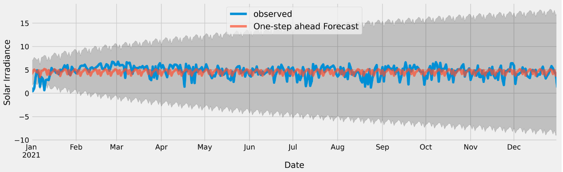
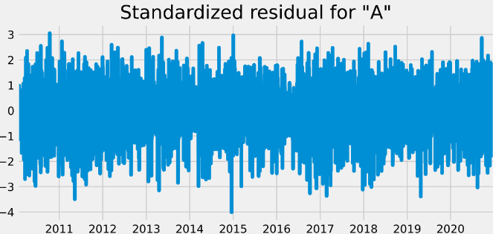
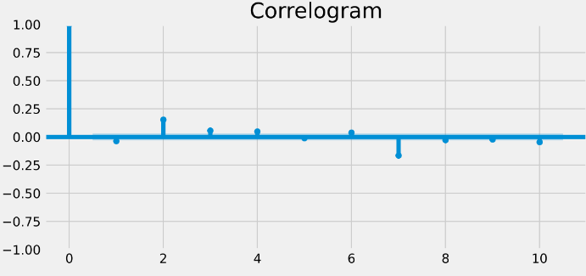
SARIMA Post-modelling Residual Validation
Figure 3: Irradiance forecast vs testing data
Figure 4: Residual plot
Generated MSE of 1.68 and a RMSE of 1.30
Majority of irradiance are between ±3
Correlation is within ±0.25 for lag 1 onwards
ANL488 Presentation
Figure 5: Residual correlogram

Slide 8
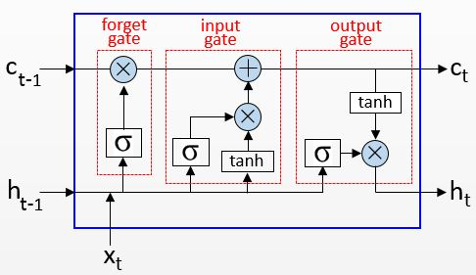
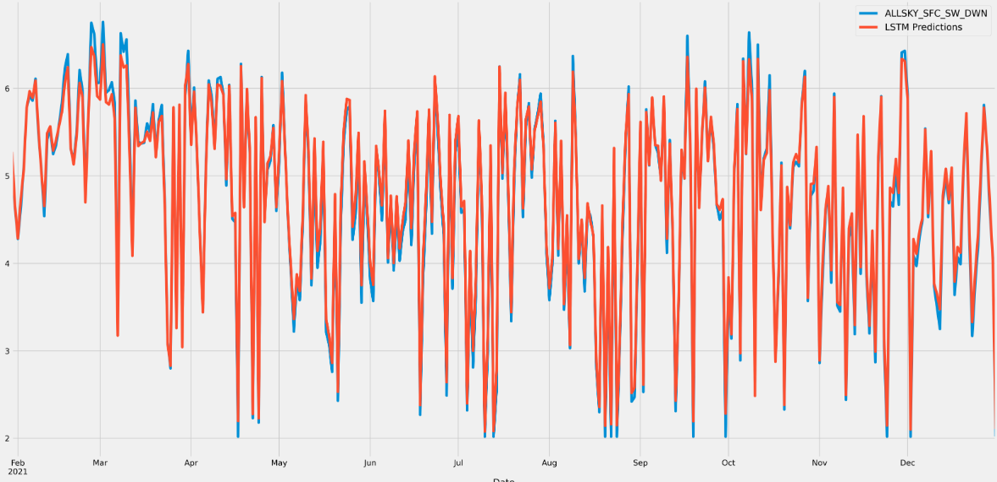
Modelling - LSTM
Use all 15 variables as compared to SARIMA
Input, hidden, output layer
Hyperparameter tuning:
learning rate
Epoch
batch size
number of neurons
Same train-test split as SARIMA
Generated MSE of 0.02 and a RMSE of 0.14
Figure 6: LSTM memory cell
ANL488 Presentation
Figure 7: LSTM Forecast vs testing data

Slide 9
Results and Discussion
Figure 8: SARIMA forecast vs testing data
Figure 9: LSTM Forecast vs testing data
SARIMA
LSTM
Generated MSE of 1.68 and a RMSE of 1.30
Generated MSE of 0.02 and a RMSE of 0.14
Pros:
Easier to understand
Less computationally expensive
Captures anomalous information
Pros:
More accurate than SARIMA
Considers exogenous variables
Better at capturing sequential information
Cons:
Forecast is less accurate than LSTM
Cons:
Difficult to understand beyond input layer
ANL488 Presentation

Slide 10




Deployment process
Solar developer identifying possible sites
Data collection from NASA Power
Input on LSTM Model and get forecast
Calculate generation potential
Make investment decision
Site location
Deploy model
Area of Solar panel
ANL488 Presentation

Slide 11


Conclusion and Future research
Further areas of study
Economic models to test algorithm reliability
Satellite-based
data inputs
Hourly-based forecasting
ANL488 Presentation

Slide 12
Thank you For your kind attention
Notes:
That will be the end of my presentation, thank you for your attention, and now I will open the floor for questions.

Slide 13
References
Alsharif, M., Younes, M., & Kim, J. (2019). Time Series ARIMA Model for Prediction of Daily and Monthly Average Global Solar Radiation: The Case Study of Seoul, South Korea. Symmetry, 11(2), 240. doi:10.3390/sym11020240
Colak, I., Yesilbudak, M., Genc, N., & Bayindir, R. (2015). Multi-period Prediction of Solar Radiation Using ARMA and ARIMA Models. 2015 IEEE 14th International Conference on Machine Learning and Applications (ICMLA). doi:10.1109/icmla.2015.33
Diagne, M., David, M., Lauret, P., Boland, J., & Schmutz, N. (2013). Review of solar irradiance forecasting methods and a proposition for small-scale insular grids. Renewable and Sustainable Energy Reviews, 27, 65–76. doi:10.1016/j.rser.2013.06.042
Fathima, T. A., Nedumpozhimana, V., Lee, Y. H., Winkler, S., & Dev, S. (2019). Predicting Solar Irradiance in Singapore. 2019 Photonics & Electromagnetics Research Symposium - Fall (PIERS - Fall). doi:10.1109/piers-fall48861.2019.9021313
HDB (2021). SolarNova Programme. Retrieved July 25th, 2022, from: https://www.hdb.gov.sg/about-us/our-role/smart-and-sustainable-living/solarnova-page
Ihshaish, H., Cort́es, A., & Senar, M. A. (2012). Towards Improving Numerical Weather Predictions by Evolutionary Computing Techniques. Procedia Computer Science, 9, 1056–1063. doi:10.1016/j.procs.2012.04.114
IPCC. (2022). Summary for Policy Makers. Retrieved July 25th, 2022, from: https://www.ipcc.ch/report/ar6/wg2/downloads/report/IPCC_AR6_WGII_SummaryForPolicymakers.pdf
IRENA. (2020). ADVANCED FORECASTING OF VARIABLE RENEWABLE POWER GENERATION. Retrieved July 25th, 2022, from: https://www.irena.org/-/media/Files/IRENA/Agency/Publication/2020/Jul/IRENA_Advanced_weather_forecasting_2020.pdf%20?%20%20la=en&hash=8384431B56569C0D8786C9A4FDD56864443D10AF
ANL488 Presentation

Slide 14
References
Manoj Kumar, N., & Subathra, M. S. P. (2019). Three years ahead solar irradiance forecasting to quantify degradation influenced energy potentials from thin film (a-Si) photovoltaic system. Results in Physics, 12, 701–703. doi:10.1016/j.rinp.2018.12.027
NASA. (2021). The POWER Project. Retrieved July 25th, 2022, from: https://power.larc.nasa.gov/
NCCS. (2022). SINGAPORE’S APPROACH TO ALTERNATIVE ENERGY. Retrieved July 25th, 2022, from: https://www.nccs.gov.sg/singapores-climate-action/singapore-approach-to-alternative-energy/
Oh, T. (2022). Government considering more initiatives to push solar energy adoption in Singapore. The Business Times. Retrieved July 25th, 2022, from: https://www.businesstimes.com.sg/government-economy/government-considering-more-initiatives-to-push-solar-energy-adoption-in
Ouma, Y. O., Cheruyot, R., & Wachera, A. N. (2021). Rainfall and runoff time-series trend analysis using LSTM recurrent neural network and wavelet neural network with satellite-based meteorological data: case study of Nzoia hydrologic basin. Complex & Intelligent Systems. doi:10.1007/s40747-021-00365-2
Parasyris, A., Alexandrakis, G., Kozyrakis, G., & Spanoudaki, K. (2022). Predicting Meteorological Variables on Local Level with SARIMA, LSTM and Hybrid Techniques. Atmosphere, 13(878), doi:10.3390/atmos13060878
Qing, X., & Niu, Y. (2018). Hourly day-ahead solar irradiance prediction using weather forecasts by LSTM. Energy, 148, 461–468. doi:10.1016/j.energy.2018.01.177
Rana, M., Atef, M., Sarkar, R., & Uddin, M. (2022). A Review on Peak Load Shaving in Microgrid—Potential Benefits, Challenges, and Future Trend. Energies, 15(6):2278, doi:10.3390/en15062278
ANL488 Presentation

Slide 15
References
Reikard, G. (2009). Predicting solar radiation at high resolutions: A comparison of time series forecasts. Solar Energy, 83(3), 342–349. doi:10.1016/j.solener.2008.08.007
Sayago, S., Ovando, G., Almorox, J., & Bocco, M. (2019). Daily solar radiation from NASA-POWER product: assessing its accuracy considering atmospheric transparency. International Journal of Remote Sensing, 1–14. doi:10.1080/01431161.2019.1650986
Shadab, A., Ahmad, S., & Said, S. (2020). Spatial forecasting of solar radiation using ARIMA model. Remote Sensing Applications: Society and Environment, 20, 100427. doi:10.1016/j.rsase.2020.100427
Shamim, M. A., Remesan, R., Bray, M., & Han, D. (2015). An improved technique for global solar radiation estimation using numerical weather prediction. Journal of Atmospheric and Solar-Terrestrial Physics, 129, 13–22. doi:10.1016/j.jastp.2015.03.011
Sharma, N., Sharma, P., Irwin, D., & Shenoy, P. (2011). Predicting solar generation from weather forecasts using machine learning. 2011 IEEE International Conference on Smart Grid Communications (SmartGridComm). doi:10.1109/smartgridcomm.2011.61
Sharma, V., Yang, D., Walsh, W., & Reindl, T. (2016). Short term solar irradiance forecasting using a mixed wavelet neural network. Renewable Energy, 90, 481–492. doi:10.1016/j.renene.2016.01.020
Siddiqui, T. A., Bharadwaj, S., & Kalyanaraman, S. (2019). A Deep Learning Approach to Solar-Irradiance Forecasting in Sky-Videos. 2019 IEEE Winter Conference on Applications of Computer Vision (WACV). doi:10.1109/wacv.2019.00234
ANL488 Presentation

Slide 16
References
Ssekulima, E. B., El Moursi, M. S., Al Hinai, A., & Anwar, M. B. (2016). Wind speed and solar irradiance forecasting techniques for enhanced renewable energy integration with the grid: a review. IET Renewable Power Generation, 10(7), 885–989. doi:10.1049/iet-rpg.2015.0477
Vakitbilir, N., Direkoglu, C., & Hilal, A. (2021). Prediction of Daily Solar Irradiation Using CNN and LSTM Networks. ICAFS-2020, 230-238, doi:10.1007/978-3-030-64058-3_28
Verbois, H., Huva, R., Rusydi, A., & Walsh, W. (2018). Solar irradiance forecasting in the tropics using numerical weather prediction and statistical learning. Solar Energy, 162, 265–277. doi:10.1016/j.solener.2018.01.007
Wang, W., Feng, J., & Xu, F. (2021). Estimating Downward Shortwave Solar Radiation on Clear-Sky Days in Heterogeneous Surface Using LM-BP Neural Network. Energies, 14(2), 273. doi:10.3390/en14020273
Yang, D., Kleissl, J., Gueymard, C. A., Pedro, H. T. C., & Coimbra, C. F. M. (2018). History and trends in solar irradiance and PV power forecasting: A preliminary assessment and review using text mining. Solar Energy, 168, 60–101. doi:10.1016/j.solener.2017.11.023
Yu, Y., Cao, J., & Zhu, J. (2019). An LSTM Short-Term Solar Irradiance Forecasting Under Complicated Weather Conditions. IEEE Access, 7, 145651–145666. doi:10.1109/access.2019.2946057
Zhang, Y., Yang, H., Cui, H., & Chen, Q. (2019). Comparison of the Ability of ARIMA, WNN and SVM Models for Drought Forecasting in the Sanjiang Plain, China. Natural Resources Research. doi:10.1007/s11053-019-09512-6
ANL488 Presentation

