Slide 1
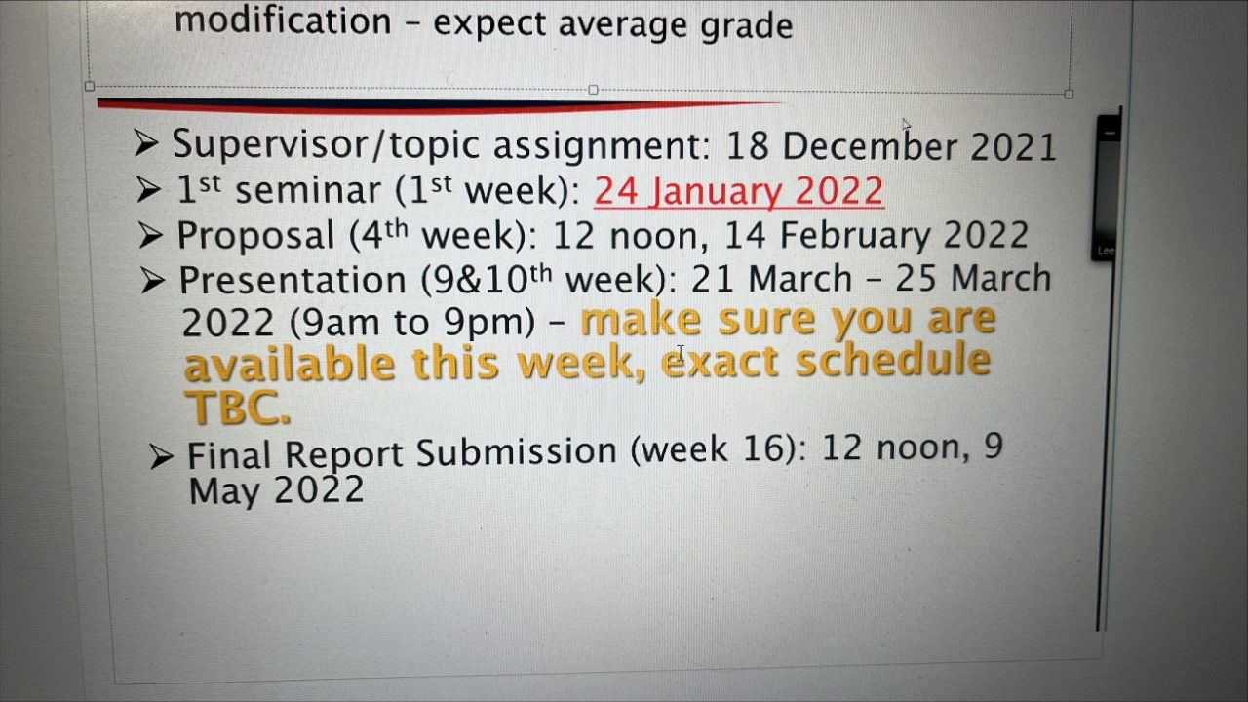

Slide 2
Dates 2022
1st meeting : Before 1st week of semester (24 Jan)
Proposed Date Student-Supervisor Meeting 1: 23rd Jan at 5.30 pm
2nd meeting : before proposal deadline (14 Feb 12 noon)
Proposed Date Student-Supervisor Meeting 2: 31 Jan at 5.30 pm
3rd meeting : before orals (21-25 Mar, 9 am -9 pm)
Proposed Date Student-Supervisor Meeting 3: 7 Mar 2021 at 5.30 pm
4th & 5th meetings : before final report submission (9 May 2021)
Proposed Date Student-Supervisor Meeting 4: 18 Apr at 5.30 pm
Proposed Date Student-Supervisor Meeting 5: 2 May at 5.30 pm

