Slide 1

ANL488 Presentation
Evaluating Clustering Algorithms for
Prediction of Rock Type
for Oil and Gas Applications across Different Geographies
Tan Wen Xuan
Z1981074
Presentation date: 200922

Slide 2
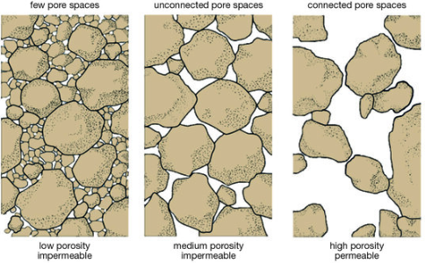
Introduction
Rock typing is the process of grouping rocks based on their characteristics
Background
Oil & Gas are acquired by drilling wells in sedimentary basins
Rock samples are extracted to discover flow capacity and storage
Generalised for future drilling
Business Problem
Traditional methods are time consuming
Require domain knowledge
Can be costly
Objective
Compare unsupervised algorithms against a traditional method
Note. Department of Mines, Industry Regulation and Safety (n.d.).
ANL488 Presentation

Slide 3
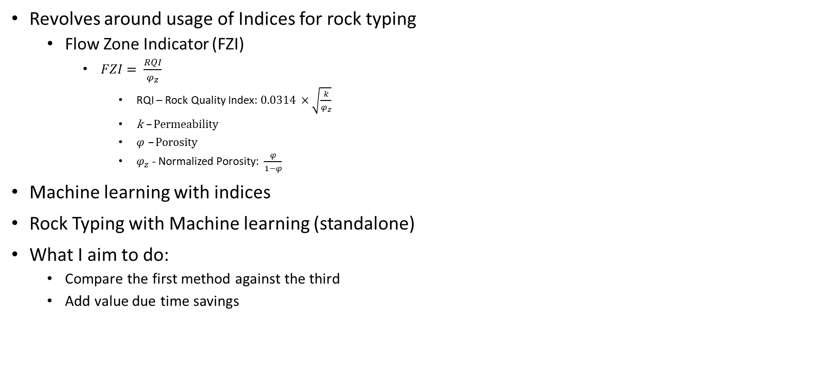
Previous Studies
Revolves around usage of Indices for rock typing
Flow Zone Indicator (FZI)
$FZI= \frac{RQI}{φ_{z}}$
RQI – Rock Quality Index: $0.0314 ×\sqrt{\frac{k}{φ_{z}}}$
k – Permeability
$φ$ – Porosity
$φ_{z}$ - Normalized Porosity: $\frac{φ}{1−φ}$
Machine learning with indices
Rock Typing with Machine learning (standalone)
What I aim to do:
Compare the first method against the third
Add value due time savings
ANL488 Presentation

Slide 4
Data
Publicly available core data from three regions (UK, USA and North Sea)
Columns needed were derived first
All data were min-max normalized
Cleaned data’s columns are mainly porosity and permeability
Training of models done on UK first
End Goal: Complete training on 2-3 regions
Merge Separate File(s)
Select Columns based on knowledge and null values
Remove problematic data etc null/random strings
Fill missing values whenever possible
Remove outliers
Derive columns needed for traditional method
Min Max Normalise
Adjust Dtypes
General Dataset Preparation Process
ANL488 Presentation

Slide 5

Pre-Modelling Data Preparation
Data preparation needed for the traditional method (using FZI)
Calculation of RQI, Porosity Index, FZI, Log RQI and Log Porosity Index
Recap:
$FZI= \frac{RQI}{φ_{z}}$
RQI – Rock Quality Index: $0.0314 ×\sqrt{\frac{k}{φ}}$
k – Permeability
$φ$ – Porosity
$φ_{z}$ - Normalized Porosity: $\frac{φ}{1−φ}$ (Porosity Index)
Merge Separate File(s)
Select Columns based on knowledge and null values
Remove problematic data etc null/random strings
Fill missing values whenever possible
Remove outliers
Derive columns needed for traditional method
Min Max Normalise
Adjust Dtypes
General Dataset Preparation Process
ANL488 Presentation

Slide 6
Modelling
1 Industry standard and 3 unsupervised algorithms
UK core data was trained first
104,834 samples (rows), 4 features
Results and comparison
Repeat the process for other datasets (as many as possible)
Cleaned Data
Industry Standard Benchmark
KMeans
SOM + KMeans
DBSCAN
Repeat for other datasets
Compare and Evaluate
Gaussian Mixture Model
BIRCH
ANL488 Presentation

Slide 7
Traditional Method Selected
Method – Iterative multi-linear regression (IMLR) (Khalid et. al., 2019)
Plot scatter plot log normalized porosity (x-axis) against log RQI (y-axis)
Guess intercept value based on mean FZI for each visible straight line
Lines selected based on the points
Line all have slope = 1
Allocate samples to closest line
Calculate new intercept using least square regression
Re-adjust lines if difference is too big
Other Methods
Histogram Analysis
Log fzi
Normal Probability Plot
Log fzi
ANL488 Presentation

Slide 8
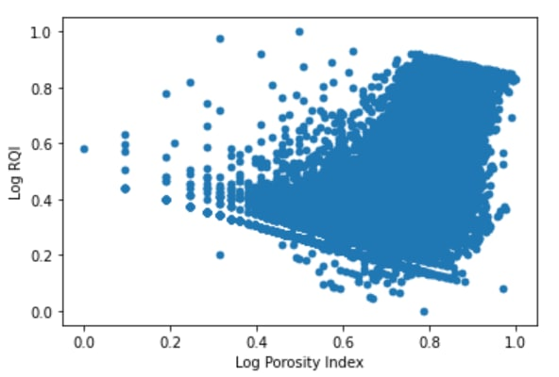
Failure of Traditional Method
Method Requirement
there must be clear separation in the log-log plot to select initial lines
Failure – method not feasible due to data too close
Failure -> limited traditional method
Proposed method – own method (adapted from different sources)
ANL488 Presentation

Slide 9
Methods Employed
Flow Zone Inzdicator (FZI) [Own Method]
KMeans
Plot Log-Log Scatter (Porosity index [x-ax] vs RQI [y-ax])
All Algorithm tested with 1-10 clusters
On the whole dataset
Plot Linear Reg line
Will be covered in subsequent slides
Fit data
Loop range(1,11)
Predict Y with X
Loop Reach 11
Find R^2
Yes
Plot Inertia plot
Loop Reach 10
No
Get the different Metric values
Yes
Compare using R^2 vs no. of clusters plot
Fit KMeans with dataset
Select optimal cluster
Due to dataset being sorted by fzi
No
Store inertia value in a list
Split data according to iteration number
Select Optimal Cluster number
Train using optimal cluster
Train using optimal cluster
Store iteration value in a list
Train, fit, predict LR for each split portion
Tag cluster labels to unnormalized data
Tag cluster labels to unnormalized data
Take average R^2
Generate cluster summary
ANL488 Presentation
Generate cluster summary

Slide 10
Methods Employed
Self Organising Maps (SOM) + KMeans
DBSCAN
10 neighbours
KNN to find average distance between points
Using MiniSOM
Fit data
100 Clusters. Each row is 1 input
Sort by increasing dist
Get the different Metric values
Plot point vs distance
Tag cluster labels to unnormalized data
SOM init (10 X 10 grid)
Each row belongs to 1/100 neurons
Train Data
Use kneed to max curve distance
Generate cluster summary
Obtain winner neurons
Value used as epsilon
Exclude noise points
KMeans
Init DBSCAN min_sample = 70 and epison from step above
ANL488 Presentation

Slide 11
Training and Visualisation
Different method’s modelling and visualisation
Scatterplots done for visualisation
Cluster labelling are fixed with a specific colour
Clusters re-ordering was attempted for comparison
Visualisation with 1000 sample data
Y-axis (permeability) log scaled to remove skew
Cluster | 1 | 2 | 3 | 4 | 5 | 6
Colour | Red | Blue | Green | Magenta | Yellow | Black
ANL488 Presentation

Slide 12
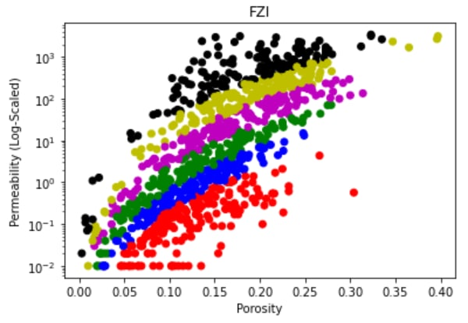
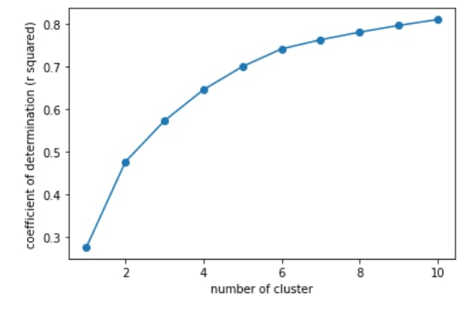
Own Implementation of Traditional Method
Iteration 1-10
Plot corresponding number of LR line
Get average R^2
Compare using R^2 vs Cluster plot
Optimal Cluster of 6 chosen
ANL488 Presentation

Slide 13
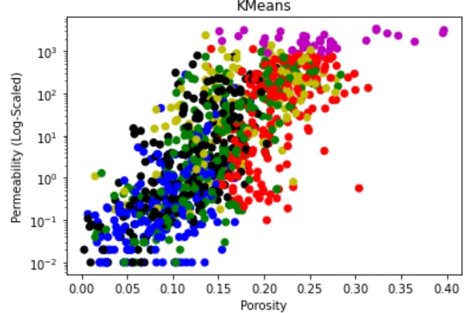
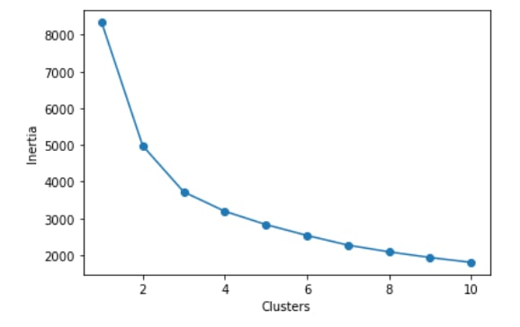
KMeans
Used Elbow plot to determine optimal clusters
Range trained was from 1 to 11
Based on elbow plot, optimal cluster of 6 is chosen
ANL488 Presentation

Slide 14
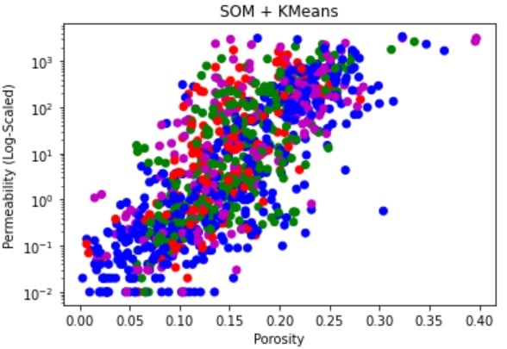
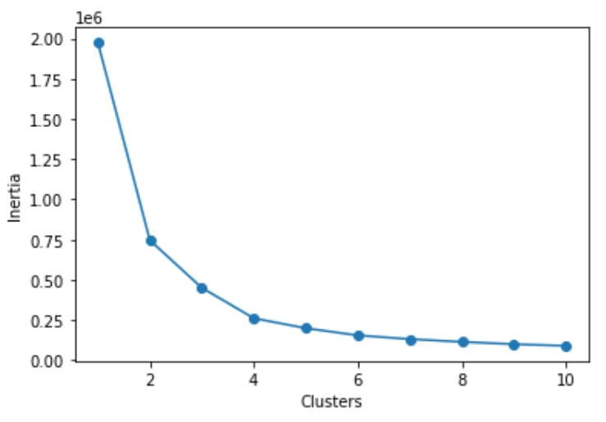
Self Organizing Map (SOM) + KMeans
Trained UK data using SOM with 10 X 10 grid
Output is 100 clusters
Used KMeans to combine the clusters
Optimal clusters chosen using elbow plot
Optimal clusters of 4 was chosen
ANL488 Presentation

Slide 15
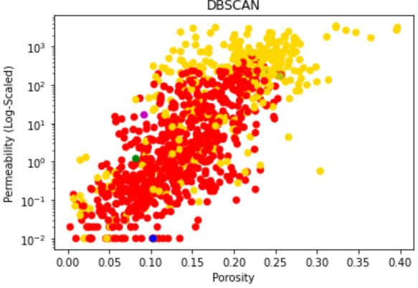
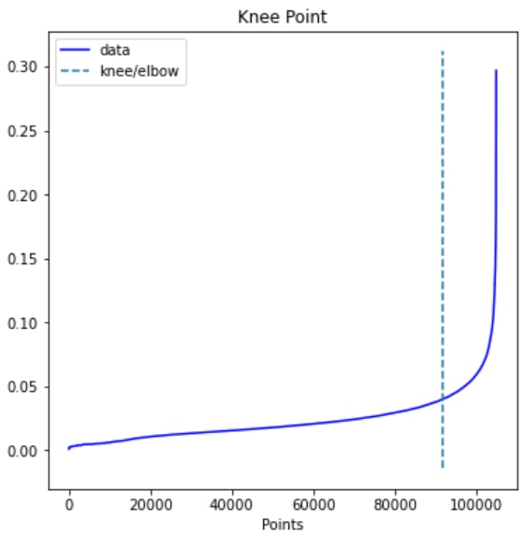
DBSCAN
Find Optimal eps (epsilon) using avg distance of k-nearest neighbour
K set to 10 at random
Maximum curvature used as epsilon
Dbscan initialised and fitted
min_samples set at 70
0.397
ANL488 Presentation

Slide 16
Comparison of the unsupervised algorithms to industry standard
Benchmark
KMeans
SOM+KMeans
DBSCAN
ANL488 Presentation

Slide 17
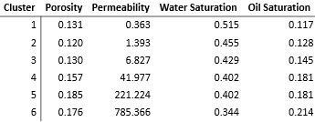
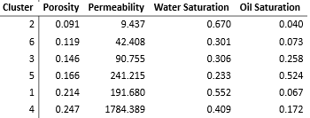

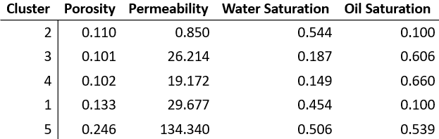
Comparison of the unsupervised algorithms to industry standard
Benchmark
KMeans
SOM+KMeans
DBSCAN
ANL488 Presentation

Slide 18
Comparison between clustering algorithms
Metrics use: Silhouette Coefficient, Calinski-Harabaz Index, Davies-Bouldin Index
The metrics evaluates uniqueness of clusters
For Silhouette Coefficient and Calinski-Harabaz Index, higher values are better
For Davies-Bouldin Index, the lower the value the better
KMeans has a better performance than SOM+Kmeans and DBSCAN
Clustering Algorithms | Silhouette Coefficient | Calinski-Harabaz Index | Davies-Bouldin Index
KMeans | 0.25 | 42838.32 | 1.13
SOM + KMeans | 0.10 | 23282.77 | 2.35
DBSCAN | 0.09 | 4840.08 | 1.36
ANL488 Presentation

Slide 19
Future Works and Conclusion
There are further areas that can definitely be included given time
Application of more algorithms
More sets of data to account for variability
Benchmarking against one or more industry standards
Using different methods for benchmarking
Comparing to benchmark
Clustering algorithms are not similar to benchmark
Comparing between clustering algorithms
KMeans have a much better result than SOM + Kmeans and DBSCAN
More research can be done for a better comparison
ANL488 Presentation

Slide 20
Q&A
Thank You
ANL488 Presentation

Slide 21
References
Department of Mines, Industry Regulation and Safety. (n.d.). Introduction to unconventional resources. https://www.dmp.wa.gov.au/Petroleum/Introduction-to-unconventional-25621.aspx
Khalid, M. Saad, E. D., Desouky, S., Rashed, M., Shazly, T., & Sediek, K. (2019). Application of hydraulic flow units’ approach for improving reservoir characterization and predicting permeability. Journal of Petroleum Exploration and Production Technology, 10(2). https://doi.org/10.1007/s13202-019-00758-7
ANL488 Presentation

