Slide 1


Comparison of SARIMA and LSTM models in forecasting solar irradiance
Chen Guo Hao Alvin
N1981071
Presentation date: 190922
ANL488 Presentation

Slide 2



Project background
Business problem
Singapore needs solar energy, but solar assets are challenged by intermittent generation
Business objective
De-risk investment on solar assets
Data mining objective
Identify the best model for forecasting annual solar irradiance using historical solar irradiance
ANL488 Presentation
Notes:
To provide the project background, I first explored a range of industries, and landed on the Singapore’s renewable industry as it is an emerging topic especially with the emerging need to combat climate change.
As renewables rely on natural resources to generate energy, I first looked at Singapore’s geographical features. While the nation has limited land resources, insufficient wind speeds and hydropower, it boasts intensive solar resources with 1,580 kWh/m² of irradiation per annum. Hence, this research will focus on the application of data science in the field of solar energy.
To scope out the business problem, we examine the solar business landscape. Singapore’s industry consists of private developers who finance and maintain ownership of the solar projects, then recuperating costs by selling the solar energy generated to the contracted agencies. As a result, the project payback period and return on investment relies on the quantity of energy generated from PV systems.
However, a key issue with solar assets would be intermittent generation. PV generation is strongly dependent on solar irradiation – the quantity of sunlight received per square meter, characterized by high variability due to weather parameters such as cloudy skies or time of day. As solar developers require a feasibility study of the energy potential and economic benefits before investing in PV systems, the need for an accurate irradiance forecast emerges which leads us to the data mining objective: identifying the best model for forecasting annual irradiance

Slide 3

Gaps in literature review
Out of scope
Area of focus
Numerical weather prediction models
(forecast period too short hence out of scope)
WRF
GFS
Linear models
SARIMA by Alsharif et al. (2019)
ARIMA
Triple Exponential Smoothing
Linear regression
Non-linear models
LSTM by Qing & Niu (2018)
ANN – Artificial neural network
WNN – Wavelet neural network
CNN – For satellite imagery
No direct comparison between linear and non-linear performance for irradiance
Hence we compare SARIMA (best linear) and LSTM (best non-linear)
ANL488 Presentation
Notes:
Across past research, there is a common trend for methodologies to forecast irradiance. These methods can be dissected into numerical weather predictions (NWP) which are the first weather algorithms, followed by statistical approaches such as the Box-Jenkins (ARIMA) methodology, with non-linear algorithms such as neural networks being the latest approach. While numerical weather predictions are still applied today, their forecasting scope is usually up to 3-4 days which is too short for our data mining objective of annual forecasting, hence we will focus on comparing linear and non-linear models for this project.
Within linear models, the top contender would be SARIMA, also known as seasonal autoregressive integrated moving average as indicated by Alsharif et al ; For non-linear models, the long short term memory network by Qing and Niu is the best model. While SARIMA and LSTM are the top contenders for their linear and non-linear models respectively, a direct comparison has yet to be published in the discipline of irradiance forecasting. Hence, we will employ both the approaches taken by Alsharif et al. (2019) for SARIMA, as well as Qing & Niu (2018) for LSTM to forecast daily irradiance

Slide 4
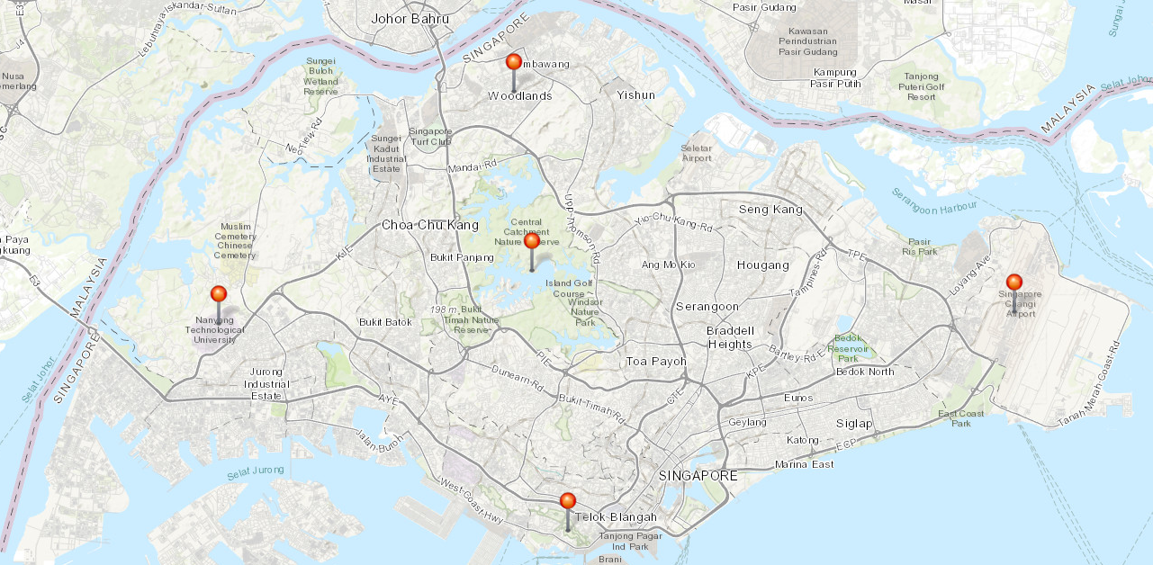
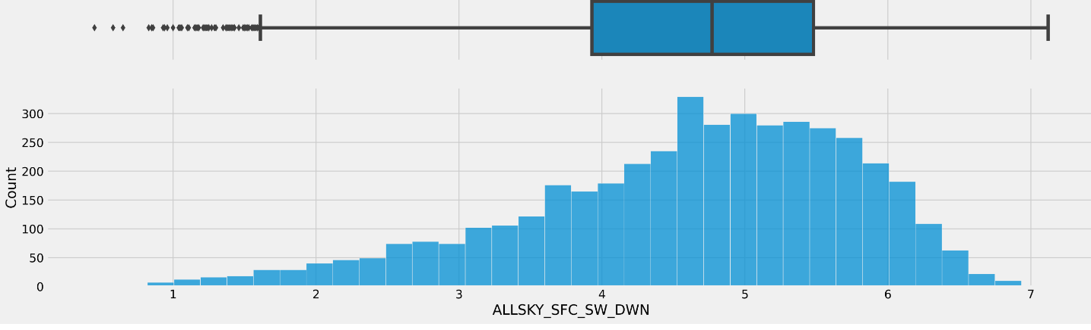
Data collection and understanding
Data source: NASA Power
Collected from 5 locations to cover Singapore
15 variables collected, 3 ordinal 12 continuous
From January 2010 to December 2021
Irradiance is left skewed
1.4373N, 103.778E
1.3683N, 103.8022E
1.3505N, 103.6811E
1.3603N, 103.9918E
1.2734N, 103.8178E
Figure 1 – data collection location
ANL488 Presentation
Figure 2 – Histogram of solar irradiance
Acknowledgements: The data were obtained from the NASA Langley Research Center (LaRC) POWER Project funded through the NASA Earth Science/Applied Science Program
Notes:
For the data collection, I collected a mix of ordinal and continuous data from NASA Power renewable energy dataset, which includes weather parameters collected from satellites to facilitate the system planning phase for PV and wind powered assets. Data from 5 locations were collected as illustrated in figure 1, to cover for north south east west and central of Singapore. The ordinal data would be the year, month and day of the weather parameters collected – ranging from 2010 January to December 2021. The continuous data would be the weather parameters such as solar irradiance, the daily averages of temperature, dew point which indicates the amount of moisture in the air, wet bulb temperature which measures how much water vapor the atmosphere can hold, humidity, precipitation, surface pressure, wind speed and wind direction for 10- and 50-meters elevation, and lastly all sky insolation which refers to how cloudy the sky is. For data understanding analysis, the solar irradiance tends to cluster in the higher range as indicated in the solar irradiance histogram which is left skewed.

Slide 5
Data preparation
Common steps for both models
Model specific steps
Stationary + Seasonality test (SARIMA)
Is data quality ok?
Interpolate missing data
Raw data
Remove outliers
Compute average across all locations
Normalization (LSTM)
ANL488 Presentation
Notes:
Upon reading raw data into Python, there are 9 missing entries for downward radiation and 170 missing values for insolation clearness index. To fill in the missing values, interpolation is performed using historical data as reference. After filling in the missing data, removal of outliers was then carried out. Data from the 5 locations is then consolidated by computing the daily average. Afterwards, the data preparation steps are customized to the model requirements. In the case of SARIMA, I will apply stationery and seasonality test.Stationarity means that the statistical properties of a process generating a time series do not change over time. It is important for a time series to be stationary as it has a significant impact on the model’s predictability. On the other hand, seasonality refers to regular and predictable changes that recur every calendar year, testing for it will help to improve model performance and insights.
As LSTM models use a variety of inputs with different value ranges, normalization is necessary to reduce computation time. This involves scaling data inputs into the range between 0 to 1 while preserving relationships between variables.

Slide 6
Modelling - SARIMA
Daily irradiance
Data preparation
Stationarity test
Identify AR and MA terms
Fit model to parameters identified
SARIMA to account for exogeneous variable,
function of pdq x s(pdq)
Dickey-Fuller (ADF) for stationarity
Determine p and q by plotting ACF and PACF
AIC to compare model performance*
2010 to 2020 for training, 2021 for testing
Forecast and check residuals
Model Deployment
ANL488 Presentation
*It is normal for model parameter converged from AIC to be different from terms initially identified in stationarity and ACF/PACF plots
Notes:
As a permutation of the ARIMA algorithm, SARIMA, is similarly constituted by the autoregressive (AR) and moving average (MA) terms. SARIMA does not only carry over ARIMA’s reliability and simplicity in forecasting solar irradiance but has also been proven to be effective in modelling seasonal data such as daily solar irradiance over the year as identified in the literature review. As SARIMA is univariate in nature, only day input and solar irradiance parameter is used.
For stationarity test, I use ADF test which is binary, as it tells us whether the unit root is present in the model which implies non-stationarity. As our p-value was less than the significance level of 0.05, we rejected the null hypothesis and concluded that our time series is stationary without the need for differencing.
To find the optimal SARIMA parameters, we included several combinations to determine the best model. Akaike information criterion (AIC) is a popular metric for measuring prediction error for statistical models. Using the maximum likelihood estimation as a basis for scoring, the model with the lowest AIC would provide the best fit.
Our next step would then be to fit the training data based on the model parameters. For the train: test split, we used data from 2010 to 2020 as training data, followed by 2021 irradiance for testing data.

Slide 7
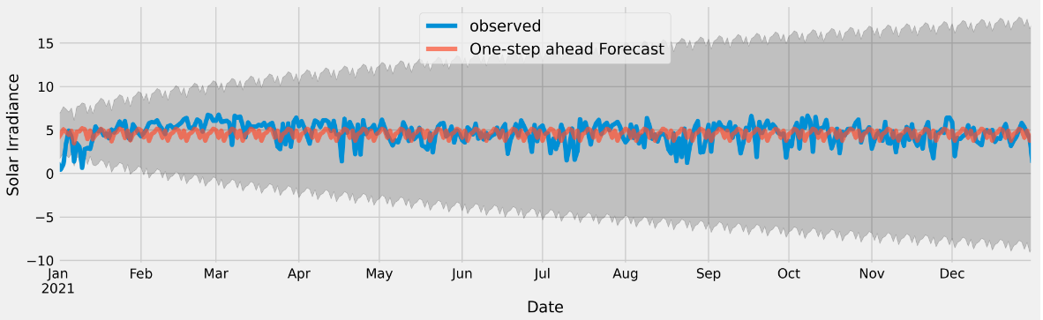
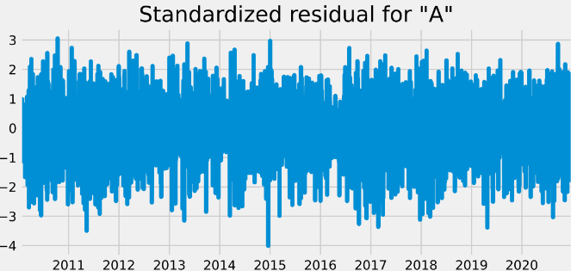
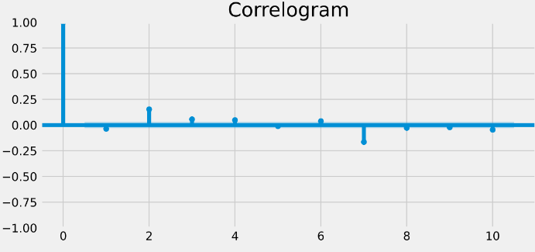
SARIMA Post-modelling Residual Validation
Figure 3: Irradiance forecast vs testing data
Figure 4: Residual plot
Generated MSE of 1.68 and a RMSE of 1.30
Majority of irradiance are between ±3
Correlation is within ±0.25 for lag 1 onwards
ANL488 Presentation
Figure 5: Residual correlogram
Notes:
As we are comparing the SARIMA model against the LSTM approach, we would use RMSE as the common scoring metric. By comparing the model forecasts with observed data, our model generated an MSE of 1.8 and a RMSE of 1.34. To examine the goodness of fit, we then plotted the standardized residual for daily irradiance. The residual plot tells us if our model has captured the information needed from the time series. While there are a few outliers, they fall within the 95% confidence interval as majority of irradiance residuals are between ±3. Another measure of model goodness would be the correlogram. This visualization tells us the degree of correlation across different lags. As observed from the figure, the correlation is within ±0.25 for lag 1 onwards. Using the benchmarks from past literature review such as Alsharif et al, we can conclude that the residuals are uncorrelated, and that our model has captured the information needed for forecasting.

Slide 8
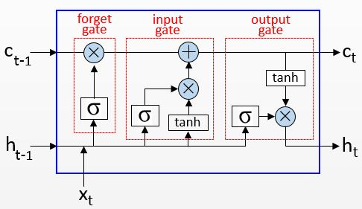
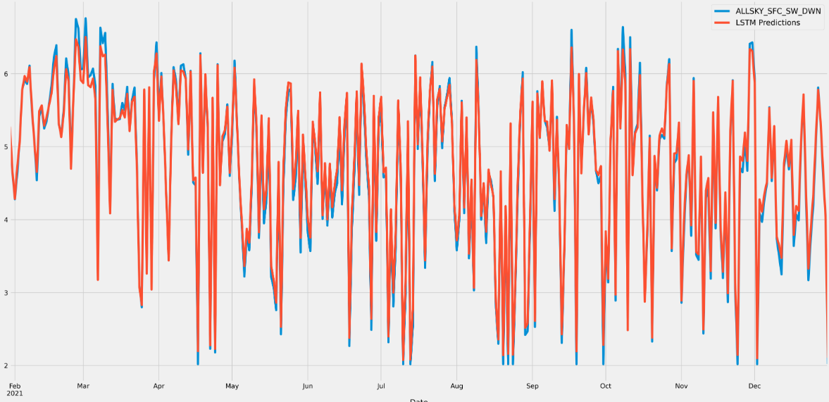
Modelling - LSTM
Use all 15 variables as compared to SARIMA
Input, hidden, output layer
Hyperparameter tuning:
learning rate
Epoch
batch size
number of neurons
Same train-test split as SARIMA
Generated MSE of 0.02 and a RMSE of 0.14
Figure 6: LSTM memory cell
ANL488 Presentation
Figure 7: LSTM Forecast vs testing data
Notes:
Unlike the SARIMA methodology, the long short term memory network, also known as LSTM, requires other input weather parameters as explored in the data understanding phase. As illustrated in figure 6, the LSTM’s holds a memory cell which retains the captured information over longer time periods and preserves useful constituents using its input and forget gates, hence optimizing information captured while reducing computation intensity. By taking in the variable inputs, the LSTM algorithm applies a recurrent connection within the hidden layer to capture information associated with sequential data . As a deep learning algorithm, the LSTM model also has a greater emphasis on hyperparameter tuning to avoid model over and underfitting. As compared to parameters which are derived from model training, hyperparameters are defined before training. As the value of these hyperparameters significantly impact model performance, we employed Python’s randomizedsearch to test out a range of hyperparameters and determine the model with the best R² value. After applying the optimal hyperparameter, we generated a forecasted model in figure 7 with MSE of 0.02 and a RMSE of 0.14, which can be observed in the testing phase.
https://dwbi1.wordpress.com/2021/08/07/recurrent-neural-network-rnn-and-lstm/

Slide 9
Results and Discussion
Figure 8: SARIMA forecast vs testing data
Figure 9: LSTM Forecast vs testing data
SARIMA
LSTM
Generated MSE of 1.68 and a RMSE of 1.30
Generated MSE of 0.02 and a RMSE of 0.14
Pros:
Easier to understand
Less computationally expensive
Captures anomalous information
Pros:
More accurate than SARIMA
Considers exogenous variables
Better at capturing sequential information
Cons:
Forecast is less accurate than LSTM
Cons:
Difficult to understand beyond input layer
ANL488 Presentation
Notes:
By putting both forecasts side by side, with the orange lines being forecast and blue lines being testing data, we can observe that the LSTM model is much better at capturing the finer variations in irradiance across the year. Supported by LSTM’s lower MSE and RMSE, we can hence conclude that LSTM is the better performing model. While the scope of this research focuses on MSE and RMSE as the means of model comparison, some limitation to consider would be the complexity of neural network like LSTM which makes it harder to interpret than SARIMA, as well as the longer computation time as it takes other weather parameters as inputs. Having said that, the benefit of including other weather parameters supported by LSTM’s sequential modelling supports its position as one of the best forecasting algorithms for annual irradiance.

Slide 10


Future research
Other areas to be studied:
Economic models
Hourly forecasting
Seasonal weather
ANL488 Presentation
Notes:
Beyond this project, future studies which would be interesting include forecasting irradiance on the hourly interval to provide more granular insights, other countries with higher variant weather such as UK with 4 seasons, as well as the deployment of the LSTM models to economic models including PV costs and revenue from energy generated to understand the reliability of these models over time.

Slide 11
Thank you For your kind attention
Notes:
That will be the end of my presentation, thank you for your attention, and now I will open the floor for questions.

Slide 12
References
Alsharif, M., Younes, M., & Kim, J. (2019). Time Series ARIMA Model for Prediction of Daily and Monthly Average Global Solar Radiation: The Case Study of Seoul, South Korea. Symmetry, 11(2), 240. doi:10.3390/sym11020240
Colak, I., Yesilbudak, M., Genc, N., & Bayindir, R. (2015). Multi-period Prediction of Solar Radiation Using ARMA and ARIMA Models. 2015 IEEE 14th International Conference on Machine Learning and Applications (ICMLA). doi:10.1109/icmla.2015.33
Diagne, M., David, M., Lauret, P., Boland, J., & Schmutz, N. (2013). Review of solar irradiance forecasting methods and a proposition for small-scale insular grids. Renewable and Sustainable Energy Reviews, 27, 65–76. doi:10.1016/j.rser.2013.06.042
Fathima, T. A., Nedumpozhimana, V., Lee, Y. H., Winkler, S., & Dev, S. (2019). Predicting Solar Irradiance in Singapore. 2019 Photonics & Electromagnetics Research Symposium - Fall (PIERS - Fall). doi:10.1109/piers-fall48861.2019.9021313
HDB (2021). SolarNova Programme. Retrieved July 25th, 2022, from: https://www.hdb.gov.sg/about-us/our-role/smart-and-sustainable-living/solarnova-page
Ihshaish, H., Cort́es, A., & Senar, M. A. (2012). Towards Improving Numerical Weather Predictions by Evolutionary Computing Techniques. Procedia Computer Science, 9, 1056–1063. doi:10.1016/j.procs.2012.04.114
IPCC. (2022). Summary for Policy Makers. Retrieved July 25th, 2022, from: https://www.ipcc.ch/report/ar6/wg2/downloads/report/IPCC_AR6_WGII_SummaryForPolicymakers.pdf
IRENA. (2020). ADVANCED FORECASTING OF VARIABLE RENEWABLE POWER GENERATION. Retrieved July 25th, 2022, from: https://www.irena.org/-/media/Files/IRENA/Agency/Publication/2020/Jul/IRENA_Advanced_weather_forecasting_2020.pdf%20?%20%20la=en&hash=8384431B56569C0D8786C9A4FDD56864443D10AF
ANL488 Presentation

Slide 13
References
Manoj Kumar, N., & Subathra, M. S. P. (2019). Three years ahead solar irradiance forecasting to quantify degradation influenced energy potentials from thin film (a-Si) photovoltaic system. Results in Physics, 12, 701–703. doi:10.1016/j.rinp.2018.12.027
NASA. (2021). The POWER Project. Retrieved July 25th, 2022, from: https://power.larc.nasa.gov/
NCCS. (2022). SINGAPORE’S APPROACH TO ALTERNATIVE ENERGY. Retrieved July 25th, 2022, from: https://www.nccs.gov.sg/singapores-climate-action/singapore-approach-to-alternative-energy/
Oh, T. (2022). Government considering more initiatives to push solar energy adoption in Singapore. The Business Times. Retrieved July 25th, 2022, from: https://www.businesstimes.com.sg/government-economy/government-considering-more-initiatives-to-push-solar-energy-adoption-in
Ouma, Y. O., Cheruyot, R., & Wachera, A. N. (2021). Rainfall and runoff time-series trend analysis using LSTM recurrent neural network and wavelet neural network with satellite-based meteorological data: case study of Nzoia hydrologic basin. Complex & Intelligent Systems. doi:10.1007/s40747-021-00365-2
Parasyris, A., Alexandrakis, G., Kozyrakis, G., & Spanoudaki, K. (2022). Predicting Meteorological Variables on Local Level with SARIMA, LSTM and Hybrid Techniques. Atmosphere, 13(878), doi:10.3390/atmos13060878
Qing, X., & Niu, Y. (2018). Hourly day-ahead solar irradiance prediction using weather forecasts by LSTM. Energy, 148, 461–468. doi:10.1016/j.energy.2018.01.177
Rana, M., Atef, M., Sarkar, R., & Uddin, M. (2022). A Review on Peak Load Shaving in Microgrid—Potential Benefits, Challenges, and Future Trend. Energies, 15(6):2278, doi:10.3390/en15062278
ANL488 Presentation

Slide 14
References
Reikard, G. (2009). Predicting solar radiation at high resolutions: A comparison of time series forecasts. Solar Energy, 83(3), 342–349. doi:10.1016/j.solener.2008.08.007
Sayago, S., Ovando, G., Almorox, J., & Bocco, M. (2019). Daily solar radiation from NASA-POWER product: assessing its accuracy considering atmospheric transparency. International Journal of Remote Sensing, 1–14. doi:10.1080/01431161.2019.1650986
Shadab, A., Ahmad, S., & Said, S. (2020). Spatial forecasting of solar radiation using ARIMA model. Remote Sensing Applications: Society and Environment, 20, 100427. doi:10.1016/j.rsase.2020.100427
Shamim, M. A., Remesan, R., Bray, M., & Han, D. (2015). An improved technique for global solar radiation estimation using numerical weather prediction. Journal of Atmospheric and Solar-Terrestrial Physics, 129, 13–22. doi:10.1016/j.jastp.2015.03.011
Sharma, N., Sharma, P., Irwin, D., & Shenoy, P. (2011). Predicting solar generation from weather forecasts using machine learning. 2011 IEEE International Conference on Smart Grid Communications (SmartGridComm). doi:10.1109/smartgridcomm.2011.61
Sharma, V., Yang, D., Walsh, W., & Reindl, T. (2016). Short term solar irradiance forecasting using a mixed wavelet neural network. Renewable Energy, 90, 481–492. doi:10.1016/j.renene.2016.01.020
Siddiqui, T. A., Bharadwaj, S., & Kalyanaraman, S. (2019). A Deep Learning Approach to Solar-Irradiance Forecasting in Sky-Videos. 2019 IEEE Winter Conference on Applications of Computer Vision (WACV). doi:10.1109/wacv.2019.00234
ANL488 Presentation

Slide 15
References
Ssekulima, E. B., El Moursi, M. S., Al Hinai, A., & Anwar, M. B. (2016). Wind speed and solar irradiance forecasting techniques for enhanced renewable energy integration with the grid: a review. IET Renewable Power Generation, 10(7), 885–989. doi:10.1049/iet-rpg.2015.0477
Vakitbilir, N., Direkoglu, C., & Hilal, A. (2021). Prediction of Daily Solar Irradiation Using CNN and LSTM Networks. ICAFS-2020, 230-238, doi:10.1007/978-3-030-64058-3_28
Verbois, H., Huva, R., Rusydi, A., & Walsh, W. (2018). Solar irradiance forecasting in the tropics using numerical weather prediction and statistical learning. Solar Energy, 162, 265–277. doi:10.1016/j.solener.2018.01.007
Wang, W., Feng, J., & Xu, F. (2021). Estimating Downward Shortwave Solar Radiation on Clear-Sky Days in Heterogeneous Surface Using LM-BP Neural Network. Energies, 14(2), 273. doi:10.3390/en14020273
Yang, D., Kleissl, J., Gueymard, C. A., Pedro, H. T. C., & Coimbra, C. F. M. (2018). History and trends in solar irradiance and PV power forecasting: A preliminary assessment and review using text mining. Solar Energy, 168, 60–101. doi:10.1016/j.solener.2017.11.023
Yu, Y., Cao, J., & Zhu, J. (2019). An LSTM Short-Term Solar Irradiance Forecasting Under Complicated Weather Conditions. IEEE Access, 7, 145651–145666. doi:10.1109/access.2019.2946057
Zhang, Y., Yang, H., Cui, H., & Chen, Q. (2019). Comparison of the Ability of ARIMA, WNN and SVM Models for Drought Forecasting in the Sanjiang Plain, China. Natural Resources Research. doi:10.1007/s11053-019-09512-6
ANL488 Presentation

