Slide 1
Clean
Green
Renewable
Biomass
Nuclear
Large-impact Hydropower
Geothermal
Solar
Wind
Low-impact Hydropower

Slide 2
VADER Applied on Tweet
Compound Score Generated
Manual Classification
Returns probabilities that tweet is positive, neutral, and negative
Based on the 3 probabilities, VADER generates a score ranging from -1 to 1
Score > 0.25 (Positive)
-0.25 ≤ Score ≤ 0.25 (Neutral)
Score < -0.25 (Negative)

Slide 3
VADER Applied on Tweet
Examines lexical features of tweet
Generate Compound Score
Based on the 3 probabilities
Manual Classification
Score > 0.25 (Positive)
Applies 5 Rules
Returns 3 Probabilities
Determines a preliminary score
E.g. Sentiment Amplifiers, Negations, Contrastive Conjunctions
P(Positive)
P(Neutral)
P(Negative)
Normalised between -1 and 1
-0.25 ≤ Score ≤ 0.25 (Neutral)
Score < -0.25 (Negative)

Slide 5
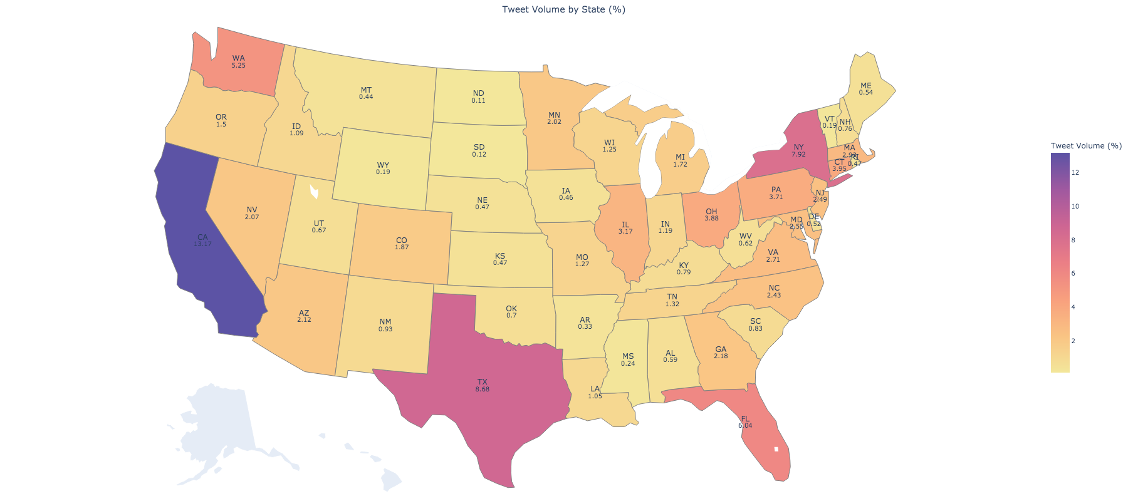
Tweet Volume (%)
2
4
6
8
10
12

Slide 6

WA
5.25
MN
2.02
NY
7.92
MA
2.93
MI
1.72
PA
3.71
CT
3.95
NV
2.07
OH
3.88
NJ
2.49
IL
3.17
CA
13.17
CO
1.87
MD
2.55
VA
2.71
NC
2.43
AZ
2.12
GA
2.18
TX
8.68
FL
6.04
Tweet Volume (%)
2
4
6
8
10
12

Slide 7
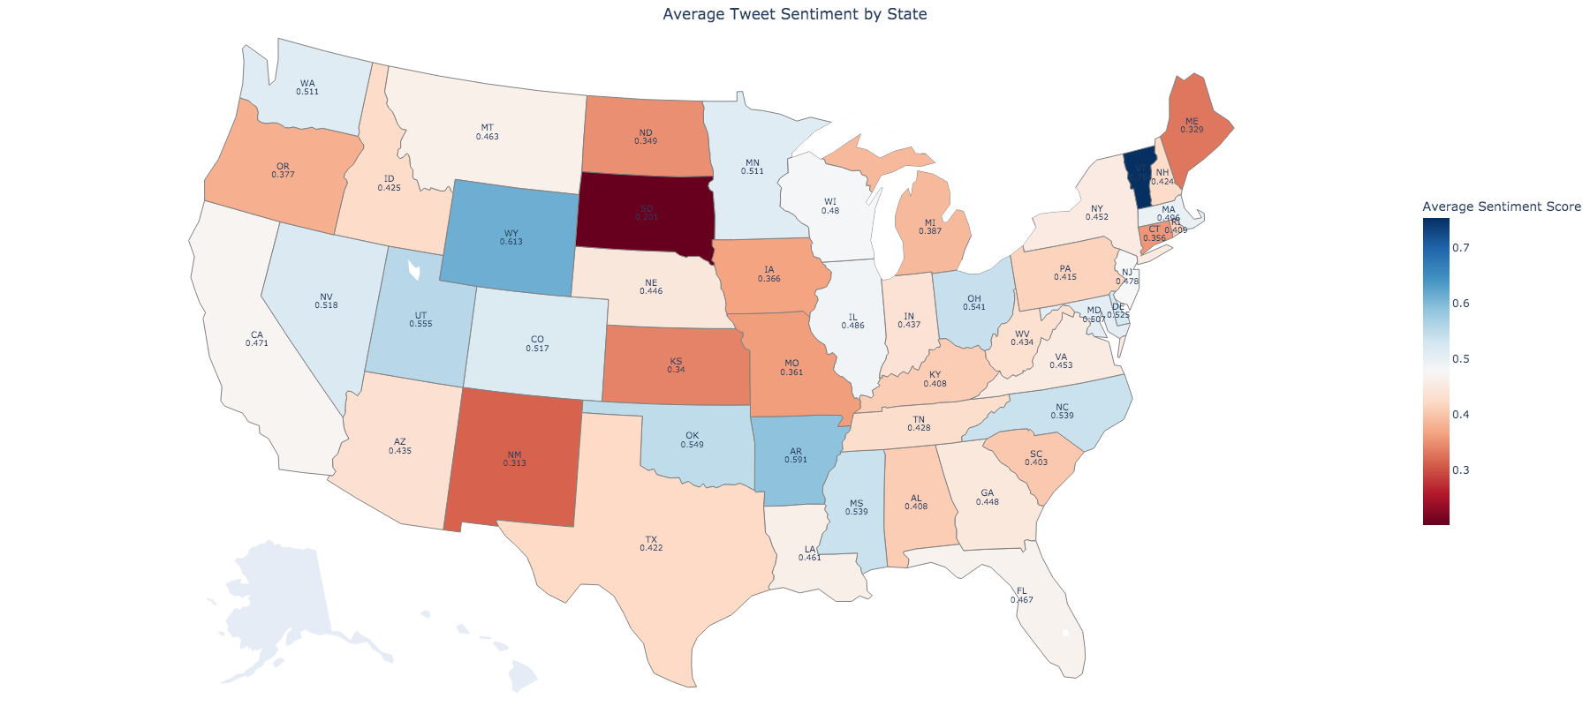
Average Sentiment Score
0.3
0.4
0.5
0.6
0.7

Slide 8
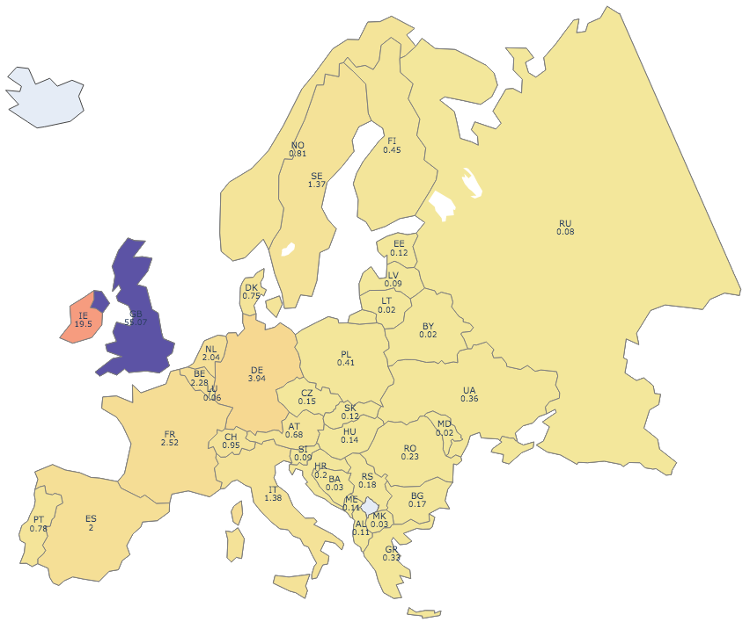
Tweet Volume (%)
10
20
30
40
50

Slide 9
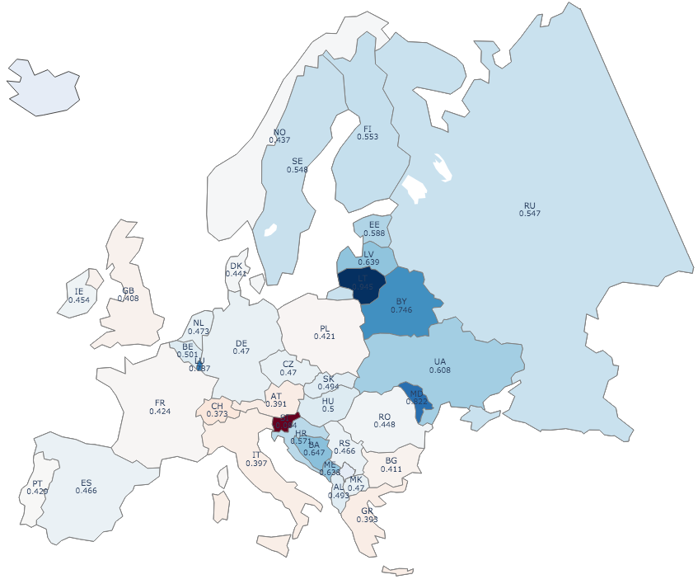
Average Sentiment Score
0
0.2
0.4
0.6
0.8

Slide 10
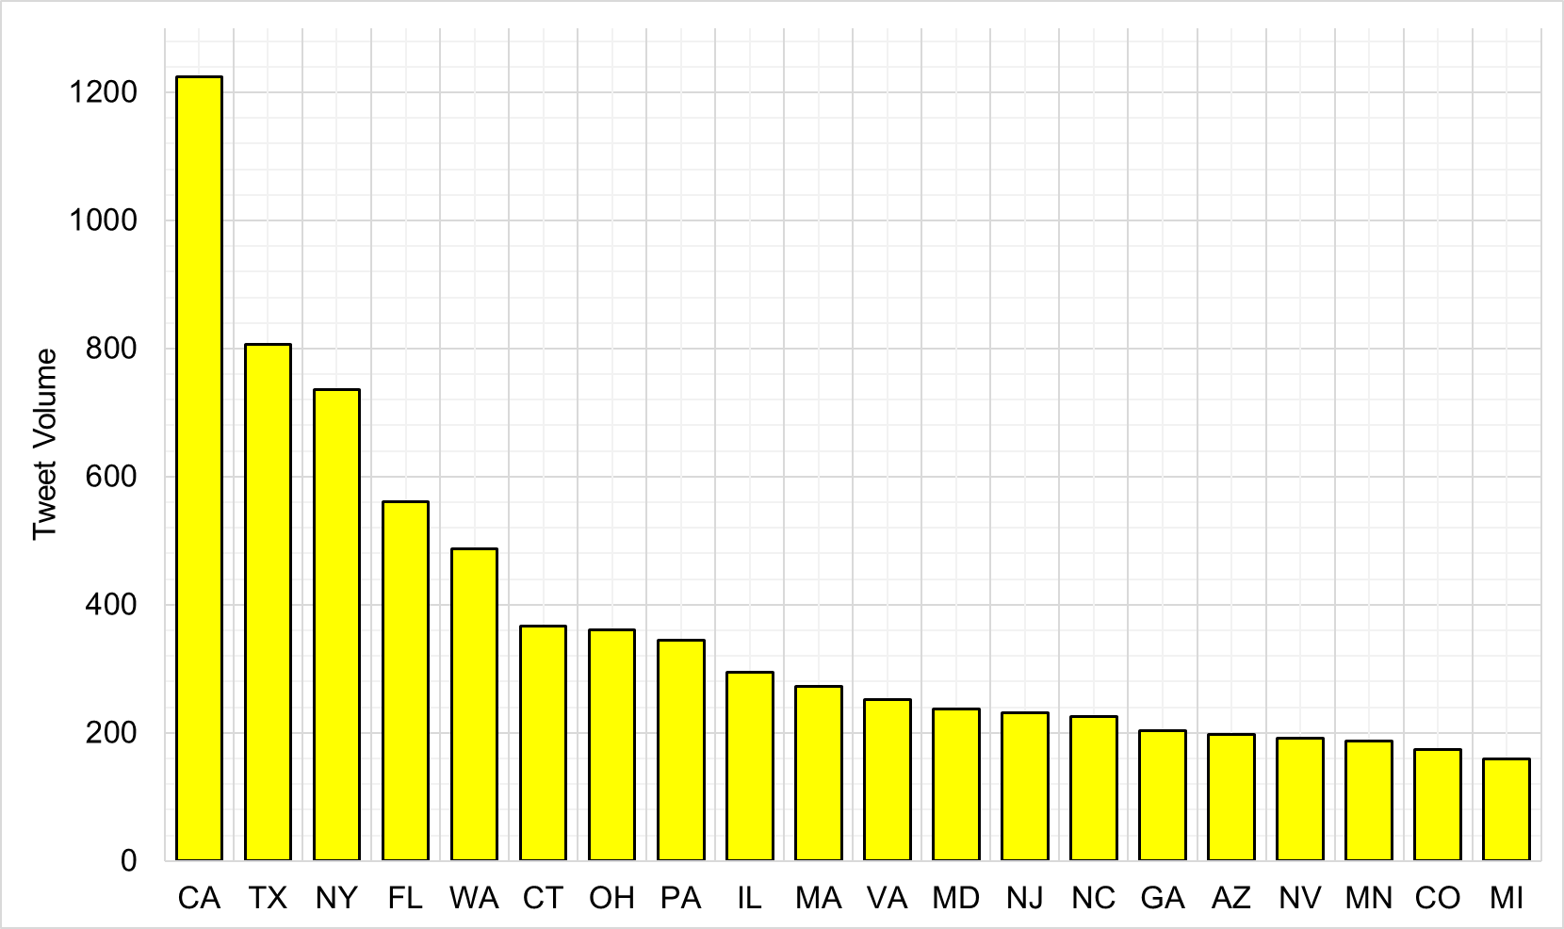
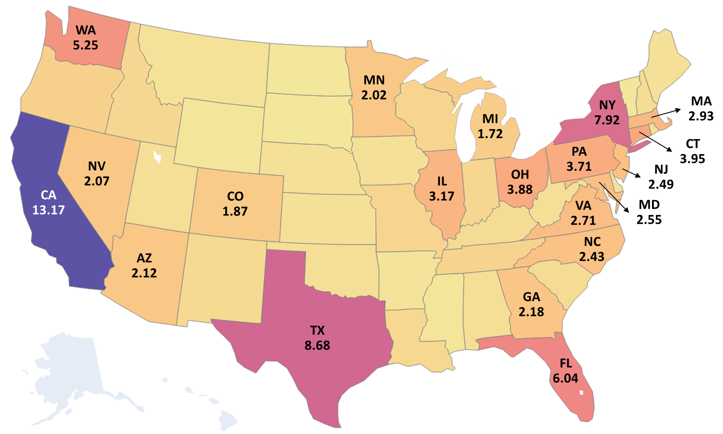
Tweet Volume (%)
2
4
6
8
10
12

Slide 11
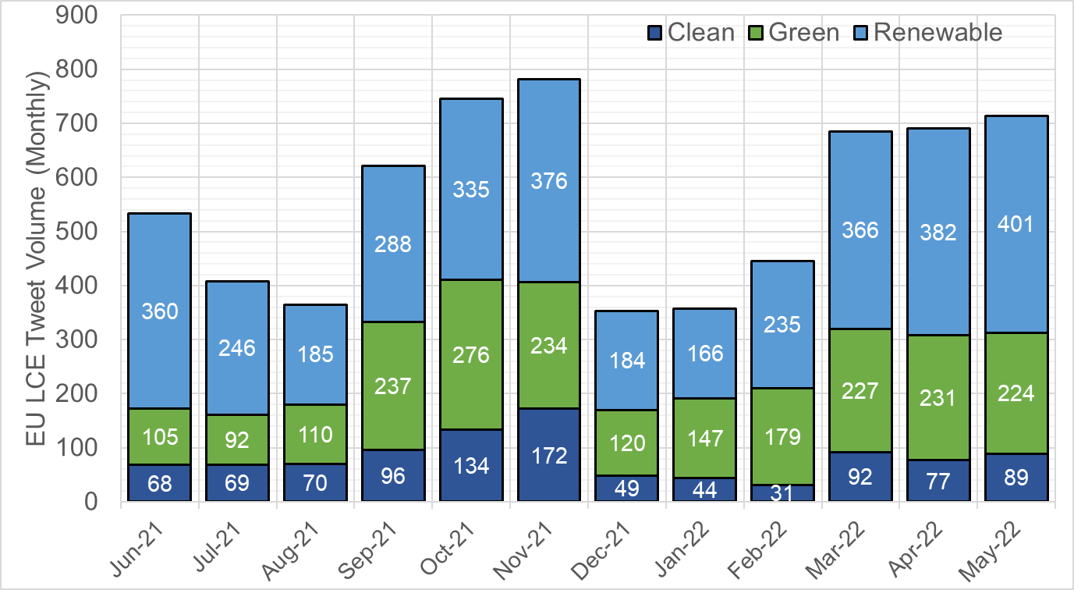
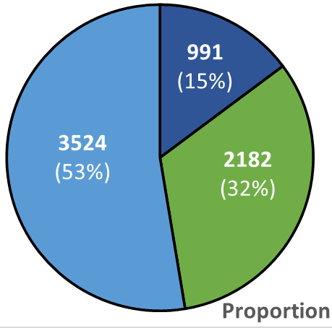
COP26
Russian- Ukraine War

Slide 12
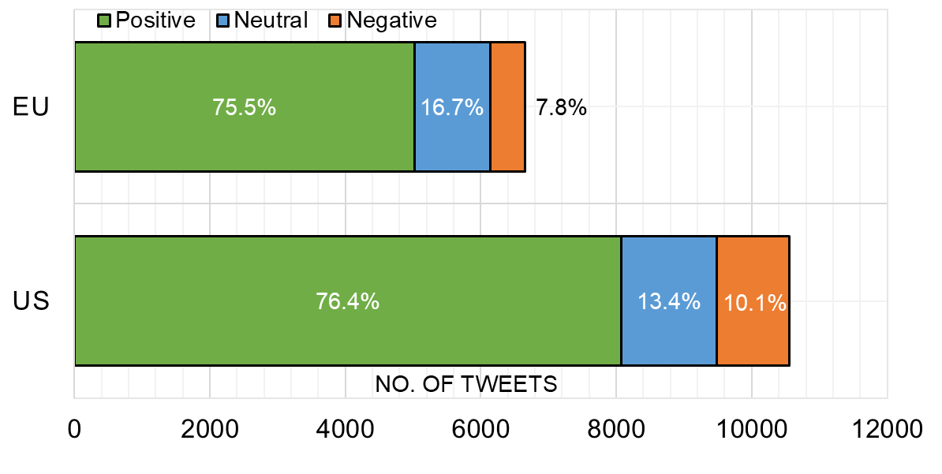
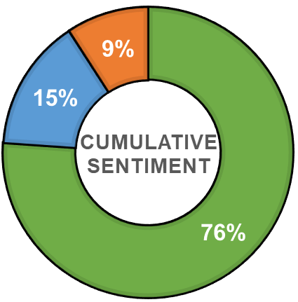

Slide 13
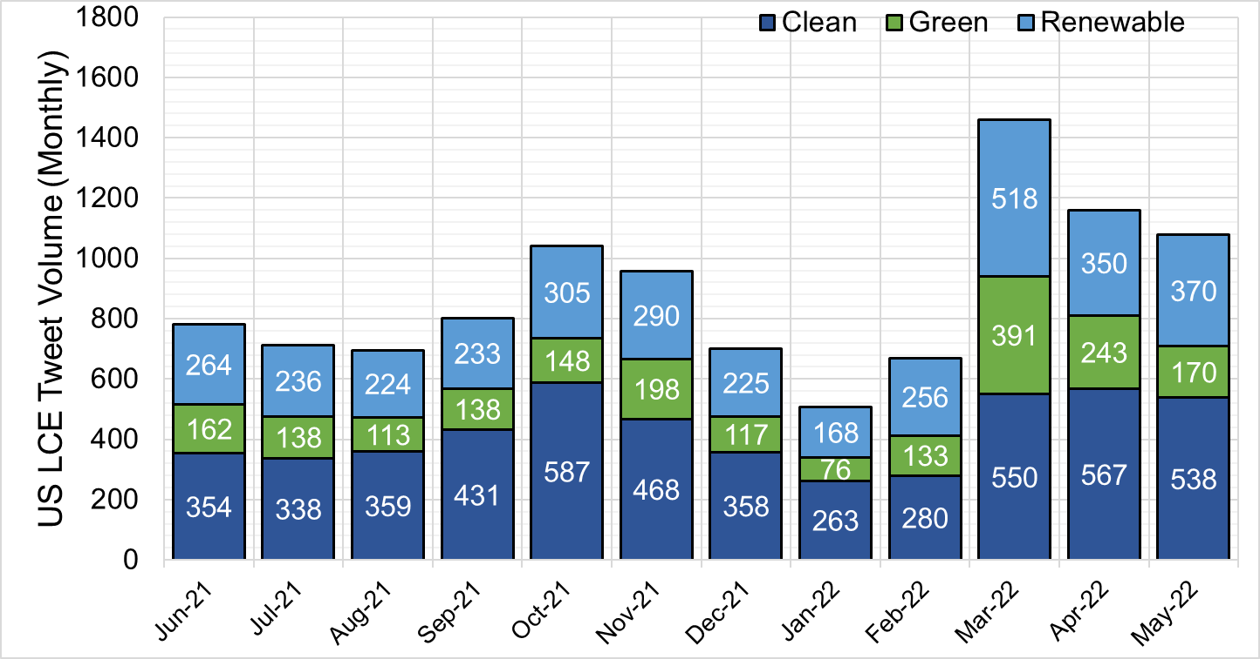
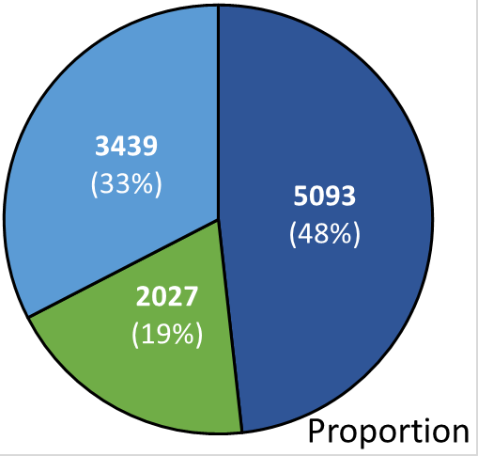
Russian- Ukraine War

