Slide 1

ANL488 Presentation
Bryan Lim Tze Yuan
H1981079
Presentation date: 190922
ANL488 Presentation

Slide 2
Introduction
Background
Rise in GHG emissions
Increase in temperatures
Increase in global population
Objective
Forecast future GHG emission levels
Given current trend of GDP, Population and CO2 emissions
Lit Review
LSTM and ARIMA used for forecasting time series data
ANL488 Presentation

Slide 3

Data Understanding
Source | Columns | Description
 | Country | Name of country
 | Year | Year of observation
 | Co2 | Annual co2 emissions (million tonnes)
 | Trade_co2 | Net co2 emissions from trade
 | … | …
 | Gdp | Gross Domestic Product for country
 | Energy_per_capita | Energy consumption per capita (kilowatt-hours per year)
Dataset features
25989 Entries
60 Columns
ANL488 Presentation

Slide 4
Data Preparation – Chosen variables
Variables chosen for multivariate LSTM
Column | Description
Country | Name of country
Year | Year of observation
Co2 | Annual co2 emissions (million tonnes)
Population | Population of country
GDP | GDP of country
ANL488 Presentation

Slide 5
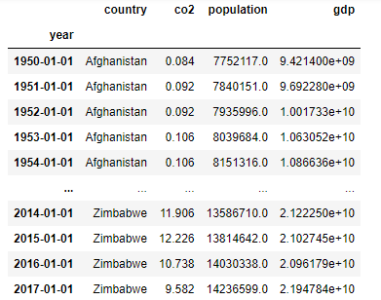
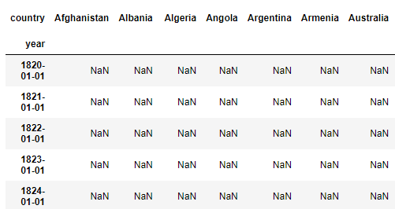
Data Preparation – Missing values
Pivot table
ANL488 Presentation

Slide 6
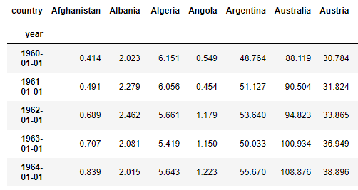
Data Preparation – Missing values
2. Choose last 60 years data in a row, drop NA values
ANL488 Presentation

Slide 7
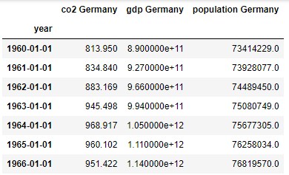
Data Preparation – Final Dataset
Find top 5 co2 emitters
Extract co2 emissions, GDP and population of top 5 countries
Put them into their respective dataframes
Final dataset size: 59 Rows X 3 Columns
ANL488 Presentation

Slide 8
Model - LSTM
Normalize values
Shape data to fit model
Train model / Predict
Inverse values back to original and plot
ANL488 Presentation

Slide 9
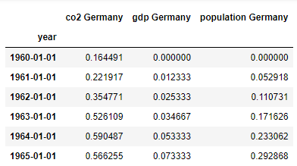
Model – Normalize and Shape
1) Normalize data
2) Shape data
Predictor |  |  |  |  | Predicted
1 | 2 | 3 | 4 | 5 | 6
2 | 3 | 4 | 5 | 6 | 7
3 | 4 | 5 | 6 | 7 | 8
4 | 5 | 6 | 7 | 8 | 9
ANL488 Presentation

Slide 10
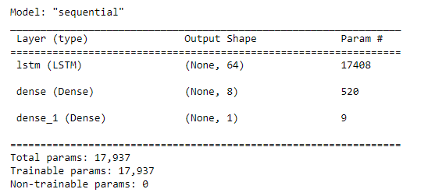
Model - Training
Sampling method
Training (70%), Validation (10%), Testing (20%)
Model Summary:
64 memory units, 1 output layer
ANL488 Presentation

Slide 11
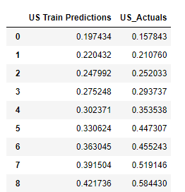
Model - Training
Fit model to training data, validate with validation data
Example of predictions
ANL488 Presentation

Slide 12
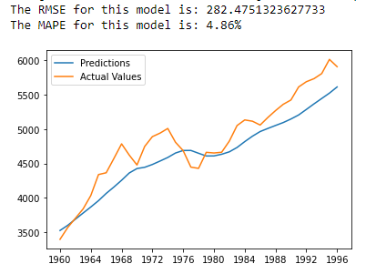
Model – Inverse and plot
Inverse scaling function and plot predictions to actuals
Predictions vs actuals for US co2
ANL488 Presentation

Slide 13
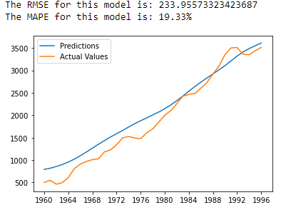
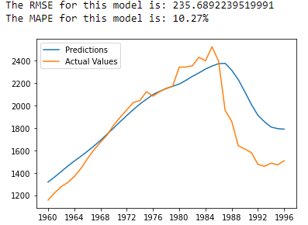
Model – Inverse and plot
China Model
Russia Model
ANL488 Presentation

Slide 14
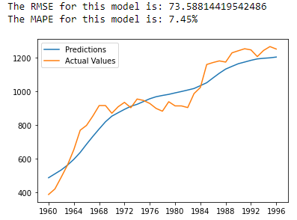
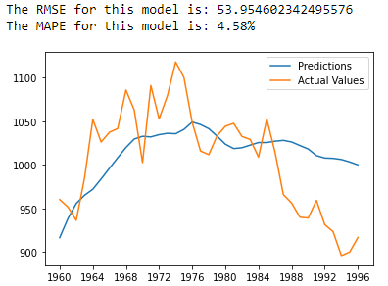
Model – Inverse and plot
Japan Model
Germany Model
ANL488 Presentation

Slide 15
Future Work
Forecasting of co2 emissions for future dates
Forecasting using ARIMA
Improving on current model accuracy
ANL488 Presentation

