Slide 1
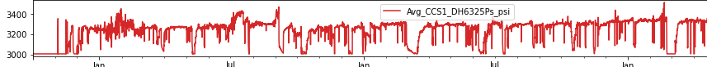
After Data Cleaning
Before Data Cleaning

