Slide 1
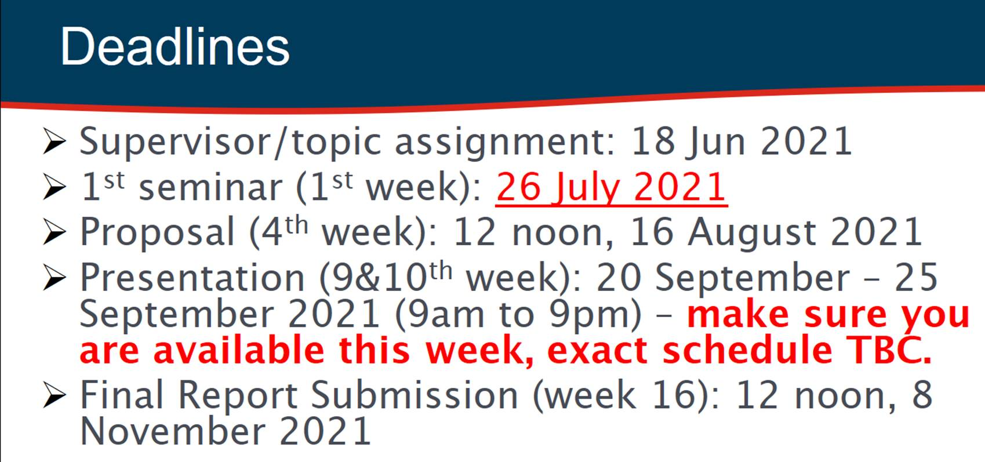

Slide 2
Dates
Pre-Course Start Meeting 0 – 6th Jul 2021, 6 pm
1st meeting : Before 1st week of semester (26 Jul)
Proposed Date Student-Supervisor Meeting 1: 23rd Jul at 5.30 pm
2nd meeting : before proposal deadline (16 Aug, 2021, 12 noon)
Proposed Date Student-Supervisor Meeting 2: 6th Aug 2021 at 5.30 pm
3rd meeting : before orals (20-25 Sept, 9 am -9 pm)
Proposed Date Student-Supervisor Meeting 3: 10th Sept 2021 at 5.30 pm
4th & 5th meetings : before final report submission (8 Nov 2021)
Proposed Date Student-Supervisor Meeting 4: 15th Oct 2021 at 5.30 pm
Proposed Date Student-Supervisor Meeting 5: 29th Sept 2021 at 5.30 pm

