Slide 1
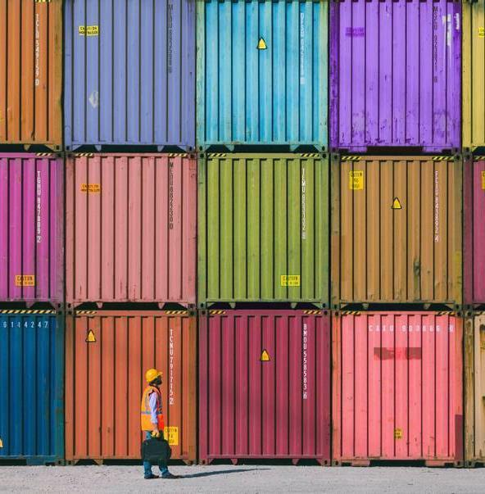
ANL488 Business Analytics Project
Effect Of Social-Economic Parameters On Logistics Performance Index

Slide 2
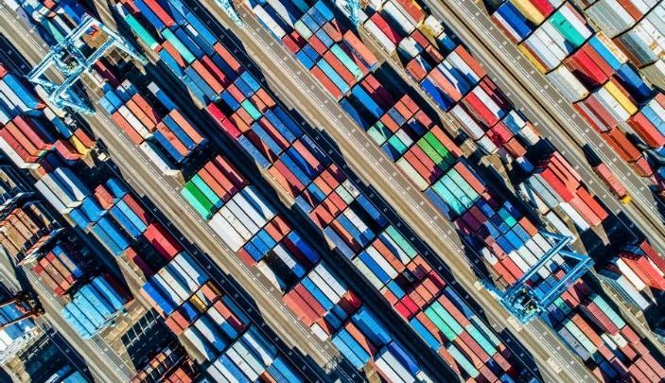

Agenda
Introduction
Business Understanding
Literature Review
Data Understanding & Preparation
Modelling
Evaluation
Deployment
Recommendation
Questions & Answers

Slide 3
Introduction
Logistics Performance Index
Global Competitiveness
Policy-Making
Social-Economic Parameters
Post-Covid Challenges
Data Mining Models
Prediction Analysis
How social-economic parameters relate to Logistics Performance Index
Notes:
Research and development expenditure (% of GDP)
Gross domestic expenditures on research and development (R&D), expressed as a percent of GDP. They include both capital and current expenditures in the four main sectors: Business enterprise, Government, Higher education and Private non-profit. R&D covers basic research, applied research, and experimental development.
Domestic credit to private sector by banks (% of GDP)
Domestic credit to private sector by banks refers to financial resources provided to the private sector by other depository corporations (deposit taking corporations except central banks), such as through loans, purchases of nonequity securities, and trade credits and other accounts receivable, that establish a claim for repayment. For some countries these claims include credit to public enterprises.
Current account balance (% of GDP)
Current account balance is the sum of net exports of goods and services, net primary income, and net secondary income.
Domestic general government health expenditure per capita (current US$)
Public expenditure on health from domestic sources per capita expressed in current US dollars.
External balance on goods and services (% of GDP)
External balance on goods and services (formerly resource balance) equals exports of goods and services minus imports of goods and services (previously nonfactor services).
Coal rents (% of GDP)
Coal rents are the difference between the value of both hard and soft coal production at world prices and their total costs of production.
Services, value added (% of GDP)
Services correspond to ISIC divisions 50-99 and they include value added in wholesale and retail trade (including hotels and restaurants), transport, and government, financial, professional, and personal services such as education, health care, and real estate services. Also included are imputed bank service charges, import duties, and any statistical discrepancies noted by national compilers as well as discrepancies arising from rescaling. Value added is the net output of a sector after adding up all outputs and subtracting intermediate inputs. It is calculated without making deductions for depreciation of fabricated assets or depletion and degradation of natural resources. The industrial origin of value added is determined by the International Standard Industrial Classification (ISIC), revision 3 or 4.
Agriculture, forestry, and fishing, value added (% of GDP)
Agriculture, forestry, and fishing corresponds to ISIC divisions 1-3 and includes forestry, hunting, and fishing, as well as cultivation of crops and livestock production. Value added is the net output of a sector after adding up all outputs and subtracting intermediate inputs. It is calculated without making deductions for depreciation of fabricated assets or depletion and degradation of natural resources. The origin of value added is determined by the International Standard Industrial Classification (ISIC), revision 4. Note: For VAB countries, gross value added at factor cost is used as the denominator.
Trade (% of GDP)
Trade is the sum of exports and imports of goods and services measured as a share of gross domestic product.
Imports of goods and services (% of GDP)
Imports of goods and services represent the value of all goods and other market services received from the rest of the world. They include the value of merchandise, freight, insurance, transport, travel, royalties, license fees, and other services, such as communication, construction, financial, information, business, personal, and government services. They exclude compensation of employees and investment income (formerly called factor services) and transfer payments.

Slide 4
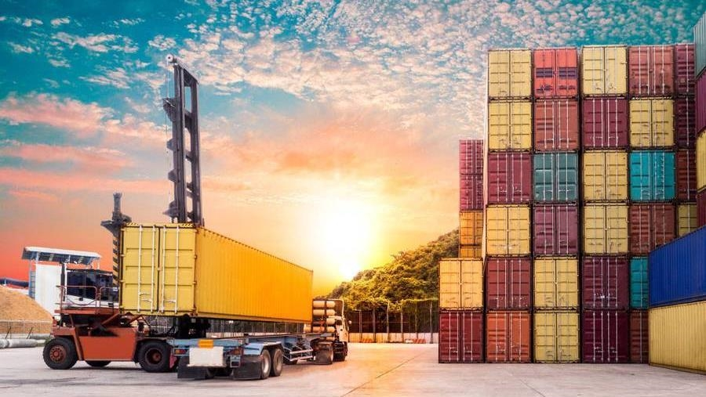
Business Understanding
Business Problem | Business Analytics Problem | Data Mining Goals

Slide 5
Business Understanding
Business Problem
Business Analytics Problem
Limited understanding of the relationship between social-economic parameters and logistics performance, particularly in the post-pandemic world.
COVID-19 hit hard on the trade and supply chain industry after healthcare.
Countries have to look out for factors to maintain competitiveness in the international trade.
To uncover relationships between social-economic parameters and logistics performance.
To discover important indicators that contribute strongly to the Logistics Performance Index.
To extract insights to help countries and businesses in their decision-making on international trade and allocation of investments.

Slide 6
Business Understanding
Data Mining Goals
Feature Selection
To include the more important fields
To exclude fields with too many missing values
To reduce time taken for the modelling process
Predictive Modelling
To accurately predict the LPI value

Slide 7
Literature Review
Ekici et al. (2016) | Jomthanachai et al. (2022) | Ekici et al. (2019) |
Jayathilaka et al. (2022)

Slide 8
Previous Studies
 | Ekici et al. (2016) | Jomthanachai et al. (2022) | Ekici et al. (2019) | Jayathilaka et al. (2022)
Title | Linking to compete: Logistics and global competitiveness interaction | An application of machine learning regression to feature selection: A Study of Logistics Performance and economic attribute | Improving logistics performance by reforming the Pillars of Global Competitiveness Index | Gross domestic product and logistics performance index drive the world trade: A study based on all continents
Objective | To relate logistics with global competitiveness using expert judgement for feature selection, and artificial neural network (ANN) for prediction | To determine the ideal set of economic attributes that best describes a variable to predict the respective LPI, using various machine learning techniques | Aims to improve logistics performance by identifying the GCI pillars that are significant in affecting logistic performance | Aims to find out how the logistics move the global trade and economy
Data | Global Competitiveness Index, World Economic Forum and Logistics Performance Index | Economic and Demographic Statistics Data (S&P Global Market Intelligence) and Logistics Performance Index | Global Competitiveness Index and Logistics Performance Index | Gross Domestic Product and Logistics Performance Index
Models | ANN | ANN, MLP-ANN, SVR, RFR, RE | BN-TAN, PLS, IPMA | Panel Regression, Random Effect
Results | Improving the global competitiveness of the country may directly relate to the improvement of the indicators in LPI | Chosen ANN for modelling | Pillar 9 (Technological readiness), Pillar 5 (Higher educational and training), Pillar 12 (Innovation), Pillar 10 (Market size) and Pillar 2 (Infrastructure) | Asia/Europe/Oceania: LPI positively related to Net Exports. Asia/African: GDP negatively related to Net Exports. Oceania/Middle East: GDP positively related to Net Exports.

Slide 9
Data Understanding & Preparation
World Bank Data | Logistics Performance Index

Slide 10
Data Understanding
Python (Jupyterlab)
World Bank Data
Logistics Performance Index
67 Sources
21 Topics
1442 Series
266 Economies/ Countries
7 Income Groups
62 years
1960 to 2021
Large dataset, ~70mb, more than 380,000 rows of data
1 Source
21 Topics
1442 Series
168 Economies/ Countries
4 Income Groups
High, Low, Lower middle and Upper middle Income Groups
6 years (LPI Editions)
2007, 2010, 2012, 2014, 2016 and 2018
LPI will be used as Target later for modelling

Slide 11
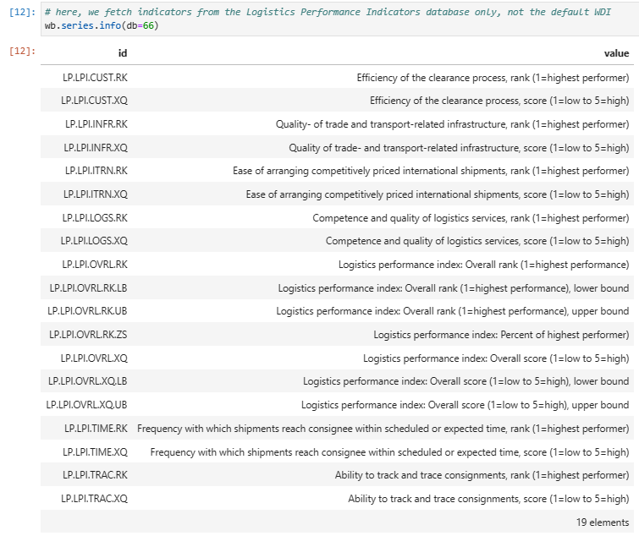
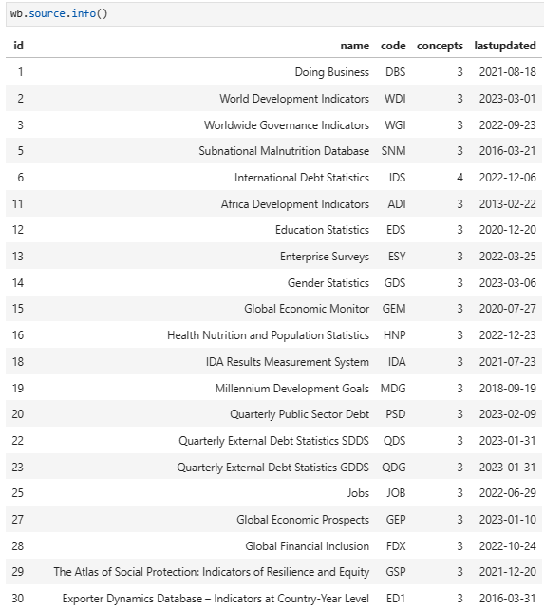
Data Understanding
Python (Jupyterlab)
World Bank Dataset, using WBGAPI

Slide 12
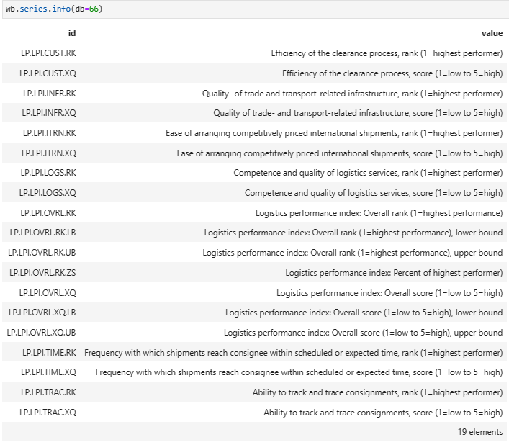
Data Understanding
Python (Jupyterlab)
Logistics Performance Index
Subtitle
Indicator Series
LP.LPI.OVRL.XQ
Indicator Name
Logistics performance index: Overall (1=low to 5=high)
Topic
Private Sector & Trade: Trade facilitation
Open the Design Ideas pane for instant slide makeovers.
When we have design ideas, we’ll show them to you right there.

Slide 13

Challenges in Data Preparation Used Python, MS Excel, IBM SPSS Modeler

Slide 14
Data Preparation
Python (Jupyterlab)
IMPORT and READ
MELT Function in PANDAS
import pandas as pd
import numpy as np
df = pd.read_csv('DATAFILE2.csv’)
# Replace null or NaN values with an empty string
df.loc[:, 'Indicator Name'] = df['Indicator Name'].fillna(‘’)
melted_test = pd.melt(df, id_vars=['Country Name', 'Country Code', 'Income Group', 'Indicator Name','Indicator Code', 'Topic'], var_name='Year', value_name='Value')
melted_test = melted_test.dropna(subset=['Value'])
melted_test = melted_test[melted_test['Value'] != 0]
y = df['Logistics performance index: Overall (1=low to 5=high)' == df['Indicator Name']].copy()

Slide 15
Data Preparation
Python (Jupyterlab)
EXPORT to CSV
UN-MELT a.k.a PIVOT_TABLE
melted_test.to_csv('melted_test.csv', index=False)
melted_y.to_csv('melted_y.csv', index=False)
pivoted_data = melted_test.pivot_table(index=['Country Name', 'Country Code', 'Income Group', 'Topic', 'Year'], columns='Indicator Code', values='Value', aggfunc='first').reset_index()
pivoted_data.to_csv('pivoted_data.csv', index=False)
EXPORT to CSV

Slide 16
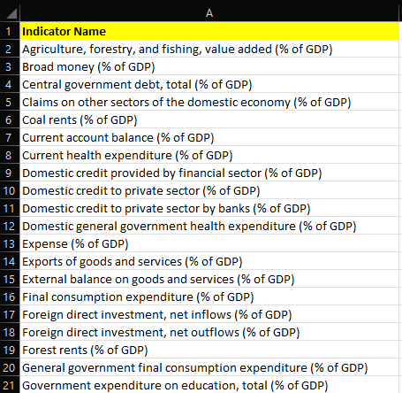
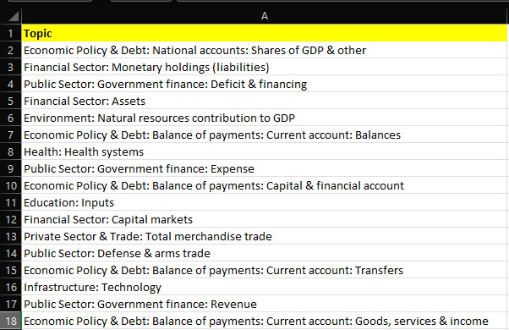
Data Preparation
Microsoft Excel
Indicators Selected 49/1442
Indicators selected to broadly represent the Topics
49 Indicators belonging to 17/21 Topics
(% of GDP)
Notes:
Indicators selected to broadly represent the Topics

Slide 17
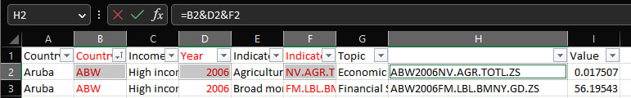
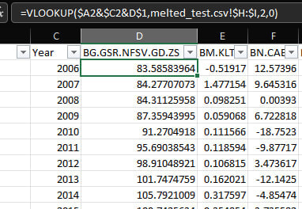
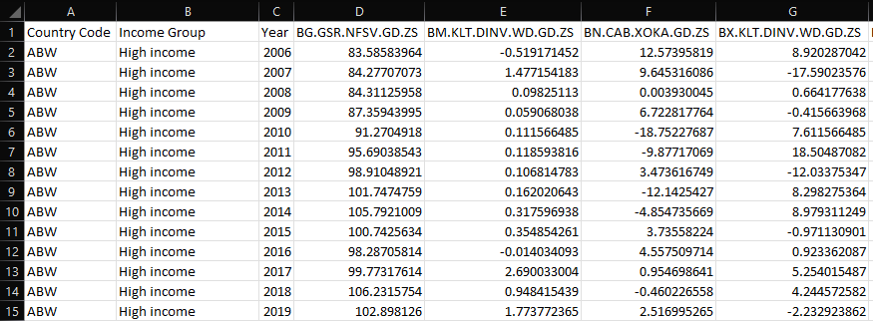
Data Preparation
Microsoft Excel
Merging Values
Subtitle

Slide 18
MOdelling
FEATURE SELECTION | PREDICTIVE MODELLING | IBM SPSS MODELER

Slide 19
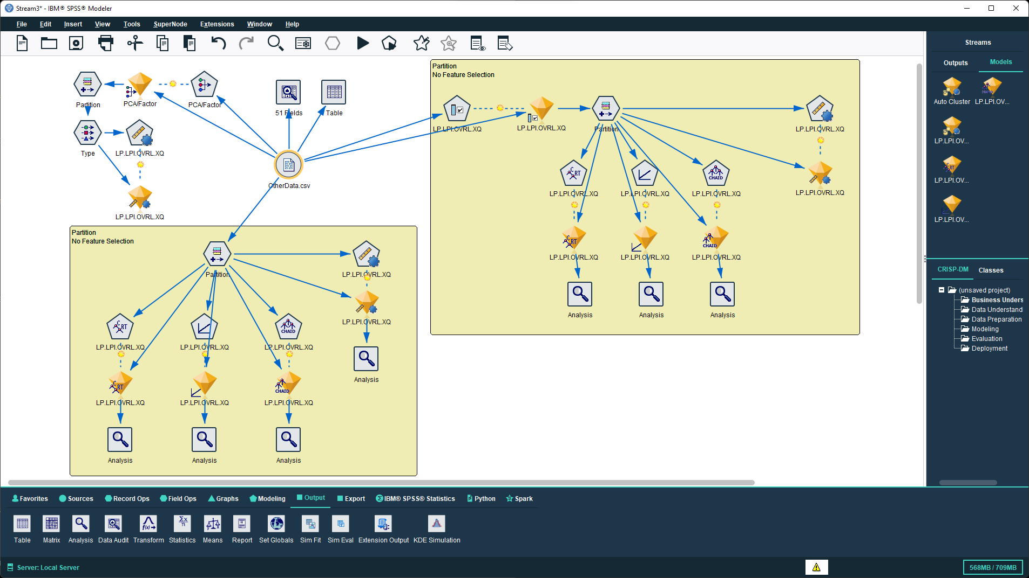
IBM SPSS Modeler

Slide 20
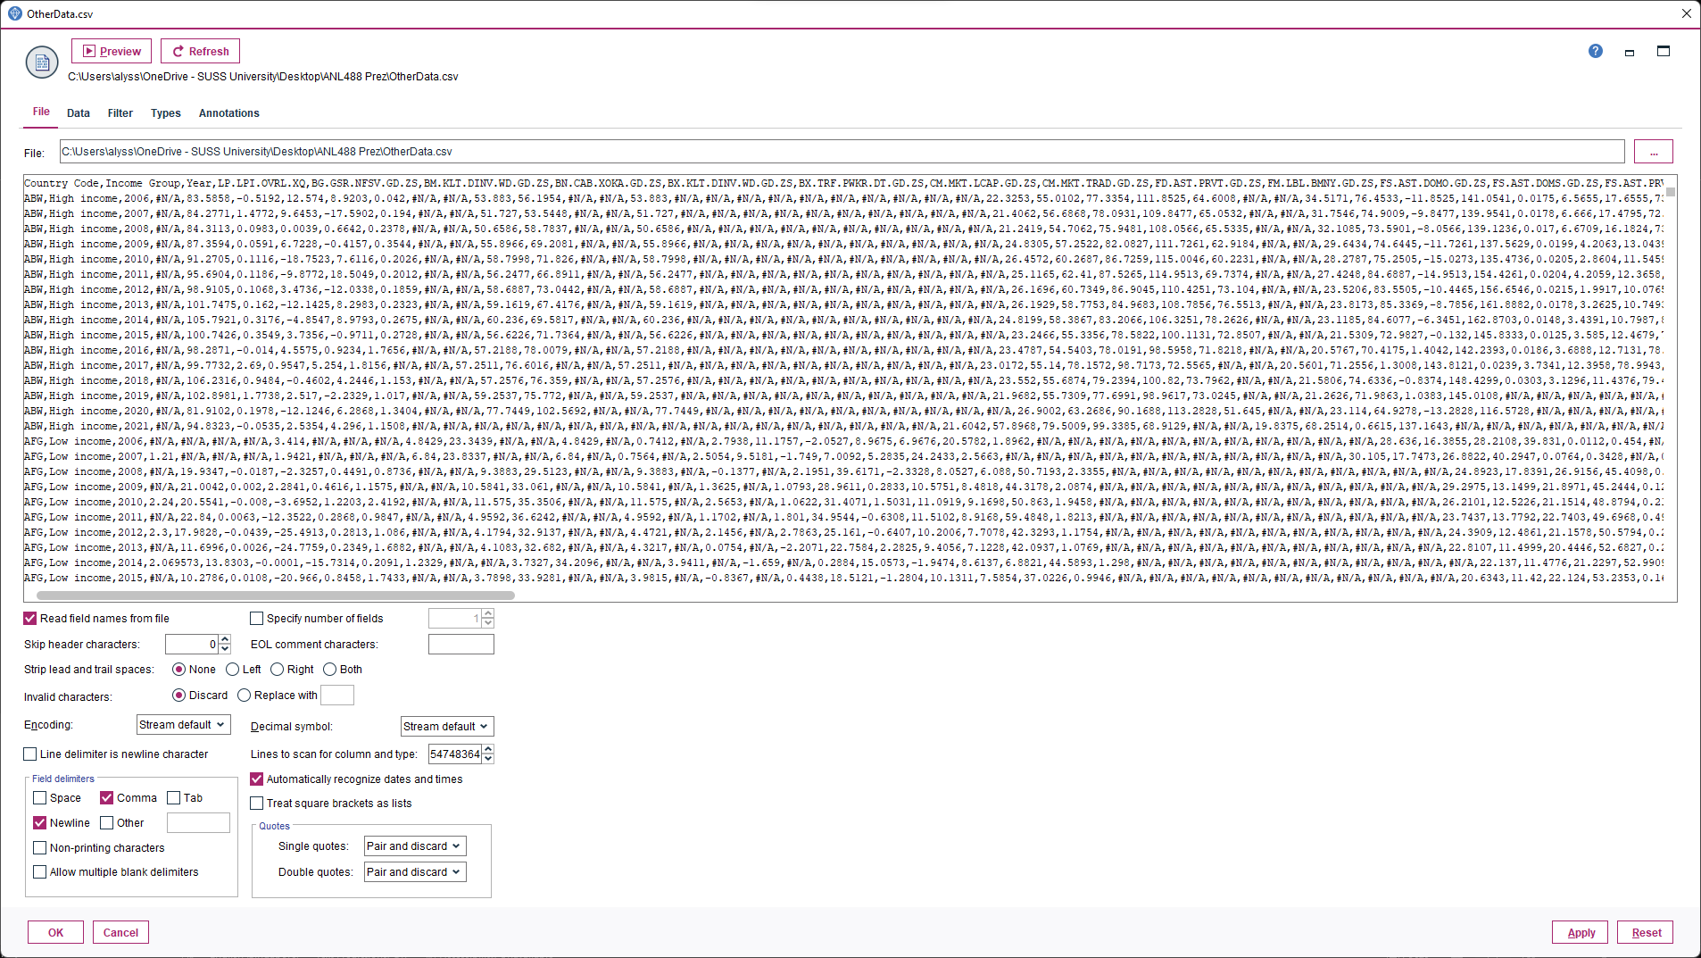
Data Loading

Slide 21
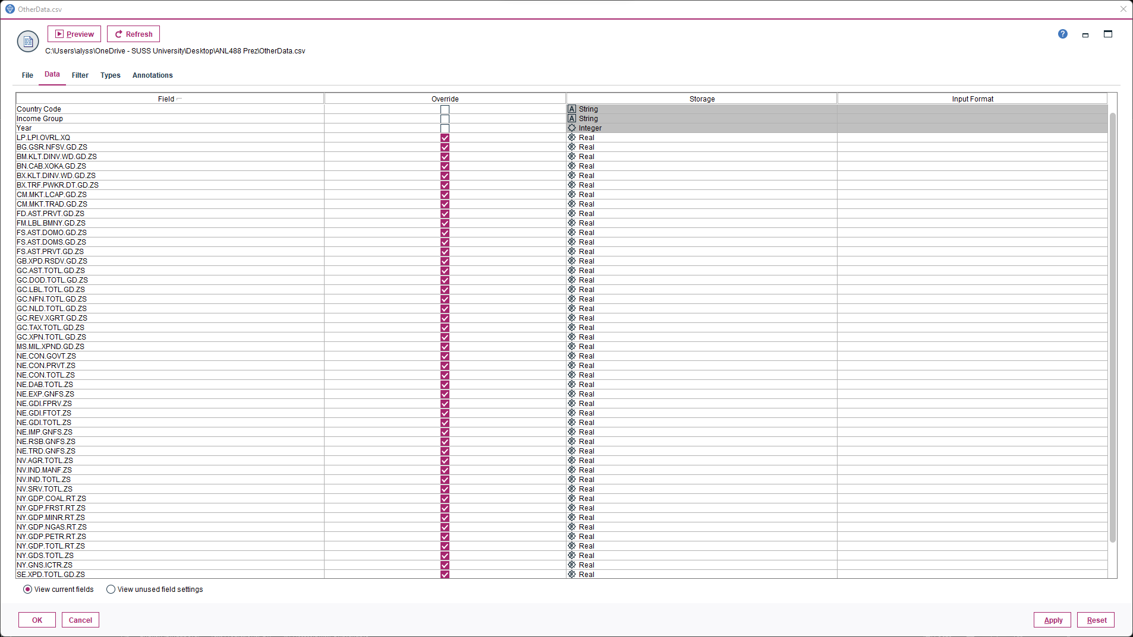
Data Type Override

Slide 22
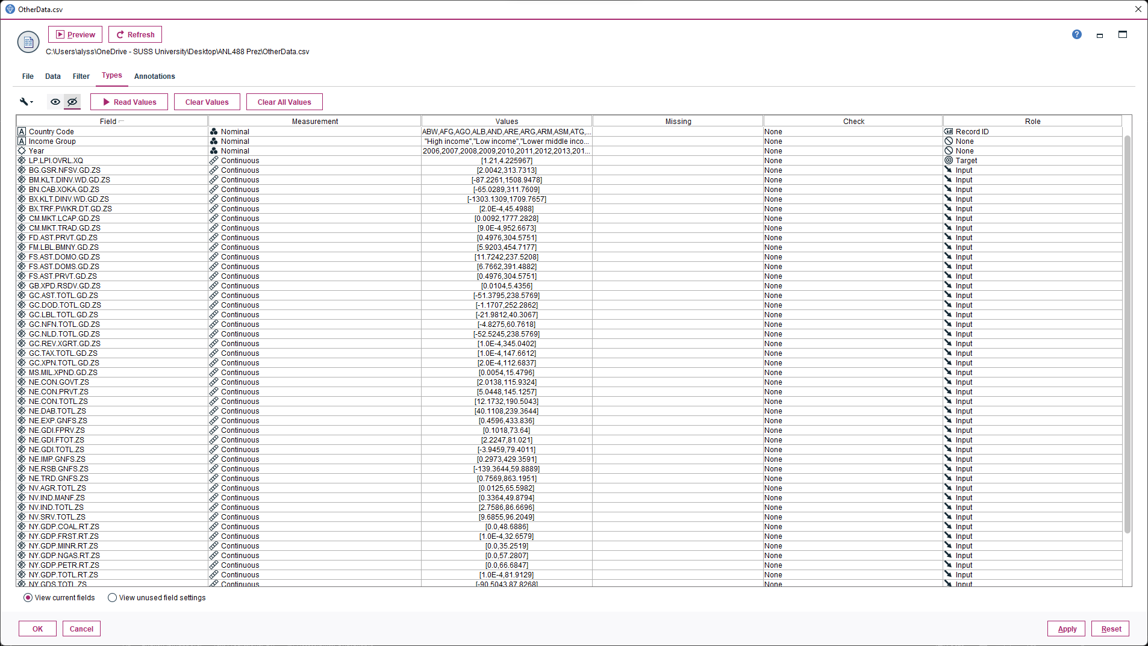
Data Types and Roles

Slide 23
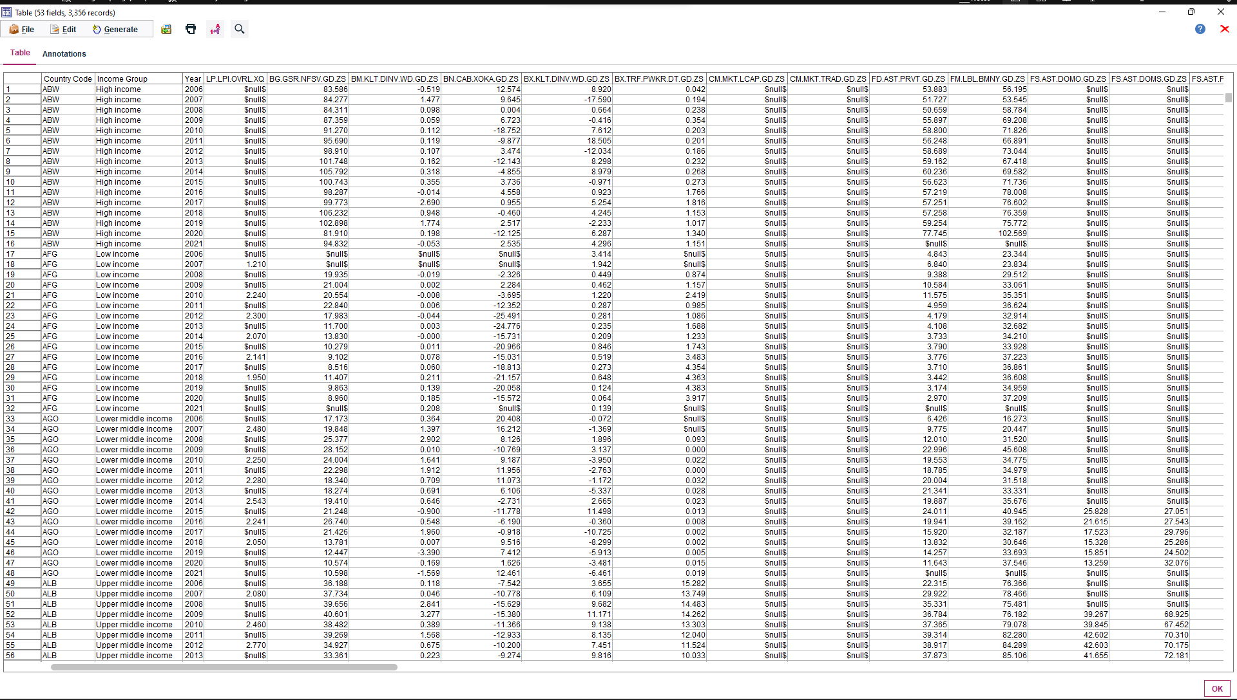
Table Node

Slide 24
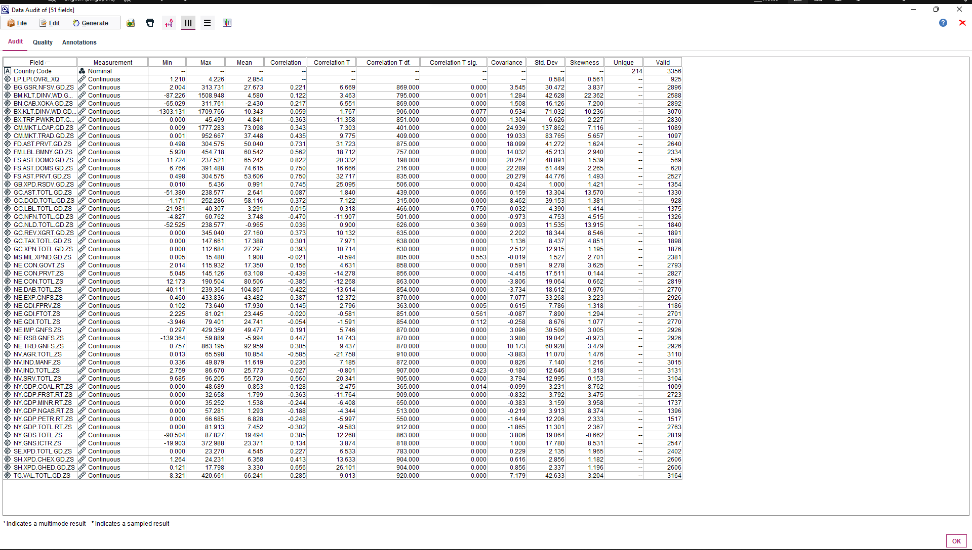
Data Audit

Slide 25
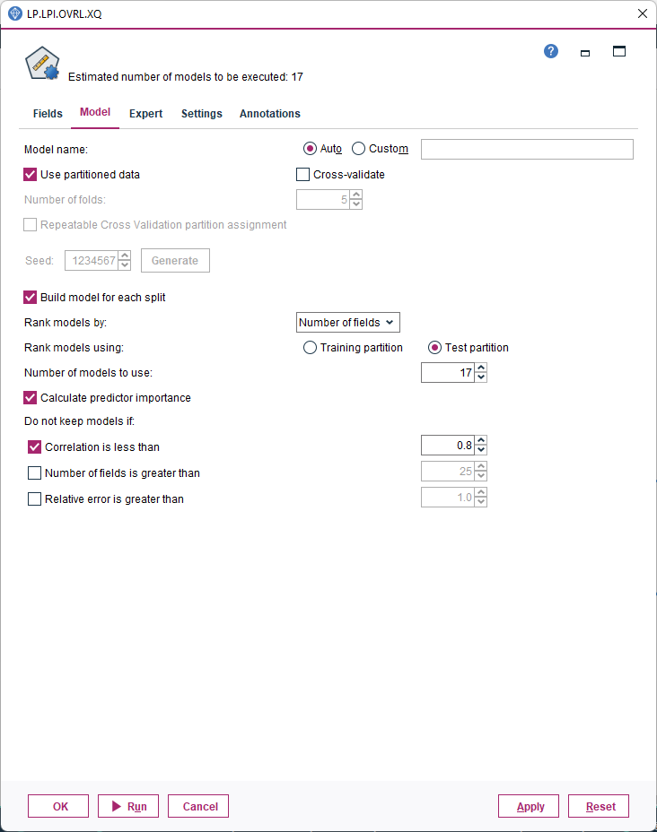
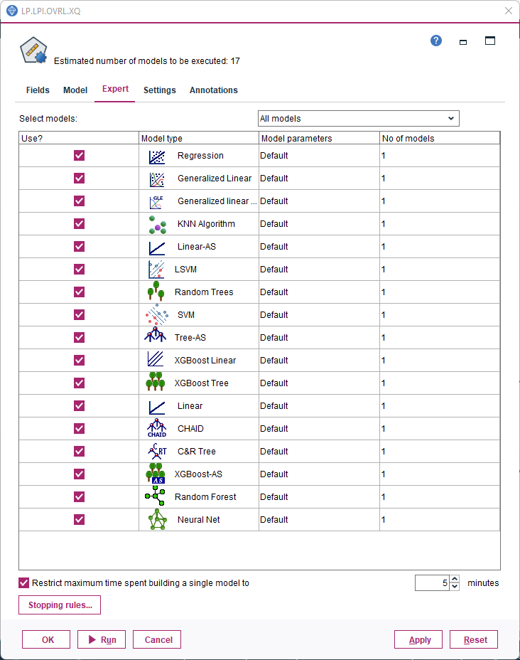
Auto Numeric Node
Set Conditions
Notes:
The Auto Numeric node estimates and compares models for continuous numeric range outcomes using a number of different methods, enabling you to try out a variety of approaches in a single modeling run.
You can select the algorithms to use, and experiment with multiple combinations of options. For example, you could predict housing values using neural net, linear regression, C&RT, and CHAID models to see which performs best, and you could try out different combinations of stepwise, forward, and backward regression methods.
The node explores every possible combination of options, ranks each candidate model based on the measure you specify, and saves the best for use in scoring or further analysis.
https://www.ibm.com/docs/en/cloud-paks/cp-data/4.6.x?topic=modeling-auto-numeric-node

Slide 26
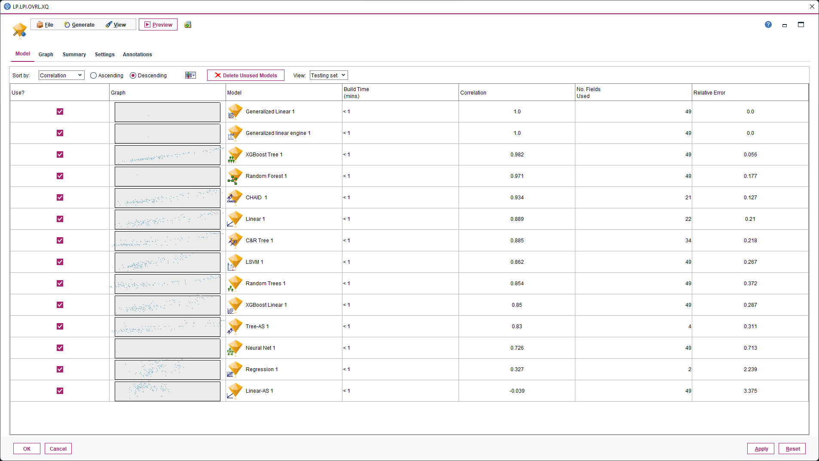
Models Generated
CHAID
Linear
CART

Slide 27
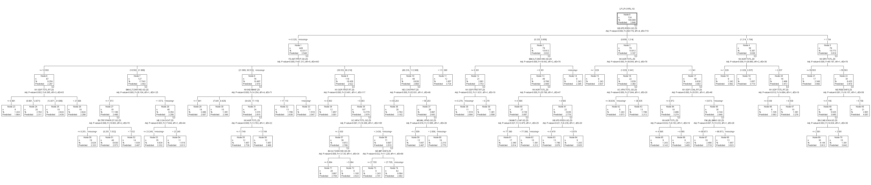
CHAID
Models Generated
Without Feature Selection, 49 Features
Interesting Model 1
Correlation: 0.934
Fields used: 21
Relative Error: 0.127

Slide 28
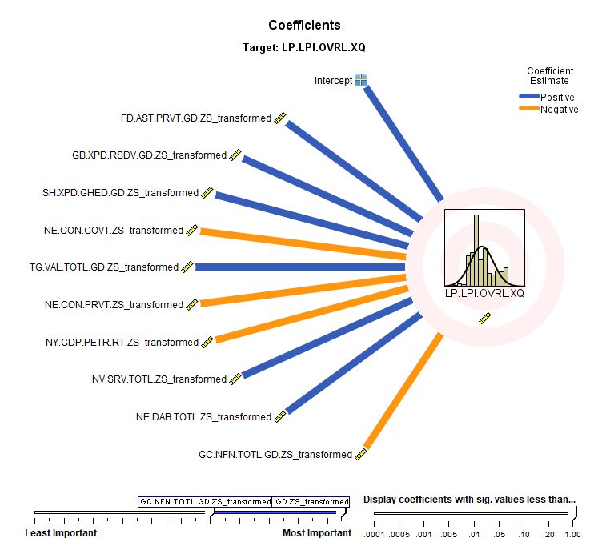
Linear
Models Generated
Without Feature Selection, 49 Features
Interesting Model 2
Correlation: 0.889
Fields used: 22
Relative Error: 0.21

Slide 29
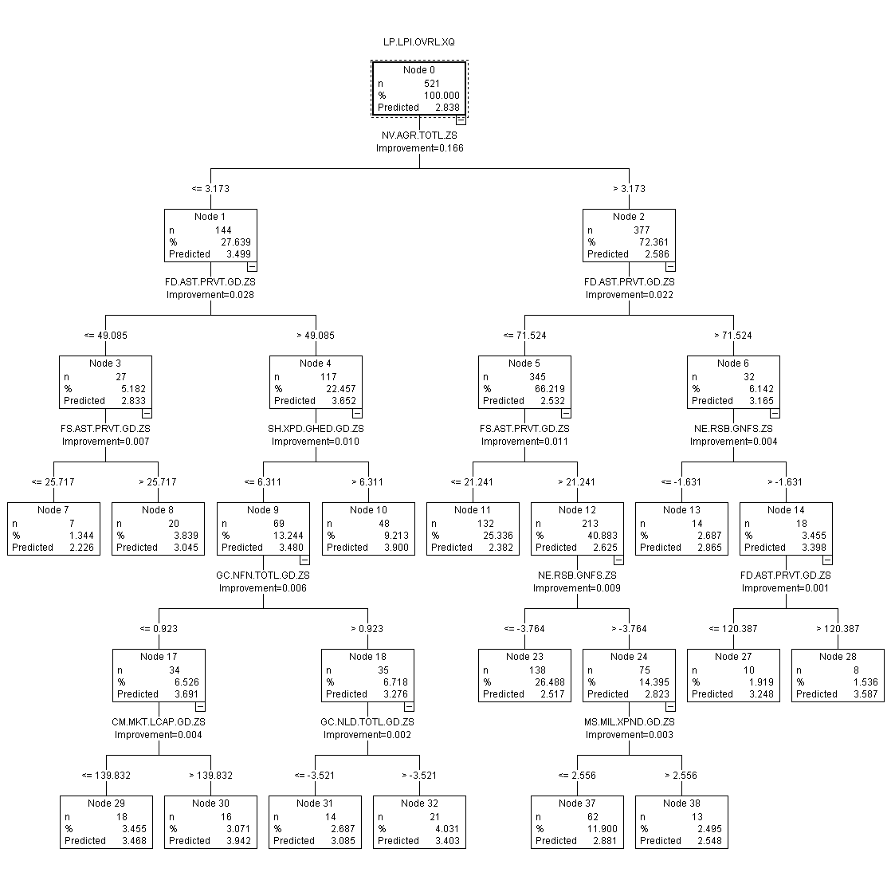
CART
Models Generated
Without Feature Selection, 49 Features
Interesting Model 3
Correlation: 0.885
Fields used: 34
Relative Error: 0.218

Slide 30
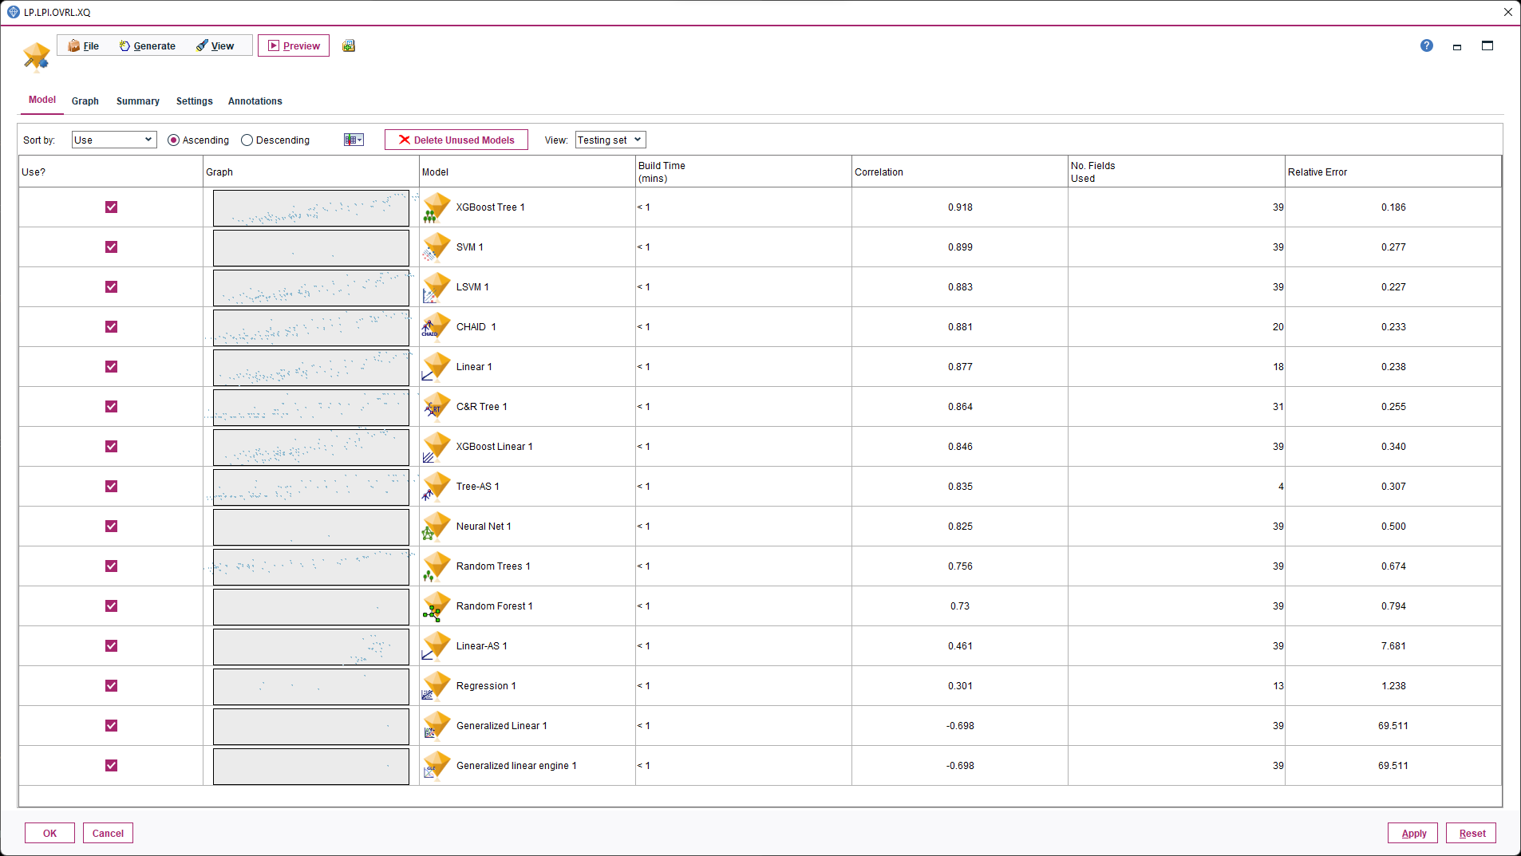
Models Generated
With Feature Selection, 39 Features
CHAID
Linear
CART
Notes:
Feature selection consists of three steps:
Screening. Removes unimportant and problematic inputs and records, or cases such as input fields with too many missing values or with too much or too little variation to be useful.
Ranking. Sorts remaining inputs and assigns ranks based on importance.
Selecting. Identifies the subset of features to use in subsequent models—for example, by preserving only the most important inputs and filtering or excluding all others.
benefits of feature selection in simplifying and speeding the modeling process
https://www.ibm.com/docs/en/cloud-paks/cp-data/4.6.x?topic=modeling-feature-selection-node

Slide 31
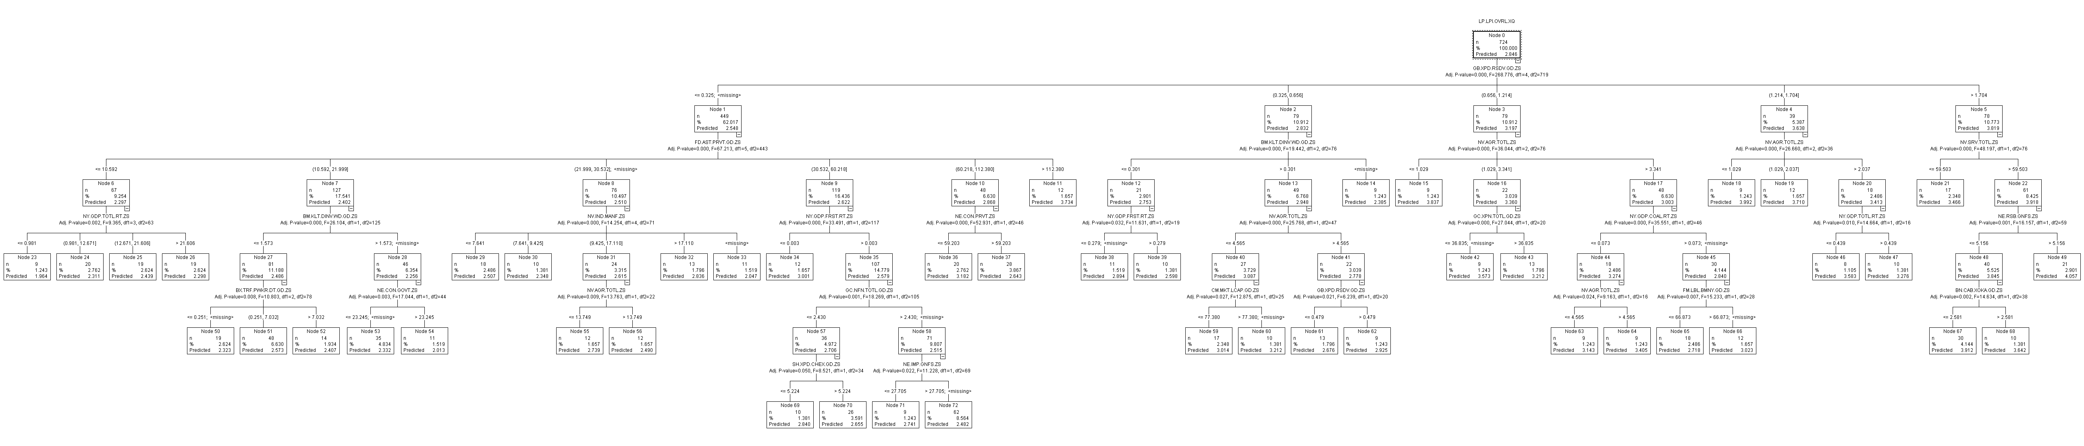
CHAID
Models Generated
With Feature Selection, 39 Features
Interesting Model 1
Correlation: 0.877
Fields used: 18
Relative Error: 0.238

Slide 32
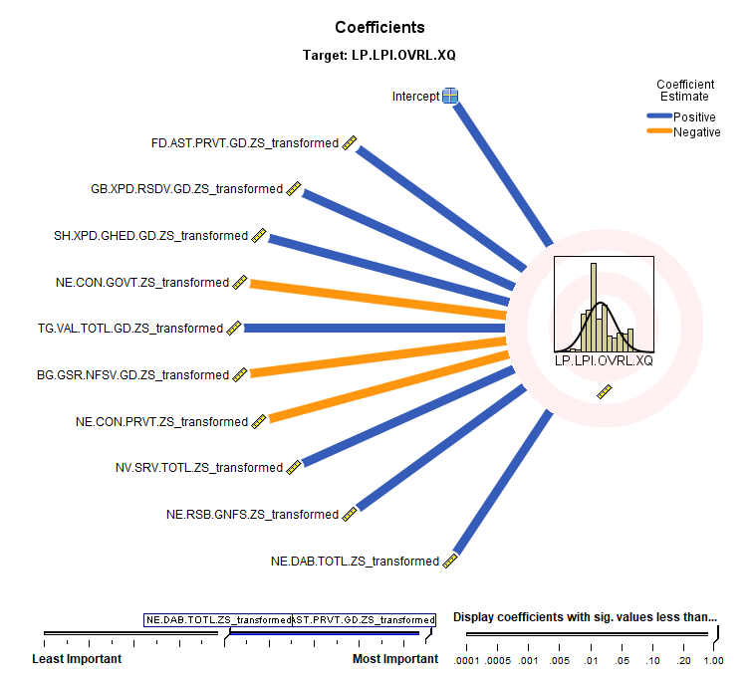
Linear
Models Generated
With Feature Selection, 39 Features
Interesting Model 2
Correlation: 0.889
Fields used: 22
Relative Error: 0.21

Slide 33
CART
Models Generated
With Feature Selection, 39 Features
Interesting Model 3
Correlation: 0.864
Fields used: 31
Relative Error: 0.255

Slide 34
Evaluation
Analysis Node | Results | CHAID | Linear | CART

Slide 35
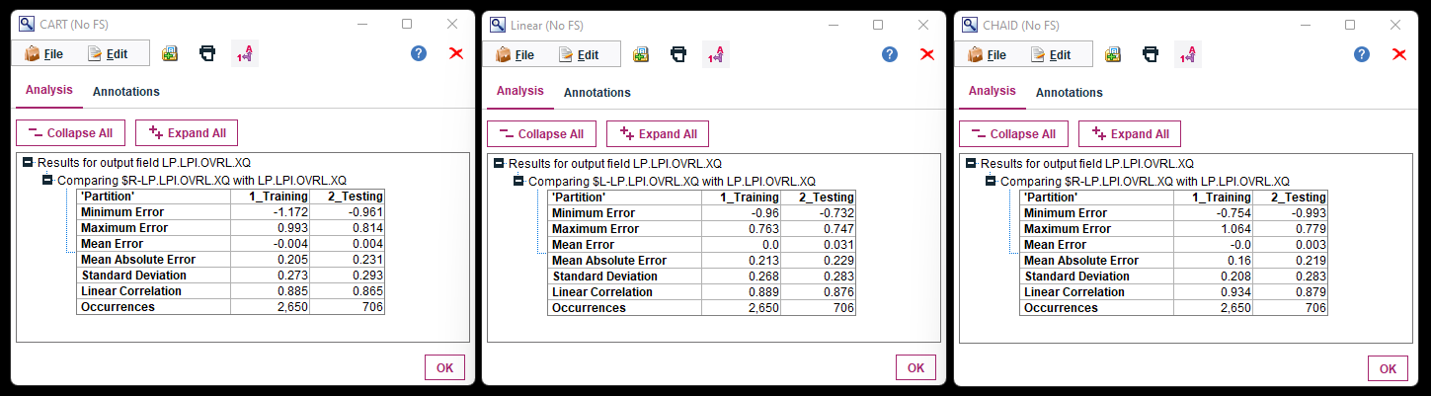
Analysis Node
Without Feature Selection
CART
Linear
CHAID
Notes:
Keen in having Mean Absolute Error smaller than 0.1
Means the regression model is not overfitted and yet performs well to predict the dependent variable LPI.

Slide 36
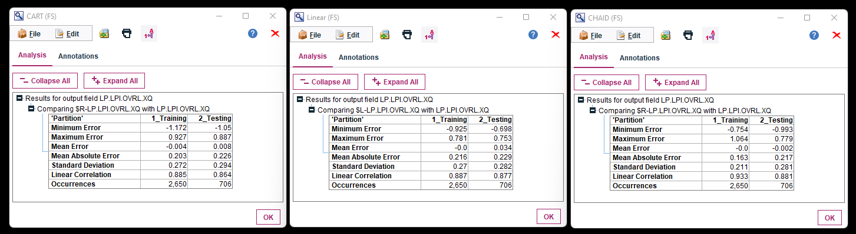
Analysis Node
With Feature Selection
CART
Linear
CHAID

Slide 37
Results
Without Feature Selection
Feature Selection
Model | CHAID | Linear | CART
Total Fields | 49 | 49 | 49
Fields Used | 21 | 22 | 34
Correlation | 0.934 | 0.889 | 0.885
Relative Error | 0.127 | 0.21 | 0.218
Mean Absolute Error | 0.231 | 0.229 | 0.219
Model | CHAID | Linear | CART
Total Fields | 39 | 39 | 39
Fields Used | 18 | 22 | 31
Correlation | 0.877 | 0.889 | 0.864
Relative Error | 0.238 | 0.21 | 0.255
Mean Absolute Error | 0.226 | 0.229 | 0.217

Slide 38
Results
Top three Indicators
Without Feature Selection
Feature Selection

Slide 39
Deployment
Predictors | Indicators

Slide 40
Predictors vs Indicators
Summary of Important Predictors
Indicators of LPI
Research and development expenditure (% of GDP)
Domestic credit to private sector by banks (% of GDP)
Current account balance (% of GDP)
Domestic general government health expenditure per capita (current US$)
External balance on goods and services (% of GDP)
Coal rents (% of GDP)
Services, value added (% of GDP)
Agriculture, forestry, and fishing, value added (% of GDP)
Trade (% of GDP)
Imports of goods and services (% of GDP)
Efficiency of customs and border management clearance,
Quality of trade and transport infrastructure,
Ease of arranging competitively priced shipments,
Competence and quality of logistics services,
Ability to track and trace consignments, and
Timeliness of shipments in reaching the destination.
Notes:
The following indicators can affect the Logistics Performance Index (LPI):
Research and development expenditure (% of GDP): Countries that invest more in research and development may have more advanced technologies, better infrastructure, and higher levels of innovation, which can positively affect their logistics performance.
Domestic credit to private sector by banks (% of GDP): Access to credit can help businesses invest in infrastructure, technology, and equipment, which can improve logistics performance. Higher levels of credit to the private sector can also indicate a more developed financial system, which can facilitate trade and logistics activities.
Current account balance (% of GDP): Countries with a current account surplus may have more resources to invest in infrastructure and logistics, which can positively affect their logistics performance. Conversely, countries with a current account deficit may face constraints on their ability to invest in logistics.
Domestic general government health expenditure per capita (current US$): A healthier population may lead to a more productive workforce and a lower risk of disruptions in logistics operations due to health-related issues.
External balance on goods and services (% of GDP): A country's external balance on goods and services reflects its trade competitiveness and ability to generate foreign exchange, which can positively affect its logistics performance.
Coal rents (% of GDP): Countries that rely heavily on coal production may have limited diversification in their economy and may face challenges in developing other sectors, including logistics.
Services, value added (% of GDP): The services sector plays a crucial role in logistics, including transportation, warehousing, and distribution. Higher levels of value added in services can indicate a more developed logistics sector.
Agriculture, forestry, and fishing, value added (% of GDP): Agriculture, forestry, and fishing activities can also have an impact on logistics, particularly in terms of transportation and storage of goods. Higher levels of value added in this sector may indicate a more developed logistics infrastructure for these activities.
Trade (% of GDP): The volume of trade can have a significant impact on logistics, with higher levels of trade indicating a greater need for transportation, warehousing, and distribution infrastructure.
Imports of goods and services (% of GDP): Imports can drive demand for logistics services, as imported goods often require transportation, warehousing, and distribution. Countries with higher levels of imports may need to invest more in logistics infrastructure to support this demand.

Slide 41
Recommendation
Future Work

Slide 42
Recommendation
Conclusion
Future Work
There are predictors that have varying impacts on a country’s Logistic Performance Index (LPI).
Predictors need not necessarily be directly impacting the LPI.
Indirect and important predictors found are:
Domestic general government health expenditure per capita (current US$)
Coal rents (% of GDP)
To explore different extract of the World Bank dataset
To explore different indicators from other databases

Slide 43
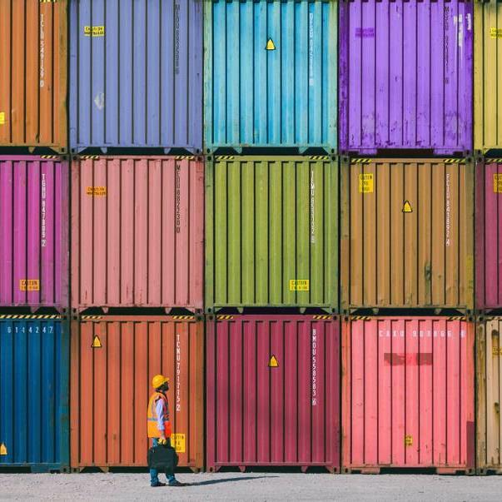
Questions & Answers

Slide 44


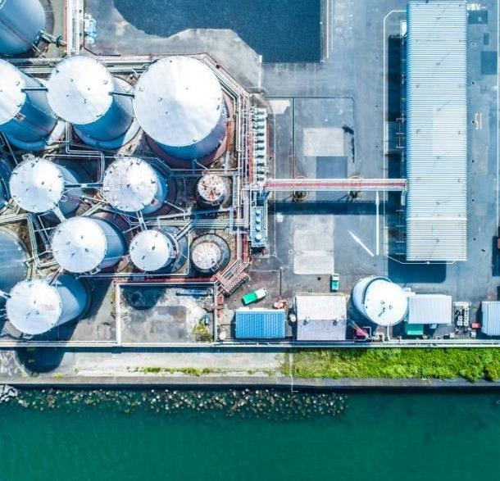
THANK YOU
Alyssa Lam Jia Yu
E2070190
Business Analytics

