Slide 1
CCUS Petrophysics
2023

Slide 2

PRMS
PRMS provides the basis for classification and categorization of all petroleum reserves and resources. Although the system encompasses the entire in-place petroleum resource and characterizes projects at various levels of technical and commercial maturity, its widest application has been for estimating commercially recoverable quantities using a globally recognized system.
While there are numerous ways to estimate producible hydrocarbons or storage potential for CO2, a common workflow is through volumetric estimation methodologies.
Petrophysical evaluation results comprise fundamental inputs to the assessment of PIIP: the hydrocarbon-bearing area above fluid contacts or limits (A), net pay thickness (h), porosity (φ), and initial water saturation (Swi). Other petrophysical inputs, including, but not limited to, permeability(k), capillary pressure, relative permeability, and wettability, are used to assess the ability of fluids to flow, informing the assessment of the recovery factor or recovery efficiency (RE)

Slide 3
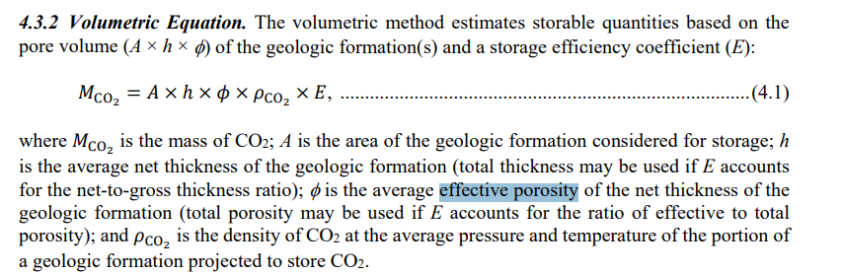
SMRS
SMRS:
Is a classification framework which aims to provide a consistent approach to estimate storable quantities of CO2, evaluate development projects, and present results within a comprehensive classification framework.
Resources intends to encompass all quantities of naturally occurring pore volume potentially suitable for storage within the Earth’s crust—discovered and undiscovered (i.e., accessible and inaccessible) plus those quantities already used for storage (i.e., stored).

Slide 4
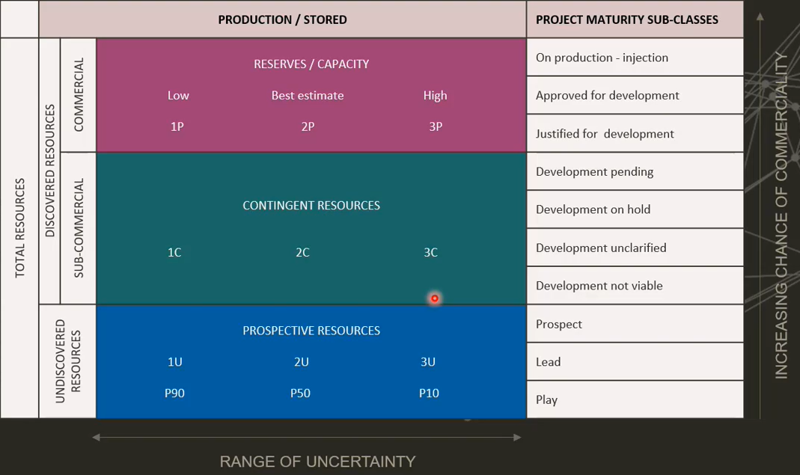
Classifications
Under both the PRMS and SMRS, identified recoverable petroleum-initially-in-place must always be assigned to one of the three classes: Reserves, Contingent Resources, or Prospective Resources.
Both frameworks are very similar in terms of classification, particularly in Contingent and Prospective Resource categories.
The key difference associated with the frameworks is that Reserves under the PRMS refer to hydrocarbons being produced, while the SMRS is focused around storage capacity for the development projects

Slide 5
Mechanisms for Storage
There are various mechanisms or Storage types for CCUS Virgin Aquifers
Depleted Oil and Gas fields
Currently Producing Oil or Gas fields
Combination – e.g. Injection down dip of a depleted field.
Considerations and uncertainties for a project vary depending on the project scope for injection (see table below):
This paper is focused on Key petrophysical aspects for SMRS, so will focus on technical issues outlined in the table above:
Capacity
Overpressure/Geological leakage
Reservoir knowledge
Geological leakage
 | Saline Aquifer | Depleted Field | EOR
Overpressure | Increase of reservoir pressure above hydrostatic (need to understand fracture gradient) | Void space has been created with intiial depletion
Reservoir Knowledge | Little data/info available | Typically date rich from field appraisal & development
Geological Leakage | Uncertainty on migration pathways | Hydrocarbon column retained over geological timescales
Leakage up legacy wells | Less legacy wells for monitoring/abandonment | Typically primary leakage mechanism
CO2 behaviour (Flow assurance) | Phase behaviour/pressure better understood | Phase change with low reservoir/injection pressures (impurities in gas). No commercail C02 projects - increasing flow rates from pilots are uncertainty
Infrastructure | Typically no infrastructure | Wellsite, Pipeline facilities available if not decommisioned
Capacity | Injection limitations (Commercial limitations on injection e.g pressure management) | May be limited by Oringinal HWC (but can inject into aquifer underneath)
Responsibilities

Slide 6
SMRS
PRMS
Storable Quantities
Prefer PHIE
Swirr
CO2 density
Efficiency factor
Continuous monitoring of Trapping mechanism
Producible Quantities
PHIT or PHIE
SWT or SWE
Bg or Bo (expansion or shrinkage factor)
Recovery factor
Area
Height
N:G
Porosity

Slide 7
 |  |  | PRODUCTION / STORED |  |  | PROJECT MATURITY SUB-CLASSES
TOTAL RESOURCES | DISCOVERED RESOURCES | COMMERCIAL | RESERVES / CAPACITY |  |  | On production - injection
 |  |  | Low | Best Estimate | High | Approved for development
 |  |  | 1P | 2P | 3P | Justified for development
 |  | SUB-COMMERCIAL | CONTINGENT RESOURCES |  |  | Development pending
 |  |  |  |  |  | Development on hold
 |  |  | 1C | 2C | 3C | Development unclarified
 |  |  |  |  |  | Development not viable
 | UNDISCOVERED RESOURCES |  | PROSPECTIVE RESOURCES |  |  | Prospect
 |  |  | 1U | 2U | 3U | Lead
 |  |  | P90 | P50 | P10 | Play

Slide 8
SRMS Classification
PRMS Classification
Discovered, sub commercial until a project has financial commitment to commence injection
(C)
Undiscovered
(U)
Total Storage Resources / In-Place resources
(P+C+U)
Discovered,
anticipated to be commercially accessible by application of a development project at a given date
(P)
Commercial Storage Capacity
Reserves
Contingent Storage Resources
Contingent Resources
Prospective Storage Resources
Prospective Resources
Total Storage Resources
In-place Resources

Slide 9
 |  |  | PRODUCTION / STORED |  |  | PROJECT MATURITY SUB-CLASSES |  | INCREASING CHANCE OF COMMERCIALITY
TOTAL RESOURCES | DISCOVERED RESOURCES | COMMERCIAL | RESERVES / CAPACITY |  |  | On production - injection
 |  |  | Low | Best Estimate | High | Approved for development
 |  |  | 1P | 2P | 3P | Justified for development
 |  | SUB-COMMERCIAL | CONTINGENT RESOURCES |  |  | Development pending
 |  |  |  |  |  | Development on hold
 |  |  | 1C | 2C | 3C | Development unclarified
 |  |  |  |  |  | Development not viable
 | UNDISCOVERED RESOURCES |  | PROSPECTIVE RESOURCES |  |  | Prospect
 |  |  | 1U | 2U | 3U | Lead
 |  |  | P90 | P50 | P10 | Play
RANGE OF UNCERTAINTY

Slide 10
V Shale
Free Fluid
Volume
Bound Volume Irreducible
V
V Clay
Φ Total
ΦEffective
Matrix
Silt
Clay
Clay Bound Water
Hydrocarbon
Capillary Bound Water
Isolated Pores
Φ Core
Φ Core (Humidity dried)

Slide 11
Prospective Storage Resources
Theoretical Capacity
Traditional petrophysical analysis of basic log suites (GR, Neut/Dens,Res) for input into theoretical storage resource volumetric equation:
Contingent Storage Capacity
Discovered but sub-commercial resource classes
Calibration of Petrophysical Model
Commercial Storage capacity
Discovered & commercial resource classes
VSH
PHIE
SWIRR
Integration of available core data (or nearby analogues) Ambient RCA, Stressed SCAL
Calibration of salinity and electrical properties
BVW
Permeability estimation: Poro-perm, Mobilities, DST analysis
SWIRR estimation from core
Residual hydrocarbon evaluation (Depleted gas fields)
Detailed PVT analysis
Petrogrpahy, Thin Section, XRD
Temperature
Pressure
Net Cutoffs
Pore Pressure and Geomechanical inputs
Overburden Stress, Effective Stress
Injection rates
Fines migration

Slide 12
gas
Supercritical Fluid
Liquid
Pressure (bar)
Critical point
gas
1
10
Temperature (K)

Slide 13
10,000
1
200
400
Temperature (K)

Slide 14
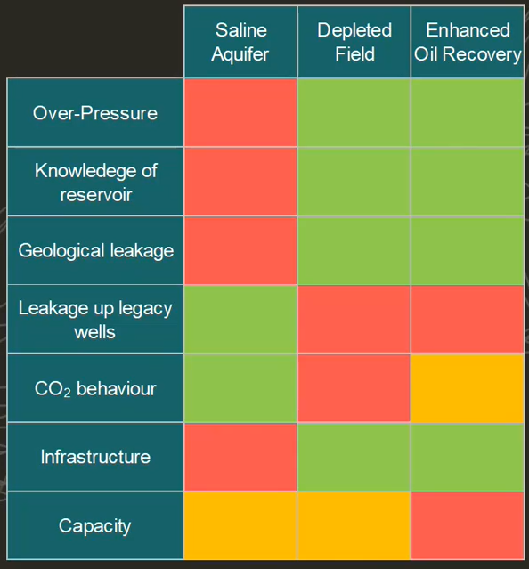
Mechanisms for Storage and Associated Risks

Slide 15
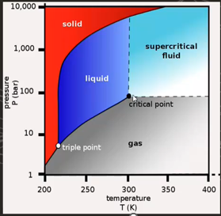
Exploration Stage Similarities/Differences
Key Similarities:
Some consistent inputs into the CO2 Capacity and HCIIP calculations:
Area
Reservoir thickness
Porosity
Key mechanisms for a working hydrocarbon system and CO2 storage site:
Permeability- ability to produce/inject fluid at commercial rates
Thick seal – ability to trap fluids
Key Differences:
Reservoir conditions critical for controlling fluid phase:
Reservoir Temp >31 deg/C
Temp >75 bar
~ 800 m depth
rule of thumb - can cause two phase issues Aquifer salinities >30,000ppm
Aquifer salinities >30,000ppm
(ppm of seawater - anything less could be used for drinking or Brackish for agriculture.
High salinities can be an issue for salt precipitation associated with injectivity
Focus on seal for competency throughout injection lifecycle
Top side requirements
Storage site fit for purpose to emitter and proximity for economic cutoffs (oil and gas bigger is often better)

Slide 16
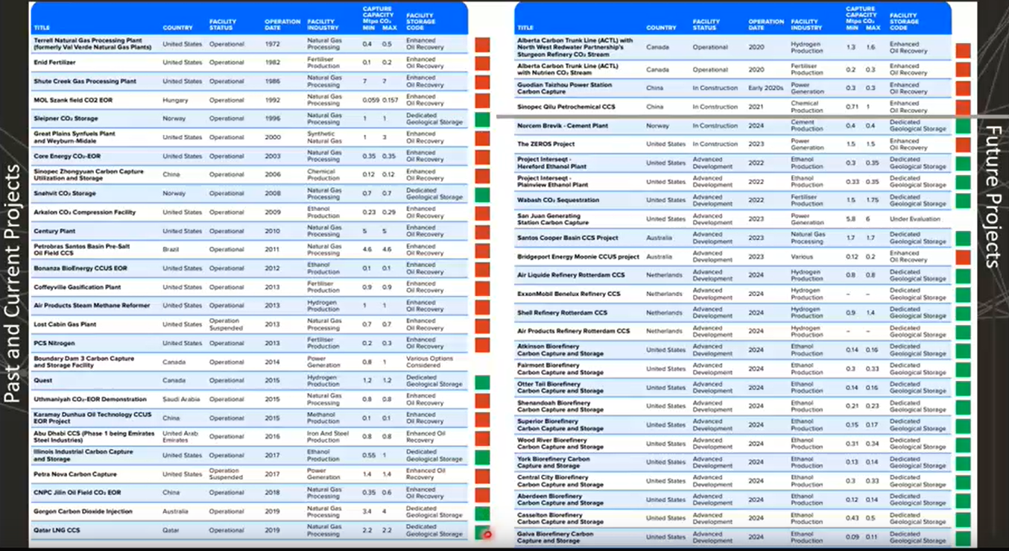
Global Projects

Slide 17
Theoretical Storage Resource
Parameter | Storage Site Type | Units | P90 (low) | P50 (mid) | Mean | P10 (high) | Distribution Type
INPUTS
Depth to Crest of Storage Site | All | m | 1220 | 1225 | 1225 | 1230 | Normal
Depth to spill point | All | m | 1386 | 1411 | 1424 | 1478 | Beta
Storage Site Area | All | km2 | 56 | 86 | 86 | 116 | Normal
Gross Rock Volume | All | million m3 | 2432 | 5380 | 5687 | 9350 | Beta
Average Gross Reservoir Thickness | All | m | 132 | 147 | 147 | 161 | Normal
Average Net to Gross | All | % | 63 | 63 | 63 | 63 | Normal
Average Net Reservoir Thickness | All | m | 83 | 92 | 92 | 102 | Normal
Average Porosity | All | % | 18 | 21 | 21 | 24 | Normal
Average Permeability | All | mD | 85 | 197 | 258 | 243 | Normal
Irreducible water Saturation | All | % | 20 | 13 | 13 | 5 | Normal
Average Residual Hydrocarbon Saturation | Depleted Field | % | N/A | N/A | N/A | N/A | N/A
Hydrocarbon Formation Volume Factor | Depleted Field |  | N/A | N/A | N/A | N/A | N/A
Initial Reservoir Pressure | All | Bar | 152 | 190 | 190 | 228 | Normal
initial Reservoir Temperature | All | °C | 48 | 50 | 50 | 52 | Normal
Formation Water Salinity | All | mg/l | 200000 | 250000 | 250000 | 300000 | Normal
Storage Efficiency Factor | All | % | 10 | 24 | 31 | 60 | Log Normal
OUTPUT
Theoretical Storage Resource (capacity) | All | MT | 31 | 97 | 131 | 275 | Probabilistic Run Output (approximates to Log Normal)
Peak Injection Rates per day | All | T/d | 5130 | 11538 | 10774 | 15400 | Simulation Model Output (approximates to Beta)
Storage Resource (capacity) | All | MT | 26 | 78 | 69 | 100 | Simulation Model Output (approximates to Beta)
Peak Brine Production per day | All | bbls/d | 0 | 0 | 0 | 0 | N/A
*Typical inputs into probabilistic model

Slide 18
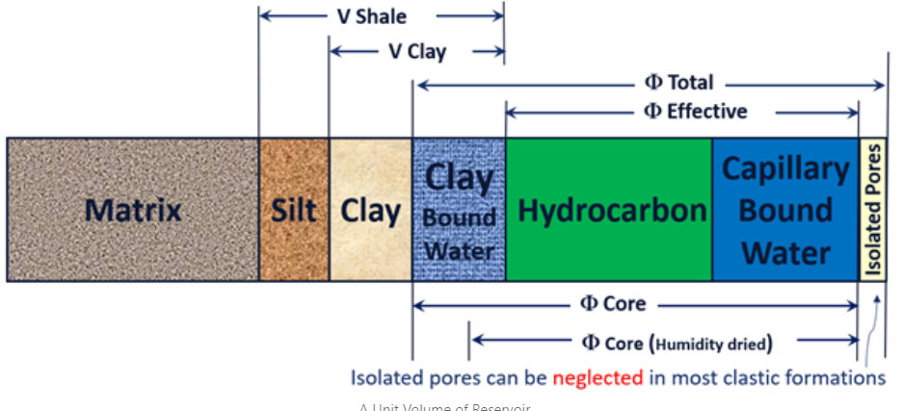
SRMS ‘Storable Quantities’ Estimate
Better to calculate PHIE from the outset. Need to convert to PHIE in order to calculate Free Fluid Volume (FFV = PHIE – Bulk Volume Irreducible or BVI). This is the actual pore volume the CO2 can be stored in – not PHIE.
In O&G the volumetric equation solves for a volume of hydrocarbon. Either PHIE or PHIT can be used as these are multiplied by corresponding SWE or SWT values to give a volume of hydrocarbon.
In CCUS reservoirs are often wet so we cannot obtain the FFV from any product of porosity and saturation as SW=1. Need to derive a SWIRR and multiply PHIE by 1-SWIRR.
FFV
BVI

Slide 19
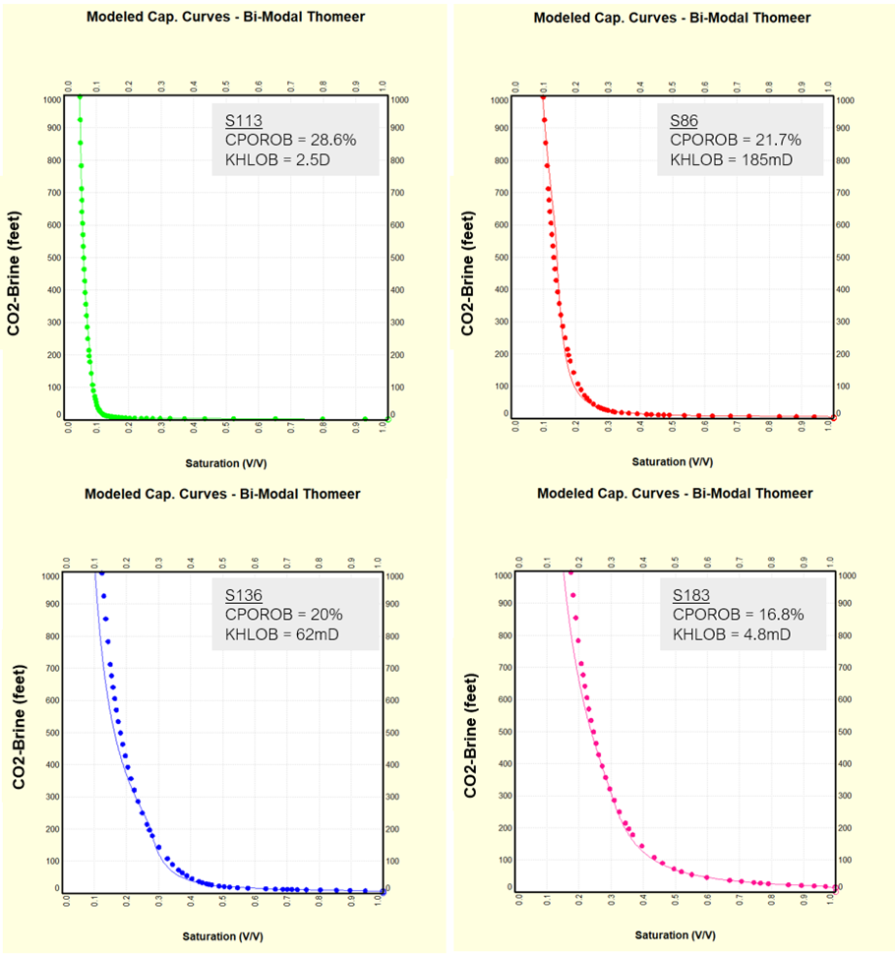
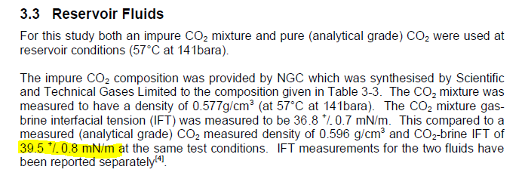
Estimating Swirr
MICP taken from nearby Endurance well.
4 plugs taken that cover range of poroperm seen in the Bunter.
Pc converted to reservoir conditions using IFT values from Weatherford study
Pc then converted to HAFWL
Crest to Spill = 207m – Sw read at this depth.
3 Swirrs used for P10, 50 & 90 in volumetrics (average taken from sample 2 & 3)
IFT Study

Slide 20
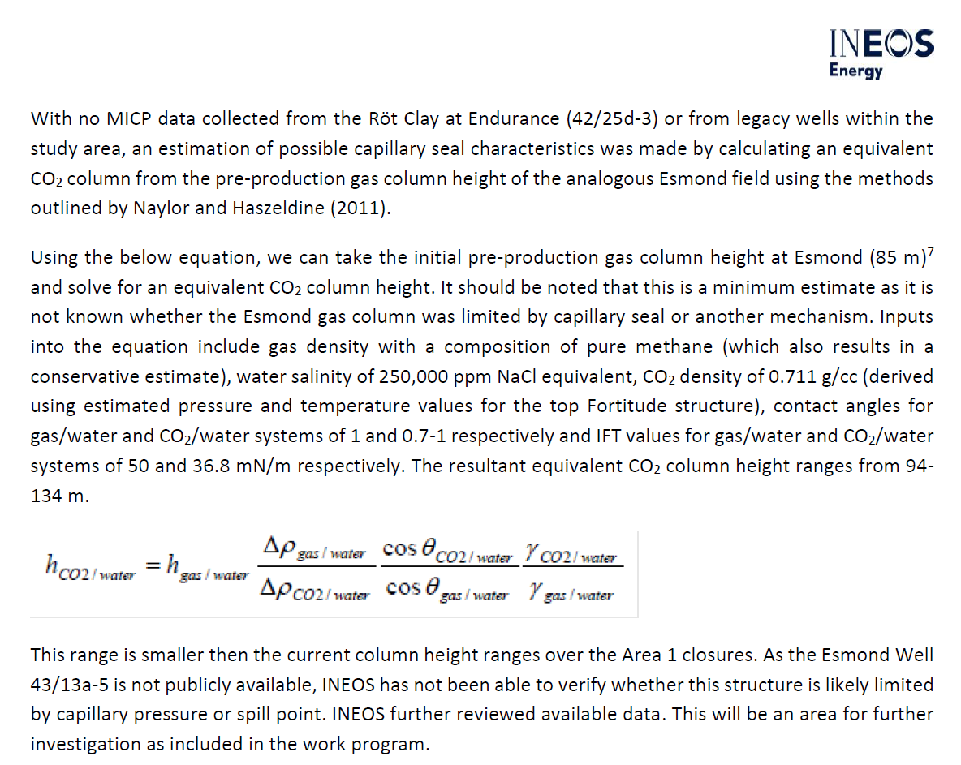
Estimating CO2 Column Height without Pc in Seal

Slide 21
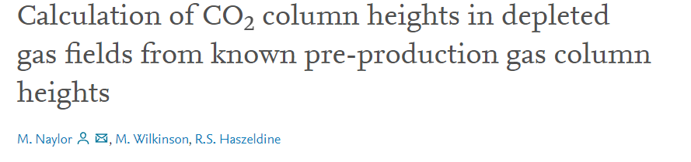
CO2 Column Heights - Paper Summary
*No Pc measurements in seal anywhere nearby to Fortitude
Can take pre-production heights and the ratios in IFT, contact angle and density differences between the Co2/water and gas/water systems to solve for a conversion factor that converts to Co2 column heights
IFT and contact angles both negatively impact the Pc_threshold for a Co2/Water system. The surface tension between co2 and water at the seal-reservoir boundary is much greater – at typical reservoir conditions the ratio of a gas/water IFT to co2/water is 0.5. This increases (more optimistic for resultant co2 column) depending on the co2 content of the gas
Contact angle – hard to quantify. Water wet angle = 0. Evidence that co2 reduces wettability which negatively impacts column heights. Most optimistic is to say seal remains water wet and ratio is 1. Less optimistic is to say interaction of co2 and seal mineralogy reduces wettability to ratio of 0.7. More studies needed.
Density difference a function of temp/pressure. At depth co2 density much closer to water than gas – therefore buoyance force is less and bigger column supported (like oil v gas columns).
These combine to give conversion factors that range from 0.7 – 2. Can calculate both optimistic and ‘safe’ column heights by adjusting assumptions in CA and IFTs.
If structure was underfilled NOT because of capillary factors – then resultant columns will be conservative estimates. If structures were capillary limited then these numbers represent maximum co2 columns possible.

Slide 22
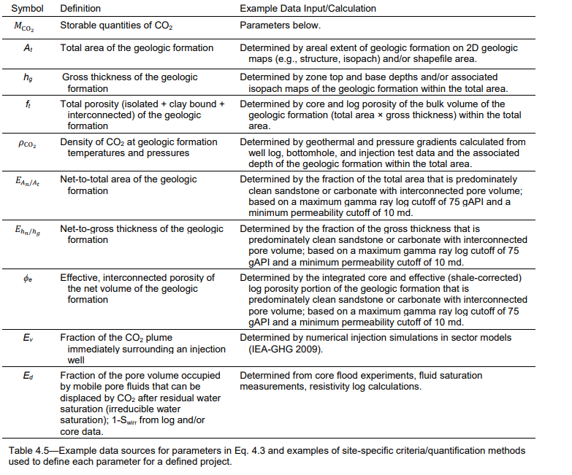
SRMS Definitions

