Slide 1
Random Forest Algorithm

Slide 2
Introduction
Random forest is a Supervised Machine Learning Algorithm that is used widely in Classification and Regression problems. It builds decision trees on different samples and takes their majority vote for classification and average in case of regression.
It can handle continuous variables as in the case of regression and categorical variables as in the case of classification. It performs better results for classification problems.

Slide 3
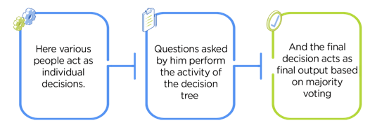
Real Life Analogy
A student named X wants to choose a course after his 10+2, and he is confused about the choice of course. He decides to consult various people. He asks them varied questions like why he should choose, job opportunities, course fee, etc. Finally, after consulting various people about the course he decides to take the course suggested by most of the people.

Slide 4
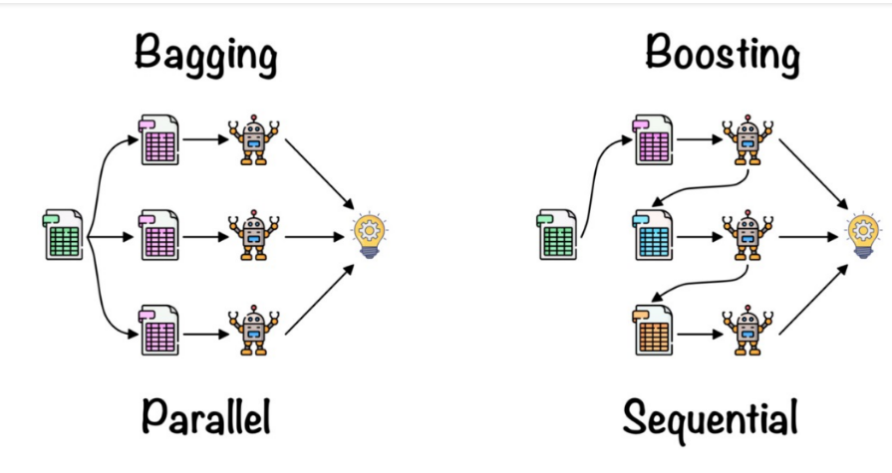
Working of Random Forest Algorithm
Random forest is an ensemble technique. Ensemble simply means combining multiple models. A collection of models is used to make predictions rather than an individual model. Ensemble uses two types of methods:
Bagging: It creates a different training subset from sample training data with replacement & the final output is based on majority voting. For example, Random Forest.
Boosting: It combines weak learners into strong learners by creating sequential models such that the final model has the highest accuracy. For example, ADA BOOST, XG BOOST.

Slide 5
Real Life Analogy
A student named X wants to choose a course after his 10+2, and he is confused about the choice of course. He decides to consult various people. He asks them varied questions like why he should choose, job opportunities, course fee, etc. Finally, after consulting various people about the course he decides to take the course suggested by most of the people.

Slide 6
Slide Title
Make Effective Presentations
Using Awesome Backgrounds
Engage your Audience
Capture Audience Attention

Slide 7
Slide Title
Product A
Product B
Feature 1
Feature 2
Feature 3
Feature 1
Feature 2
Feature 3

Slide 8


