Slide 1
Matrix Algebra

Slide 2
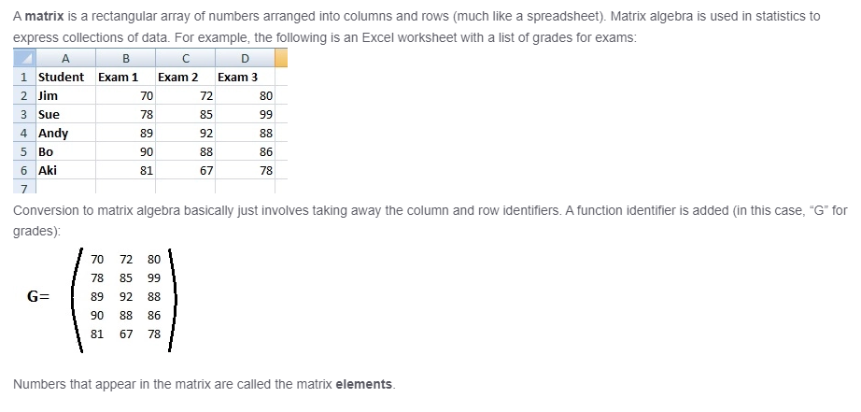
What is matrix ?

Slide 3
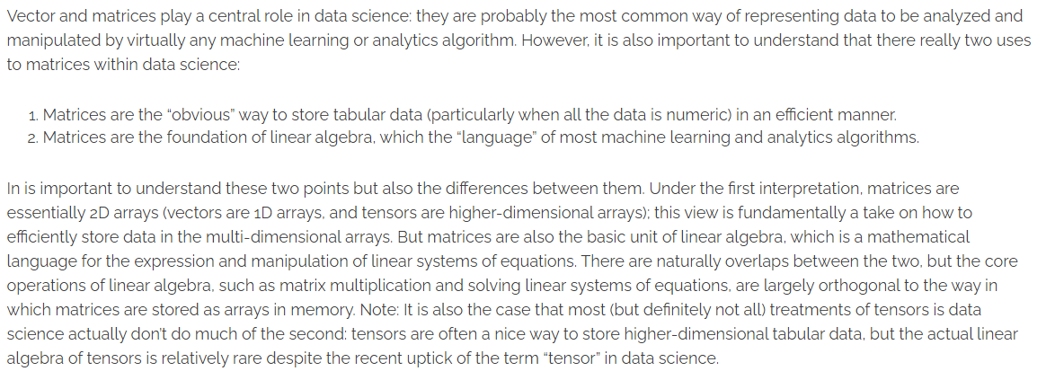
Matrices in Data Science

Slide 4
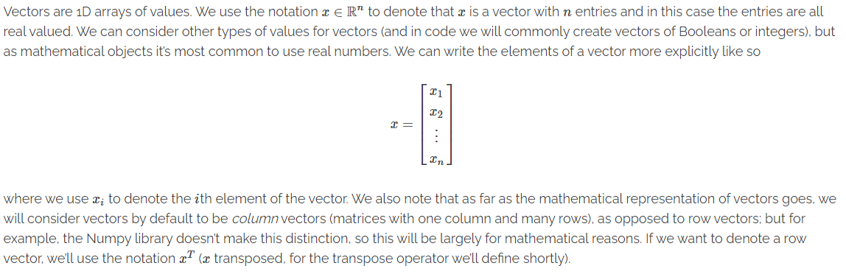
Vectors : the array view

Slide 5
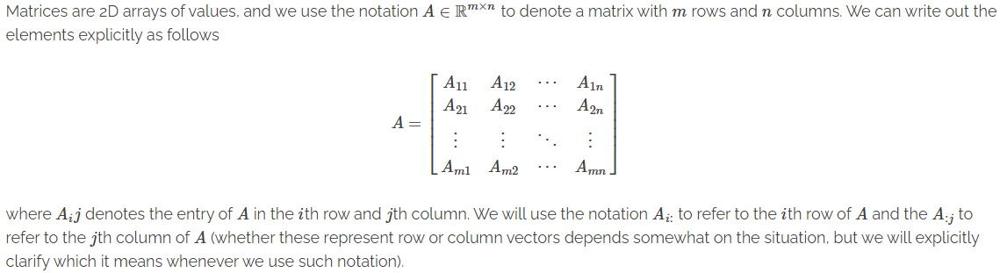
Metrices : the array view

Slide 6
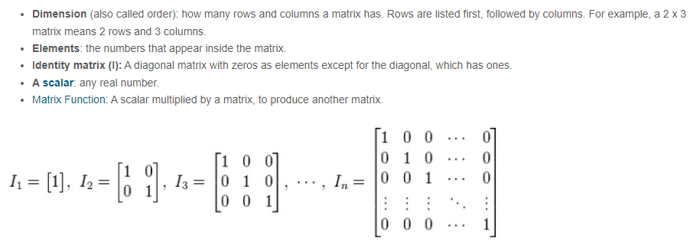
Matrices: Notation

Slide 7
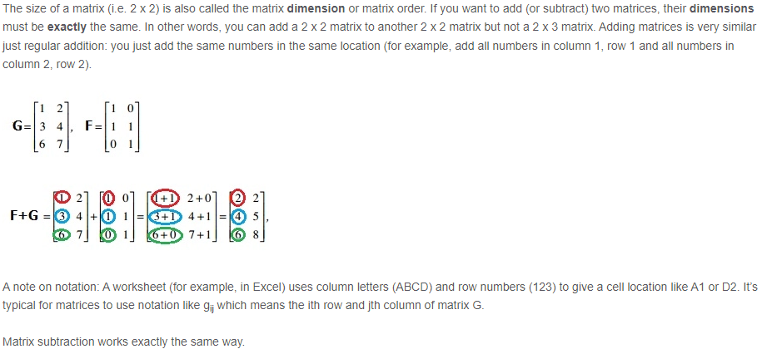
Matrices: Addition & Subtraction

Slide 8
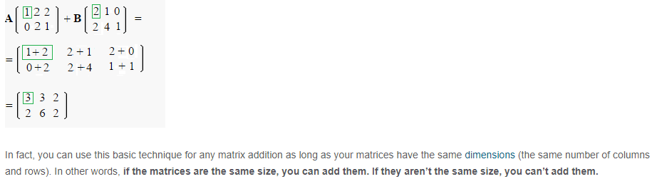
Matrices: Addition & Subtraction

Slide 9
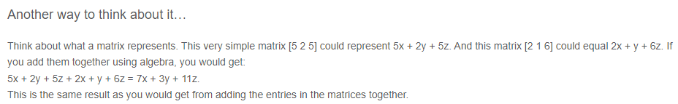
Matrices: Addition & Subtraction

Slide 10
Matrices: Addition & Subtraction

Slide 11
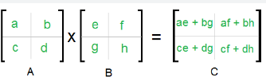

Matrix Multiplication

Slide 12
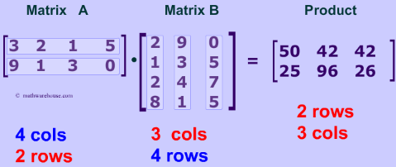
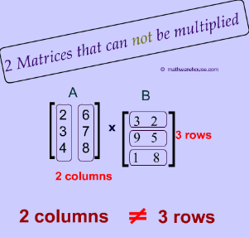
Matrix Multiplication

Slide 13
Matrix Multiplication

Slide 14
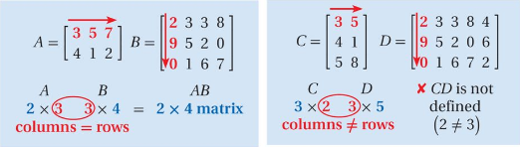
Matrix Multiplication

Slide 15
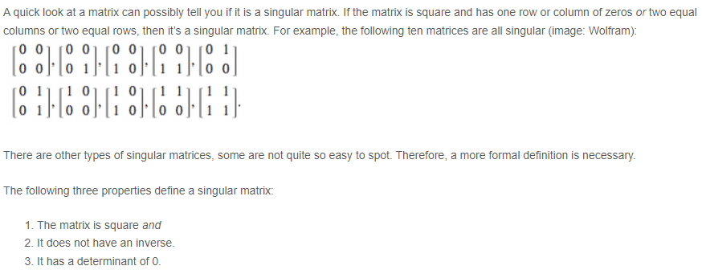
Singular Matrix

Slide 16
Square Matrix

Slide 17
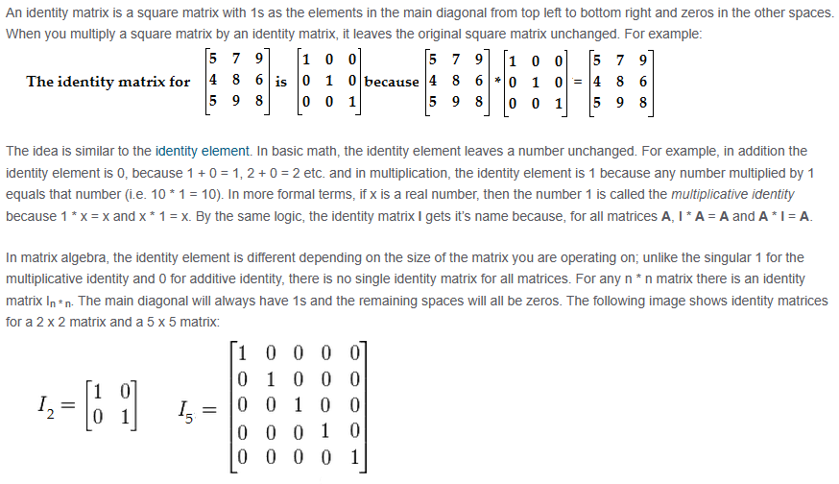
Identity Matrix

Slide 18
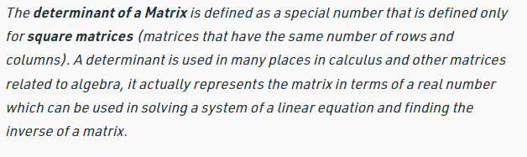
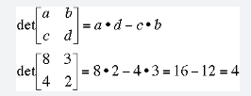
Determinant of a matrix

Slide 19
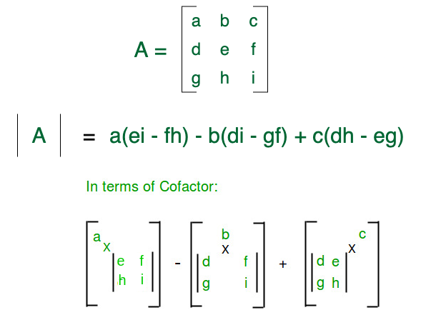
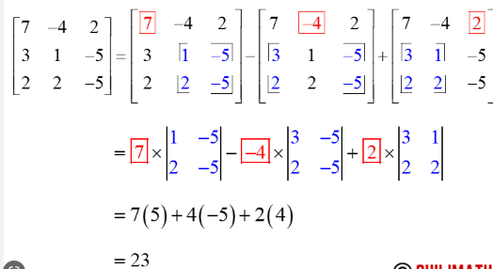
Determinant of a 3x3 matrix

Slide 20
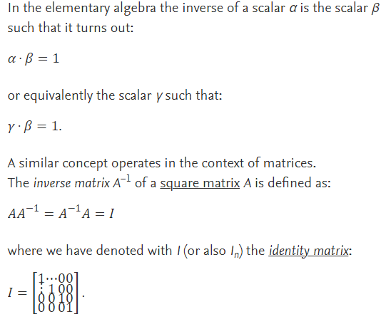
Inverse of a matrix

Slide 21
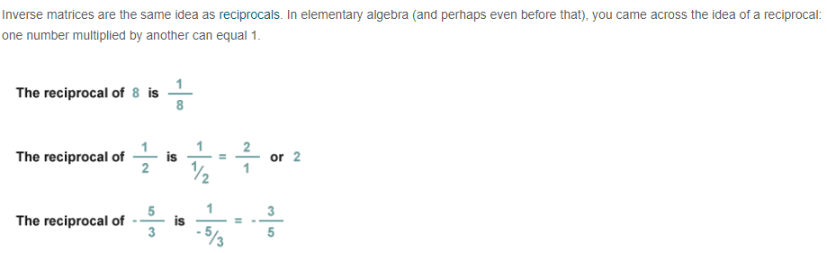
Inverse of a matrix

Slide 22
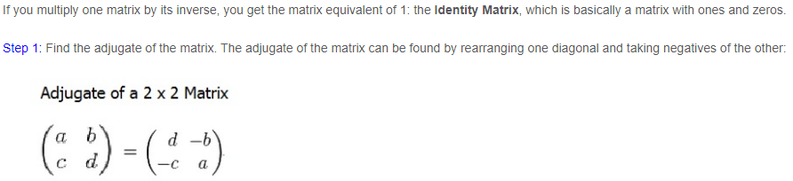

Inverse of a matrix

Slide 23
Inverse of a matrix

Slide 24
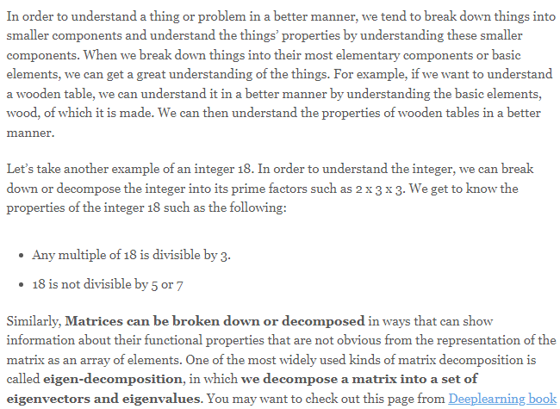
Eigen Vectors and Eigen Values

Slide 25
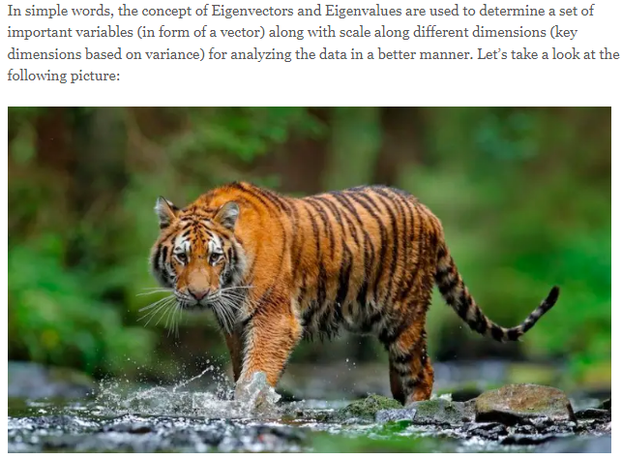
Eigen Vectors and Eigen Values

Slide 26
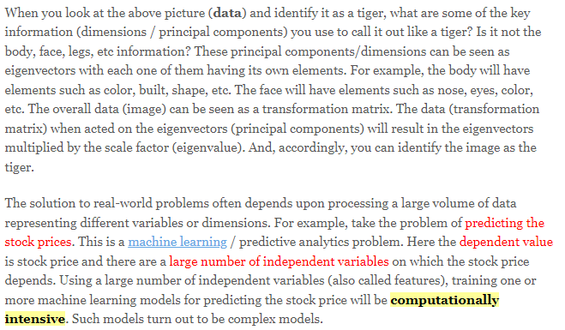
Eigen Vectors and Eigen Values

Slide 27
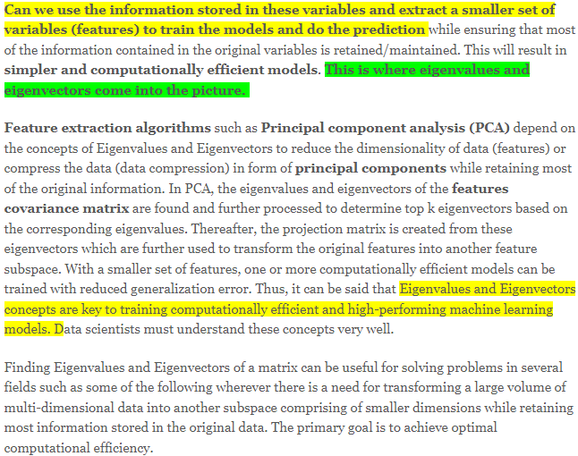
Eigen Vectors and Eigen Values

Slide 28
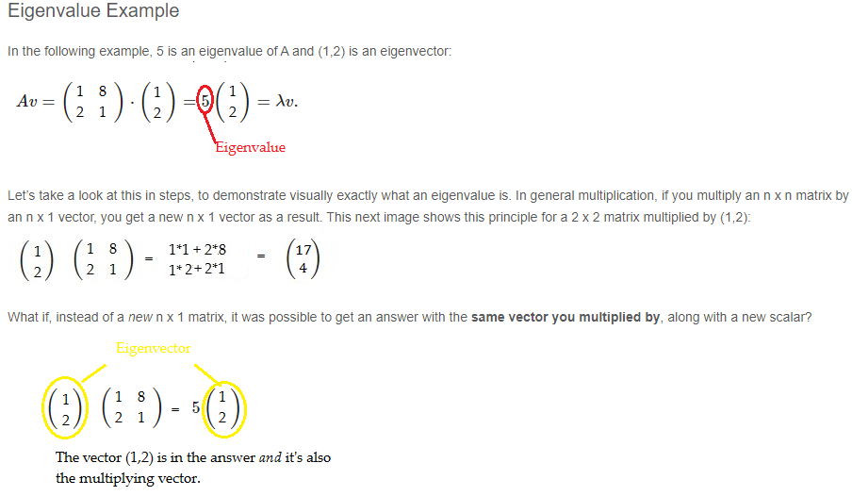
Eigen Vectors and Eigen Values

Slide 29
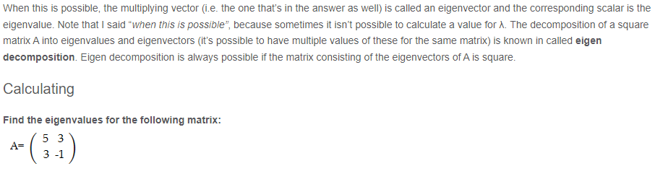
Eigen Vectors and Eigen Values

Slide 30
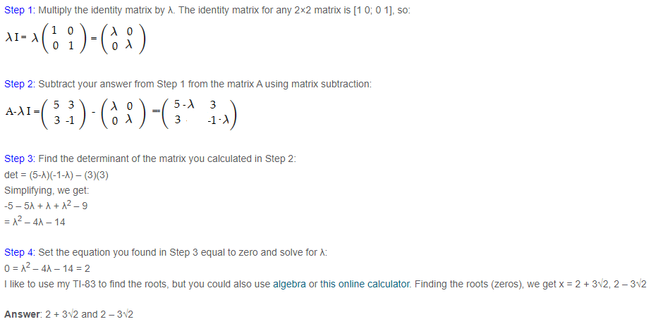
Eigen Vectors and Eigen Values

Slide 31
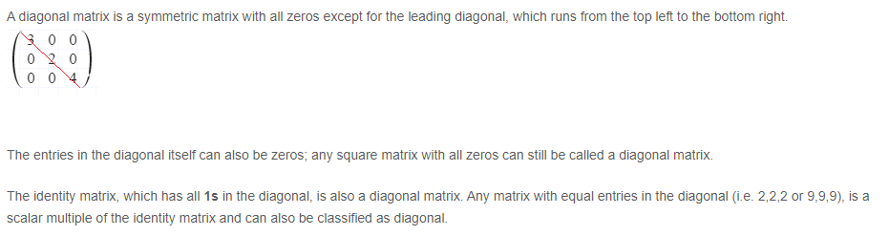
Diagonal Matrix

Slide 32
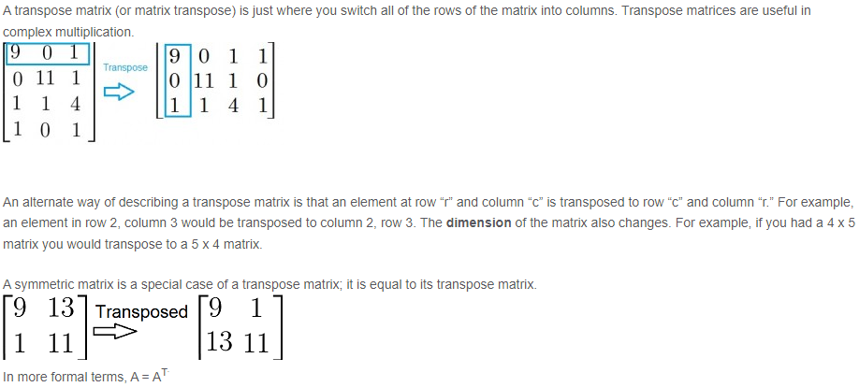
Transpose Matrix

Slide 33
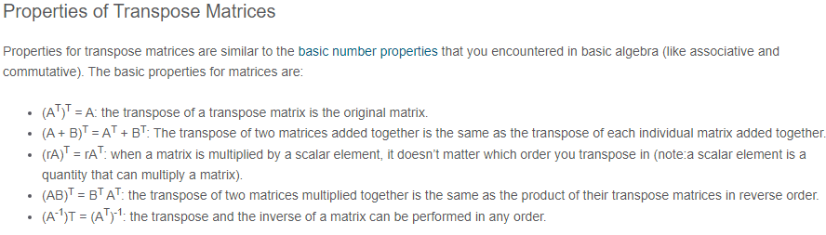
Transpose Matrix

Slide 34
Transpose Matrix

Slide 35
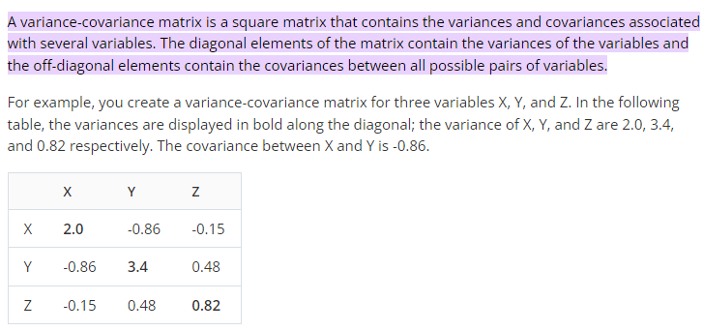
Variance-Covariance Matrix

Slide 36
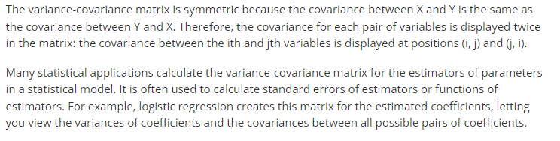
Variance-Covariance Matrix

