Slide 1
Python File Handling

Slide 2
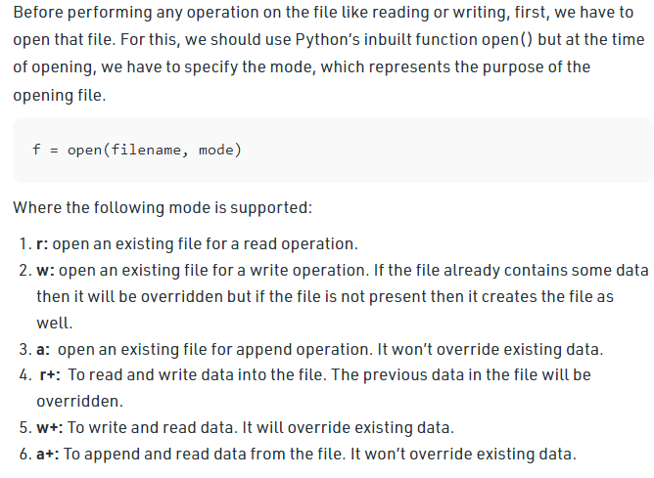
Working of open() function

Slide 3
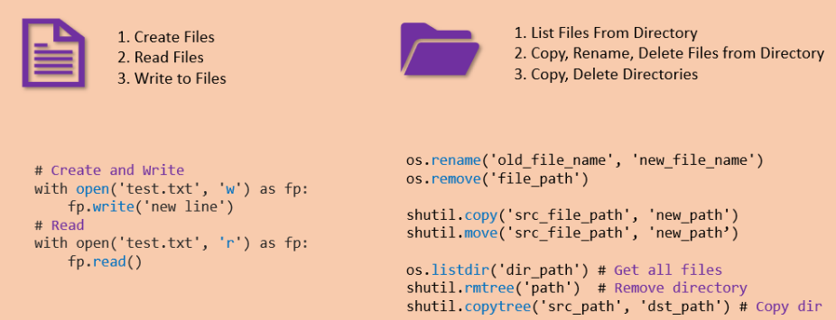
File Handling in Python

Slide 4



Reading File

Slide 5


Creating and writing to a file

Slide 6
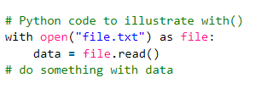

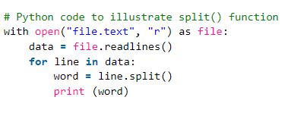
Using with() and split() functions in file handling

