Slide 1

PRESENTATION
ON
"RAINFALL PREDICTION"
submitted as partial fulfillment for the award of
BACHELOR OF TECHNOLOGY
DEGREE
SESSION 2024-25
in
CSE(AI-D)
UNDER THE SUPERVISION OF
Abhishek Shukla
BY TEAM MEMBERS:
SURAJ KUMAR 202401100300256
UDAY GANGWAR 202401100300268
SHAHID SIDDIQUI 202401100300223
UTKARSH SINGH 202401100300271
VINAY KUMAR 202401100300279

Slide 2


Rainfall forecasting poses a significant challenge due to the unpredictable and nonlinear nature of weather systems. This project aims to build a classification model to predict whether it will rain tomorrow using current weather data. The dataset, gathered from various Australian locations, includes features like temperature, humidity, wind speed, and atmospheric pressure. The target variable, “Rain Tomorrow,” represents whether rainfall occurs the next day. The process involves cleaning data, selecting key features, and applying machine learning algorithms such as logistic regression, decision trees, and random forests. The goal is to enhance forecasting accuracy and support informed decisions in climate-sensitive sectors.
INTRODUCTION

Slide 3
PROBLEM STATEMENT
Rainfall forecasting is a complex challenge due to the dynamic and nonlinear nature of weather systems. The objective of this project is to develop a classification model that can predict whether it will rain tomorrow based on today's weather conditions. Using the provided weather dataset collected from various Australian locations, the model must analyze multiple features such as temperature, wind, humidity, and atmospheric pressure to make accurate predictions. This binary classification problem requires handling missing data, selecting relevant features, and training robust algorithms to distinguish patterns associated with rainfall events. The outcome variable, "RainTomorrow," indicates whether rainfall occurred the following day, which serves as the target label for model training and evaluation. Solving this problem involves applying machine learning techniques such as logistic regression, decision trees, random forests, and others to achieve high predictive accuracy. The goal is to support better forecasting capabilities and enable timely interventions in climate-sensitive domains.

Slide 4



METHODOLOGY

Slide 5
CODE
from google.colab import files
uploaded = files.upload()
import pandas as pd
import matplotlib.pyplot as plt
import seaborn as sns
from sklearn.model_selection import train_test_split
from sklearn.preprocessing import LabelEncoder
from sklearn.impute import SimpleImputer
from sklearn.ensemble import RandomForestClassifier
from sklearn.metrics import accuracy_score, classification_report, confusion_matrix
import joblib
# Load dataset
df = pd.read_csv('weatherAUS.csv')

Slide 6
# Load dataset
df = pd.read_csv('weatherAUS.csv')
# Drop columns with many missing values
df = df.drop(columns=['Evaporation', 'Sunshine', 'Cloud9am', 'Cloud3pm'])
# Drop rows with missing target
df = df.dropna(subset=['RainTomorrow'])
# Fill numeric missing values with mean
numeric_cols = df.select_dtypes(include=['float64']).columns
imputer = SimpleImputer(strategy='mean')
df[numeric_cols] = imputer.fit_transform(df[numeric_cols])

Slide 7
# Encode all object-type columns using LabelEncoder
categorical_cols = df.select_dtypes(include=['object']).columns
label_encoders = {}
for col in categorical_cols:
le = LabelEncoder()
df[col] = le.fit_transform(df[col].astype(str))
label_encoders[col] = le
X
# Train the model
rf = RandomForestClassifier(n_estimators=100, random_state=42)
rf.fit(X_train, y_train)
# Make predictions
y_pred = rf_model.predict(X_test)
# Evaluate
print("Accuracy:", accuracy_score(y_test, y_pred))
print("Classification Report:\n", classification_report(y_test, y_pred))

Slide 8


RANDOM FOREST CLASSIFIER ALGORITHM

Slide 9

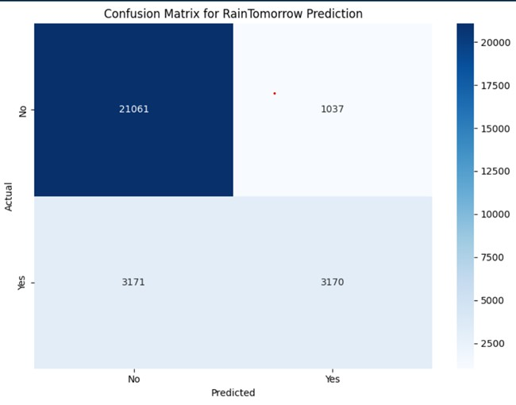
OUTPUT

Slide 10

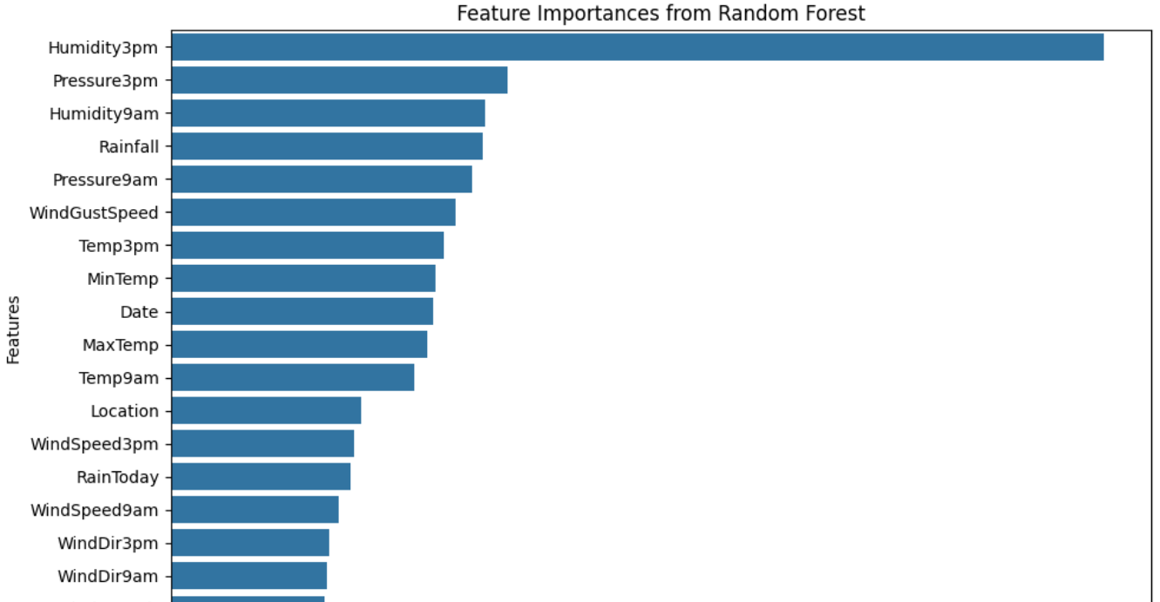

Slide 11
CHAT GPT
GOOGLE COLAB
CHROME
REFRENCES

