Slide 1

Rocking the Enterprise with Ruby
Sudhindra Rao
Munjal Budhabhatti
© ThoughtWorks, 2010

Slide 2

Ruby in the Enterprise
“Enterprise software is a system that is used to support a business and its growth.”
© ThoughtWorks, 2010
Notes:
Munjal
Different stakeholders - inventory, sales, marketing

Slide 3
Ruby in Enterprise
Domain
Technology and Delivery
Architecture
Integration with the Enterprise
OSS
© ThoughtWorks, 2010
Notes:
Sudhindra

Slide 4
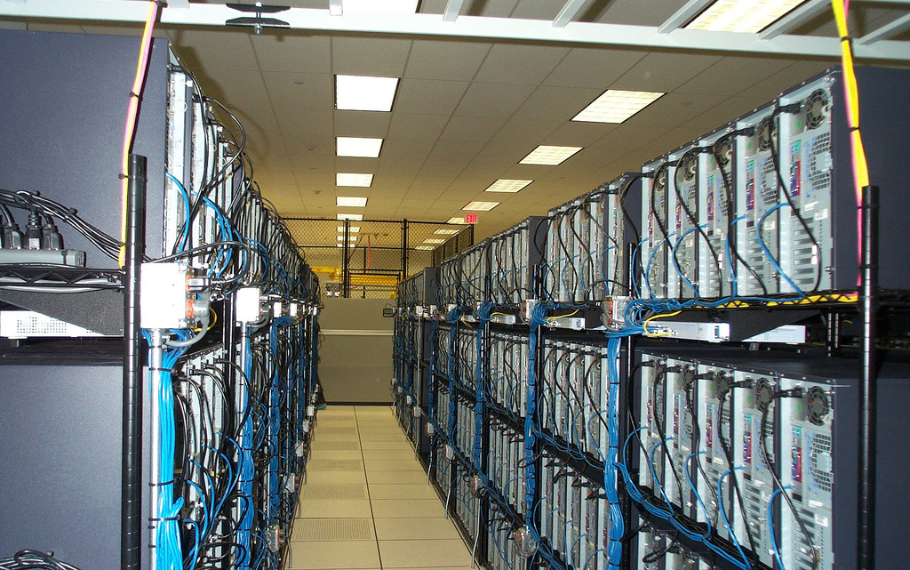
Understanding the problem domain
Server and network management
Location and Power management
Address management
Monitoring and Diagnosis
Customer Support
Back Office Support
© ThoughtWorks, 2010
Notes:
Munjal
What does a data center contain?
How do you find the sever in a data center?
Rackspace is know for it’s support. How do you find what is wrong in it?
You don’t want your best support
How to charge your bandwidth
To addresses these concerns we will talk about three key applications and we will leave out the obvious such as Location and Power Management

Slide 5
IP Automation
Limited address space with IPv4
IP Blocks management
Governing body compliance
Public, Private IPs
Public, Private Networks
IPv6 support
© ThoughtWorks, 2010
Notes:
Munjal
Complicated algorithm cause ip has limited address space with 32 bit addressing
IP Block management - Migrating customers for expansion
A customer might use different networks: private, public, backup
Supporting complications of ipv6 - mysql doesn’t directly support a datatype for ipv6. hence ipv6 translation

Slide 6
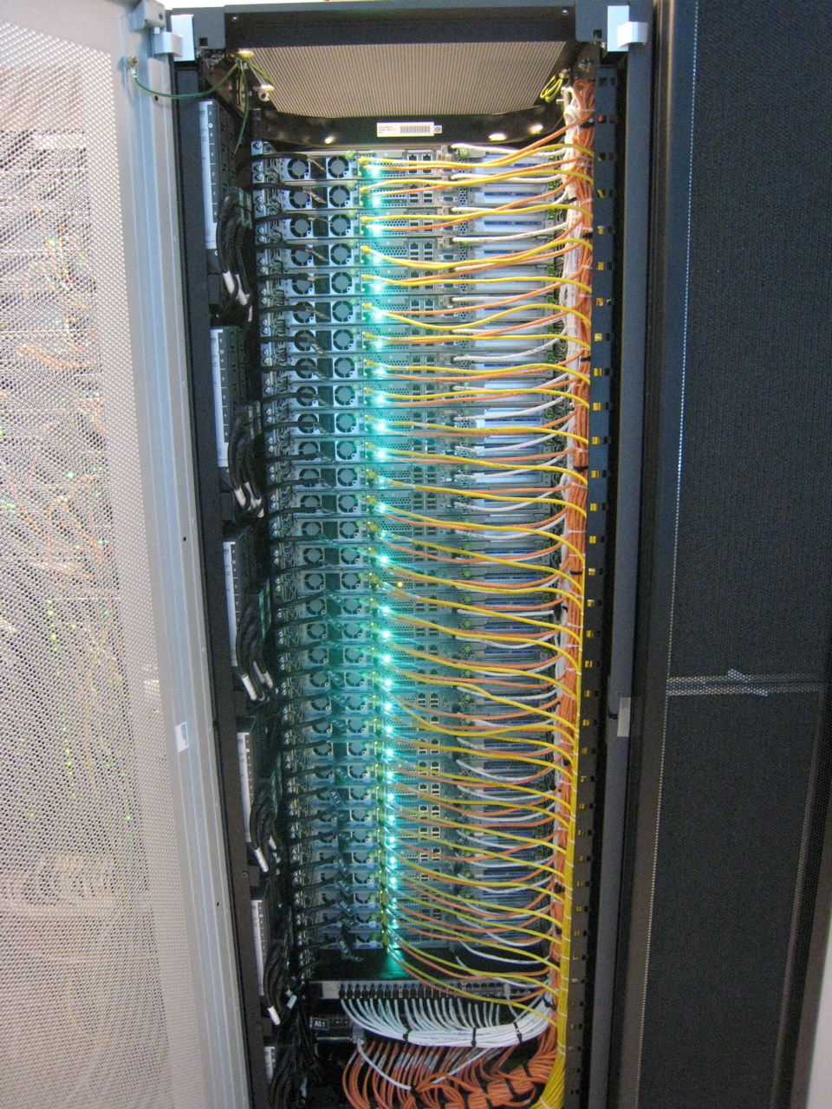
DNS Automation
Huge database
Security concerns over routing
Legal implications
Accuracy
Systems support
Always on
© ThoughtWorks, 2010
Notes:
Sudhindra

Slide 7
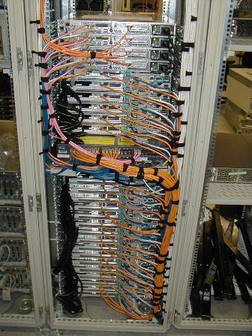
Network Device Manager
ruby DSL for network devices
Commission new devices
Intelligent command chains
Enhanced logging for debug support
© ThoughtWorks, 2010
Notes:
data scraping and custom script execution
conditional and for loops
Configure, Diagnose, Status
Intelligent command chains - Configurable to build command structures to support various hardware and OS combinations

Slide 8
Technology
Ruby
  ease of use and refactoring
  natural language syntax to support varied applications
  allows iterative addition to features
  expertise - ThoughtWorks and Rackspace
  Rails - naturally built for web applications
Fast ramp-up for developers
Spike for first small project - achieved goal at 40% cost of off-the-shelf product
© ThoughtWorks, 2010
Notes:
Sudhindra
allows iterative addition to features: LDAP/edir example

Slide 9
Delivering Continuously
Discipline
  Identify focused user base
  Strict control on features
  Delivering frequently - 2 weeks
  Small testable features
  Consistent code coverage
Feedback
  Adapt architecture
  RESTful interface
© ThoughtWorks, 2010
Notes:
Munjal
Faster feedback by frequent delivery
History of more than 90% code coverage. We are not stuck on a number but it definitely helps.
Evolve architecture. Migrating from a monolith huge application to smaller REST enabled apps.

Slide 10
Architecture
Remodelling to adapt to usage changes
  Physical Space Project
    Combined concepts of Physical and Virtual world
    Data collection, usage, and consistency issues
  Redesign
    Identify User groups and Patterns
    Split the domain
Changing Domain abstractions
Distributed transactions
Pluginization to reuse functionality
© ThoughtWorks, 2010
Notes:
Sudhindra

Slide 11
Design
REST Engine
Web based UI - Consumer
Rails templates and resource_full
Distributed testing
Selenium suite
Consumers
App
App
Engine
Engine
Engine
© ThoughtWorks, 2010
Notes:
Sudhindra

Slide 12
Pluginized Models
def setup_load_paths
extra_paths = Dir.glob(plugin_root + "/app/*/")
ActiveSupport::Dependencies.load_paths.unshift(*extra_paths)
$:.unshift(*extra_paths)
end
if should_enhance_rake_tasks?
Rake::Task["db:drop"].enhance(["#{plugin_name}:db:drop"])
Rake::Task["db:create"].enhance(["#{plugin_name}:db:create"])
end
Rake::Task["db:migrate"].enhance(["#{plugin_name}:db:migrate"])
App
© ThoughtWorks, 2010
Notes:
Sudhindra

Slide 13
Integrating with the Enterprise
Comprehensive reporting
Repurpose with API
Workflow engine
Enterprise Message System
Core api - Integration Layer
IP
NDM
ENV
NET
DNS
© ThoughtWorks, 2010
Notes:
Munjal
Reporting to other departments and data ware house
Orchestration of RESTful services for rich behavior
We will look at WE and EMS

Slide 14
Workflow Engine
Ruote - DSL based workflow engine
RESTful services orchestration and Rich abstractions
Example
Ruote Engine
IP
NDM
LOC
NET
DNS
© ThoughtWorks, 2010
Notes:
Munjal
What is one click? Instead of set of commands in different applications and keeping a note in a piece of paper, have one click do a task.
4.5 days to 18 minutes

Slide 15
Enterprise Message System
RabbitMQ - a highly reliable, available, and scalable EMS
Decoupling when Integrating with external systems
Distributed transactions
IP
NDM
LOC
NET
DNS
© ThoughtWorks, 2010
Notes:
Munjal
Decoupling with external systems such as Core, Cloud
Distributed Trx

Slide 16
OpenSource
resource_full
distributed testing
cc monitor
© ThoughtWorks, 2010

Slide 17
resource_full
Fully compliant ActiveResource Built on ActionController
RESTful parameter queryability, paging, etc.
template for making engines REST easy
template for REST consumers
Typical functionality Out of the box
Extend to return different stream types - json, xml
http://github.com/bguthrie/resource_full
© ThoughtWorks, 2010

Slide 18
resource_full
class UsersController < ResourceFull::Base
identified_by :username, :unless => lambda { |id| id =~ /^[0-9]+$/ }
queryable_with :city, :state, :from => :address
queryable_with :name, :columns => [:first_name, :last_name]
queryable_with :email_address, :fuzzy => true
queryable_with :is_active, :scope => :active
orderable_by :city, :from => :address
responds_to :html
responds_to :xml, :only => [:read, :update]
end
class AddressesController < ResourceFull::Base
nests_within :users
queryable_with :city, :state
end
© ThoughtWorks, 2010

Slide 19
Distributed Testing
Server start/stop, run tests, collect reports
Consumer
application
Service
engine
Service
engine
Service
engine
© ThoughtWorks, 2010

Slide 20
Distributed Testing
#Plugin code
require rails_root("/vendor/plugins/integration/lib/integration/helper")
include Blackbox::Integration::Helper
start_dependencies( :app1, :engine1, :location_engine )
#spec across engine and application
it "should find all data_centers" do
data_center1, data_center2 = engine_drb.setup(<<-DATA, __FILE__, __LINE__)
data_center1, data_center2 = create! :data_center, :quantity => 2
[data_center1, data_center2]
DATA
DataCenter.find(:all).should == [ data_center1, data_center2 ]
end
© ThoughtWorks, 2010

Slide 21
Distributed Testing
DRb based integration testing
Integrating multiple engines to run a test that spans the domain
Unit tests/functional tests to ensure quality of each engine
Domain level testing
Functional testing
Transaction testing
© ThoughtWorks, 2010

Slide 22
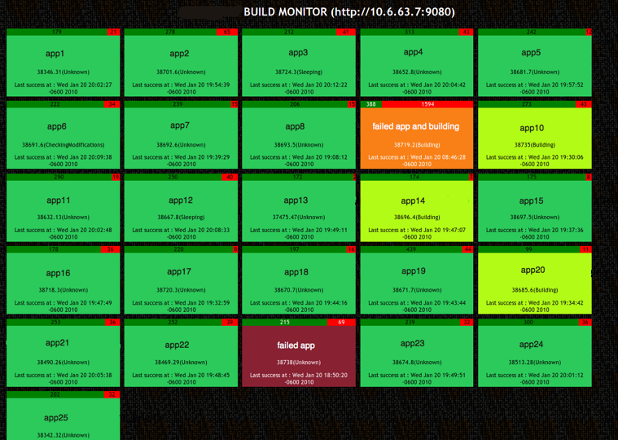
CC Monitor
Simple dashboard for all your builds
Ramaze application
Instant Feedback
Cruise, Bamboo,
http://github.com/betarelease/cc_monitor
© ThoughtWorks, 2010

Slide 23
Secrets of Success
Continuous testing and refactoring
Managed Scope and timeline
Ruby
Enterprise Ready??
© ThoughtWorks, 2010
Notes:
allowed twisting and splitting applications
allowed merging domain concepts via modularization
allowed for simple design - thus making it amenable to change
availability of libraries to support enterprise needs

Slide 24
Photo Courtesy
http://royal.pingdom.com/2008/01/24/when-data-center-cabling-becomes-art/
http://www.flickr.com/photos/chrisdag/865724585/
http://www.flickr.com/photos/digitalslurp/208731724/
http://www.flickr.com/photos/tim_d/184018928/
© ThoughtWorks, 2010

Slide 25
Questions?
© ThoughtWorks, 2010

Slide 26
ありがとうございます。
sudhindra.rao@thoughtworks.com
munjal@thoughtworks.com
@sudhindraRao
@munjal
© ThoughtWorks, 2010
Notes:
ardei ga-toe gozaimasu

