Slide 1

Network Redundancy Tester
SEL Confidential

Slide 2
Outline
Introduction
Components
What does it do?
What information can it provide?
Future?

Slide 3
Purpose
Baseline RSTP failover performance of new networks
Verify RSTP failover performance of existing networks
Verify correct VLAN configuration of edge ports on the network
Work independently from switch network topology and technology
Work independently from switch vendor

Slide 4
Components
Dedicated Linux-based hardware
One device used as publisher / subscriber (with HMI)
Link breaker with copper or fiber ports

Slide 5
What Does It Do?
Publisher device – publishing Layer 2 pseudo GOOSE messages
Pseudo GOOSE messages can be published every 250 μs
Subscriber device – watching the counter (similar to Seq# in every message)
Subscriber uses Seq# to do failover performance analysis

Slide 6
Connection Diagrams: Ladder Network Topology
Notes:
4 rung ladder
Sender into 2A and subscriber into 2B

Slide 7
Connection Diagrams: Ladder Network Topology
Notes:
4 rung ladder
Sender into 2A and subscriber into 2B

Slide 8
Connection Diagrams: Ladder Network Topology
Notes:
4 rung ladder
Sender into 2A and subscriber into 2B

Slide 9
Connection Diagrams: Ring Network Topology
Notes:
4 rung ladder
Sender into 2A and subscriber into 2B

Slide 10
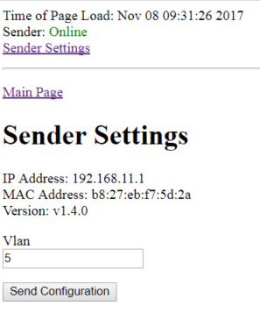
Sender Settings

Slide 11
Receiver Settings
Samples
Debounce
Inter-event wait
Wait time

Slide 12
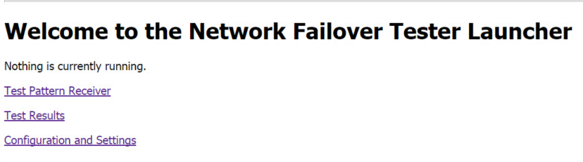
Receiver Settings Menu

Slide 13
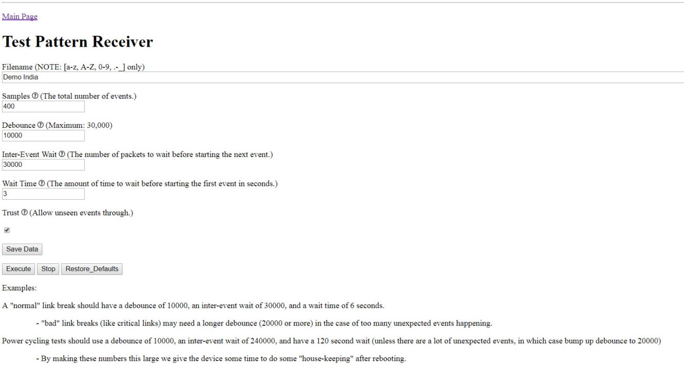
Test Pattern Receiver
SEL Confidential
Notes:
Minimum of 40 before you get graphs

Slide 14
System Behavior

Slide 15
Event Processing

Slide 16
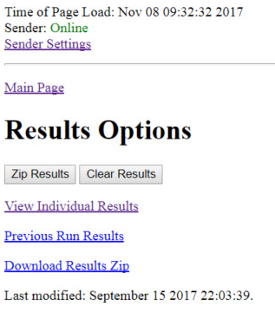
Results Menu

Slide 17
Nomenclature
Link Failure
s2A.d2B.fL1-2730M-R105.txt
Switch Failure
s2A.d2B.f1B-2730M-R105.txt

Slide 18
Demo Setup
Primary Link Up
RSTP Switching to Primary Link
Primary Link Down
RSTP Switching to Backup Link
Backup Link Up
Primary Link Up
Primary Link Up
5

Slide 19
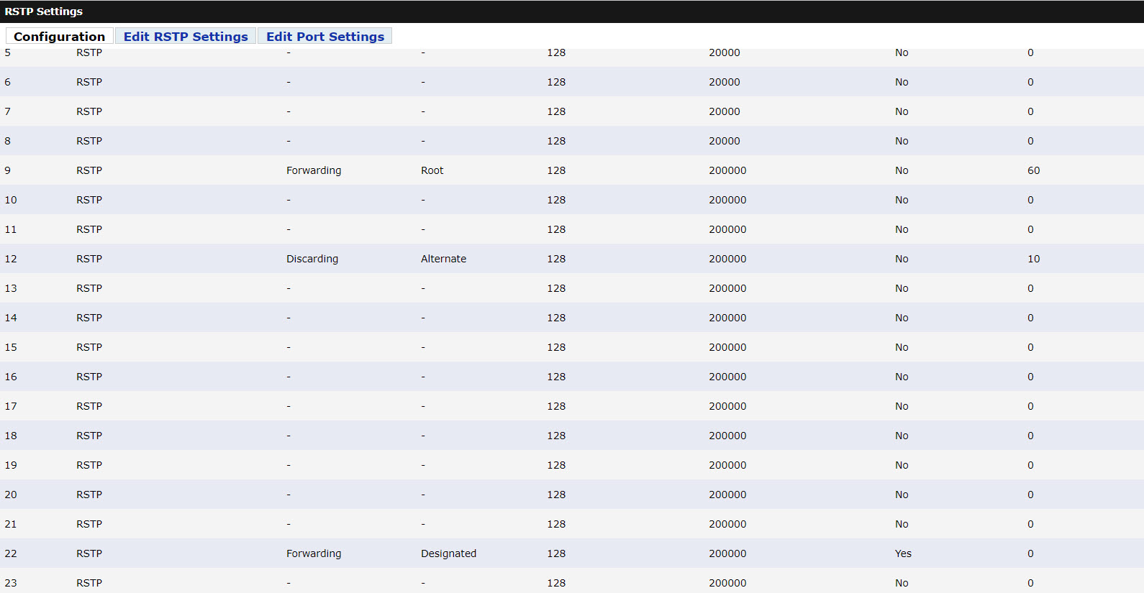
Demo Switch Port State
SEL Confidential

Slide 20
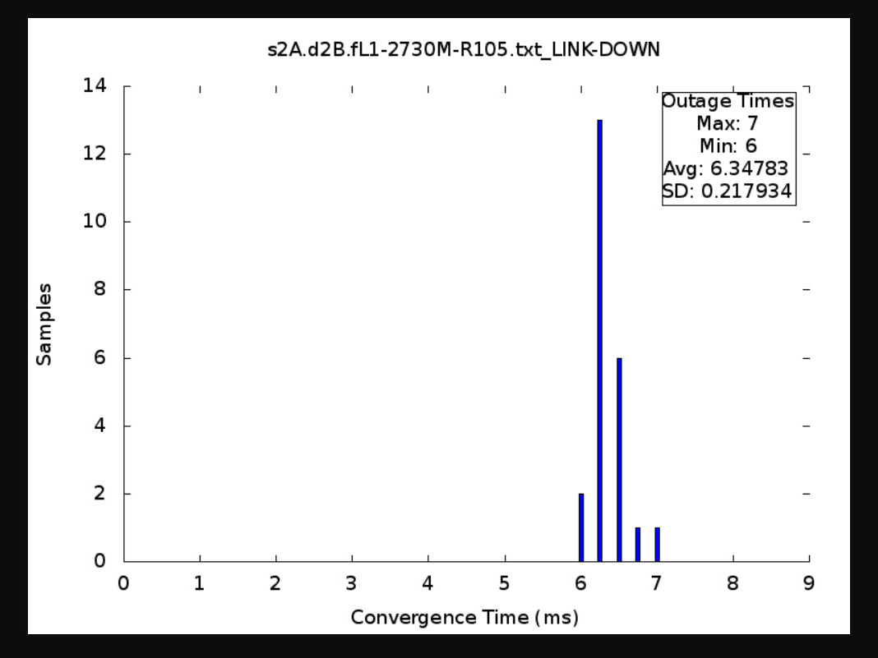
Result Histogram Analysis: Link Down

Slide 21
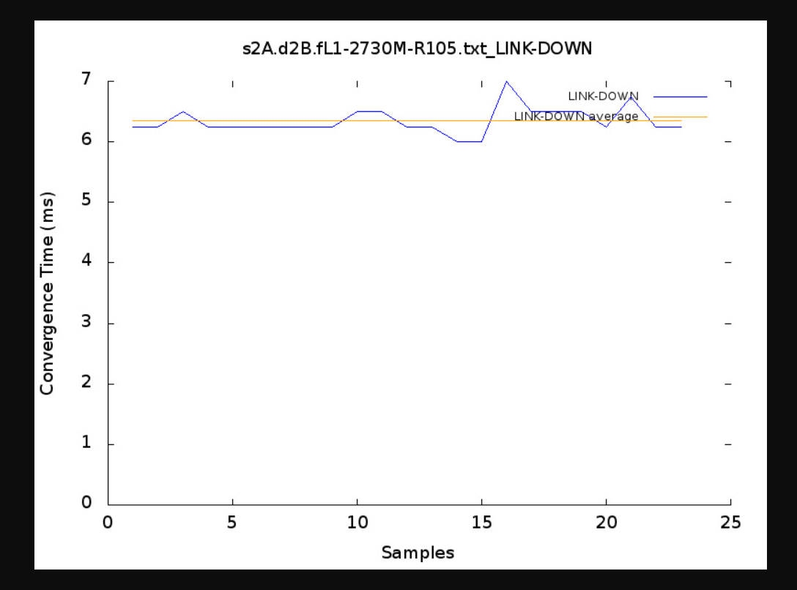
Result Line Graph Analysis: Link Down

Slide 22
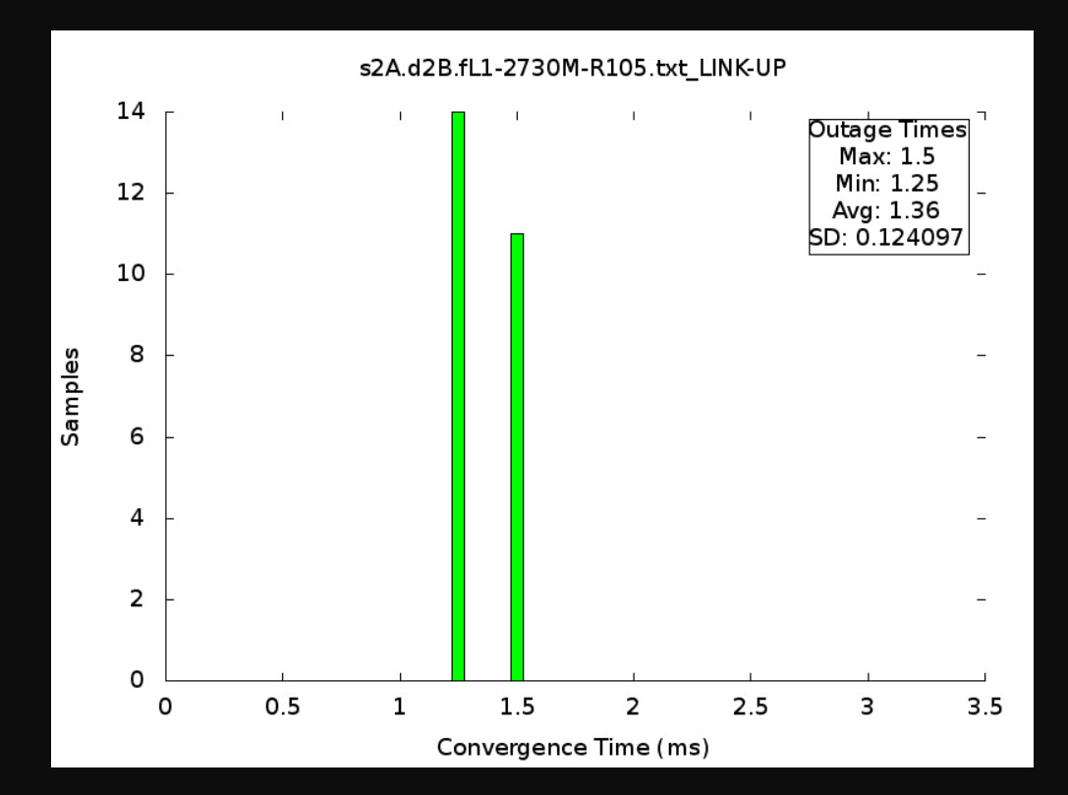
Result Histogram Analysis: Link Up

Slide 23
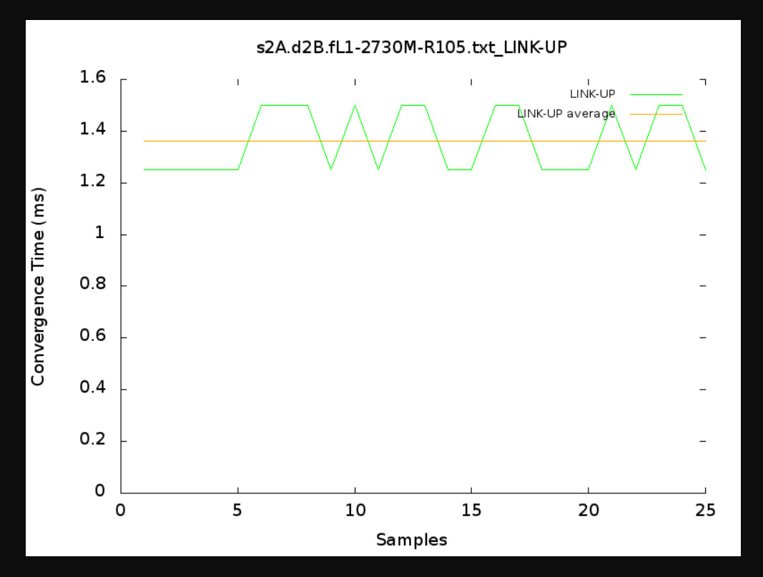
Result Line Graph Analysis: Link Up

Slide 24
Future
Cybersecurity network penetration testing
Network stress testing
Real-time protocol monitoring
Network traffic capture for troubleshooting
Human-centered GUI
Multiple-layer traffic simulation options

Slide 25
Questions

