Slide 1
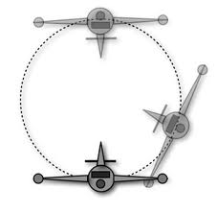
The Airplane shooter
Team name:Shooter
Members: Uuganbayar.
Bilguun.
Munkhbayar.

Slide 2
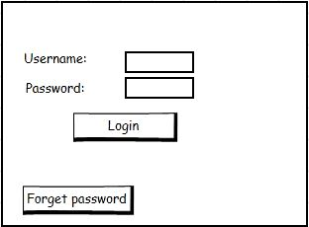
GUI Design
User will insert username and password into login
User will entry into game.
If forget password is email send.

Slide 3
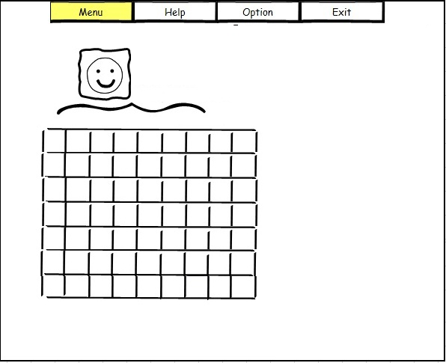
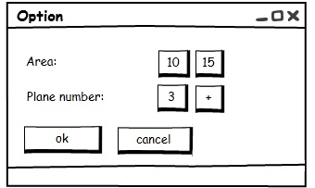
GUI Design
The host will choose the game option. (How many airplanes will use in the game and How long area will use in the game )

Slide 4
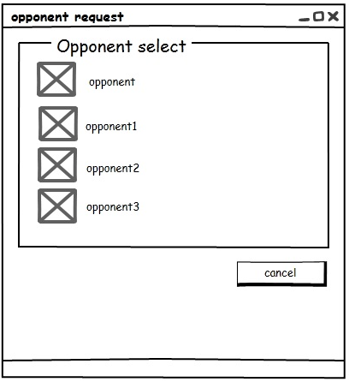
GUI Design
Player1: This player makes host. Host send request to another player(Opponent).
Request: Connect two players and sends request to another player.

Slide 5
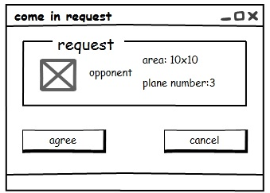
GUI Design
Player2: This player response to the host’s request. (Agree or Cancel)

Slide 6
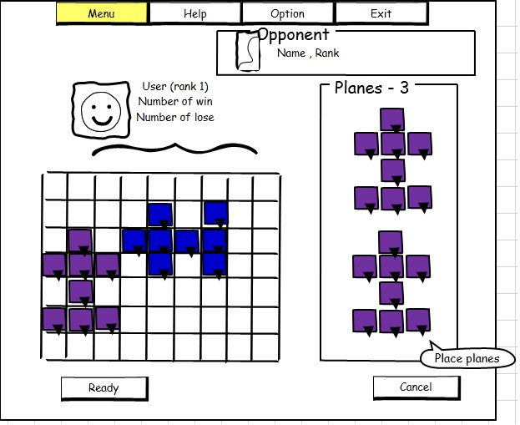
GUI Design
The two player airplane shooting game starts.

Slide 7
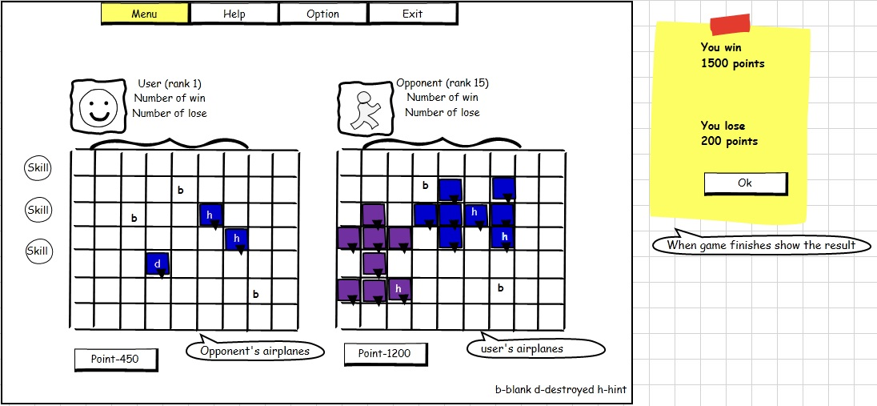
GUI Design

Slide 8
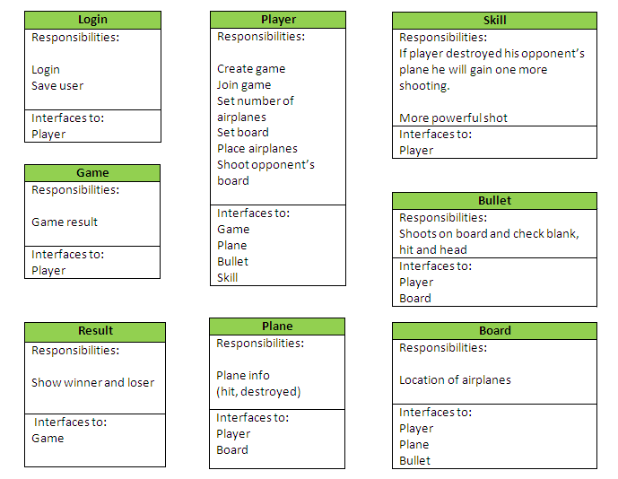
Class Design

Slide 9
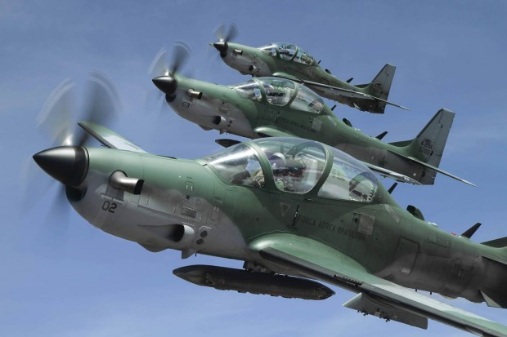
Thanks for your attention

