Slide 1
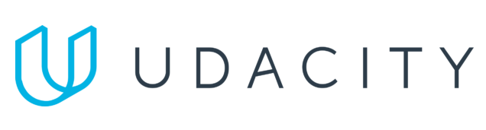
Data Lake Value Proposition
Medical Data Processing Company
DO THI KIM UYEN
Udacity IPS Version 1.0

Slide 2
Agenda
What is a Data Lake
Components of a Data Lake
Data Lake vs Data Warehouse
Business Value of Data Lake Solution
Proposed Data Lake Architecture for Medical Data Processing system
Udacity IPS Ver. 1 2/2020

Slide 3
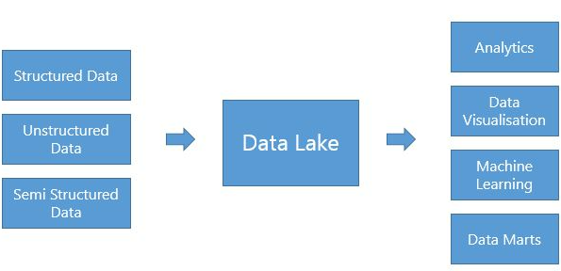
What is a Data Lake
Data Lake is a central place where we can bring together data, which can store any type of data, including structured, semi-structured, and unstructured data.
Data Lake can handle scaling of any size.
Data Lake is mainly used to break data silos, that brings all the crucial enterprise data under one centralized system to be able to provide decisive insights.
Data Lakes use Schema on Read technique, means that writing the data in the data lake maintaining its original raw format and enforce the schema when you need to read this data back.
Data Lake enables Analytics use cases, help Data Analysts access to data easier.

Slide 4
Components of Data Lake
Ingestion layer: Take on the role of ingest data from multiple sources with various formats into the Data Lake system
Processing layer: Clean and process a large amount of data with fast and accurate. Ensure both batch processing and real-time data analysis.
Storage layer: Where all the data of Data Lake is stored. Storage layer ensure that data is not loss in the even of failure or process error.
Orchestrations layer: Monitoring all the operation tasks in the Data Lake system, ensure that all the tasks is operated on planned and responsible for restart error tasks.
Other components: Governance, Security, Quality, Catalog, Audit, Lineage.

Slide 5
Data Lake vs Data Warehouse
Consider the differences between the two systems in the following table:

Slide 6

Data Lake
Data Warehouse
Data formats: Unstructured/ unrefined/ not relational data, structured data and semi-structured data
Schema on Read: Schema designed at the end
Users: data scientists and data developers, business analysts
Purposes: Used for predictive analytics, machine learning
Data types: Connecting various types of data from a wide variety of sources
Data formats: Refined/ structured/ relational data
Schema on Write: Schema designed at the beginning
Users: mainly business analysts
Purposes: Used for historical analytics, visualizations, BI
Data types: Collects similar data from multiple resources
Udacity IPS Ver. 1 2/2020

Slide 7
Business Value of Data Lake
Data Integration and Accessibility: integrate data from various data sources, such as SQL databases, FTP Files server, and IoT devices. This integration helps centralize all data, making it easier to access data for different teams and departments.
Data Exploration and Analysis: able to explore and analyze data from its raw format. This flexibility helps discover new patterns, relationships, and insights from data.
Scalability and Cost Efficiency: able to handle massive amounts of data, making them highly scalable. As data volume grows, it is easily scale up your data lake infrastructure to accommodate the increased storage and processing requirements with low cost for the resources the MPDC company is using.
Advanced Analytics and Machine Learning: provide a platform for advanced analytics, machine learning models and predictive analytics algorithms. These models can help automate processes, detect anomalies, make accurate predictions, and drive innovation.
Data Governance and Security: ensure data governance and security. With a well-designed data lake architecture, you can implement security measures, access controls, and data governance policies to protect sensitive data and comply with regulations.

Slide 8
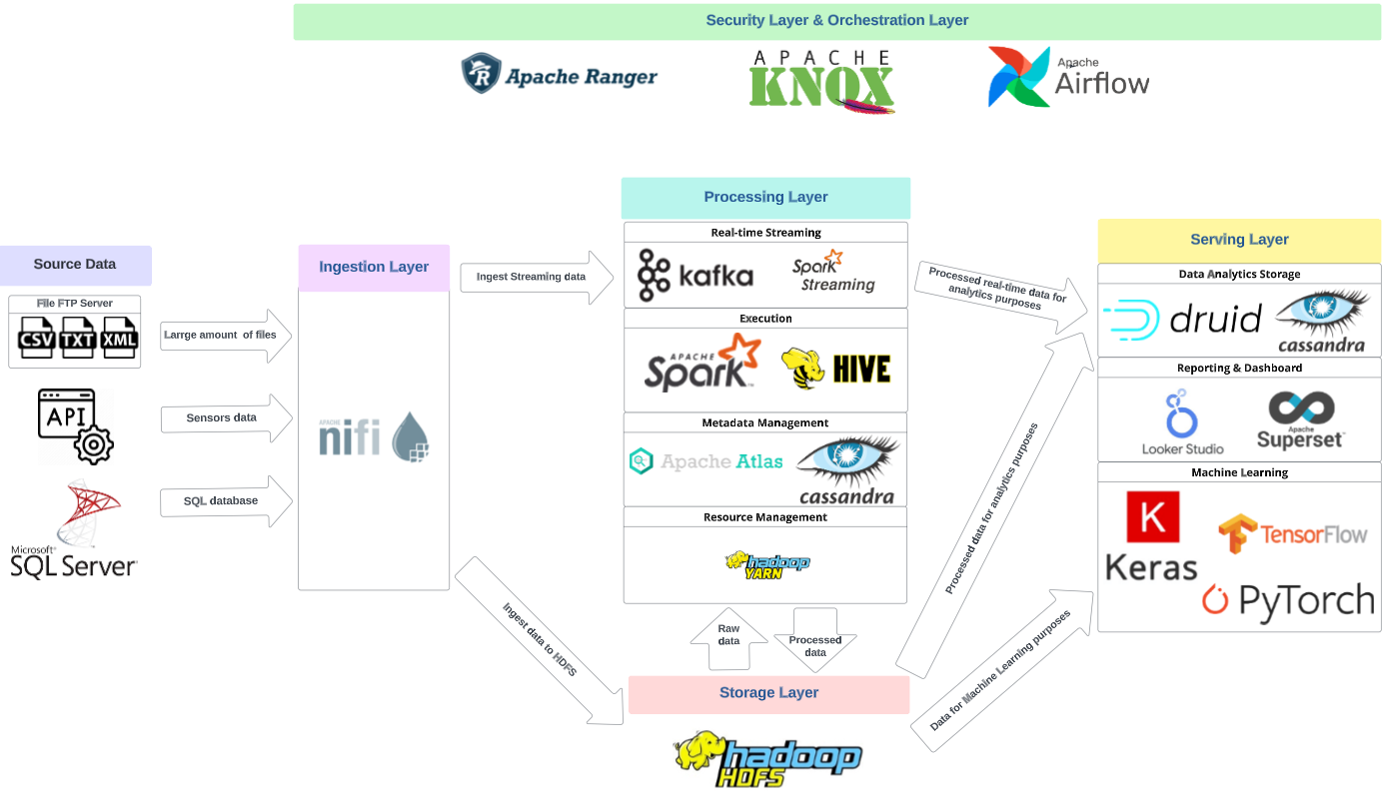
Data Lake Architecture

Slide 9
THANK YOU
Udacity IPS Version 1.0

