Slide 1


Data Governance @ SneakerPark
Prepared by: Uyen Do Thi Kim
Submitted on: 25 Aug, 2023

Slide 2
Background
SneakerPark is an online shoe reseller that allows people to buy and sell used and new shoes. Buyers can bid for shoes or buy them outright, and sellers can set a price or sell to the highest bidder.
Each buyer and seller must have an active account in order to sell, bid, or purchase sneakers using SneakerPark’s website.
SneakerPark authenticates the shoes before shipping them to the buyer, so before listing an item, the seller must ship it to SneakerPark’s warehouse. Upon receipt, SneakerPark assigns an item number to each pair of sneakers and notifies the seller that they are now free to list their item. If the item is not listed within 45 days, SneakerPark returns it to the seller and sends an invoice to the seller for the shipping cost.
If the item is found to be inauthentic or in an unacceptable condition, it is also returned back to the seller in a similar fashion.
When the item sells, the buyer’s account is credited with the purchase price minus the SneakerPark service fee and shipping fees to deliver the item to the buyer.
Currently, SneakerPark only supports sales within the United States.

Slide 3
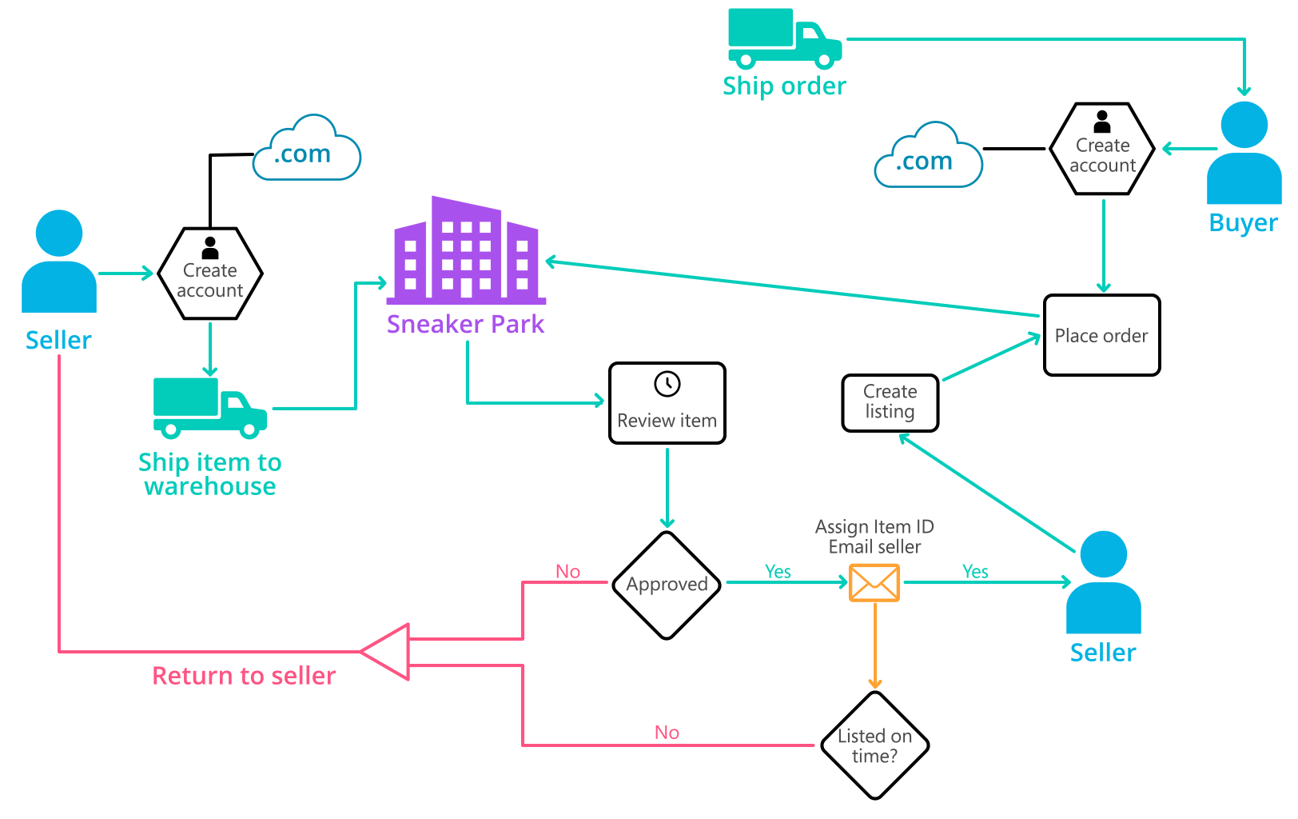
Background (cont’d)
Below you can see a diagram that will hopefully help you visualize some of SneakerPark's business processes. Keep in mind that it does not capture ALL processes and every nuance, but simply serves as another artifact to use in your project.

Slide 4
Step 1
Enterprise Data Catalog Part 1: Enterprise Data Model

Slide 5
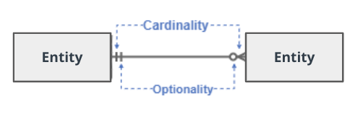
Create a conceptual data model that will provide SneakerPark with a holistic view of its data systems and help you grasp the organization's important entities and relationships, which will be instrumental as you move further in the project. You can use Lucidchart or any other diagramming tool of your choice, but please use the Crow’s Foot/IE Notation and please be sure to indicate both cardinality (the type of a relationship such as 1:N or N:N) and optionality (whether the relationship is optional or mandatory).

Slide 6
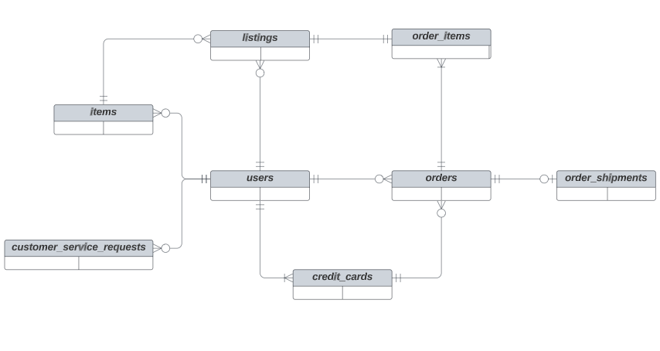
Replace the example below with your own solutions (obviously feel free to take more space):

Slide 7
Step 2
Enterprise Data Catalog Part 2: Metadata

Slide 8
Create the first version of the Metadata Catalog by documenting the metadata from all systems in the "Data Dictionary" and the “Enterprise Data Catalog” tabs of the provided Sheets template.
Please note that you are required to fill out all fields in both tabs.

Slide 9
Step 3
Data Quality
Part 1: Profiling and Cleansing

Slide 10
Profile the data to identify at least 3 data quality issues you see in the data. Also provide at least 1 data quality issue that you haven’t yet seen in the data, but can foresee occurring in the future. Based on the issues you’ve identified, come up with the data quality rule for each data quality issue, including for the one that you foresee.
Make sure you fill out all columns in the "Data Quality Issues" tab with your answers in the provided Sheets template.

Slide 11
Step 4
Data Quality
Part 2: Monitoring

Slide 12
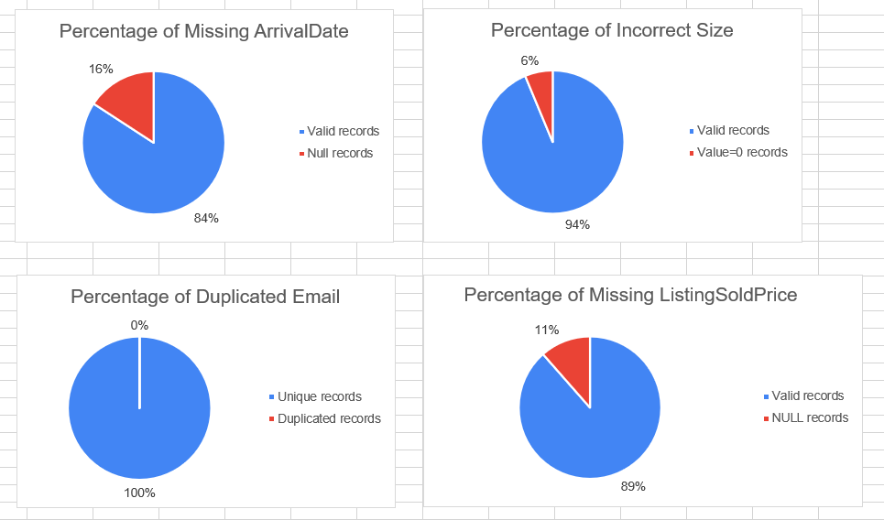
Using the metrics you've created in the last step, please create a mock-up of a data quality monitoring dashboard that will be used to monitor the data to ensure compliance with your data quality rules.
Please make sure to label your metrics clearly on your mock-up.

Slide 13
Step 5
Master Data Management
Part 1: MDM Architecture

Slide 14
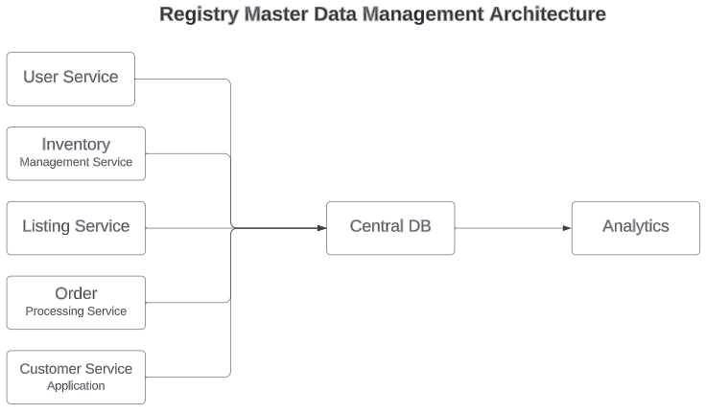
Based on what you’ve read about SneakerPark’s systems and business model, sketch out a proposed MDM implementation architecture, and write a detailed explanation of why you chose this specific approach.
Tip: Think about how your plan and its implementation might affect existing systems.

Slide 15
Explanation:
As mentioned in project overview, SneakerPark has its business grown rapidly in recent years. That led the company facing some issues caused by the inconsistency data between systems which resulted in mischarges, lost revenue, and frustrated customers.
According to the Technical details, SneakerPark has 5 source systems: User Service, Inventory Management Service, Listing Service, Order Processing Service, and Customer Service Application. The Inventory Management System and Customer Service Application are largely isolated from the other systems and from each other. But the nightly batch exports to exchange data between services and systems may cause discrepancies between systems. Those systems have the important business information, such as customer data, financial data, asset data.
In this case, SneakerPark that need a simple, low cost solution to gain better visibility and control over data systems, that causes less impact to existing system. Registry MDM architecture is simple to implement and has low cost. It also causes minimal intrusion to existing systems, as source systems are not disrupted to create master data, means that keeping the existing systems to stay uptime most of the time as expected.
While applying for the registry MDM, the master data would be created directly in the source system which is not complex for implementation, since only master data keys, attributes, names of the source system, and identifiers are necessary. Besides, the golden record is created in real-time in Registry MDM,
Moreover, Registry MDM is very first and basic MDM architecture to choose for most of the company. Later, the Registry MDM can be enhanced into Consolidated or Coexistence or Centralized MDM

Slide 16
Step 6
Master Data Management
Part 2: Master Record

Slide 17
Matching Rules for Items:
Rule 1: Table users had column UserID, and table items had column SellerID (SellerID is UserID in users table) ➔ Match the user’s info (FirstName, LastName, Email, Address, Zipcode) from the users table with items of users in items table using UserID of users table and SellerID of items table.
Rule 2: Table items had column ItemID, and table listings had column ProductID (ProductID is ItemID in items table) ➔ Match the item’s info (Style, Brand, Color, Size…) from listings table with ItemName in items table using ItemID in items table and ProductID from listings table.
Matching Rules for Customers:
Rule 1: Table users had column UserID, and table creditcards also had column UserID ➔ Match the credit card’s info (CreditCardNumber, CreditCardExpirationDate) in creditcards table with user’s info (FirstName, LastName, Email, Address, Zipcode) in users table using UserID from users table and UserID from creditcards.
Rule 2: Table users had column UserID, and table CustomerServiceRequests had column UserID ➔ Match the user’s Phone, OrderID from CustomerServiceRequests table with user’s info (FirstName, LastName, Email, Address, Zipcode) in users table using UserID from users table and UserID from CustomerServiceRequests table.

Slide 18
Step 7
Data Governance:
Roles and Responsibilities

Slide 19
Roles & Responsibilities:
1. Data Steward
The Data Steward should be responsible for Metadata Management System and Data Quality Management
Metadata Management System is to build, and maintain the Enterprise Data Model and Enterprise Data Catalog. The details would be to provide conceptual and logical data model of SneakerPark’s data, also to create the business glossaries, business rules, data dictionaries, data lineage. The purpose of this task is to capture the latest and precise data across systems.
Data Quality Management is to create data profiling, identify the data quality issues, define data quality metrics, decide data quality thresholds, and create dashboard to monitor the data quality.
The Data Steward also define the match rules, and is responsible for the golden records.
With the current employees, Jessica fit the Data Steward role as she can understand the business. But she is also the senior BA, if she already had specific tasks related to Business Analyst, then the company can hire new Data Steward. And, Jessica would be the one can train the new employee for business domain.

Slide 20
2. Data Engineer
The Data Engineer will be responsible for the build, maintain central database. Moreover, Data Engineer is also the one who build ETL pipeline or sync up technique between systems, make sure the data keep updated and consistent. Besides, Data Engineer will provide support Data Steward on Data Quality Management as well as Master Data Management, such as monitoring the dashboard, check latest data have been updated in central database or not..
Jake would be the one fit the Data Engineer tasks.
3. Data Architect
Data Architect is the one who design the database, data warehouse in central database. Defining master data, metadata and creating metrics to ensure data quality of the entire system are also the responsibilities of Data Architect.
SneakerPark now do not have any employees that fit this position. So the company need to hire the new one.

Slide 21
Standout Suggestions

Slide 22
Create a Business Glossary for SneakerPark and define common terms such as Item, Buyer, etc. Think and discuss how SneakerPark can improve on the consistency of the terms that its systems currently use. (You can use the “Business Glossary” tab of the same Sheets template you’ve been using for the other parts of this project to get you started.)
Document SneakerPark’s current naming conventions. Can you think of any improvements? (You can use the “Standard Naming Conventions” tab of the same Sheets template you’ve been using for the other parts of this project to get you started.) Some examples of Naming Conventions include;
Do not use spaces or special characters.
Use only LOWERCASE.
All identifier fields should end in “_id”.
Avoid acronyms and abbreviations.
Write SQL scripts for the matching rules that you’ve created in Step 6.

