Slide 1
Samiur rahman ID: 202410492 Department: Computer science and Engineering ASIAN UNIVERSITY OF BANGLADESH
Presentation

Slide 2
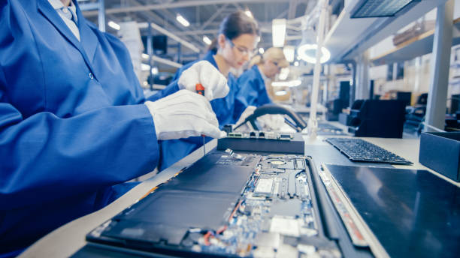
Name: Manufacturing Definition of Manufacturing: Manufacturing is the process of producing goods on a large scale using machinery, labor, tools, and technology. It involves transforming raw materials or components into finished products that can be sold to consumers, businesses, or other industries.

Slide 3
Manufacturing is the creation or production of goods with the help of equipment, labor, machines, tools, and chemical or biological processing or formulation.
Key Features of Manufacturing:
Production Process:
Involves steps like design, assembly, machining, and quality control.
Raw Material Conversion:
Utilizes raw materials (e.g., metal, wood, plastic) and transforms them into usable goods.
Machinery and Technology:
Employs tools, automated systems, and advanced robotics for efficiency.
Mass Production:
Produces large quantities of standardized products, although modern methods allow for customization.
Labor and Expertise:
Requires skilled and unskilled workers to operate machines, manage processes, and ensure quality.

Slide 4
Types of Manufacturing: Discrete Manufacturing Produces distinct items like cars, electronics, and furniture. Process Manufacturing Involves mixing, refining, or chemical processing (e.g., food, beverages, and pharmaceuticals). Additive Manufacturing Includes 3D printing, where layers of material build up a product. Lean Manufacturing Focuses on reducing waste and improving efficiency.
Example Products from Manufacturing:
Electronics: Smartphones, TVs.
Automobiles: Cars, trucks, bikes.
Clothing: Fabrics, garments.
Food & Beverage: Packaged snacks, bottled drinks.

