Slide 1


Developer Manifest: Best Practices for Code Management
Driving Quality, Collaboration, and Efficiency
by Munna Prasad

Slide 2
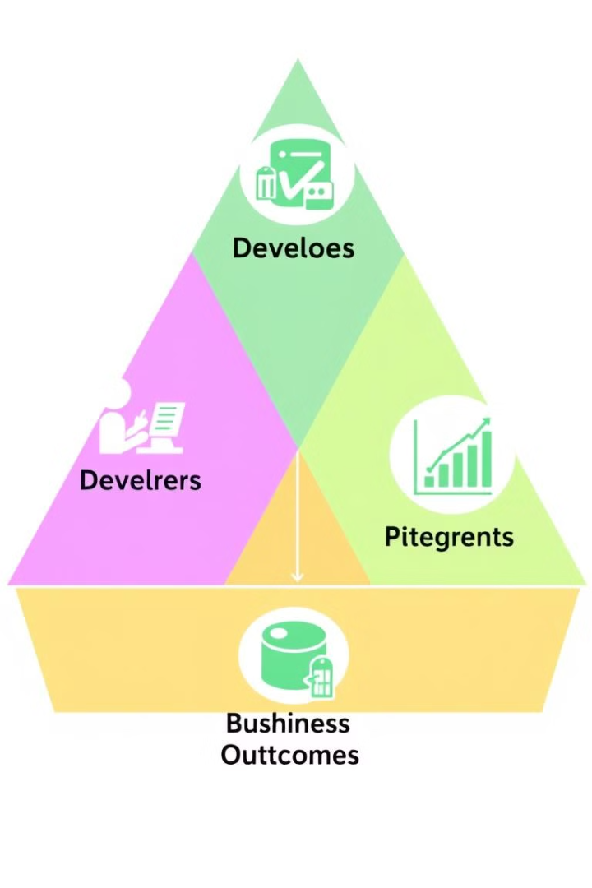
Why a Developer Manifest?
Consistency
Faster Development
Standardized practices
Improved business outcomes
Reduce Tech Debt
Ensure quality, collaboration

Slide 3





Key Principles of the Developer Manifest
Own the Code
Quality Control
Ease of Use
Manage repos effectively
Pass builds, SonarQube
Clear READMEs, simplify builds
Discipline
Keep branches tidy

Slide 4
Streamlined Workflows
Pull Request Process
CI/CD Pipeline
PR Created → Build Check → SonarQube Gate → Approve/Decline
Code Commit → Build → Test → Deploy

Slide 5
Keeping It Clean & Tidy
Clean Repos
Tidy Commits
No binaries, secrets, or large files. Keep repos small and manageable.
Tag commits to JIRAs. Write meaningful commit messages.

Slide 6
Benefits of the Developer Manifest
For Teams
For Business
Improved collaboration, code quality, faster development cycles.
Reduced technical debt, better alignment with business goals.

Slide 7

Conclusion
The Developer Manifest ensures consistency, quality, and efficiency.
Adopting these practices will drive better outcomes for teams and the business.
Quality is not an act, it is a habit. – Aristotle

