Slide 1
continuous Delivery
Git
Jenkins
Maven
Ansible

Slide 2
Jenkins
PPT : https://gitlab.com/kkc4al/DevOps-2017Jan/tree/master/Training_materials/jenkins
Plugins
Git SCM
Maven
Parameter plugins
Pipeline plugin
Promoted build plugin
Dependency graph plugin
Jobs – Free style projects
REST APIs
Demo

Slide 3
REST API
https://wiki.jenkins-ci.org/display/JENKINS/Remote+access+API
Sample
curl -X POST JENKINS_URL/job/<JOB_NAME>/build \ --data token=<TOKEN> \ --data-urlencode json='{"parameter": [{"name":"id", "value":"123"}, {"name":"verbosity", "value":"high"}]}’

Slide 4
Maven
Install Maven
Download maven : https://maven.apache.org/download.cgi
unzip apache-maven-<version>-bin.zip
Or untar -> tar xzvf apache-maven-<version>-bin.tar.gz
Update env vars
export PATH=/<maven dir>/apache-maven-3.3.9/bin:$PATH
Export M2_HOME=/<maven dir>/apache-maven-3.3.9/bin
Verify
mvn –version
.m2
Settings.xml

Slide 5
Pom.xml
Build file
Components
<groupId>com.mycompany.app</groupId>
<artifactId>my-app</artifactId>
<version>1.0.0-SNAPSHOT</version>
<packaging>jar</packaging>
Dependency management
<dependencyManagement> <dependencies> <dependency> <groupId>org.springframework</groupId> <artifactId>spring-core</artifactId> <version>${spring.version}</version> </dependency>
</dependencies>
<dependencyManagement>

Slide 6
<modules> <module>my-app-module1</module> <module>my-app-module2</module> </modules>
<scm> <connection>scm:git:git@gecgithub01.company.com:services/my-app.git</connection> <developerConnection>scm:git:git@gecgithub01.company.com:s ervices/my-app.git</developerConnection> <url>scm:git:git@gecgithub01.company.com:services/my-app.git</url> <tag>HEAD</tag> </scm>
<distributionManagement> <repository> <id>releases</id> <url>http://NEXUS_URL.com/nexus/content/repositories/releases</url> <uniqueVersion>true</uniqueVersion> </repository> <snapshotRepository> <id>snapshots</id> <url>http://NEXUS_URL.com/nexus/content/repositories/snapshots</url> <uniqueVersion>false</uniqueVersion> </snapshotRepository> </distributionManagement>

Slide 7
<dependencies> <dependency> <groupId>org.springframework</groupId> <artifactId>spring-core</artifactId> </dependency>
</dependencies>
Properties
<properties>
<spring.version>4.1.6.RELEASE</spring.version>
</properties>

Slide 8
Multi module
Parent pom
Dependency management
Non <dependencies>
Module/child pom
<parent> <groupId>com.mycompany.app</groupId> <artifactId>my-app</artifactId> <version>1.0.0-SNAPSHOT</version> </parent>
Module gav
<groupId>com.mycompany.app</groupId>
<artifactId>my-app-module1</artifactId>
<version>1.0.0-SNAPSHOT</version>
<packaging>jar</packaging>

Slide 9
<dependencies> <dependency> <groupId>org.springframework</groupId> <artifactId>spring-core</artifactId> </dependency>
</dependencies>
Version is fetched from parent pom.xml
Add distribution management

Slide 10
versioning
SNAPSHOT
Dev versions
Timestamp is appended with no version change
targets
Clean
Validate
Compile
Test
Package
Verify
Install
deploy

Slide 11
Release
release:clean
release:prepare
release:perform
Detailed steps:
http://maven.apache.org/maven-release/maven-release-plugin/

Slide 12
Continuous delivery
Promoting source code DEV to PROD
Continuous integration builds
Continuous deployments
Continuous testing
Continuous promotion
Demo

Slide 13
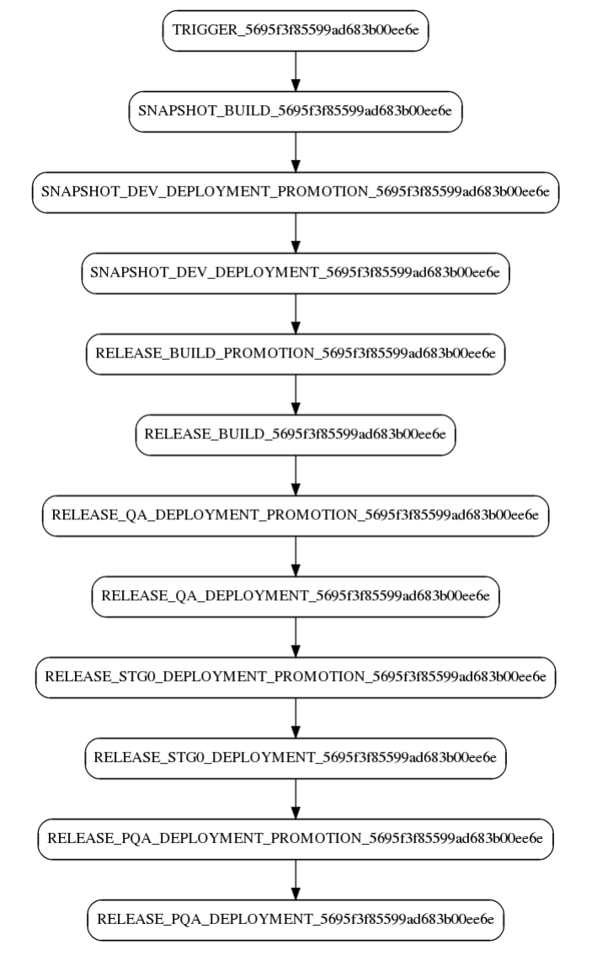

Slide 14
Exercise
Install jenkins, java, maven, nexus, ansible
Install jenkins plugins listed in slide 2
Create build job to build multi module projects:
https://github.com/idodevjobs/sample-multi-module-project
https://github.com/jamesward/maven-multi-module-example
Push artifacts to nexus
Create ansible play book to pull war from nexus and deploy to tomcat servers on a vm
Create 2nd job in jenkins and run ansible playbook from “Execute shell script”
Create third job to test
Add “Execute shell script” and add command “ wget http://<vm_url>:8080/index.jsp”
Create 4th job as a promotion job
Create 5th job a release job

