Slide 1
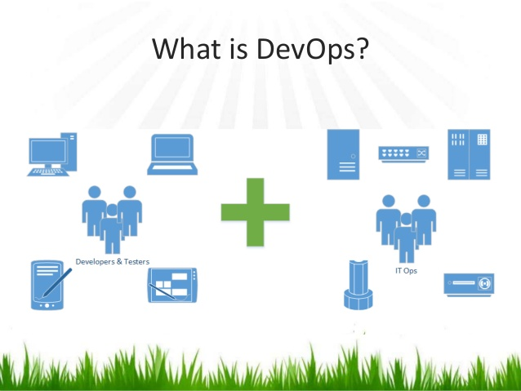

Slide 2

Introduction
Krishna Chaitanya Kurnala
Over 10 years of DevOps, Software Build, Release Engineering Experience
Passionate about SRE/ DevOps, CI/CD, Containers & Frameworks, Machine Learning etc
Passionate about Teaching and Evagelizing DevOps Tools and practices.
LinkedIn: https://www.linkedin.com/in/krishnachaitanyakurnala

Slide 3
What is DevOps?
DevOps (a combination of development and operations) is a software development method that stresses communication, collaboration and integration between software developers and information technology(IT) professionals thereby– Enable rapid evolution of products or services– Reduce risk, improve quality across portfolio, and reduce costs

Slide 4
Top 3 delivery challenges
• Release management– Better understanding of risks, dependencies, compliance issues
• Release/Deployment coordination– Better tracking of discrete activities, faster escalation of issues, documented process control and granular reporting
• Release/Deployment Automation– Usually have existing automation but want to flexibly manage and drive this automation that can be invoked by non-operations resources in specific non-production environments

Slide 5
Why Devops?
Agile Development– Addresses the gap between customer requirements and dev + testing teams– Cross-functional teams to design, develop, and test features/stories prioritized by the PO (Customer)– Focuses more on functional and non-functional readiness
• DevOps– Addresses the gap between dev + testing and Ops– Automated release management– Focuses on functional and non-functional plus operational and business readiness– Intensifies reusability and automation

Slide 6
More on DevOps …
DevOps integration targets product delivery, quality testing, feature development and maintenance releases in order to improve reliability and security and faster development and deployment cycles.
The adoption of DevOps is being driven by factors such as:
Use of agile and other development processes and methodologies
• Demand for an increased rate of production releases from application and business stakeholders
• Wide availability of virtualized and cloud infrastructure from internal and external providers
• Increased usage of data center automation and configuration management tools

Slide 7
DEV and OPS
Developers work with Ops to understand the impact of code changes
• Developers now work more closely with production-equivalent systems
• Developers focuses on metrics required by Ops team like PSR
• Ops now have more clarity on infrastructure needs
• More automation on deployment
• Closely monitors the Dev – Test – Prod pipeline for each deployment with immediate feedback
• Better collaboration and communication

Slide 8
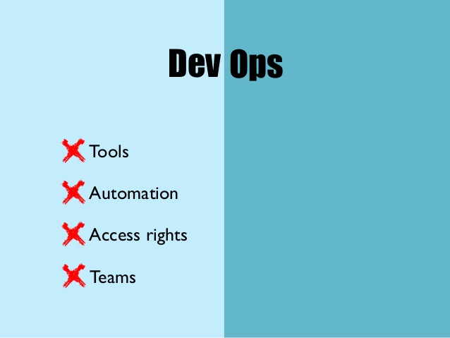
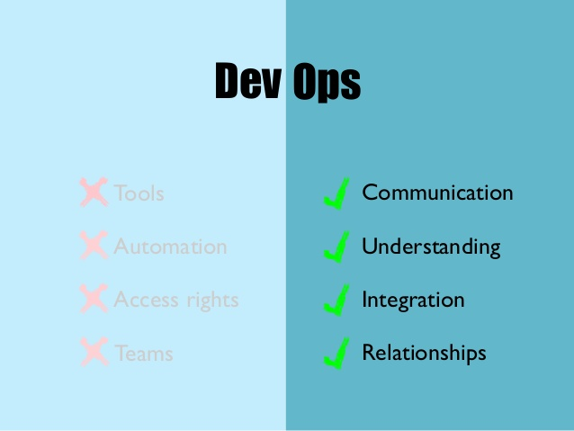

Slide 9
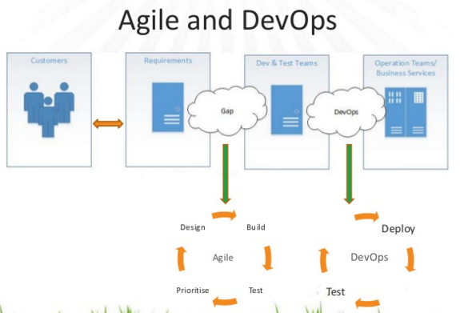

Slide 10
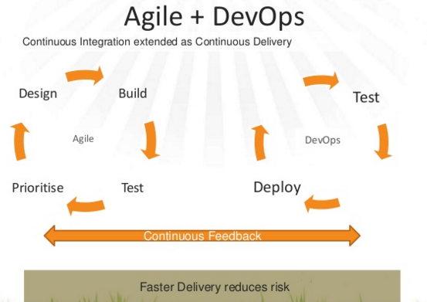

Slide 11
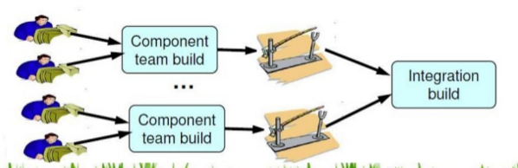
Continuous Integration
Integrate the code changes by each developer so that the main branch remains up-to-date

Slide 12
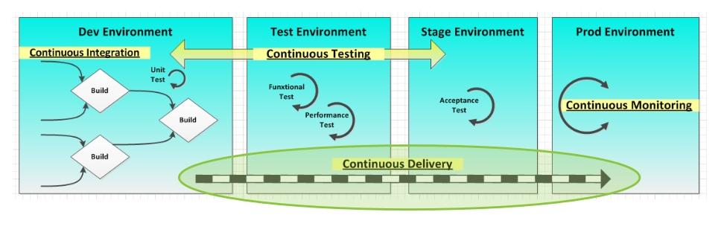
Continuous Delivery
Taking each CI build and run it through deployment procedures on production or production-equivalent environments.

Slide 13
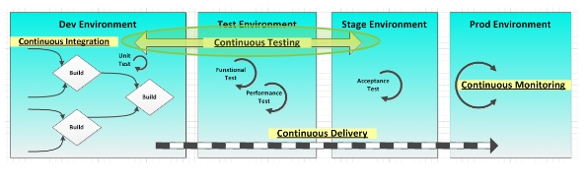
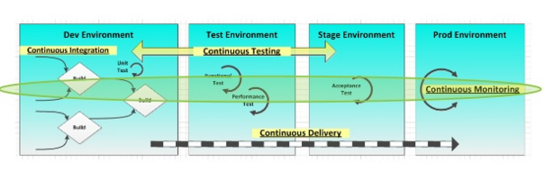
Continuous Testing and continuous Monitoring

Slide 14
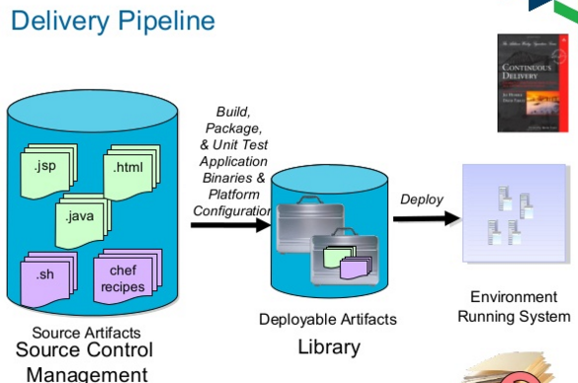

Slide 15
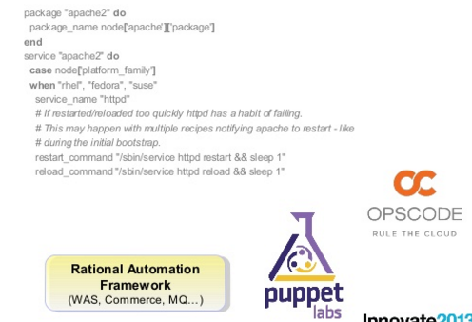
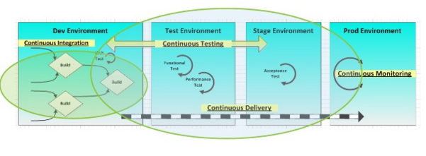
Infrastructure as code and build & delivery pipeline

Slide 16
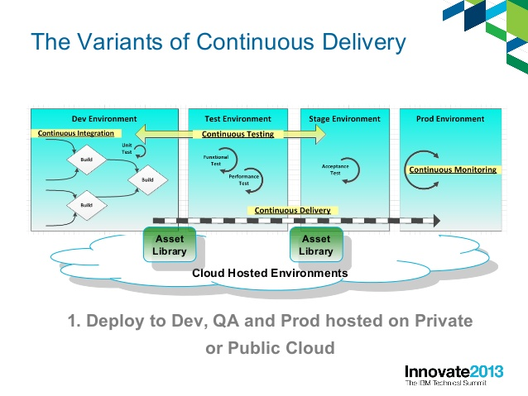

Slide 17
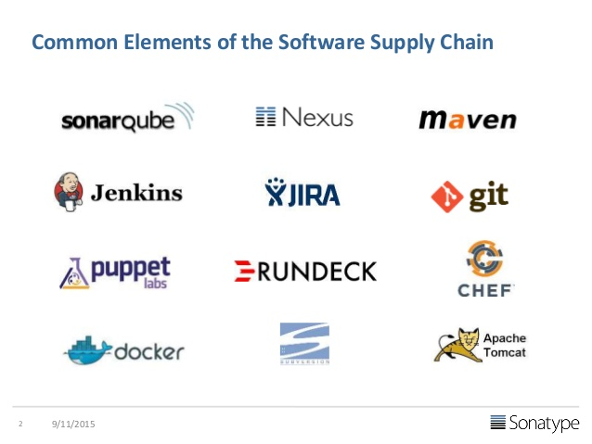

Slide 18
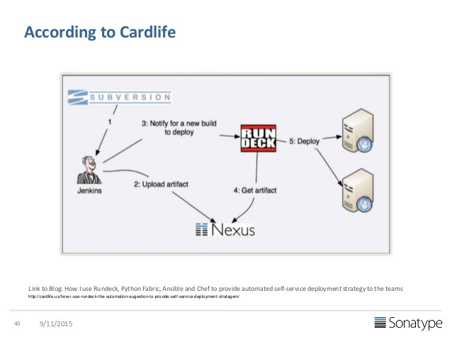
Reference Architectures

Slide 19
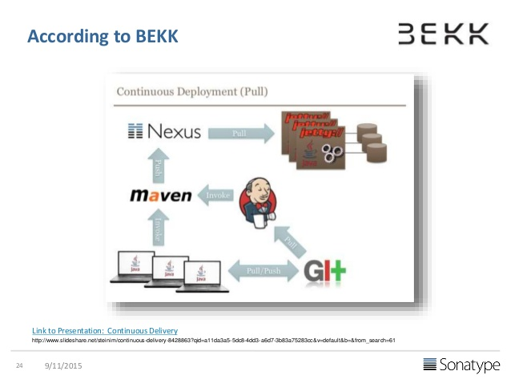

Slide 20
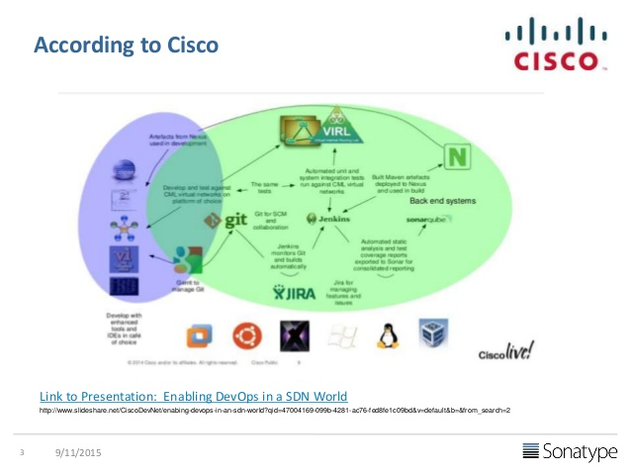

Slide 21
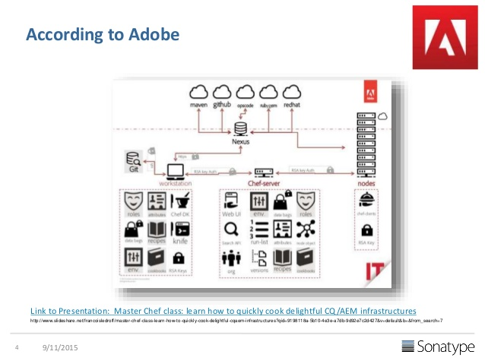

Slide 22
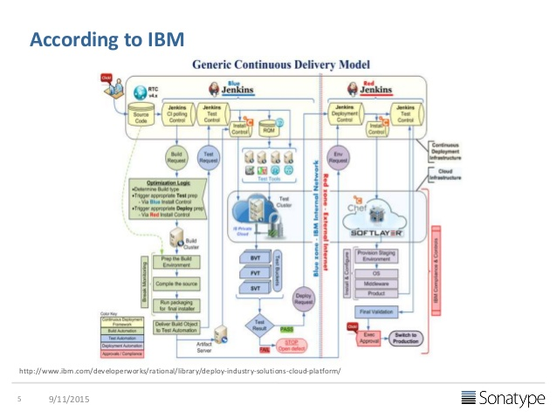

Slide 23
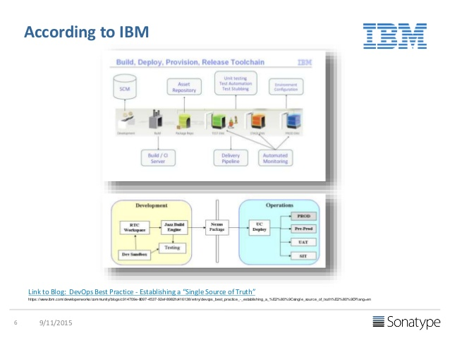

Slide 24
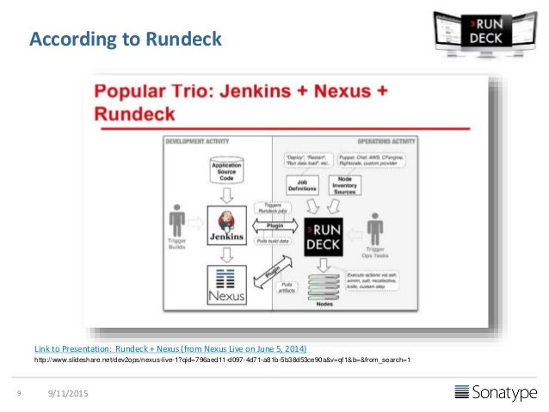

Slide 25
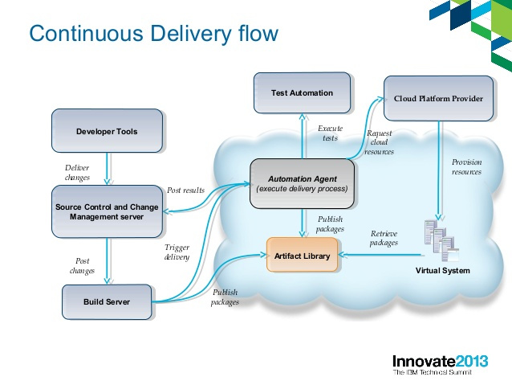

Slide 26
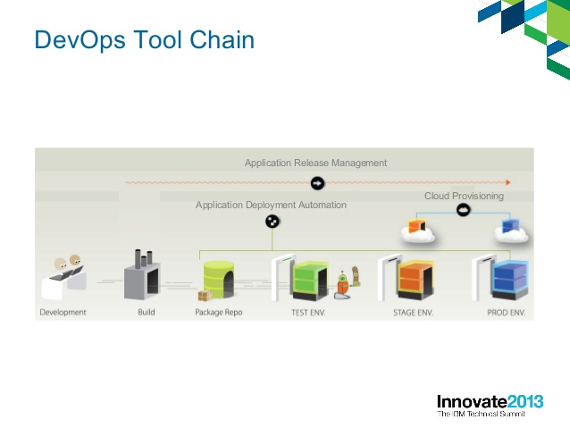

Slide 27
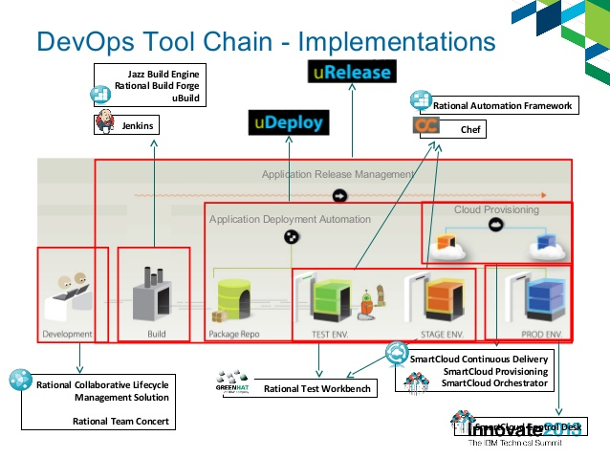

Slide 28
