Slide 1
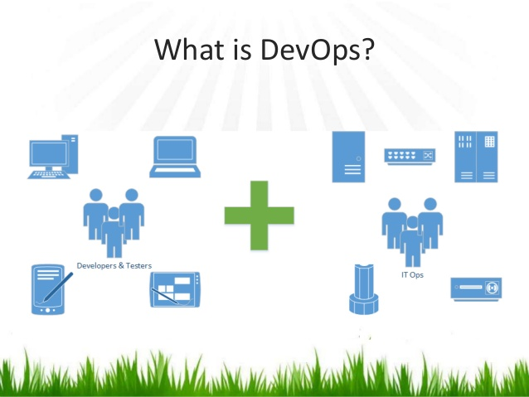

Slide 2

Introduction
Krishna Chaitanya Kurnala
Over 10 years of DevOps, Software Build, Release Engineering Experience
Officially certified in AWS as a Solutions Architect, Red Hat Systems Admin, Puppet Developer, Jenkins Engineer
Passionate about SRE/ DevOps, CI/CD, Containers & Frameworks, Machine Learning etc
Passionate about Teaching and Evagelizing DevOps Tools and practices.
My Tech Blog: https://devopshero.wordpress.com/
LinkedIn: https://www.linkedin.com/in/krishnachaitanyakurnala

Slide 3
What is DevOps?
DevOps (a combination of development and operations) is a software development method that stresses communication, collaboration and integration between software developers and information technology(IT) professionals thereby– Enable rapid evolution of products or services– Reduce risk, improve quality across portfolio, and reduce costs

Slide 4
Top 3 delivery challenges
• Release management– Better understanding of risks, dependencies, compliance issues
• Release/Deployment coordination– Better tracking of discrete activities, faster escalation of issues, documented process control and granular reporting
• Release/Deployment Automation– Usually have existing automation but want to flexibly manage and drive this automation that can be invoked by non-operations resources in specific non-production environments

Slide 5
Why Devops?
Agile Development– Addresses the gap between customer requirements and dev + testing teams– Cross-functional teams to design, develop, and test features/stories prioritized by the PO (Customer)– Focuses more on functional and non-functional readiness
• DevOps– Addresses the gap between dev + testing and Ops– Automated release management– Focuses on functional and non-functional plus operational and business readiness– Intensifies reusability and automation

Slide 6
More on DevOps …
DevOps integration targets product delivery, quality testing, feature development and maintenance releases in order to improve reliability and security and faster development and deployment cycles.
The adoption of DevOps is being driven by factors such as:
Use of agile and other development processes and methodologies
• Demand for an increased rate of production releases from application and business stakeholders
• Wide availability of virtualized and cloud infrastructure from internal and external providers
• Increased usage of data center automation and configuration management tools

Slide 7
DEV and OPS
Developers work with Ops to understand the impact of code changes
• Developers now work more closely with production-equivalent systems
• Developers focuses on metrics required by Ops team like PSR
• Ops now have more clarity on infrastructure needs
• More automation on deployment
• Closely monitors the Dev – Test – Prod pipeline for each deployment with immediate feedback
• Better collaboration and communication

Slide 8
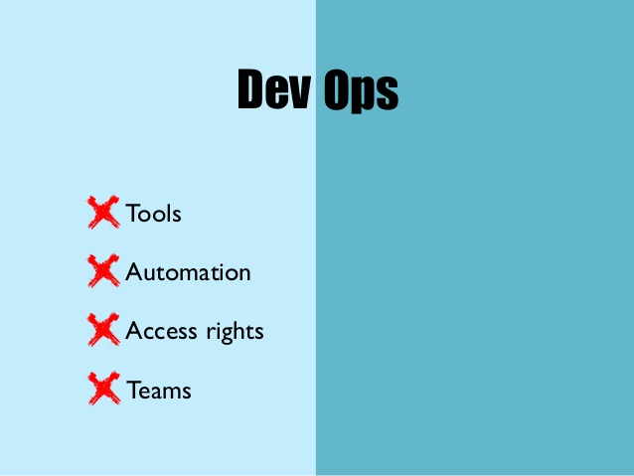
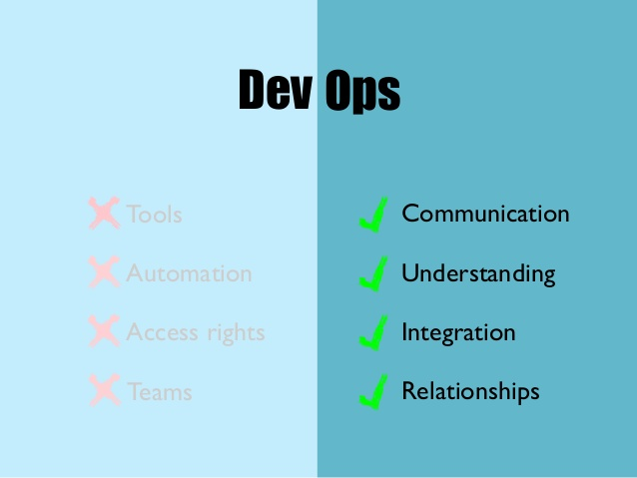

Slide 9
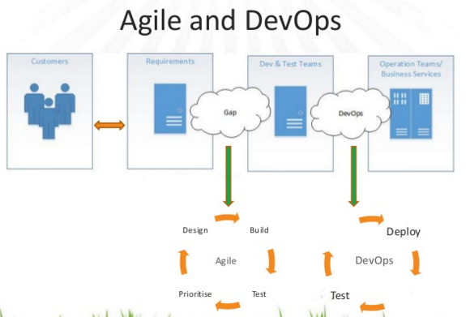

Slide 10
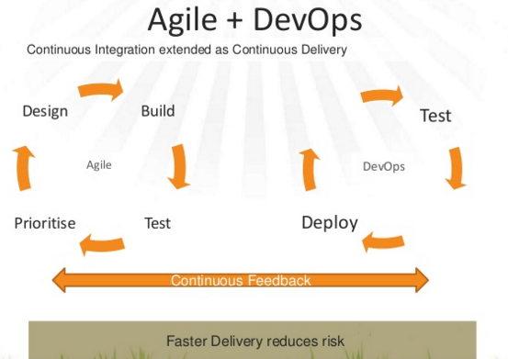

Slide 11
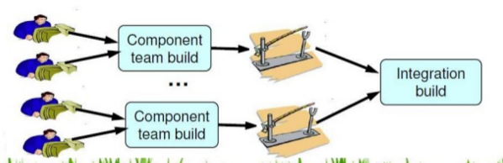
Continuous Integration
Integrate the code changes by each developer so that the main branch remains up-to-date

Slide 12
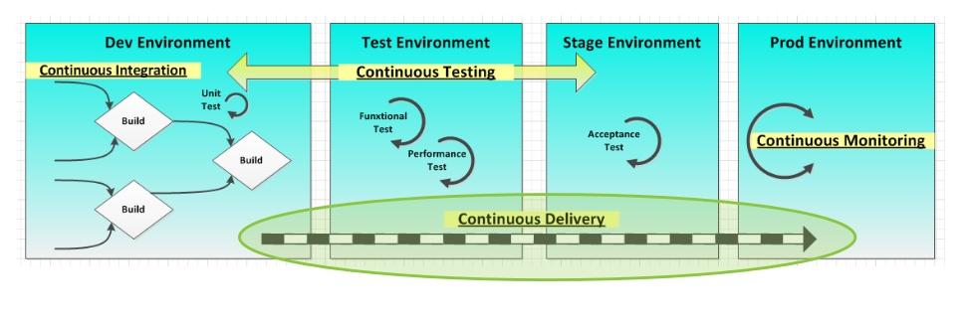
Continuous Delivery
Taking each CI build and run it through deployment procedures on production or production-equivalent environments.

Slide 13
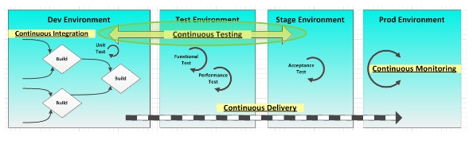
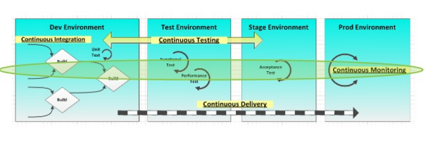
Continuous Testing and continuous Monitoring

Slide 14
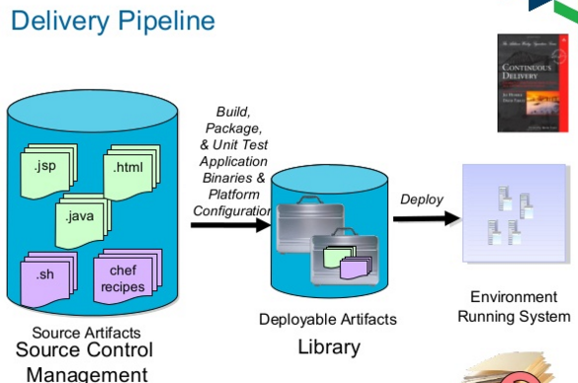

Slide 15
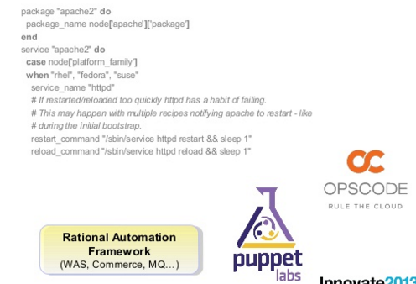
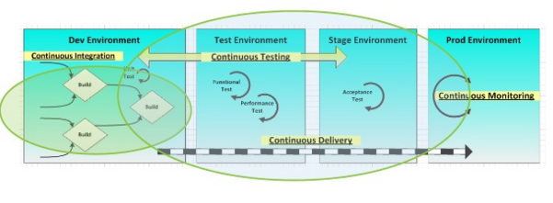
Infrastructure as code and build & delivery pipeline

Slide 16
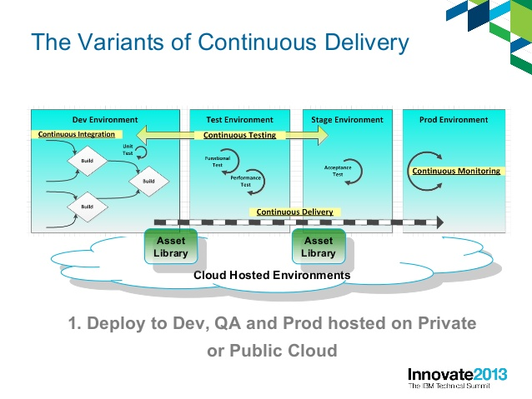

Slide 17
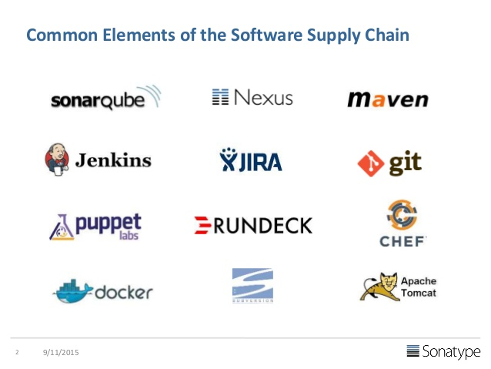

Slide 18
Key Technical Capabilities of DevOps
Version Control Systems – Git, GitHub, Artifactory, Nexus
Automation / Scripting – Python, Ruby, Bash, Linux Administrations etc
Build Tools – Maven, Ant
CI Tools – Jenkins, Team city, Bamboo
App/Web Servers – Deployment Automation
Infrastructure Provisioning and Management – Puppet,Chef, Ansible, Docker
Cloud - AWS
Daily Ops

Slide 19
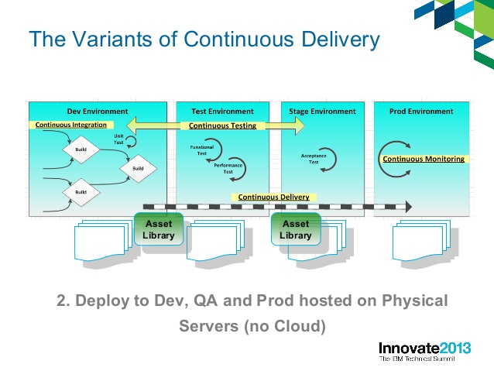

Slide 20
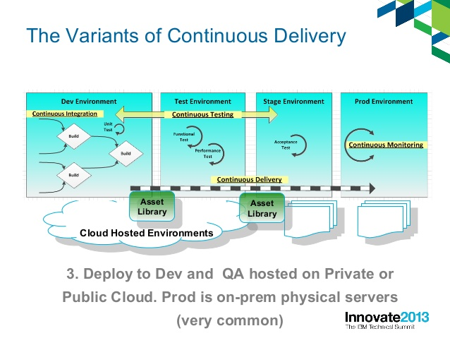

Slide 21
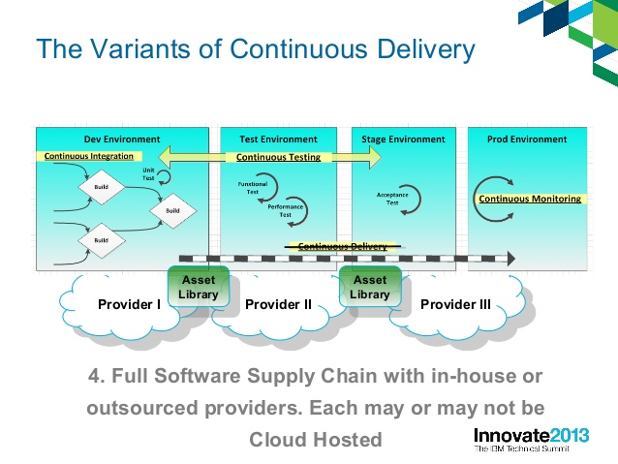

Slide 22
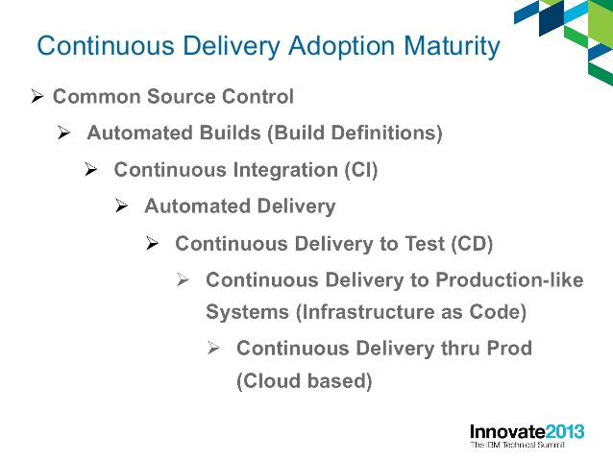

Slide 23
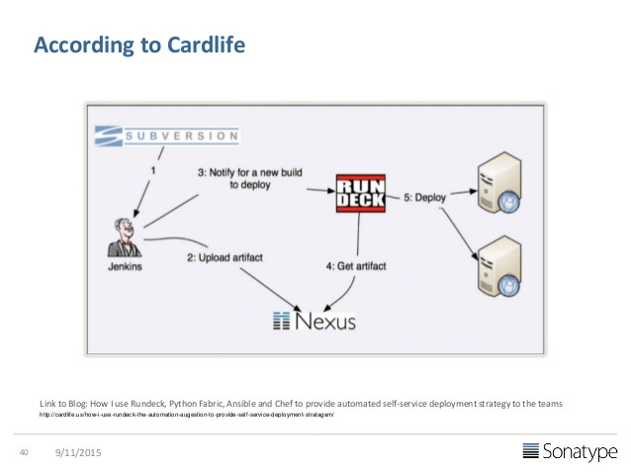
Reference Architectures

Slide 24
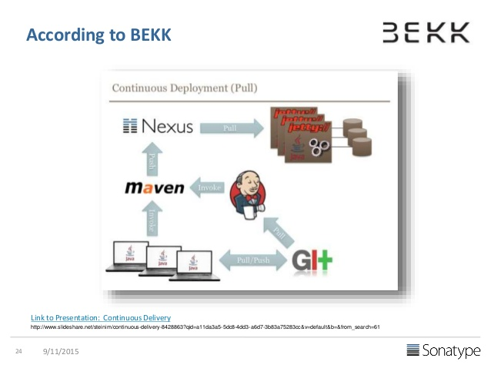

Slide 25
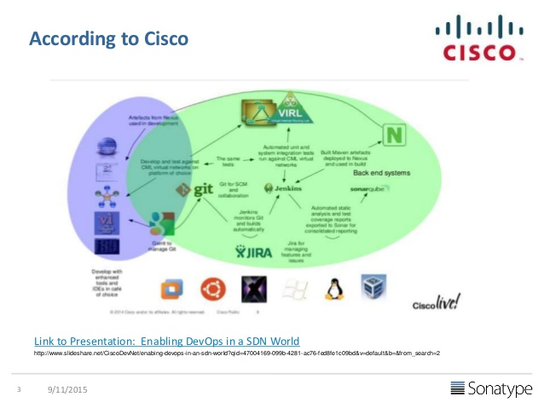

Slide 26
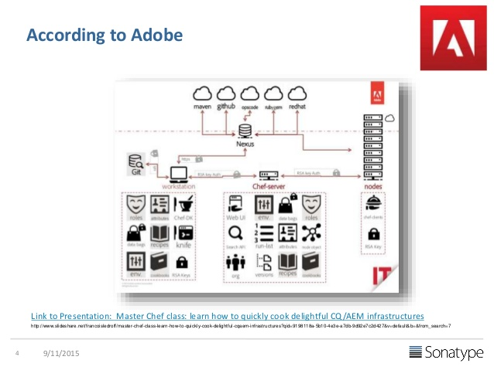

Slide 27
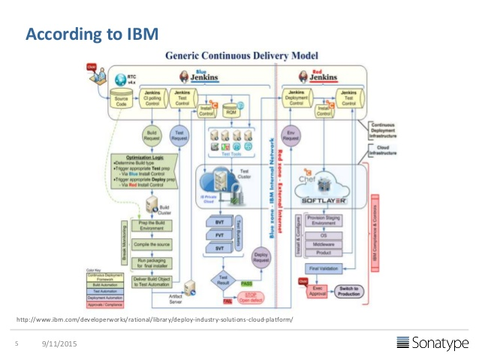

Slide 28
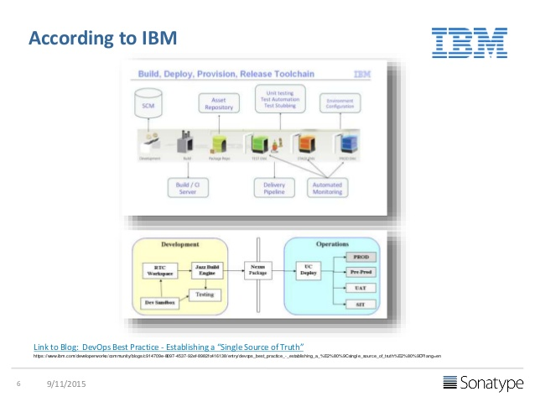

Slide 29
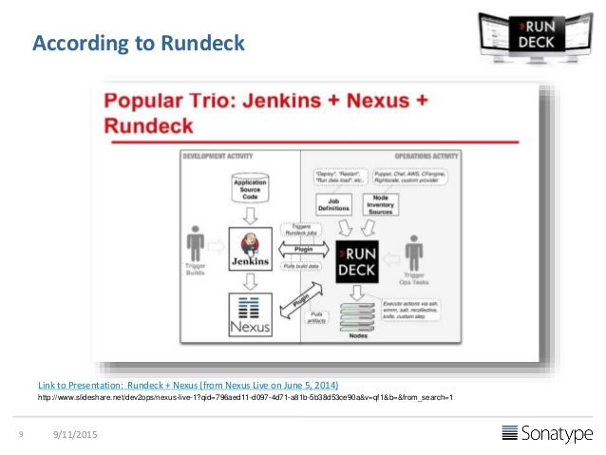

Slide 30
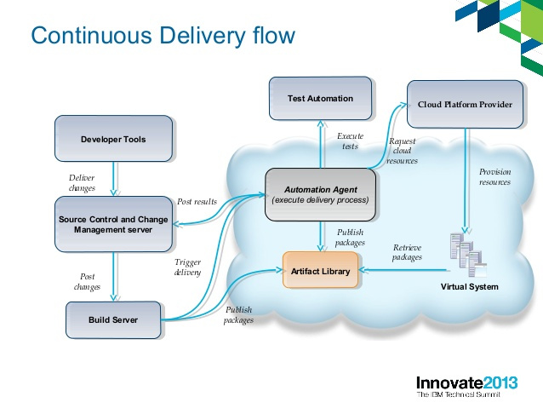

Slide 31
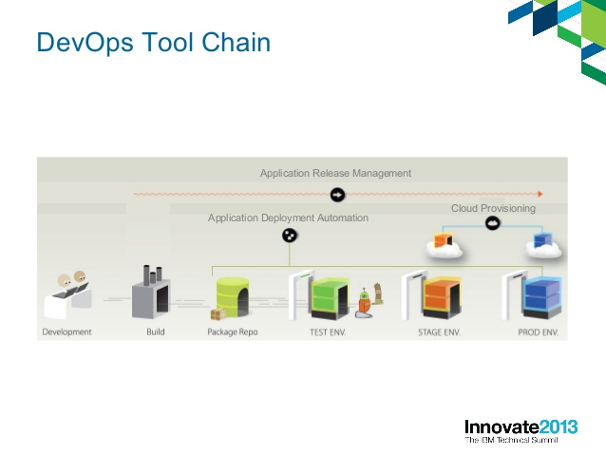

Slide 32
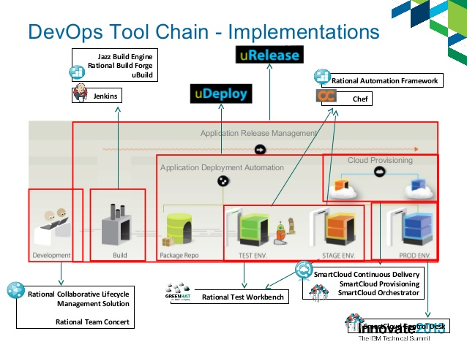

Slide 33
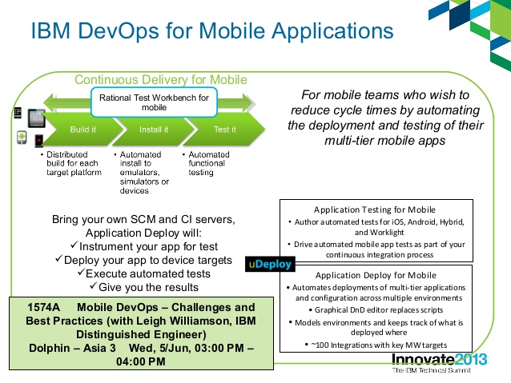

Slide 34
Course Plan
Demo / CI/ CD / DevOps Concepts
Agile/ Waterfall process / SDLC Concepts
Linux, Advanced Linux (Networking, Security and DNS Concepts, NFS etc)and Shell Scripting (BASH)
Python / Ruby scripting primers (Core scripting, Data Structures, REST Calls, Databases etc) Not Object Oriented or Web programming
Git (Hooks, Branching Strategies etc too)
Maven / Nexus
Jenkins ( CI/CD, Code Pipelines etc)
Docker & Demos of CoreOS, Kubernetes and Mesos
Puppet, Chef Demo and Concepts
Ansible Demo and Concepts
App/ Web servers – Tomcat, Nginx, Apache, Jboss – Deployment Automation
AWS – Overview of various services, Cloud as a service concepts, Arch patterns for HA, DR, multi region deployments etc, use of CLI and API’s

