Slide 1
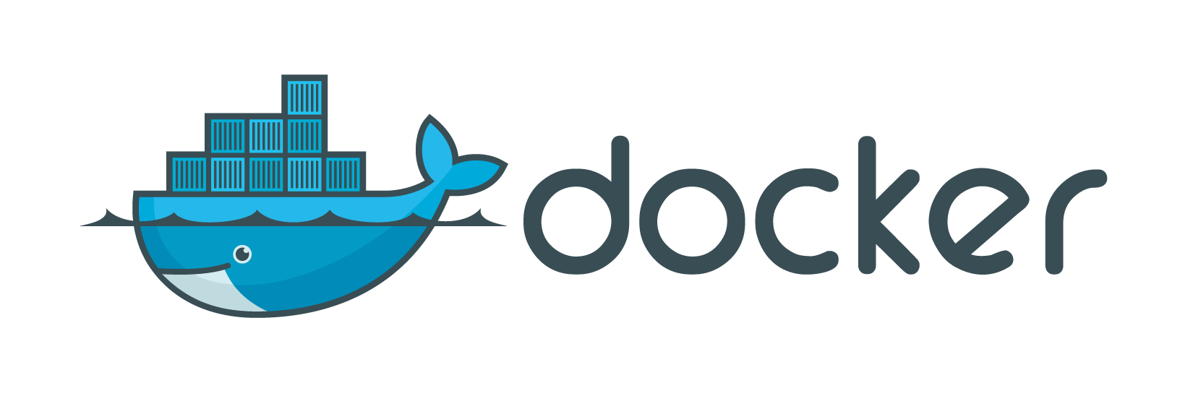
Docker Overview

Slide 2
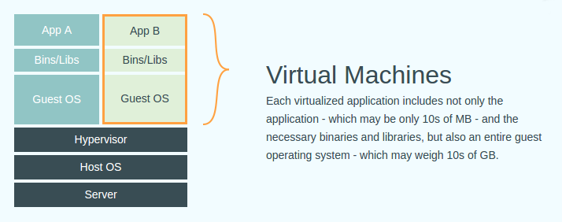
Hardware Virtualization
Virtualizing the Physical Hardware
VMware vSphere Hypervisor
Xen
KVM
VirtualBox

Slide 3
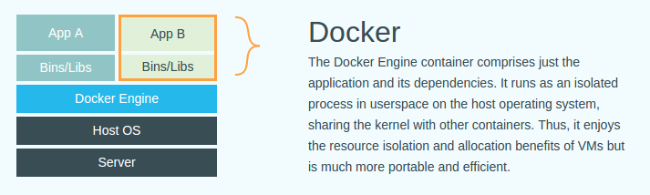
OS Virtualization
Virtualizing the Operating System
Containers have existed on *nix systems for some time
An extension of the 'chroot‘ concept
Examples:
Linux Containers
BSD “Jails”
Solaris Containers
“Understanding Docker”: https://docs.docker.com/introduction/understanding-docker/

Slide 4
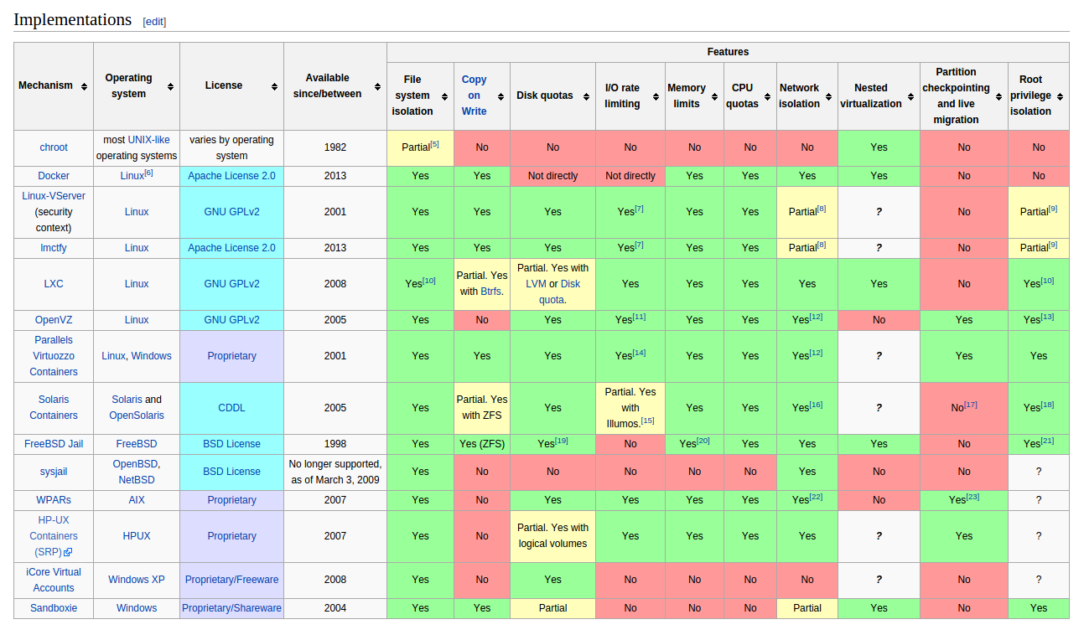
Container Implementations
From Wikipedia: Operating-system-level Virtualization

Slide 5
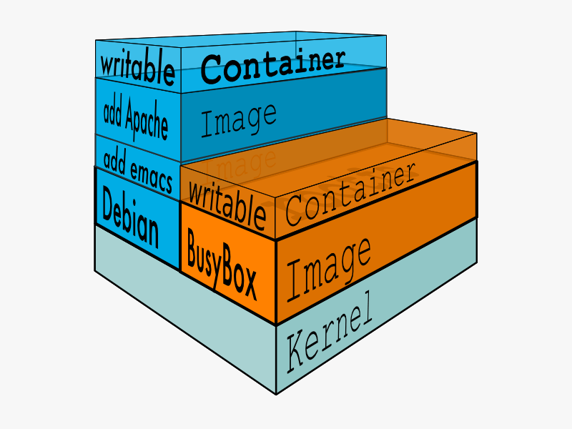
What is Docker?
Docker helps to create and manage containers easy
Docker creates an ecosystem similar to Github and Maven that makes it easy to share images
An image is a shareable snapshot of software
A container is a running instance of an image
Images can be built and managed on your local workstation
Images can be pulled and pushed from private and public repos
What is Docker? https://www.docker.com/whatisdocker/

Slide 6
Currently Linux-Centric
Linux already has container support
Container support is already in Linux
Uses Linux namespaces and control groups (cgroups)
So, what does Docker bring to the table?
makes it easy to build images
creates images that are portable
provides an ecosystem to help users share their images
Shared Registry
is open-source
has a very active community
provides security

Slide 7
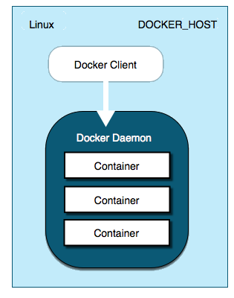
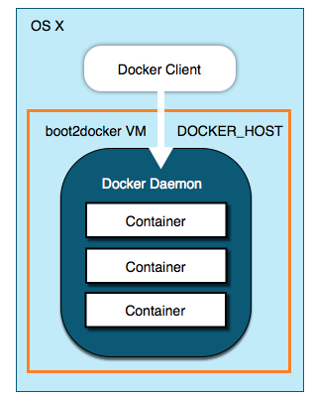
What About Mac OS?
Can run Docker under Mac OS!
Until native OS support is built – Use 'boot2docker'
Full instructions: https://docs.docker.com/installation/mac/
boot2docker runs a
lightweight VM that hosts
the Docker daemon
Docker daemon is
native under Linux

Slide 8
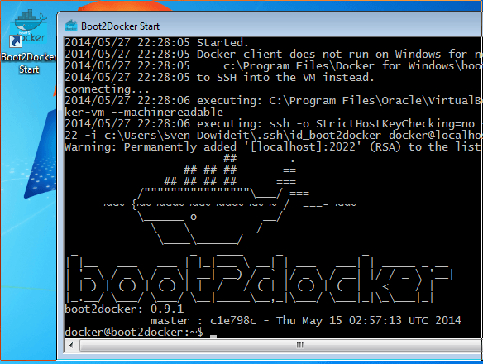
What About Windows?
Can run Docker under Windows
Until native OS support is built – Use 'boot2docker'
Uses the standard Windows installer
Startup screen looks like this:
See instructions at: https://docs.docker.com/installation/windows

Slide 9
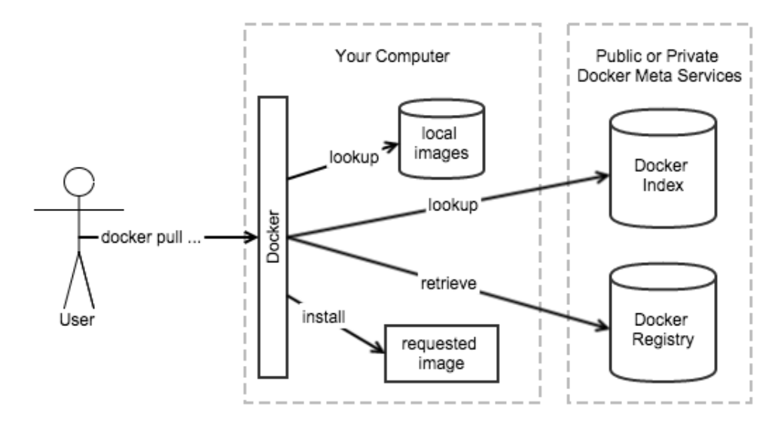
Docker Ecosystem
Docker provides a centralized repository of Images
http://registry.hub.docker.com
3rd Party private repos are available too
Or set up your own on-prem repos
Similar to Github & Maven
Diagrams from “Docker in Action”, Manning Publications

Slide 10
Demo

Slide 11
Demo: Install Docker
https://docs.docker.com/installation/ubuntulinux/
Use the “Docker-maintained Package Installation” section
For the latest version of Docker
Check for HTTPS transport for apt:
sudo apt-get update
sudo apt-get install apt-transport-https
Create a new apt sources file – docker.list
sudo vi /etc/apt/sources.d/docker.list
and add the following line:
deb https://get.docker.com/ubuntu docker main
Finish the incantation with an update and an install:
sudo apt-get update
sudo apt-get install lxc-docker
And you’re done!
For other distros: https://docs.docker.com/installation/

Slide 12
Demo: Find Images
For a web interface:
https://registry.hub.docker.com/
Or you can search for images using the CLI:
sudo docker search busybox
Stars indicate the popularity of the image
Official [OK] indicate if the image is built/maintained by Docker.com
peterc@L4377743:~$ sudo docker search busybox
[sudo] password for peterc:
NAME DESCRIPTION STARS OFFICIAL AUTOMATED
busybox Busybox base image. 135 [OK]
progrium/busybox 36 [OK]
jeanblanchard/busybox-java Minimal Docker image with Java 21 [OK]
jeanblanchard/busybox-tomcat Minimal Docker image with Apache Tomcat 10 [OK]
radial/busyboxplus Full-chain, Internet enabled, busybox made... 4 [OK]
sequenceiq/busybox 1 [OK]
peelsky/zulu-openjdk-busybox 1 [OK]
skomma/busybox-data Docker image suitable for data volume cont... 1 [OK]
alars/busybox-go-webapp 0 [OK]
…
justicefries/busybox-ssl Busybox, with SSL support 0 [OK]
…
shingonoide/archlinux-busybox Arch Linux, a lightweight and flexible Lin... 0 [OK]
openshift/busybox-http 0 [OK]
ggtools/busybox-ubuntu Busybox ubuntu version with extra goodies 0 [OK]
akolosov/busybox 0 [OK]
socketplane/busybox 0 [OK]
powellquiring/busybox 0 [OK]
openshift/busybox-http-app 0 [OK]
peterc@L4377743:~$

Slide 13
Demo: Trusted Images
“Official” Docker images
https://registry.hub.docker.com/search?q=library&searchfield=
or via CLI:
peterc@L4377743:~$ sudo docker search library
NAME DESCRIPTION STARS OFFICIAL AUTOMATED
ubuntu Official Ubuntu base image 1404 [OK]
centos The official build of CentOS. 865 [OK]
nginx Official build of Nginx. 646 [OK]
node Node.js is a JavaScript-based platform for... 559 [OK]
postgres The PostgreSQL object-relational database ... 554 [OK]
redis Redis is an open source key-value store th... 547 [OK]
mysql MySQL is a widely used, open-source relati... 507 [OK]
mongo MongoDB document databases provide high av... 478 [OK]
debian (Semi) Official Debian base image. 368 [OK]
jenkins Official Jenkins Docker image 284 [OK]
wordpress The WordPress rich content management syst... 234 [OK]
registry Containerized docker registry 204 [OK]
golang Go (golang) is a general purpose, higher-l... 166 [OK]
rails Rails is an open-source web application fr... 144 [OK]
fedora Official Fedora 21 base image and semi-off... 144 [OK]
busybox Busybox base image. 142 [OK]
python Python is an interpreted, interactive, obj... 138 [OK]
java Java is a concurrent, class-based, and obj... 137 [OK]
php While designed for web development, the PH... 136 [OK]
ruby Ruby is a dynamic, reflective, object-orie... 133 [OK]
tomcat Apache Tomcat is an open source implementa... 77 [OK]
perl Perl is a high-level, general-purpose, int... 29 [OK]
ubuntu-upstart Upstart is an event-based replacement for ... 21 [OK] peterc@L4377743:~$

Slide 14
Demo: Running an Image
First time you ‘run’ an image, you download the image
The image, once running, is called a ‘container’
peterc@L4377743:~$ sudo docker run -ti busybox:latest
/ # ls -alp /
total 56
drwxr-xr-x 24 root root 4096 Feb 27 19:32 ./
drwxr-xr-x 24 root root 4096 Feb 27 19:32 ../
-rwxr-xr-x 1 root root 0 Feb 27 19:32 .dockerenv
-rwxr-xr-x 1 root root 0 Feb 27 19:32 .dockerinit
drwxrwxr-x 2 root root 4096 May 22 2014 bin/
drwxr-xr-x 5 root root 380 Feb 27 19:32 dev/
drwxr-xr-x 6 root root 4096 Feb 27 19:32 etc/
drwxrwxr-x 4 root root 4096 May 22 2014 home/
drwxrwxr-x 2 root root 4096 May 22 2014 lib/
lrwxrwxrwx 1 root root 3 May 22 2014 lib64 -> lib/
lrwxrwxrwx 1 root root 11 May 22 2014 linuxrc -> bin/busybox
drwxrwxr-x 2 root root 4096 Feb 27 2014 media/
drwxrwxr-x 2 root root 4096 Feb 27 2014 mnt/
drwxrwxr-x 2 root root 4096 Feb 27 2014 opt/
dr-xr-xr-x 321 root root 0 Feb 27 19:32 proc/
drwx------ 2 root root 4096 Feb 27 19:32 root/
lrwxrwxrwx 1 root root 3 Feb 27 2014 run -> tmp/
drwxr-xr-x 2 root root 4096 May 22 2014 sbin/
dr-xr-xr-x 13 root root 0 Feb 27 19:32 sys/
drwxrwxrwt 3 root root 4096 May 22 2014 tmp/
drwxrwxr-x 6 root root 4096 May 22 2014 usr/
drwxrwxr-x 4 root root 4096 May 22 2014 var/
/ # exit
peterc@L4377743:~$ sudo docker ps -a
CONTAINER ID IMAGE COMMAND CREATED STATUS PORTS NAMES
3bc3868dd6aa busybox:latest "/bin/sh" 15 minutes ago Exited (0) 8 seconds ago cocky_wilson
peterc@L4377743:~$

Slide 15
Demo: Help
At this point, you’re wondering: “How do I remember all this?”
peterc@L4377743:~$ docker help
…
…
Commands:
attach Attach to a running container
build Build an image from a Dockerfile
commit Create a new image from a container's changes
cp Copy files/folders from a container's filesystem to the host path
create Create a new container
diff Inspect changes on a container's filesystem
events Get real time events from the server
exec Run a command in a running container
export Stream the contents of a container as a tar archive
history Show the history of an image
images List images
import Create a new filesystem image from the contents of a tarball
info Display system-wide information
inspect Return low-level information on a container or image
kill Kill a running container
load Load an image from a tar archive
login Register or log in to a Docker registry server
logout Log out from a Docker registry server
logs Fetch the logs of a container
port Lookup the public-facing port that is NAT-ed to PRIVATE_PORT
pause Pause all processes within a container
ps List containers
pull Pull an image or a repository from a Docker registry server
push Push an image or a repository to a Docker registry server
rename Rename an existing container
restart Restart a running container
rm Remove one or more containers
rmi Remove one or more images
run Run a command in a new container
…

Slide 16
Demo: Help
And you can get extensive help on each command:
peterc@L4377743:~$ docker help run
Usage: docker run [OPTIONS] IMAGE [COMMAND] [ARG...]
Run a command in a new container
-a, --attach=[] Attach to STDIN, STDOUT or STDERR.
--add-host=[] Add a custom host-to-IP mapping (host:ip)
-c, --cpu-shares=0 CPU shares (relative weight)
--cap-add=[] Add Linux capabilities
--cap-drop=[] Drop Linux capabilities
--cidfile="" Write the container ID to the file
--cpuset="" CPUs in which to allow execution (0-3, 0,1)
-d, --detach=false Detached mode: run the container in the background and print the new container ID
--device=[] Add a host device to the container (e.g. --device=/dev/sdc:/dev/xvdc:rwm)
--dns=[] Set custom DNS servers
--dns-search=[] Set custom DNS search domains (Use --dns-search=. if you don't wish to set the search domain)
-e, --env=[] Set environment variables
--entrypoint="" Overwrite the default ENTRYPOINT of the image
--env-file=[] Read in a line delimited file of environment variables
--expose=[] Expose a port or a range of ports (e.g. --expose=3300-3310) from the container without publishing it to your host
-h, --hostname="" Container host name
…
All the command details are available in the Docker website docs:
https://docs.docker.com/reference/commandline/cli/

Slide 17
Demo: node.js + redis app
Let’s spin up a node.js & redis app:
Arbitrarily picked nodejs-todo app off github for this demo
It uses these modules: ejs, express, underscore, and of course, redis
Start a redis instance
peterc@L4377743:~$ sudo docker run –d --name redis redis:latest
fb173fb5194afa5fbeaa24d2acf1b6f9dd8e72cfefa6088ff3b3e4e9b3059c66
peterc@L4377743:~$
Check for the running container
peterc@L4377743:~$ sudo docker ps -a
[sudo] password for peterc:
CONTAINER ID IMAGE COMMAND CREATED STATUS PORTS NAMES
fb173fb5194a redis:latest "redis-server /etc/r About an hour ago Up About an hour 6379/tcp redis
3bc3868dd6aa busybox:latest "/bin/sh" 4 hours ago Exited (0) 4 hours ago cocky_wilson
peterc@L4377743:~$
We did not specify a port on the ‘run’ command
Default port for redis is 6379
All networking access is explicit; it has to be specified on ‘run’ if it’s required
Try ‘netstat’ or ‘telnet’… No 6379 port listening.
Run in detached mode
Give it a name so it’s easy to link
No port specified. Never needs to communicate outside containers

Slide 18
Demo: node.js + redis app
The redis container is now up and running
Let’s get a sample node.js app to run and use the redis database
Get nodejs-todo
peterc@L4377743:~/tmp$ git clone https://github.com/amirrajan/nodejs-todo.git
Cloning into 'nodejs-todo'...
remote: Counting objects: 32, done.
remote: Total 32 (delta 0), reused 0 (delta 0), pack-reused 32
Unpacking objects: 100% (32/32), done.
Checking connectivity... done.
peterc@L4377743:~/tmp$
Examine source. Make a one-line modification
peterc@L4377743:~/tmp/nodejs-todo$ vi server.js
peterc@L4377743:~/tmp/nodejs-todo$ git diff server.js
diff --git a/server.js b/server.js
index 20263cd..59323fe 100644
--- a/server.js
+++ b/server.js
@@ -11,7 +11,7 @@ var client = null;
if(process.env.REDISTOGO_URL) { //heroku
client = require('redis-url').connect(process.env.REDISTOGO_URL);
} else if(config.env == "development") {
- client = redis.createClient();
+ client = redis.createClient(secret.redisPort, secret.redisMachine);
} else { //nodejitsu
client = redis.createClient(secret.redisPort, secret.redisMachine);
client.auth(secret.redisAuth, function (err) {
peterc@L4377743:~/tmp/nodejs-todo$

Slide 19
Demo: node.js + redis app
There are a couple of code changes needed so that the app runs under Docker
First, the nodejs-todo needs one dependency update…
Modify package.json
(Lock in express version 3.0.1, since newer versions require code changes)
peterc@L4377743:~/tmp/nodejs-todo$ git diff package.json
diff --git a/package.json b/package.json
index 39bd9de..052ecff 100644
--- a/package.json
+++ b/package.json
@@ -11,7 +11,7 @@
"url": "git://github.com/amirrajan/nodejs-todo.git"
},
"dependencies": {
- "express": "~3.0.1",
+ "express": "3.0.1",
"ejs": "~0.8.3",
"jasmine-node": "~1.0.26",
"underscore": "~1.4.2",
peterc@L4377743:~/tmp/nodejs-todo$

Slide 20
Demo: node.js + redis app
When we start the node container, it will need to connect with redis
There are many ways to do this
Let’s use the Docker CLI to get the redis IP address
Get redis container’s IP address
peterc@L4377743:~/tmp/nodejs-todo$ export DOCKER_IP=`sudo docker inspect --format='{{.NetworkSettings.IPAddress}}' \
> fb173fb5194a`
peterc@L4377743:~/tmp/nodejs-todo$ echo $DOCKER_IP
172.17.0.2
peterc@L4377743:~/tmp/nodejs-todo$
Set up nodejs-todo’s configuration file
peterc@L4377743:~/tmp/nodejs-todo$ sed -e "s/\"redisMachine\": \"\",/\"redisMachine\": \"$DOCKER_IP\",/" \
> lib/secret.js.example > lib/secret.js
peterc@L4377743:~/tmp/nodejs-todo$ cat lib/secret.js
module.exports = {
"redisPort": 6379,
"redisMachine": "172.17.0.2",
"redisAuth": "",
};
peterc@L4377743:~/tmp/nodejs-todo$
Now the nodejs-todo app is ready to go
(Note that all of this is easily scriptable.)

Slide 21
Demo: node.js + redis app
Now let’s fire up the node.js container
We’ll bring it up as a terminal session, so you can see its internals
That will also allow us to install the ‘required’ modules
Since the generic node.js container doesn’t know anything about the nodejs-todo app
We’ll inject that app into the container when we start it
Start node.js container
peterc@L4377743:~/tmp/nodejs-todo$ sudo docker run -ti -p 3000:3000 -v ~/tmp/nodejs-todo:/opt/nodejs-todo \
> --link redis:redis library/nodejs:0.10.36 /bin/bash
bash: -e: command not found
[ root@4b47ff312f4a:/data ]$ cd /opt/nodejs-todo
[ root@4b47ff312f4a:/opt/nodejs-todo {master *} ]$ cat lib/secret.js
module.exports = {
"redisPort": 6379,
"redisMachine": "172.17.0.2",
"redisAuth": "",
};
The --link option links this node container to the already running redis container.
Does the secret.js file look familiar?
We’re now accessing it inside the container.
Interactive terminal session
Expose port 3000 (as 3000)
Place node app under /opt folder

Slide 22
Demo: node.js + redis app
Starting the node.js container, continued…
The node.js container is now running
But before we start the node server, nodejs-todo requires 4 modules
Installing the app’s node dependencies in the container
root@595627a55592:/# cd /opt/nodejs-todo/
root@595627a55592:/opt/nodejs-todo# npm install
underscore@1.4.4 node_modules/underscore
ejs@0.8.8 node_modules/ejs
redis@0.8.6 node_modules/redis
jasmine-node@1.0.28 node_modules/jasmine-node
├── walkdir@0.0.7
├── coffee-script@1.9.1
├── requirejs@2.1.16
└── jasmine-reporters@2.0.5 (mkdirp@0.3.5)
express@3.0.1 node_modules/express
├── methods@0.0.1
├── fresh@0.1.0
├── cookie-signature@0.0.1
├── range-parser@0.0.4
├── cookie@0.0.4
├── crc@0.2.0
├── commander@0.6.1
├── mkdirp@0.3.3
├── debug@2.1.2 (ms@0.7.0)
├── send@0.1.0 (mime@1.2.6)
└── connect@2.6.2 (pause@0.0.1, bytes@0.1.0, formidable@1.0.11, qs@0.5.1)
root@595627a55592:/opt/nodejs-todo#
Start the server
[ root@4b47ff312f4a:/opt/nodejs-todo {master *} ]$ node server.js

Slide 23
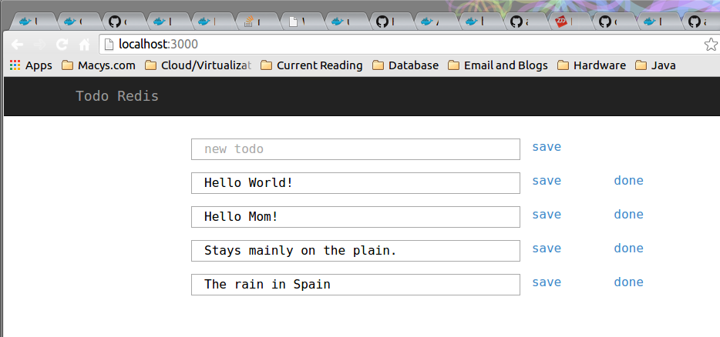
Demo: node.js + redis app
The node.js container is now running the nodejs-todo app
We can now run the app in a browser
Start browser on localhost:3000
Play around. Stop the node container. Restart it. The redis data is still there!

Slide 24
New Docker Features
in Development

Slide 25
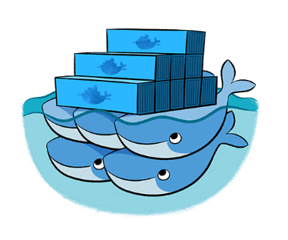
Docker Swarm
Run many containers as a cluster
Turns pool of Docker hosts into a single, virtual host
Swarm uses the existing Docker API
Pluggable backends
Allows swapping with more powerful backends
For example: Mesos
TLS support for all server communications
CLI to Swarm
Swarm to Docker nodes
https://github.com/docker/swarm/

Slide 26
Docker Machine
Makes Docker host creation much easier
Works on:
Local laptop
On cloud providers
In customer datacenters
Single command:
Creates servers
Installs Docker on them
Configures Docker client to communicate with them
In beta
https://github.com/docker/machine

Slide 27
Docker Collaborations
These are just some of the integrations:
Google Compute Engine & Kubernetes
IBM Containers
Fedora Container & Docker Support
Openstack & Docker
Rackspace & Docker
Red Hat (Project Atomic)
VMware & Pivotal
Microsoft Azure

Slide 28
Other Vendors
In the Container Space

Slide 29
Container Vendors 1
Vagrant | Linux, Mac & Windows | Manages virtual dev environments by wrapping virtualization & configuration.
LXD Ubuntu | Linux | Provides a container-based hypervisor for creating and managing container clusters.
Project Atomic Red Hat | Linux | A direct competitor to Docker, focusing initially on the Red Hat distros. Additionally supporting large-scale cluster support.
EC2 Container Service Amazon | Linux | Docker container support in an AWS EC2 context.
Flockport Startup | Linux | Very small, recent startup in direct competitiion with Docker.

Slide 30
Container Vendors 2
Kubernetes Google | Linux | Provides large-scale cluster management for Docker Containers.
Shipyard Startup | Linux | Provides a management console for Docker Containers.
Tutum Startup | Linux | Provides cloud-based support for setup and management of dev environments to many different cloud providers.
Rocket CoreOS | CoreOS | Provides container support for CoreOS which is a fork of ChromeOS. VERY immature product.
Spoon Xenocode | Windows | Provides container-like support for Windows. Meanwhile, Microsoft may build in LXC-type support into Windows...
Docker Swarm | Linux | Provides large-scale cluster management for Docker Containers. In beta.

Slide 31
Vagrant
What is it?
Vagrant is computer software for creating and configuring virtual development environments. It can be seen as a wrapper around virtualization software such as VirtualBox, KVM, VMware and around configuration management software such as Ansible, Chef, Salt or Puppet.
Wikipedia.org
Since?
2012. Current Release: 1.6.5 (9/4/2014)
Open Source?
Yes. MIT License
On Github: https://github.com/mitchellh/vagrant
Runs on?
Windows, MacOS & Linux
Cloud & Virtualization Ready?
VirtualBox, VMware, AWS, OpenStack.
Compatible with Docker.
Requirements?
Ruby 2.0 and LXC or libvert
Resources?
Website: https://www.vagrantup.com
Repository: https://atlas.hashicorp.com/boxes/search

Slide 32
LXD: “The Linux Container Daemon”
What is it?
LXD, pronounced Lex-Dee, is a container-based hypervisor sponsored by Canonical, the company that supports Ubuntu Linux. It provides a way to manage containers, via a REST API and a CLI.
Tycho Anderson (Canonical) at Linux.conf.au 2015 Auckland, New Zealand
Since?
Announced at Paris OpenStack Summit 2014 (November)
0.1 release January 2015, container management only
Open Source?
Yes. Apache 2.0 License.
On Github: https://github.com/lxc/lxd
Runs?
Linux distros under Ubuntu. No Windows. No Mac.
Cloud & Virtualization Ready?
OpenStack. Compatible with Docker.
Requirements?
Golang 3.0+ and LXC
Resources?
Website: http://www.ubuntu.com/cloud/tools/lxd

Slide 33
Project Atomic
What is it?
Platform for rolling out Docker-based containizered apps. Supports atomic upgrades and rollbacks. Web-based Cockpit provides storage, services and logging control, plus ability to browse and inspect images and containers. Integrates with Kubernetes.
Project Atomic Website
Since?
Announced last year at Red Hat Summit
Included in Fedora 21 (12/9/2014)
Open Source?
Yes. GPL 2 License.
On Github: https://github.com/projectatomic/atomic-site/
Runs?
Fedora (now) and Centos & RHEL (later).
Cloud & Virtualization Ready?
Compatible with Docker.
Requirements?
Virtual Machine Manager (virt-manager) for Linux
VirtualBox for Windows & Mac OS X
Resources?
Website: http://www.projectatomic.io/

Slide 34
Amazon EC2 Container Service
What is it?
Amazon EC2 Container Service is a highly scalable, high performance container management service that supports Docker containers and allows you to easily run distributed applications on a managed cluster of Amazon EC2 instances.
Amazon EC2 Container Service website
Since?
Currently in Preview mode
Open Source?
No.
Runs?
EC2 Instances
Cloud & Virtualization Ready?
Compatible with Docker.
Requirements?
Amazon EC2 Instances
Resources?
Website: http://aws.amazon.com/ecs/

Slide 35
Flockport
What is it?
Flockport provides web stacks and application in LXC containers that can be deployed on any Linux server or VM in seconds. Looks like a direct competitor to Docker. Very small company.
Flockport FAQs
Since?
Startup. September 9, 2014.
Open Source?
??? No information on their website or in any articles.
Runs?
Any Linux that supports LXC
Cloud & Virtualization Ready?
They “...will shortly enable users to deploy Flockport containers directly to a number of public clouds directly from Flockport.com...”
Support for KVM for local work
Requirements?
Container Hub: http://www.flockport.com/containers/
Resources?
Website: http://www.flockport.com/

Slide 36
Kubernetes
What is it?
Kubernetes is an open source container cluster manager. It schedules any number of container replicas across a group of node instances. A master instance exposes the Kubernetes API, through which tasks are defined. Kubernetes spawns containers on nodes to handle the defined tasks. The number and type of containers can be dynamically modified according to need. An agent (a kubelet) on each node instance monitors containers and restarts them if necessary. Kubernetes is optimized for Google Cloud Platform, but can run on any physical or virtual machine..
Kubernetes project website
Since?
June 1, 2014.
Open Source?
Yes. Apache 2.0 License.
Github repo: https://github.com/googlecloudplatform/kubernetes
Runs?
Docker Images
Cloud & Virtualization Ready?
Yes.
Requirements?
Hosting: Google Cloud Platform, Digital Ocean
Resources?
Website: http://kubernetes.io/

Slide 37
Shipyard
What is it?
Built on the Docker cluster management toolkit Citadel, Shipyard gives you the ability to manage Docker resources including containers, hosts and more. Shipyard differs from other management applications in that it promotes composability. Using "Extension Images" you can add functionality such as application routing and load balancing, centralized logging, deployment and more.
Shipyard Project website
Since?
June 2013
Open Source?
Yes. Apache 2.0 License.
Github site: https://github.com/shipyard/shipyard
Runs?
Standard Docker Containers
Cloud & Virtualization Ready?
Uses Citadel for scheduling containers on a Docker cluster.
Requirements?
Golang 1.3+
Resources?
Website: http://shipyard-project.com/

Slide 38
Tutum
What is it?
Web-hosted Docker container support. Build Docker compatible images and deploy the containers to any cloud provider.
Tutum website
Since?
In beta.
Open Source?
No. Proprietary.
Runs?
Docker-compatible containers
Cloud & Virtualization Ready?
Yes.
Requirements?
Tutum Private Registry – requires account creation.
Resources?
Website: https://www.tutum.co

Slide 39
Rocket
What is it?
Part of the CoreOS platform. CoreOS is a fork of ChromeOS. Partners with Pivotal. Direct competitor with Docker but very immature product. Different philosophy from Docker: focus on core container management, not on creating a full container platform.
CoreOS is building a container runtime, Rocket (12/1/2014)
Since?
Prototype version currently on Github
Open Source?
Yes. Apache 2.0 License.
Github: https://github.com/coreos/rocket
Runs?
On CoreOS
Cloud & Virtualization Ready?
Direct competitor of Docker.
Run CoreOS instances on Amazon AWS, Google or Rackspace now.
Requirements?
Run Linux distros later...
Resources?
Website: https://github.com/coreos/rocket

Slide 40
Spoon
What is it?
Container support in Windows. Uses Spoon VM instead of LXC. Hosts a component repository.
What is Spoon?
Since?
Xenocode (2006-2010), then rebranded to Spoon in 2010.
Open Source?
No. Proprietary.
Runs?
Windows containers
Cloud & Virtualization Ready?
Docker and Spoon operate on different platforms (Linux vs. Windows).
Requirements?
Windows
Spoon.net Hub: https://spoon.net/hub
Third-party Hub: http://turbo.net
Resources?
Website: https://spoon.net/

