Slide 1
DNS Class 2

Slide 2
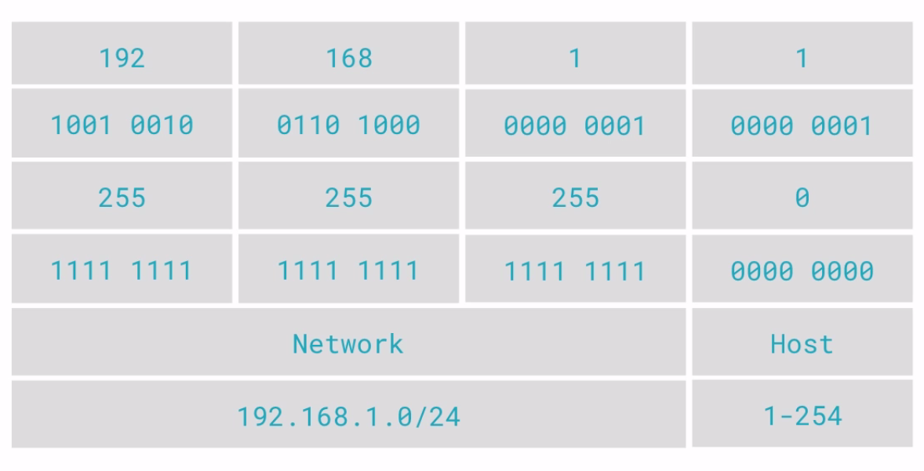
Subnetting

Slide 3
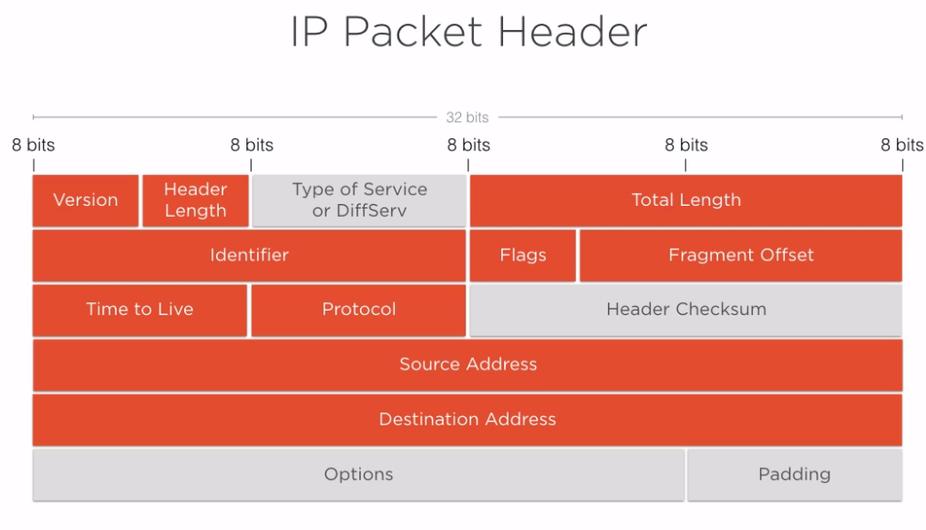

Slide 4
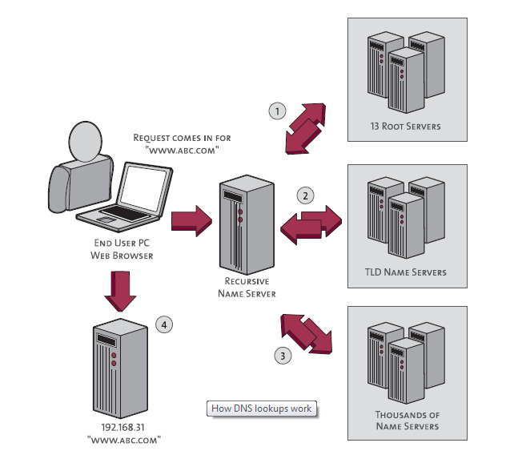
DNS Flow
Notes:
name server is a computer designated to translate domain names into IP addresses. These servers do most of the work in the DNS system.
A zone file is a simple text file that contains the mappings between domain names and IP addresses.
DNS server which keeps all root zone is called TLD name server.
A TLD (top-level domain) is the highest level of domain names in the root zone of the DNS of the Internet. For all domains in lower levels, it is the last part of the domain name, that is, the label that follows the last dot of a fully qualified domain name.
Zone files reside in name servers
Root servers handle requests for information about Top-level domains. So if a request comes in for something a lower-level name server cannot resolve, a query is made to the root server for the domain.
The root servers won't actually know where the domain is hosted. They will, however, be able to direct the requester to the name servers that handle the specifically requested top-level domain.
At this point, the requester has the IP address of the name server that is responsible for knowing the actual IP address of the resource. It sends a new request to the name server asking, once again, if it can resolve "www.wikipedia.org".
The name server checks its zone files and it finds that it has a zone file associated with "wikipedia.org". Inside of this file, there is a record for the "www" host. This record tells the IP address where this host is located. The name server returns the final answer to the requester.

Slide 5
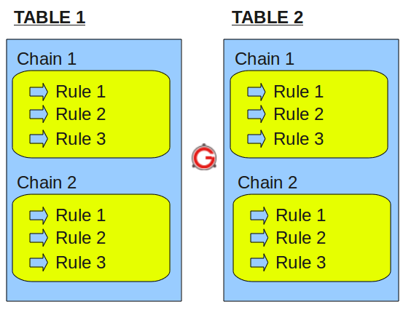
IP Tables
Notes:
On a high-level iptables might contain multiple tables. Tables might contain multiple chains. Chains can be built-in or user-defined. Chains might contain multiple rules. Rules are defined for the packets.
So, the structure is: iptables -> Tables -> Chains -> Rules. This is defined in the following diagram.

Slide 6
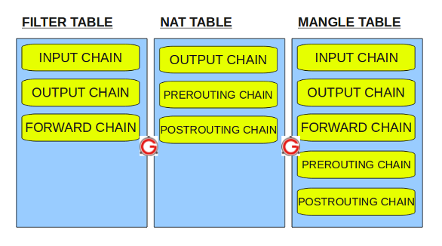
Built in tables

Slide 7
Usage
Block a IP
iptables -A INPUT -s 10.10.10.10 -j DROP
Block SSH Connection
iptables -A INPUT -p tcp --dport ssh -s 10.10.10.10 -j DROP
To save the rules
/sbin/service iptables save or /etc/init.d/iptables save
iptables –L
iptables –F → To clear all rules

Slide 8
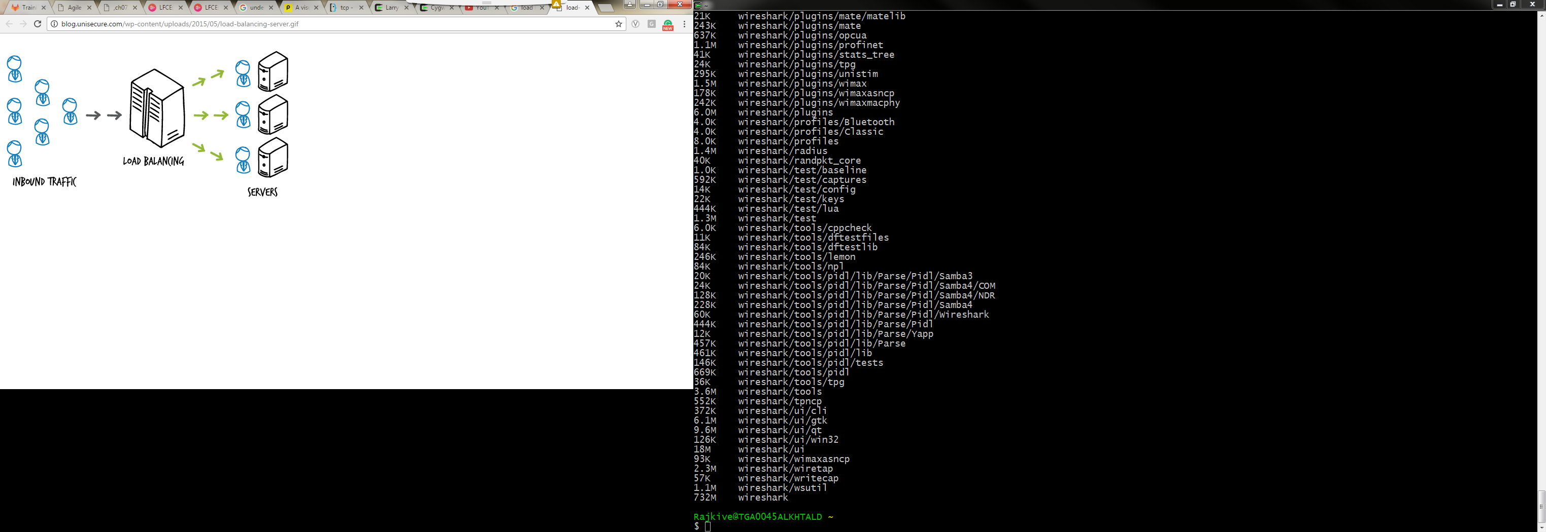
Load Balancing
Notes:
Distributes client requests or network load efficiently across multiple servers
Ensures high availability and reliability by sending requests only to servers that are online
Provides the flexibility to add or subtract servers as demand dictates

Slide 9
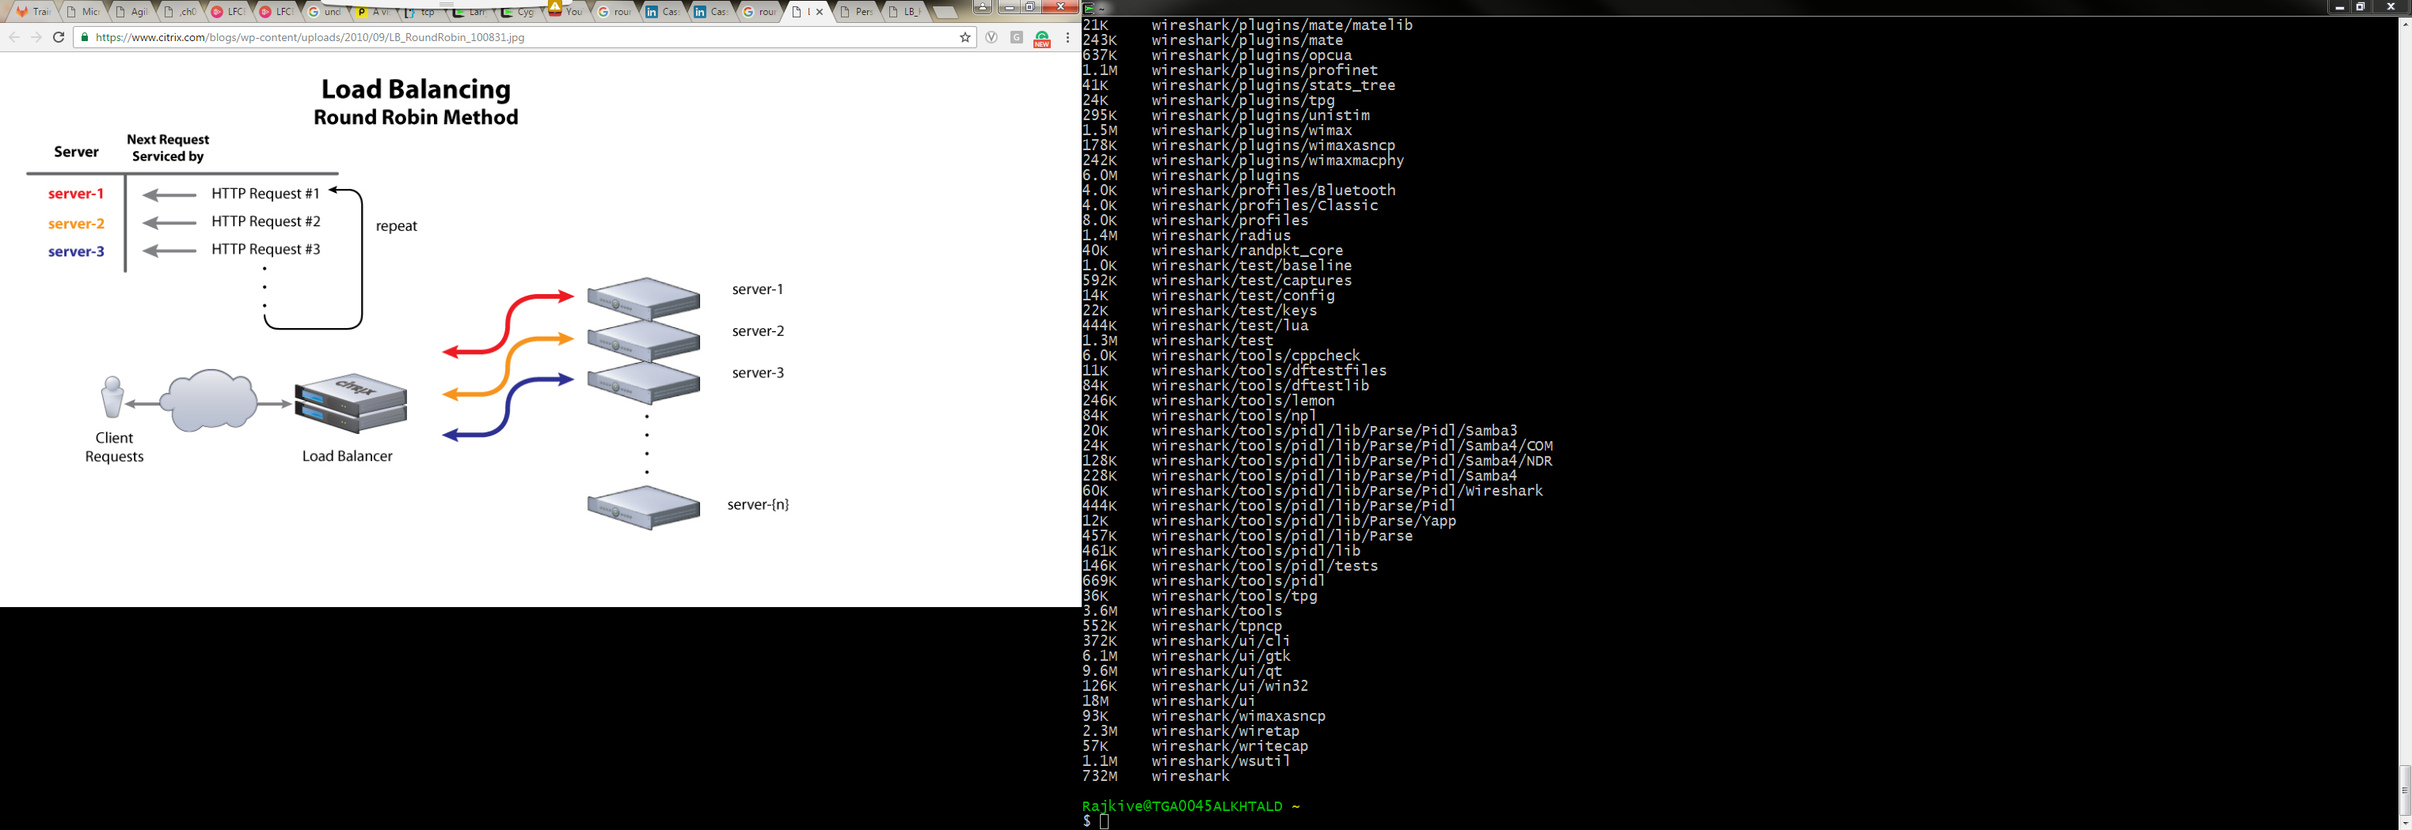
Round-robin

Slide 10
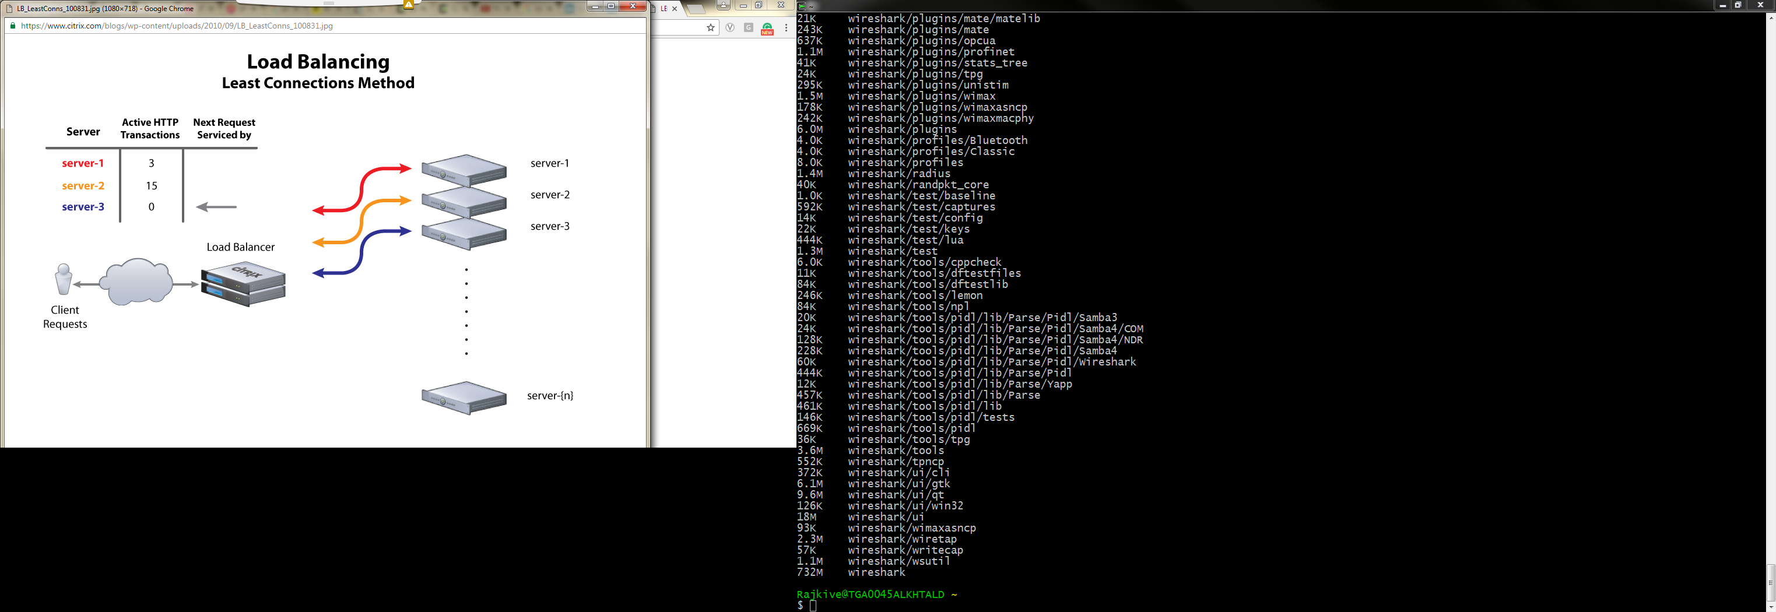
Least connections

Slide 11
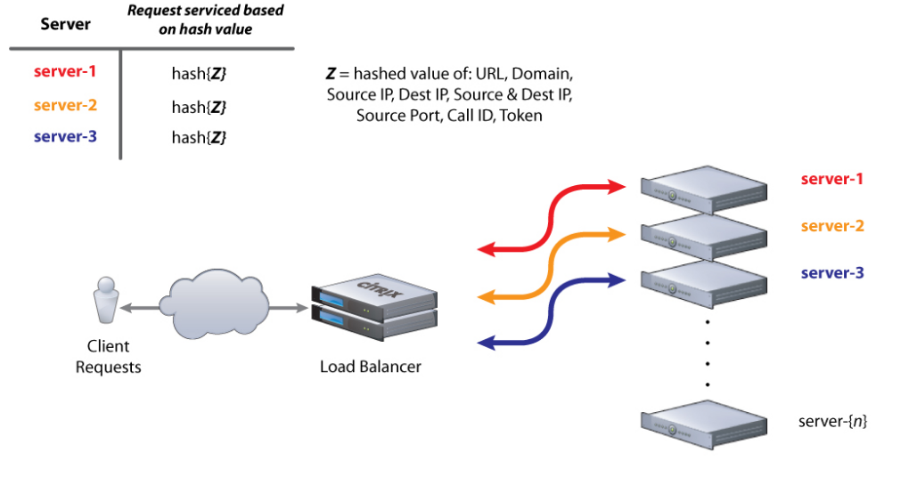
IP hash

Slide 12
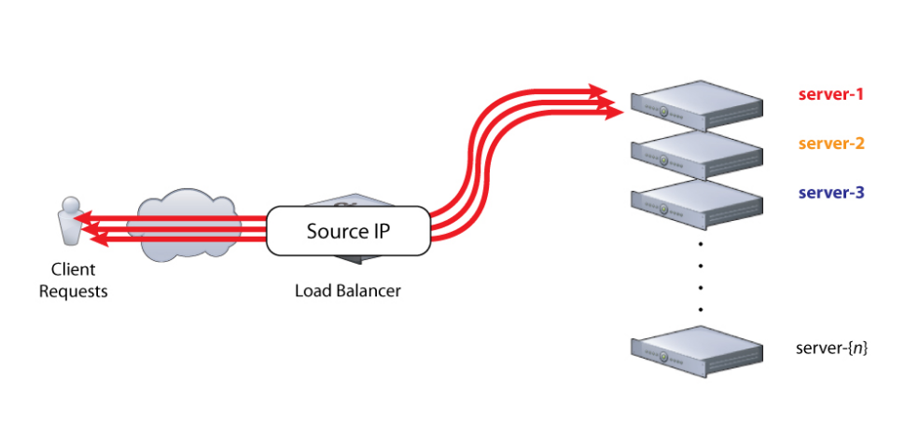
IP Persistance
Notes:
Information about a user’s session is often stored locally in the browser. For example, in a shopping cart application the items in a user’s cart might be stored at the browser level until the user is ready to purchase them. Changing which server receives requests from that client in the middle of the shopping session can cause performance issues or outright transaction failure. In such cases, it is essential that all requests from a client are sent to the same server for the duration of the session. This is known as session persistence.

Slide 13
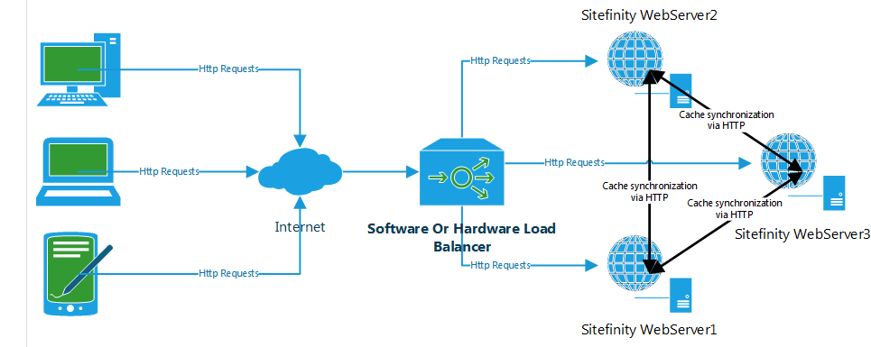
Hardware Load Balancing VS Software load balancing
Notes:
Hardware load balancers rely on firmware to supply the internal code base -- the program -- that operates the balancer. Hardware balancers include a management provision to update firmware as new versions, patches and bug fixes become available. Although firmware updates are usually downloadable, the actual firmware patch process is often more involved than common operating system or application file patches. Load balancers with security capabilities can update application security features such as firewalls, or some malware protection.
Software load balancers could be sensitive to OS versions, and virtual appliance deployments could experience hypervisor dependencies. If you select the software load balancing route, ensure that any OS changes or updates don't adversely affect the software load balancer. For example, platforms updates or patches can still disrupt a virtual appliance that supports VMware ESX/ESXi, Citrix XenServer, Microsoft Hyper-V, Oracle VirtualBox and other hypervisors. Conduct advanced testing to avoid the possibility of any server load-balancer disruption that OS or hypervisor dependencies can cause.

