Slide 1
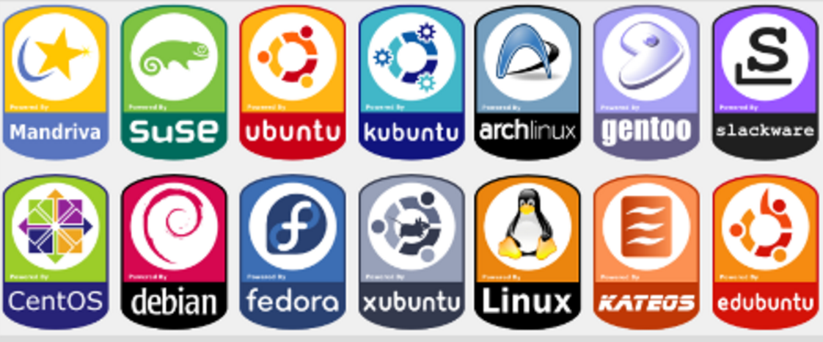
Linux Intro
Notes:
Linux is a fully multitasking (a method where multiple tasks are performed during the same period of time), multiuser operating system, with built-in networking and service processes known as daemons in the UNIX world.

Slide 2
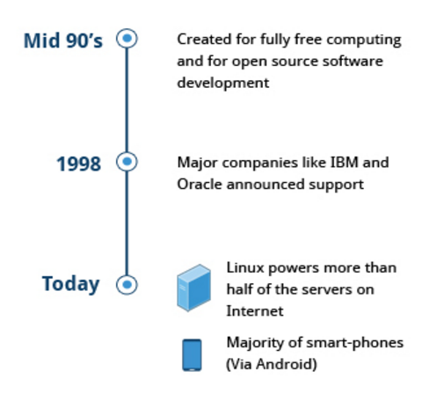

Linux History
Linus Torvalds
850,000 Android phones
700,000 TVs sold everyday
Google, Twitter, Facebook, and Amazon are all powered by Linux.
Built collaboratively across companies, geographies, and market.
Rate of development is simply unmatched.

Slide 3
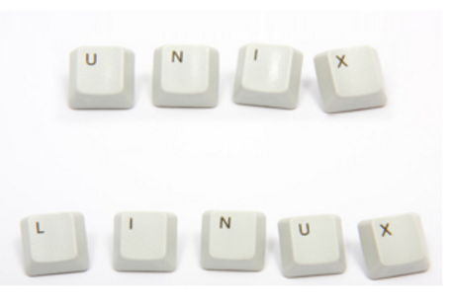
Linux Philosophy
Free and open source version of UNIX
Multitasking and multiuser

Slide 4
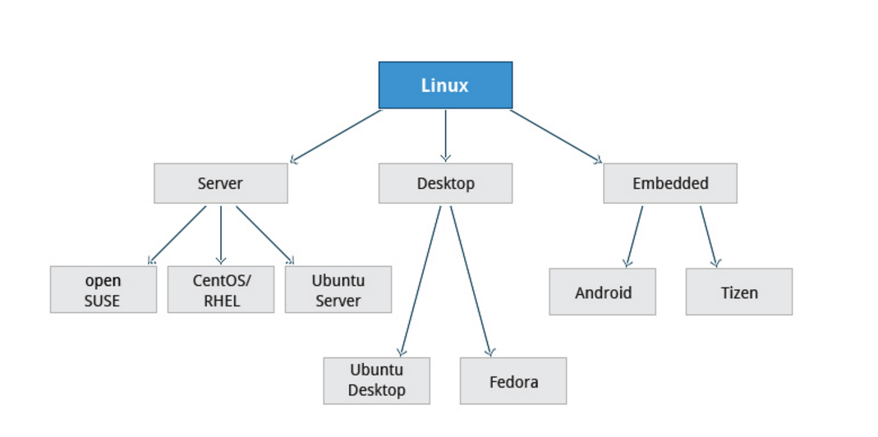
Linux Terminology
kernel
distribution
service
filesystem
command line interface
Shell
desktop environment

Slide 5
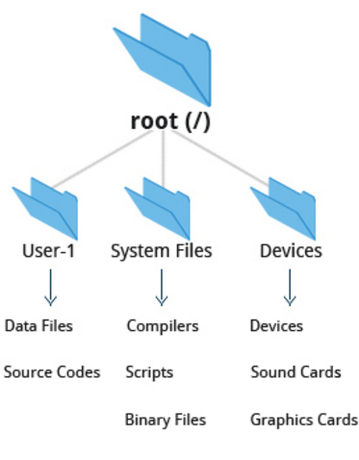
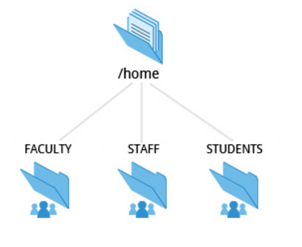
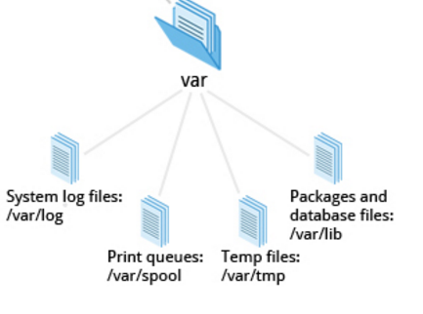
Linux Filesystem

Slide 6
We see all the basic with options
We will cover file permissions

Slide 7
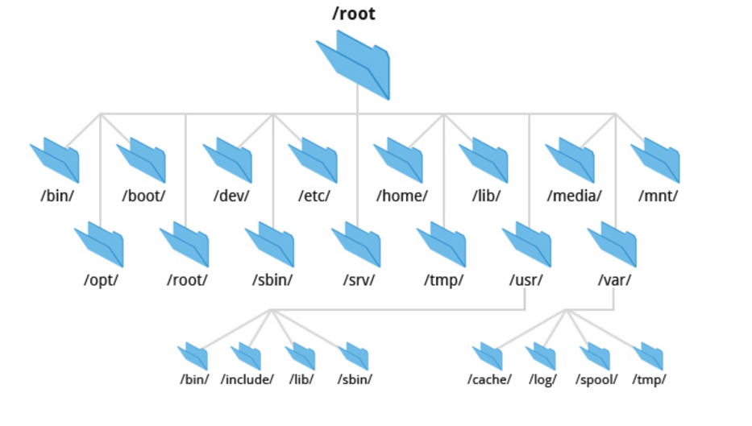
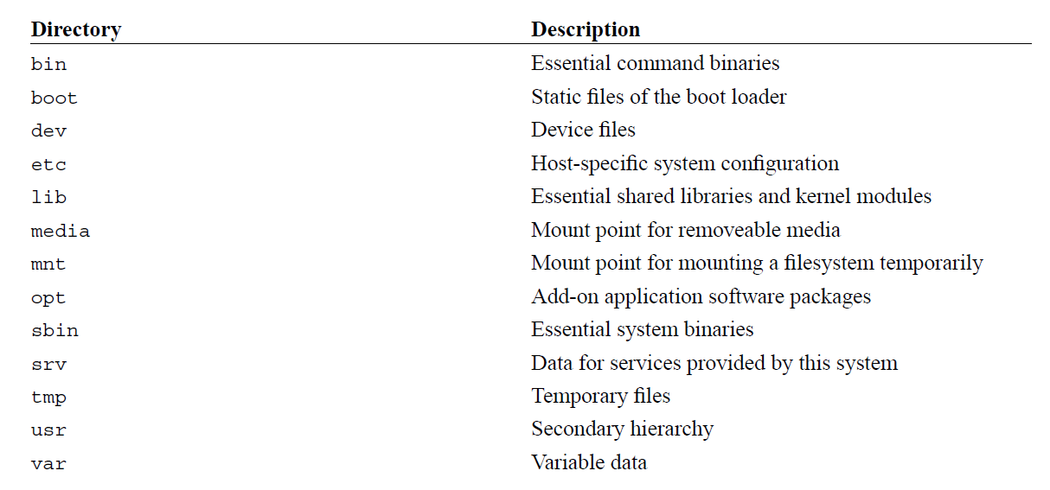
File system tree
Notes:
Cd → /bin/cd

Slide 8
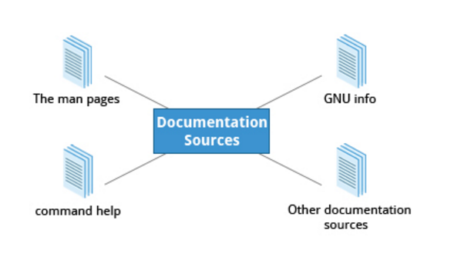
Documentation Sources

Slide 9
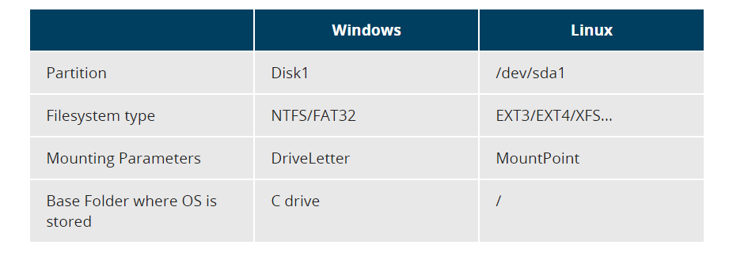
File system
Notes:
A partition is a logical part of the disk, whereas a filesystem is a method of storing/finding files on a hard disk (usually in a partition). By way of analogy, you can think of filesystems as being like family trees that show descendants and their relationships, while the partitions are like different families (each of which has its own tree).

Slide 10
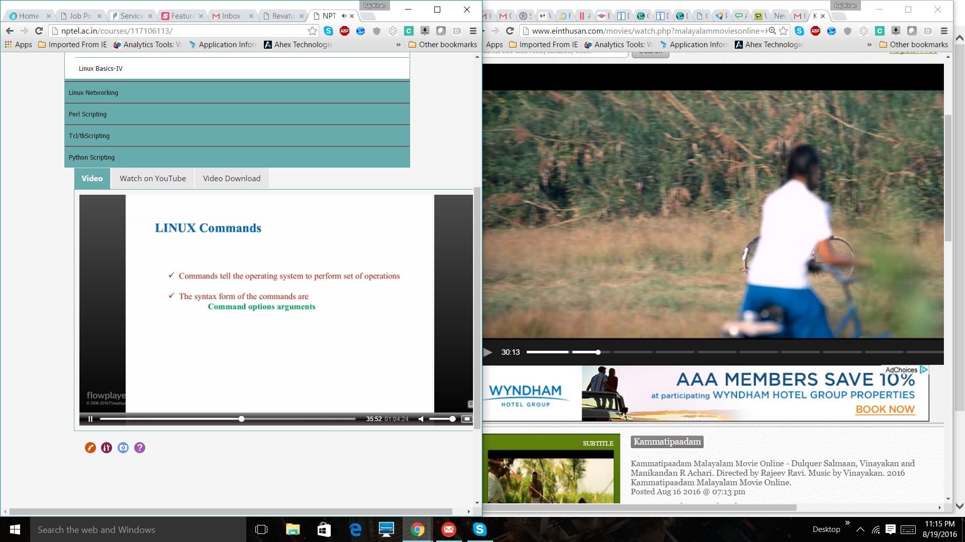
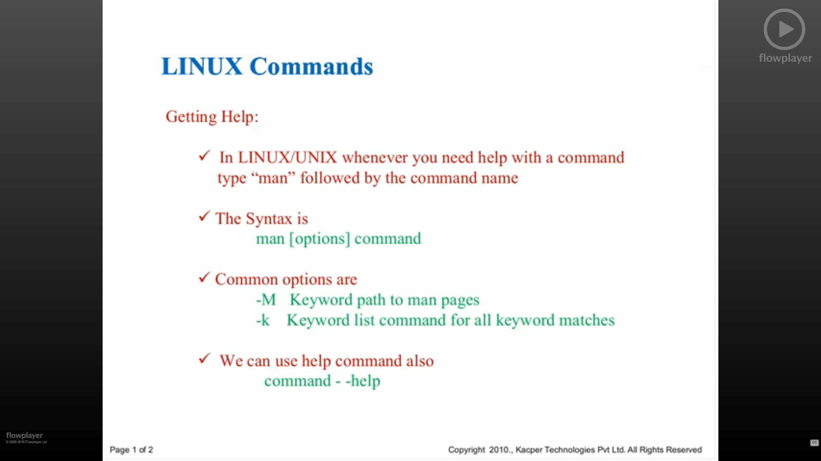
Linux Commands Commands are CASE SENSITIVE!
Notes:
The command is the name of the program you are executing. It may be followed by one or more options (or switches) that modify what the command may do. Options usually start with one or two dashes, for example,-p or--print, in order to differentiate them from arguments, which represent what the command operates on.
However, plenty of commands have no options, no arguments, or neither. You can also type other things at the command line besides issuing commands, such as setting environment variables.

Slide 11
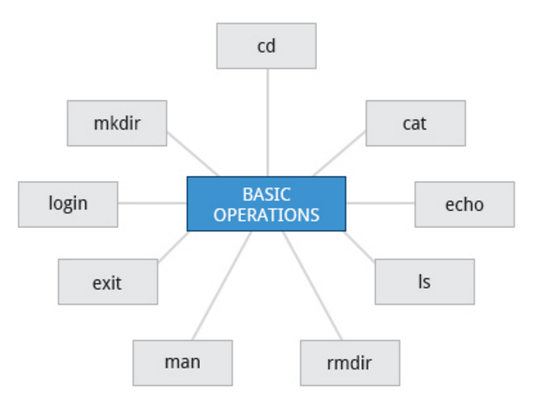
Basic Operations

Slide 12
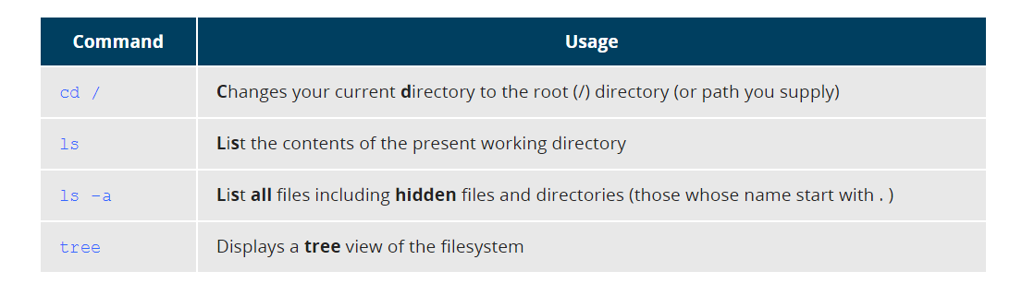
Exploring the Filesystem
Absolute path: $ cd /usr/bin
Relative path: $ cd ../../usr/bin

Slide 13
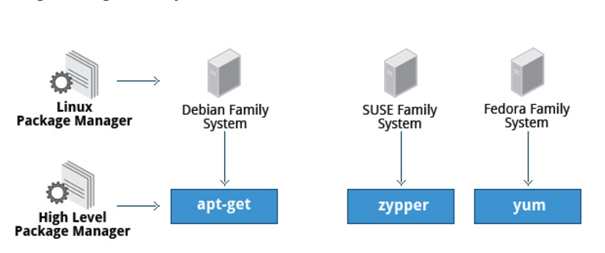
Package manager

Slide 14
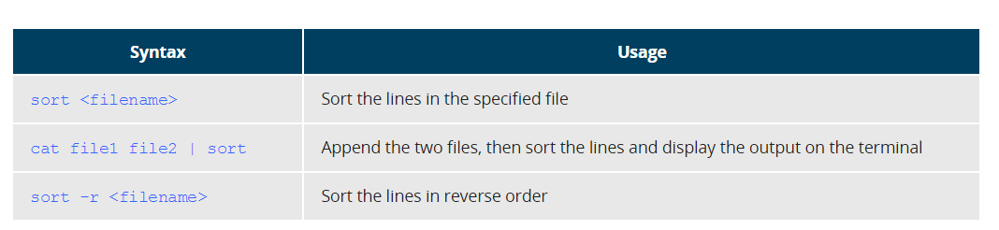
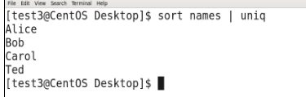
File Manipulation Utilities
sort
uniq
sort file1 file2 | uniq > file3
paste
join
split

Slide 15
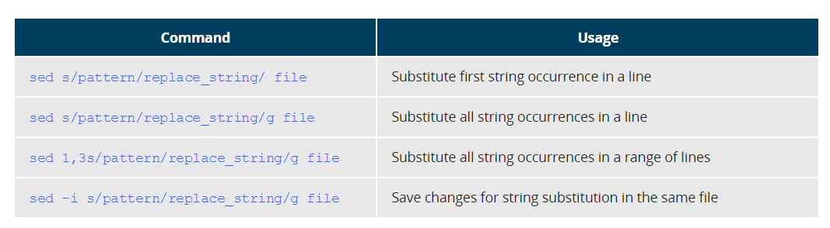
sed

Slide 16
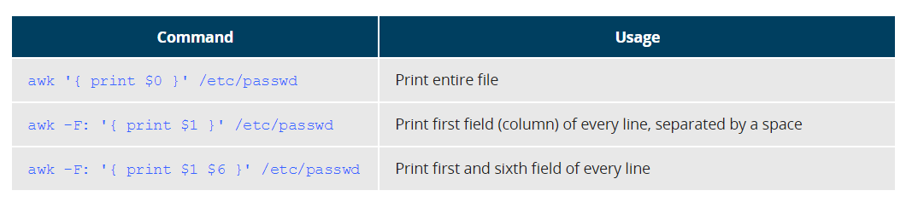
awk (Alfred Aho, Peter Weinberger, and Brian Kernighan)

Slide 17
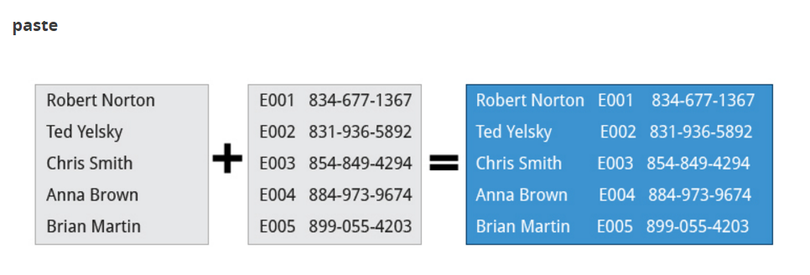
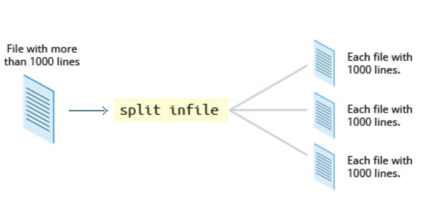
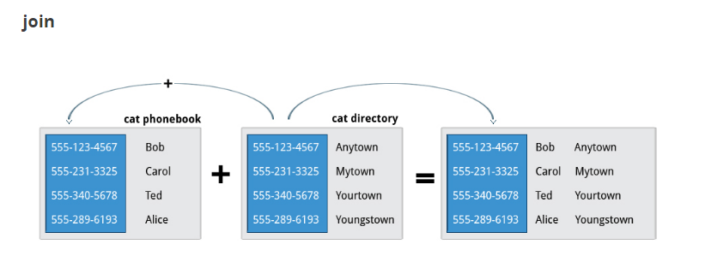

Slide 18
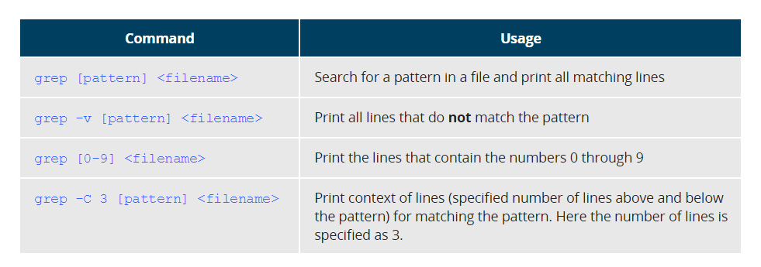
grep

Slide 19
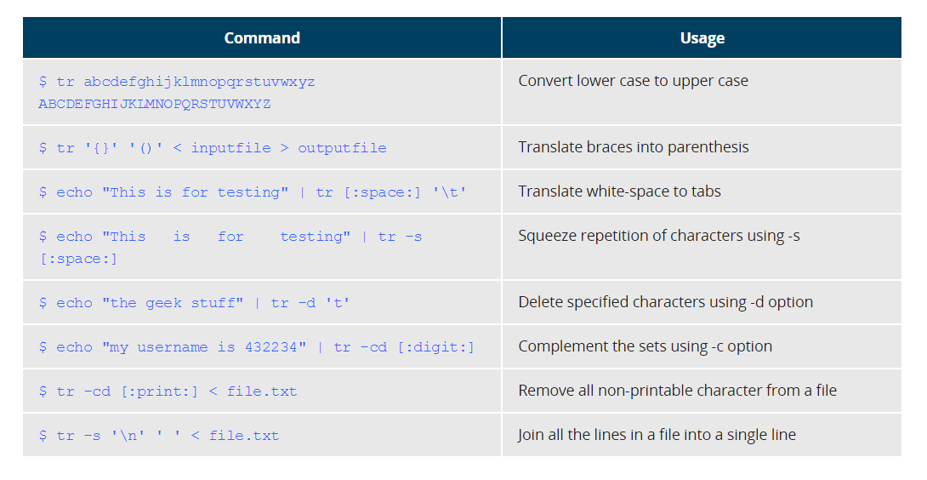
tr ---- cat city | tr a-z A-Z

Slide 20
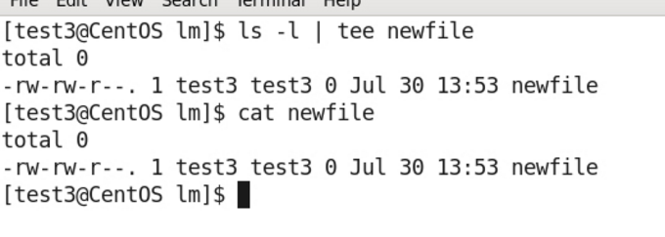
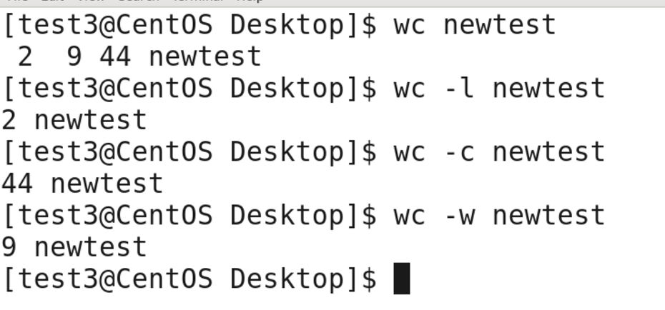
tee and wc
lines, words, and characters

Slide 21
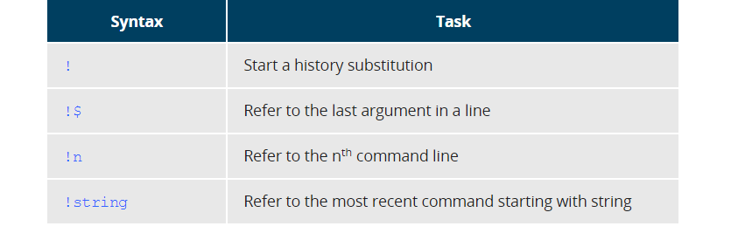
Executing Previous Commands

Slide 22
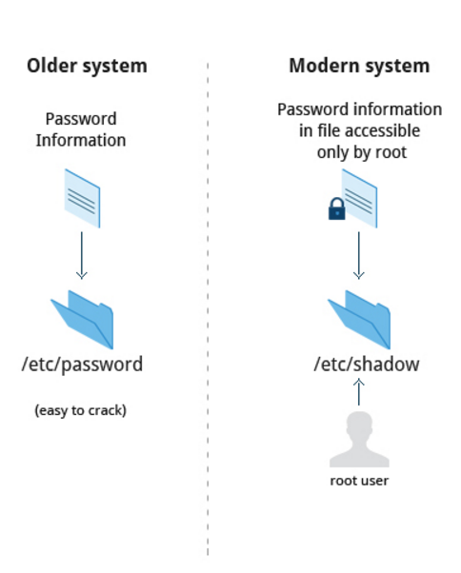
How Passwords are Stored

Slide 23
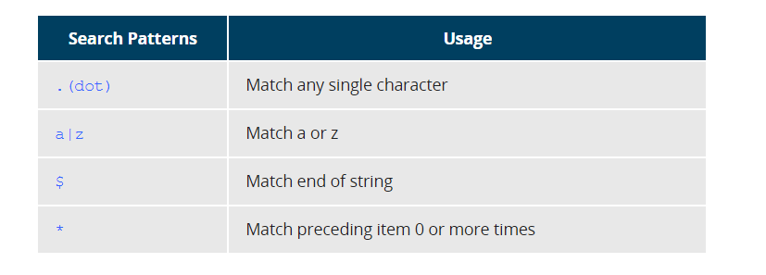
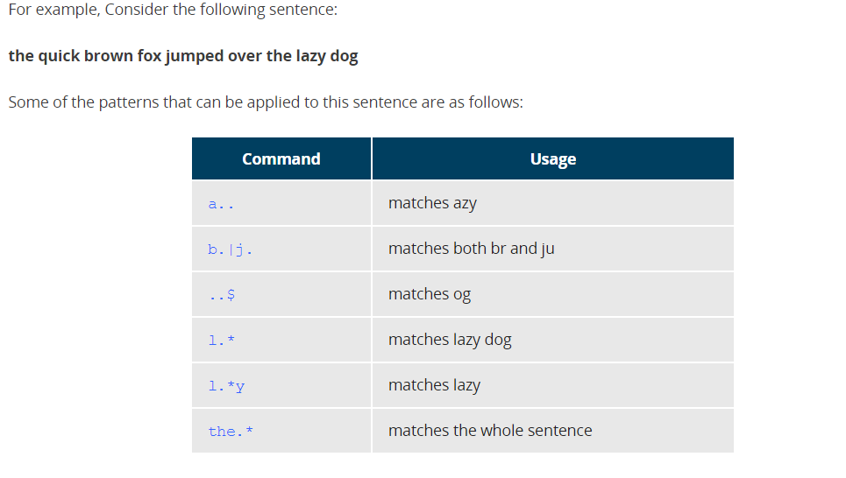
Regular expressions

Slide 24
Archive files
zip
unzip
tar → c – create v – verbose f – file x – extract
gzip
dd → dd

Slide 25
Download files
wget
curl
Memory
du
df
free
vmstat

Slide 26
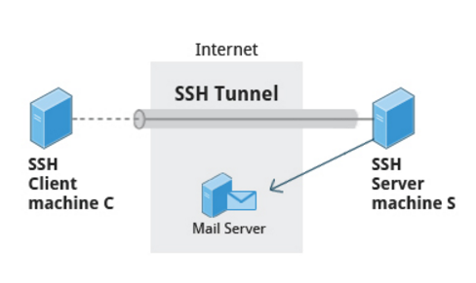
SSH
ssh user@ip
ssh –i key.pem user@ip

Slide 27
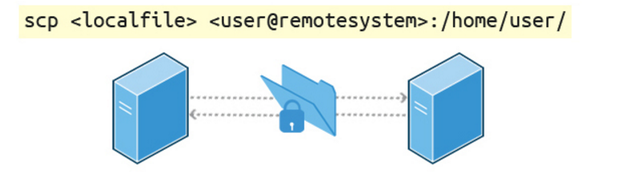
Copying Files Securely with scp
scp finename user@ip:/home/vkiran/
scp –i key.pem filename user@ip:/home/vkiran/
scp username@hostname:/location/filename /home/raj/

Slide 28
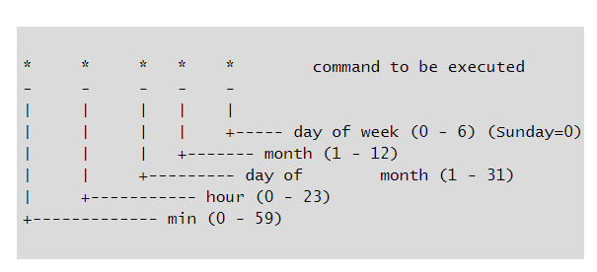
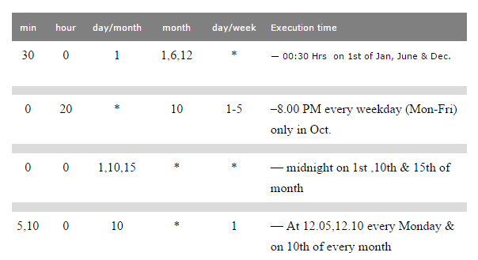
Crontab
8103706666
v

