Slide 1
Networking
Notes:
Network Topologies
Network topologies. There's one core design principle we can't overcome when designing a network. And that's the speed at which electrons can move between devices. The longer the distance, the longer it takes for something, or data, in our case, to move between systems. And so systems within a close geographic distance, let's say the same room or even the same building or even region, such as a campus, can be connected with high-bandwidth, low-latency network connections. And these types of networks are called local area networks. Generally today, you see Ethernet as the dominant connectivity method here. Now to connect geographically dispersed systems or networks, you'll need to rely on a different type of connectivity, generally leased lines or some other long-haul connection. These connections usually are lower in bandwidth and higher in latency but can traverse much longer distances. This type of network is called a wide area network. And we use those to connect LANs together. A quick story. A few years back, I had a client in Chicago, and they had offices in U.S. and in Europe. And within the U.S., we expected no greater than a 20-millisecond latency between all of our sites, even across the WAN links. When traffic went from Chicago to Europe, we expected 80 milliseconds between the two continents. But then, the company expanded, and we opened an office in Asia. And the initial connectivity provided was 140 milliseconds round-trip. This level of latency impacted the usability of our applications, and at the time, we couldn't get a better connection. So we had to make a change to the way that our applications worked to support our business best. And so, not all LANs and WANs are created equal. And your type of connectivity depends on your type of workload on the network. And up next, we'll learn how these network topologies are physically connected together, and in the later modules, we'll use learn how data moves through both types of network topologies.

Slide 2
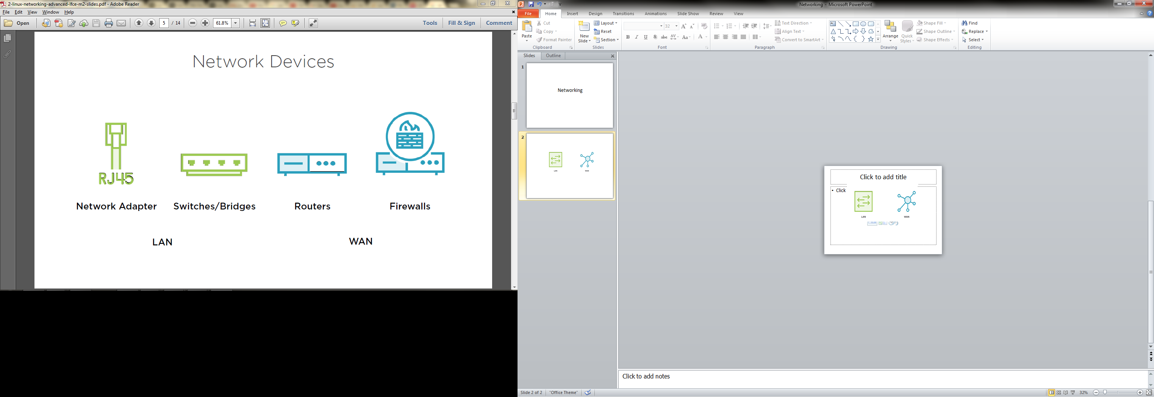
Notes:
Network devices. So with LANs and WANs fresh in our head, let's check out some connectivity methods. Up first, our most common LAN connectivity method, the network adapter. Generally in a server or a workstation, this means you're going to have a physical, wired connection that goes from the computer's network adapter and plugs into a device called a switch. A switch takes all the connections and is the fundamental building block of a LAN. A switch is a high-bandwidth, generally in the one- to ten-gigabit speed range, and a very low-latency, generally sub-millisecond networking device. Switches within the same floor, building, or server room can be connected together to make a larger LAN, or switch fabric. Now let's say we want to connect our high-speed LAN with our remote office in another state. This is where a router comes in. A router takes traffic that's destined for another network, packages it up, and ships it to the remote site via a WAN connection. Generally speaking, routers connect networks; switches connect computers. So it makes sense that devices that require to talk to each other a lot, perhaps applications that require interactivity or use a lot of data, perhaps something like a database, be positioned on the same network, physically close together so that they can be connected to the same LAN for high-bandwidth and low-latency access. Now our networks aren't all private networks. And certainly each of our companies has an internet connection or perhaps a connection with a business partner that we have some level of trust with. These are where firewalls come in. Traditional firewalls are a special type of router that is purpose-built to control access to networks and network resources. And so we can allow or deny trafficbased on where it's coming from, what type of traffic it is, and many other facets. One thing we keep in mind, though, is that in modern networking devices the lines between all these devices is getting blurred based on what manufacturers are implementing in their products and technology advances.

Slide 3
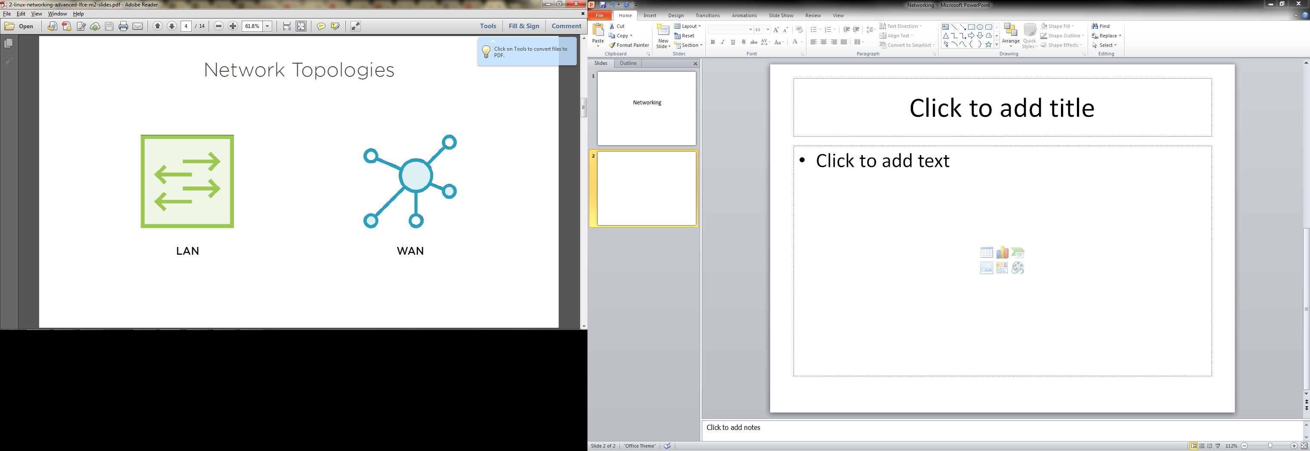
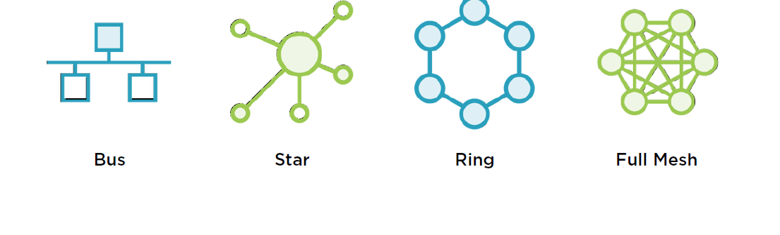
Notes:
So network topologies in the real world are usually somewhere in the middle, where you have some sites that look like a hub and spokethat may be hanging off of another site. This is usually due to a blend of connectivity methods that you have, based on what your local telco or connectivity provider offers in that geographic region. So as you can see here, there's a possibility of several paths for the node on the top left to go to the node on the bottom right. And if this were a network of routers, that's where routing protocols come in. Routing protocols are the decision makers on which path to take in a layer three network, and we'll dive much more into that in the routing module.But we can also use the same diagram to represent a network of switches. And there's also protocols for switches that will find a path in a network at that layer, as well. The key here is that either the router or the switch layer, it's finding a path without making a loop and perhaps even an optimal path, based on characteristics of the network. If this were a network of switches, the network would find a loopand disable or prune that link so that the network could function without a loop.

Slide 4
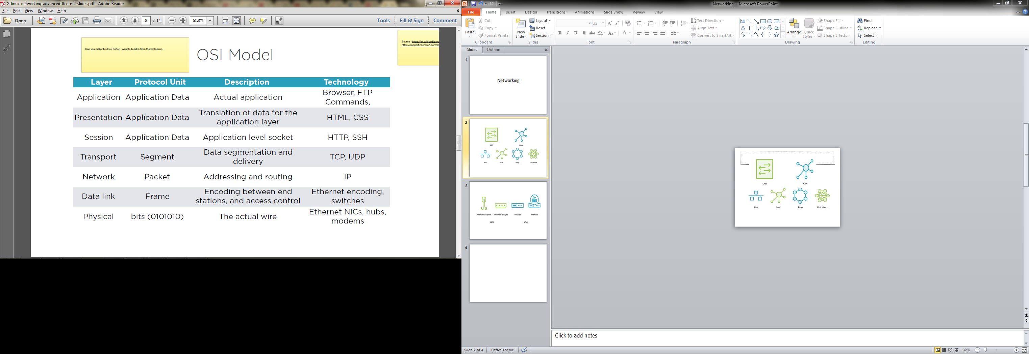
OSI Model
Notes:
OSI stands for open systems interconnect. There are several other models that represent modern networking, but this is the one that I grew up with, and I'm introducing it to you guys, not because I'm an academic but because this is the foundation of our troubleshooting methodology that I use when I'm working on systems, whether it's servers, workstations, or networking devices. And so here we go. At the bottom, we have the physical layer. Each layer is often referred to numerically, so this is going to be called layer one. This is the actual electric signaling on the wire. Then up a level is the data link layer. This is the layer that encodes those bits so that they can transmitted between end stations, or, in other words, computers, routers, anything that's physically plugged into the layer two device. The unit of transmission here is called the frame. And you'll hear me say Ethernet frame a lot in this course. Next up, at layer three, is the network layer, most commonly implemented as IP. It's used to connect networks, basically moving packets of data around between systems and via a router. Much more on this later in the sequence of modules on IP. Then there's the transport layer. Its unit of transmission is the segment.This is your actual application data, ready for movement from one location to another. The key piece here is that the transport layer is tasked with breaking your application data into chunks, or in other words, segments, and delivering them to the correct place on the remote system, usually a course binding the application. Think clients talking to servers. Now up into the session layer, this is going to be application-level constructs, something that's going on inside of your client or your server. For example, when a web server sees a request,it has its own code to start up its own concept of a connection. Two more layers to go. The presentation layer, that's going to be used for encoding application data. So think of things like HTML, CSS, or XML. This is responsible for how our applications exchange application data in their own application-specific formats. And then finally the application layer. This is the thing that the user actually interacts with.So think of our browsers, FTP clients, command-line commands, et cetera.

Slide 5
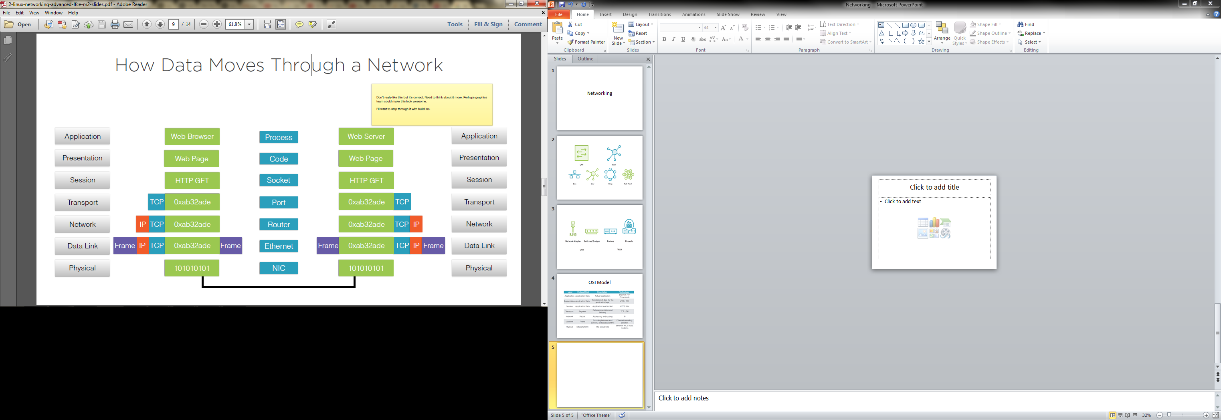
Notes:
How data moves through a network. So let's get into how data actually moves across your network. And the key concept is encapsulation.Application data gets broken up and encoded and then passed to a lower layer on the sending side of the connection. And then on the receiving side, it's de-encapsulated and put back together and passed up into the application. So let's say we're sitting at a web browserand we want to load a website. Well, our browser goes and tries to load the webpage. But it doesn't have any of that data yet. So it uses its session-layer protocol to perform an HTTP get, to tell the server on the other side to deliver a certain webpage. So we have to segment our request and turn it into bytes and add some information about where it's going on the remote computer at the transport layer. If we're using TCP, we take our data, add a header, and then we pass it on to the network layer to tell our network where to send the request to. So we add that information in the IP header. But in this example, we're showing where the client and server are going to be on the same network. So no routing has to occur. Then it's got to hit our data link layer to be encoded, then turned into electrons and transmitted to the other end of the connection. Now in reverse, the bits on the local layer two segment read the frame and send it to the right end stationon that segment. It strips off the frame header and passes it up to the network layer, where it's decoded. Its header is removed, and it's passed up to the transport layer, which sends the application data to the correct process, which decodes the request for the page. It's passed up to the web server, and the page is read from disk, and the process happens again to encode the page and send it back to the original requester. So let's look at how this all comes together in an actual network. So a NIC is used at layer one. An Ethernet is used at layer two. Routers move data at layer three. In a TCP/IP-based connection, ports are going to be responsible at layer four, and at layer five,we're going to see an application-level construct called a socket. Layer six is going to be our actual program code, and then finally at layer seven, the actual running processes on the computers. It sounds like a lot, but the mechanisms here are very efficient at moving data, and I'm doing a little bit of hand-waving right now, but it's going to become much more clear in the upcoming modules, when we dive deep into layers two, three, and four.

Slide 6
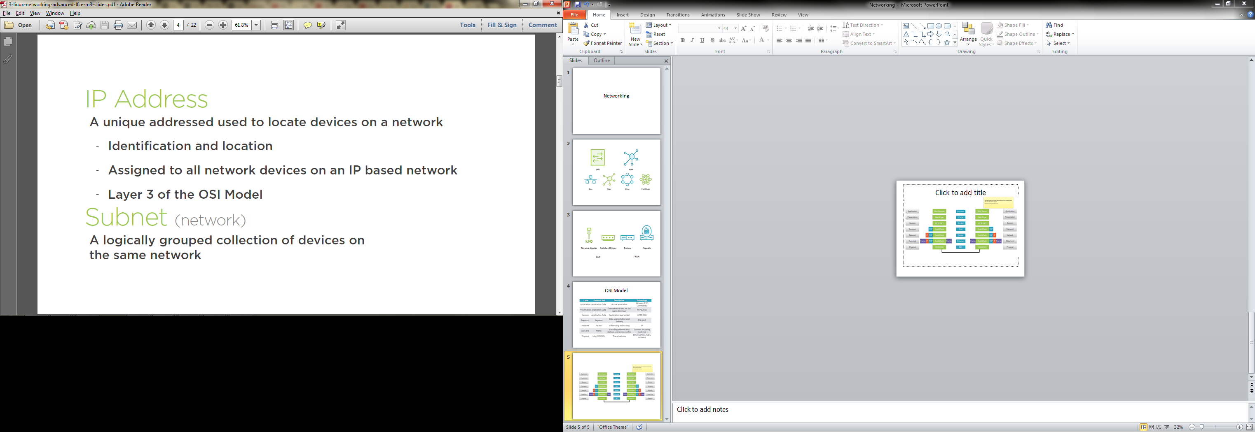
Notes:
IP addresses, so at it's core, an IP address is used to locate a device on a particular network and it's really used for identification and location, so what machine am I heading to on which network? And to do that, all network devices on an IP based network require that they have an IP address. In the last module, we discussed layer 3, the network layer and how data moves between networks conceptually.This is how it actually gets done, with an IP address. Now, I said identification and location, how do we locate which network? This is where the subnet comes in. It's a logical grouping of devices on the same network. Let's dig deeper. Anatomy of an IP address. IP addresses are normally displayed as a series of four octets, so an octets really means eight bits. So, we can convert the decimal form into four sets of eight bits and that's where our 32-bit address space comes from, 32 bits across, right here, but let's learn how to convert between the two.So, if we take our bits, each of those represents a particular value, so from right to left, the first bit is a one, the second a two, third four, and then so on, all the way up to the eighth bit, which represents 128. Now, we have two bits set here in the first octet. The bit that represents 128 and the bit for 64, so we can add those two together, 128 plus 64 and we get 192. Let's do this one more time. In the second octet, you can see the 128 is set, the 32 and the eight, add those up, 168 and for the last two octets, only the one bit is set, so that's a decimal one as well. Network masks and IP subnets. So, now we know what an IP address looks like. Let's figure how it's used to find the location of a machine on particular network. Perhaps even a remote network. A subnet is a concept that is used to partition larger IP-based networks into smaller ones and it does this by breaking up the IP address into two portions, the host portion and the network portion, or in computer terms, which bits help with locating the network and which bits help with identifying the individual host on that network? How can you tell apart the host bits from the network bits? That's where the network mask comes in. The network mask, or subnet mask, identifies where the network portion stops and the host portion begins. Now, since it's used for network location, it's required that all nodes on the same network segment have the same network mask. Let's check out what a network mask actually looks like.

Slide 7
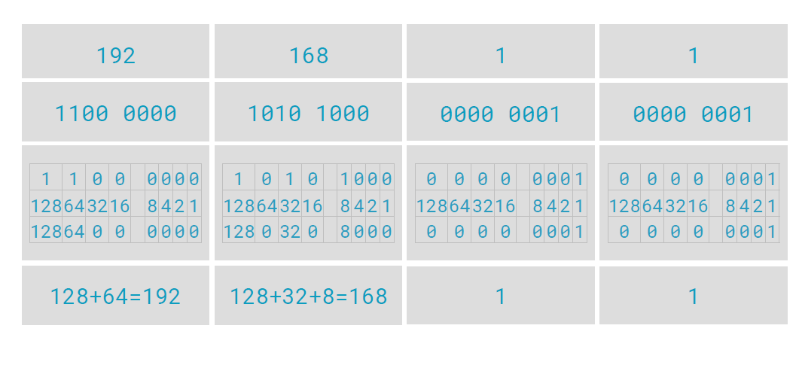
Anatomy
Notes:
Let's work out an example of an IP and it's subnet mask. Here we have our 192.168.1.1 address again and let's pull up its binary representation. Now, it's likely you've also seen this before, 255.255.255.0, that's a subnet mask, but let's look at it's binary representation too. The 255 comes from adding up all the decimal values at each set bit in that octet and now, check out where the ones stop, right after the third octet. That's called the network portion of the address and the bits to the right of that, that's the host portion of the address, or where it's all zeros, and now, back in decimal, this is how we identify the network, the 192.168.1.0 is the network address and that /24 is shorthand notation to represent the subnet where there are 24 bits in the mask. There are eight remaining bits here in the host portion, so we can easily calculate the number of IPs on the network, which are all possible bit combinations of those eight bits and in decimal, that's going to be zero for 255. The network address is going to be the first address on the subnet or when the host portion is all zeros and the broadcast address is going to be when the host portion is all ones. More info on those special addresses in an upcoming slide. The remaining addresses one through 254 are useable IPs for hosts on this subnet. So, the network addresses you use for the location of a network and the host portion is used to identify the hosts on that network. So, with this new subnet mask knowledge in our brain, let's connect this back to routing packets. In summary, we use masks to define networks and we use IP to move data between networks. So, when the internet was initially divided up, things were divided up based on octet boundaries, another work for this is classful and that left us with a network configuration that looked like this. There were class A networks and they used eight bits for the network mask and 24 bits for the hosts and the mask was 255.0.0.0 and with some exponential math, we can see that two raised to the seventh is 128 or 128 networks and 1.6 million hosts. That's not a lot of networks and that's a lot of hosts. Now, you see that it's two to the seventh and there are eight bit dedicated to the network. The leading bit in that first octet is reserved for a special purpose to help identify the class. Now, class B is an even split, 16 network bits and 16 host bits and you see that it's two raised to the 14th, rather than 16, because two of those bits are used to identify the class as well, and then finally, class C, which is 21 and eight bits, where three bits are used to identify the class and that network mask that we've seen a bunch, 255.255.255.0, now, there's nothing special about that subnet, it's just a very commonly used maskto break up into a small network, but breaking up the internet using classful addresses left us with one big issue. Classful subnetting leads to inefficient allocation of addresses. Those class A networks gobbled up tons of IPs and we really didn't have any ability to break those subnets into smaller networks until some new concepts came along and those concepts are variable length subnet masks and classless inter domain routing. What these allowed us to do is to move the bits around in our network mask to have variable length based on our network's needs, not just predefined boundaries, so we could adjust the number of networks and we could also adjust the number of hosts per network, but doing just that would cause the routers of the world to potentially have to track many more subnetted networks and to overcome that challenge, CIDR was introduced, which allowed us to partition subnets into smaller networks and then aggregate those subnets into larger supernets and route on those summarized routes, that way, routers could represent these many smaller networks with a smaller number of routes. So, let's work on example of a variable length subnet mask. Here's our 192.168.1.0 network address and it's binary notation. Here's a new decimal network mask and it's binary form. This time, we moved our network mask to the right and took one bit from the last octet and our new decimal network mask is 255.255.255.128, since we're using that first bit of the last octet, which is a decimal 128. We now represent the network portion with a /25, describing the 25 bits of the network portion and we have seven bits left for hosts on the network. Let's see what that does to our number of networks and our IP addressing. Moving that bit to the right and using a /25 mask on our 192.168.1 network breaks that network into two subnets. The first 24 bits of our network address will be the same, but that 25th bit can be a zero or a one, uniquely identifying two subnets. When the 25th bit is a zero, that network is 192.168.1.0 and when it's a one, that network is 192.168.1.128, now for IPs on those networks, there are seven remaining host bits which identify 128 unique IPs on each network. So, our 192.168.1.0 network goes from zero through 127 and our 192.168.1.128 network has 128 through 255. Now, the router that connects these two subnets will need to know routes for both networks because it'll eventually have to choose on where to send the traffic, but what's cool with CIDR, other routers in our network can summarize these two networks as 192.168.1.0/24 still, reducing the number of routes needed to be tracked.

Slide 8
Special and Reserved IP
0.0.0.0 → means all IPv4 addresses on the local machine
127.0.0.0 → Device communicating itself
255.255.255.255 → Broadcast
Notes:
So, we talked a bit about IP addresses, but there are a few special cases we need to be aware of when designing or troubleshooting our networks. First up, there's the network address. This is the first IP on a network with all zeros in the host portion of the address. The network address is used to identify the network and you'll see this often on routers when defining routes. Now, on the other side, there's the broadcast address and that's the last IP on our network with the host portion being all ones. The broadcast address is used in caseswhere we need to find other hosts on our local subnet without knowing their IP addresses, more on that in an upcoming module, and then finally, there's the loopback address. This address is 127.0.0.1. This is really a specially defined address that exists on all machines for testing.So, if you ping 127.0.0.1, or you ping the name local host, you'll be sending traffic to yourself testing your local network stack. Now, there are also specially defined network addresses that are reserved for private use. What this means is that these IPs are not used on the public internet and can be used by organizations to address their internal or private networks. In large corporations, it's common to see the network to be address with 10.0.0.0, the largest of the reserved addresses. Then up next is 172.16.0.0, and then finally, the smallest is 192.168.0.0, you'll see these pop up most often in small offices or home networking implementations. Now, since we learned about CIDR and variable length subnet masks, we're not constricted to the /8, /12 or the /16 network masks defined. Those are the supernets that we can use and then within those networks, we can break them down into smaller networks with variable length subnet masks and CIDR.

Slide 9
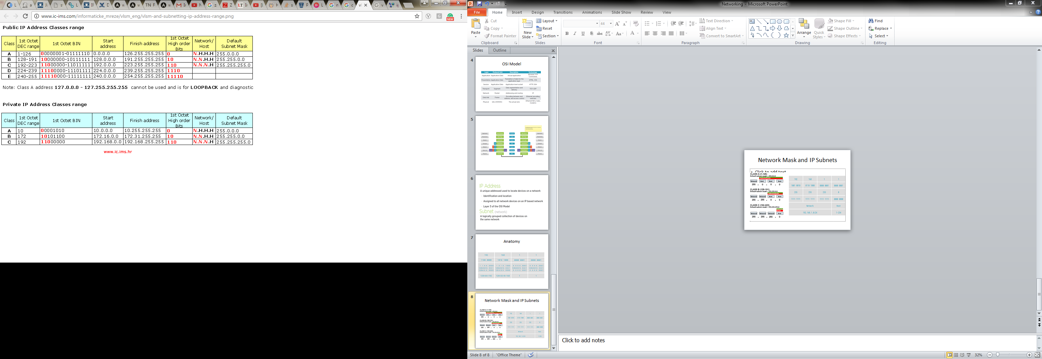
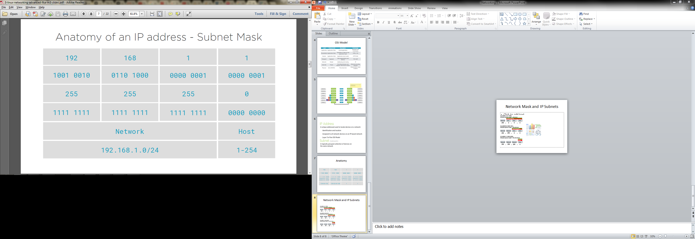
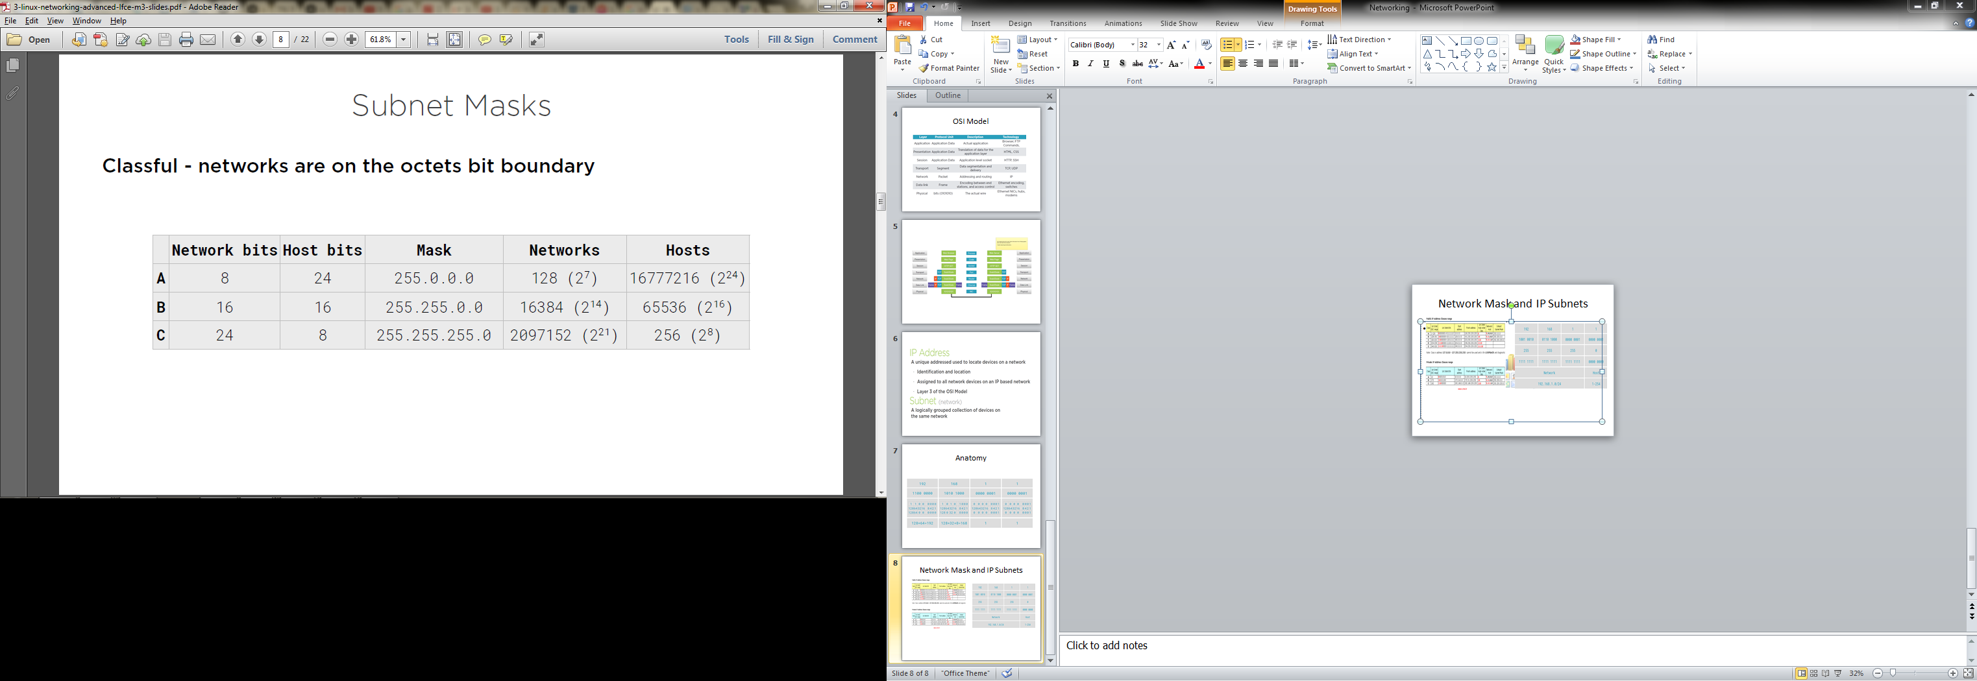
Network Mask and IP Subnets

Slide 10
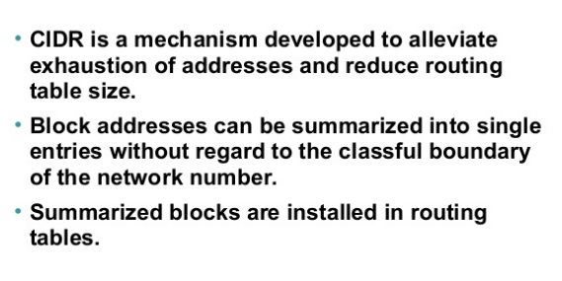
CIDR
Notes:
192.0.2.0/18. 18 says that the first 18 bits are the network part of the address and rest 14 bits are available for specific host address.

Slide 11
NAT
Notes:
Network Address Translation
Network address translation, it's likely the case that we won't want to put a public IP on our host and place that directly on the internet for security reasons. So, when we want to assign a public address to a computer on our private network, we can use network address translation for this, commonly called NAT. NAT is usually implemented on a firewall or a router on the network perimeter. This means wherever your internet connection is coming into your network. You perform the mapping or NAT-ing there. Primary motivations to use NAT are IP conservation, like we just discussed, and also security, using NAT, we can expose individual hosts on our network to the internet and define very granular access rules for that exposed host. There are two types of NAT. First is one to one. This means we're explicitly mapping one public address to one private address. This is commonly used when we want to put and individual host onto the internet to provide a service, like a web server. Second is a many to one. You'll see this referred to as PAT or port address translation. What this does is takes many hosts on a network and exposes them to the internet via one IP address. This is commonly used when we want to give a network of computers access to the internet. They still need a public address to access internet resources, but it isn't mapped to an individual IP. This is a very effective way to conserve IP addresses and also allows for good administrative control of internet traffic leaving or entering an organization or network.

