Slide 1

CSE214: Algorithms
Introduction to Greedy Approach
A I TAZIB
Lecturer, CSE
Department of CSE, DIU
‹#›
Notes:
‹#›

Slide 2
Today’s Contents
Introduction to Greedy Approach
Discussion on Coin Change Problem
Discussion on Bin packing Problem
‹#›
Notes:
‹#›

Slide 3
Greedy Algorithm
Greedy algorithms make the choice that looks best at the moment.
Find simple and straightforward solutions.
Gives you locally optimal solution without looking ahead.
This locally optimal choice may or may not lead to a globally optimal solution (i.e. an optimal solution to the entire problem).
‹#›

Slide 4
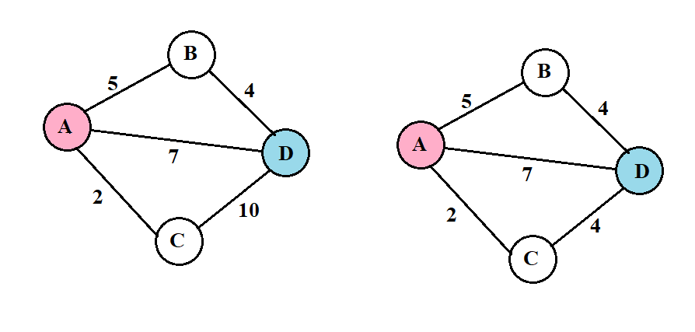


Example
Find the Shortest Path From a Graph (Node A -> D)
‹#›

Slide 5
Advantages and disadvantages
Advantages
Simple
Quick
Easy to program
Disadvantages
Does not always lead to a global optimal solution.
‹#›

Slide 6
We are going to learn
1. Greedy Coin Change
2. Greedy Bin Packing
3. Greedy Partial Knapsack
4. Greedy Huffman Coding
‹#›

Slide 7

Greedy Algorithms
Part -1 : Greedy Coin Changing Algorithm
Notes:
‹#›

Slide 8
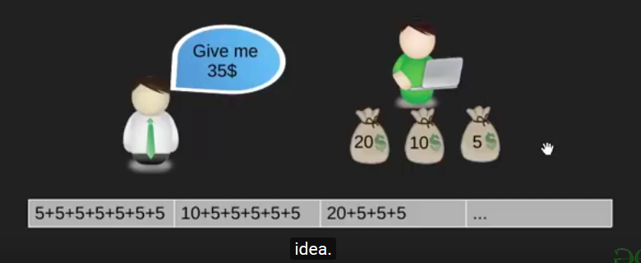
Coin Change
‹#›

Slide 9
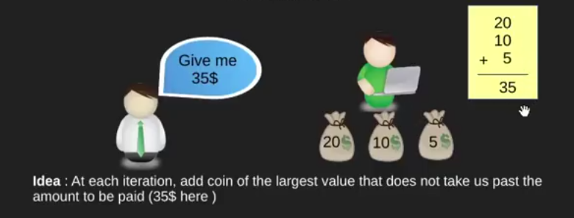
Objective of Coin Change
Pay out a given sum S with the smallest number of coins possible.
‹#›

Slide 10
Coin Change
Assume that we have an unlimited number of coins of various denominations:
$1, $5, $10, $25, $50
Now use a greedy method to give the least amount of coins for $41
‹#›

Slide 11
Coin Change
Assume that we have an unlimited number of coins of various denominations:
$1, $5, $10, $25, $50
Now use a greedy method to give the least amount of coins for $41
41 – 25 = 16 ------ 25
16 – 10 = 6 ------- 10
6 – 5 = 1 ------- 5
1 - 1 = 0 ------- 1
We have to give: 25 10 5 1
‹#›

Slide 12
Making Change – A big problem - 1
Assume that we have an unlimited number of coins of various denominations:
$4 , $10, $25
Now use a greedy method to give the least amount of coins for $41
41 – 25 = 16 ------ 25
16 – 10 = 6 ------- 10
6 – 4 = 2 ------- 4
2 ------- ???
We should choose 25 4 4 4 4
‹#›

Slide 13
Making Change – A big problem -2
Coins are valued
$30, $20, $5, $1
Make change for $40
Does not have greedy-choice property, since $40 is best made with two $.20’s,
but the greedy solution will pick three coins (which ones?)
‹#›

Slide 14
The greedy coin changing Algorithm
while S > 0 do
c = value of the largest coin <= S
num = S / c
// pay out num coins of value c
S = S - num*c
20 | 10 | 5 | 2 | 1
Make change for 45
‹#›

Slide 15
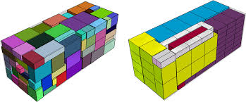
Greedy Algorithms
Part -2 : Bin Packing Problem
Notes:
‹#›

Slide 16
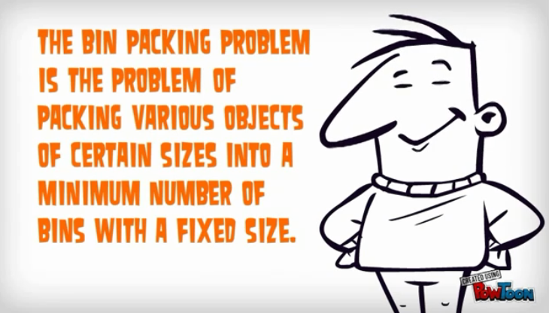
Concept of Bin Packing
‹#›

Slide 17
Bin Packing
In the bin packing problem, objects of different volumes must be packed into a finite number of bins or containers each of volume V in a way that minimizes the number of bins used.
There are many variations of this problem,
such as 2D packing,
linear packing,
packing by weight,
packing by cost, and so on.
They have many applications, such as filling up containers, loading trucks with weight capacity constraints, creating file backups in media ad so non.
‹#›

Slide 18
Ways of Solution
First Fit Algorithm
First Fit Decreasing Algorithm
Full Bin Algorithm
Other Algorithms
‹#›

Slide 19
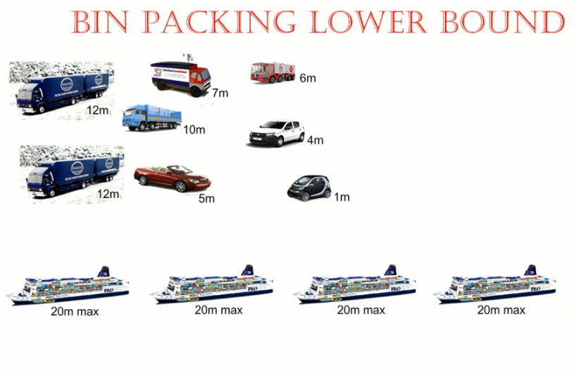
Find The Lower Bound
Total size =
12 + 12 + 7 + 6 + 10 + 4 + 5 + 1 = 57
Bin (Ship) Size = 20
Lower Bound = ┌ 57/20 ┐ =┌2.85┐ = 3
‹#›

Slide 20
1. First Fit Algorithm
This is a very straightforward greedy approximation algorithm.
The algorithm processes the items in arbitrary order.
For each item, it attempts to place the item in the first bin that can accommodate the item. If no bin is found, it opens a new bin and puts the item within the new bin.
‹#›

Slide 21
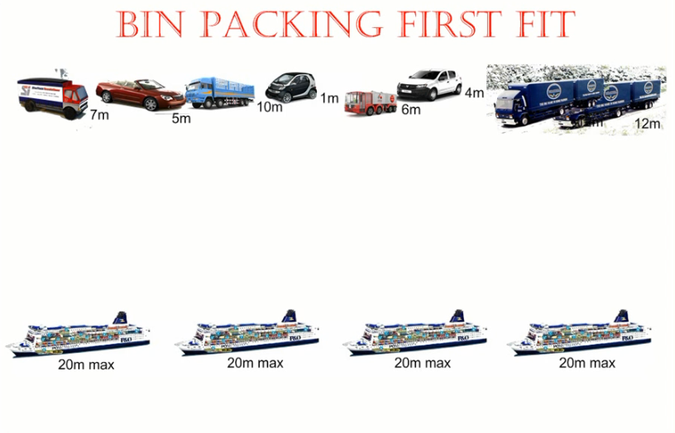
How First Fit Algorithm works
‹#›

Slide 22
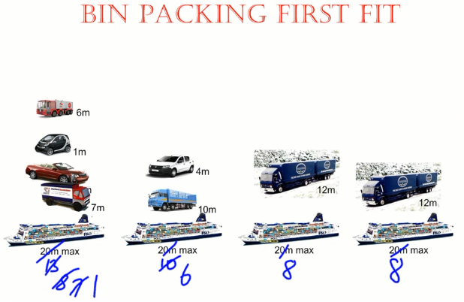
First Fit Solution
‹#›

Slide 23
2. First Fit Decreasing Algorithm
Sort the items in decreasing order.
Repeat the process First Fit.
‹#›

Slide 24
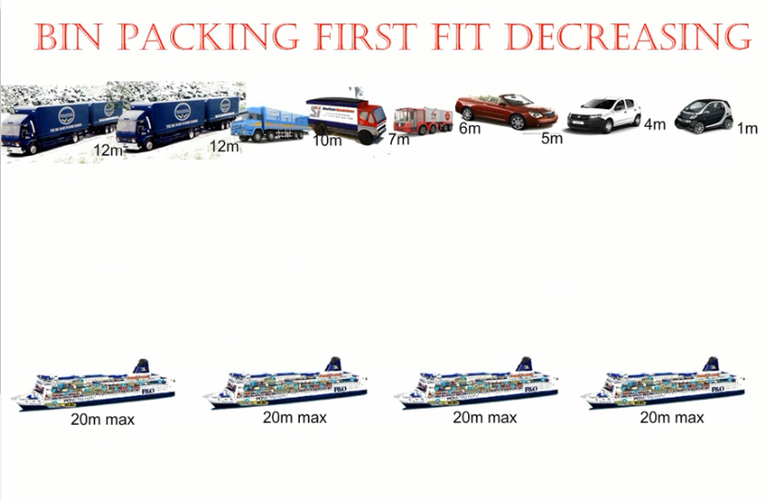
How First Fit Decreasing works
‹#›

Slide 25
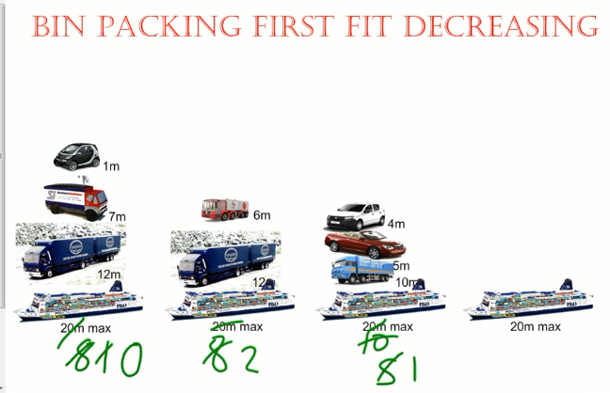
First Fit Decreasing Solution
‹#›

Slide 26
3. Full Bin Algorithm
The full bin packing algorithm is more likely to produce an optimal solution – using the least possible number of bins – than the first fit decreasing and first fit algorithms.
It works by matching object so as to fill as many bins as possible.
‹#›

Slide 27
Full Bin Concept
Place the Items into the most full bin, which could accept it.
Keeps bins open even when the next item in the list will not fit in the previous opened bins, in the hope that a later smaller item will fill.
Put it in the bins so that smallest empty space is left.
‹#›

Slide 28
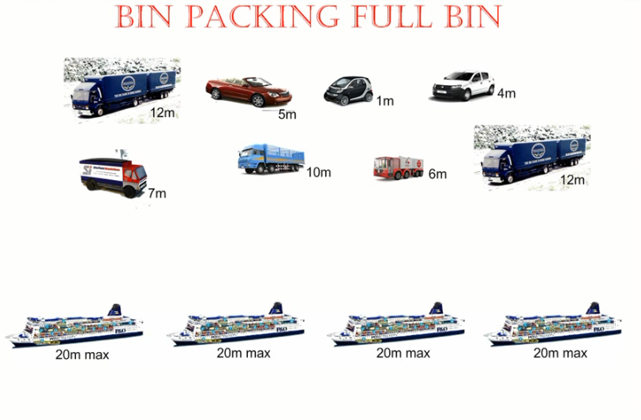
How Full Bin Algorithm Works
‹#›

Slide 29
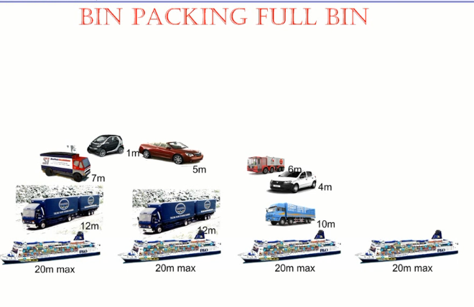
Full Bin Solution
‹#›

Slide 30
Analysis of Three Algorithms
Algorithm | Features
FIRST FIT | Easiest to use Isn’t optimal
FIRST FIT DCREASING | Easy to use Isn’t optimal always
FULL BIN | Optimal Difficult to use
‹#›
Notes:
‹#›

Slide 31
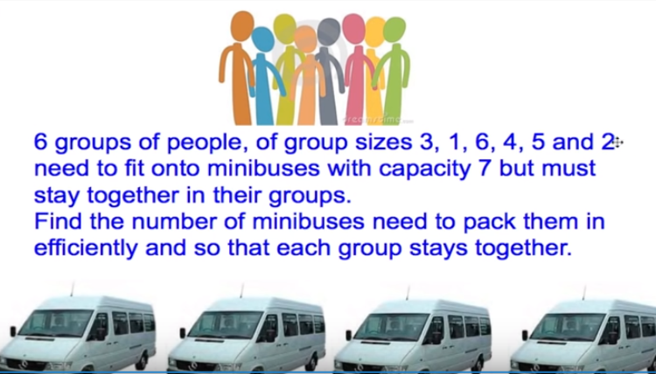
Exercise- 1
‹#›

Slide 32
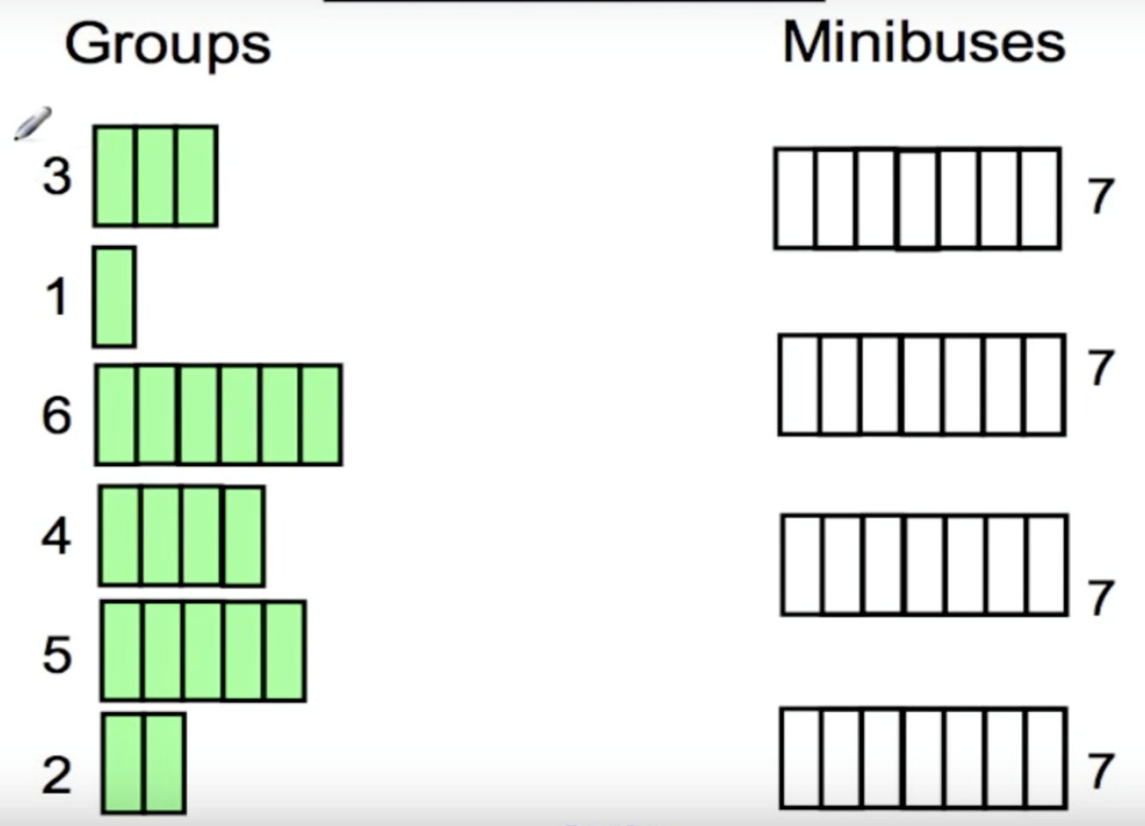
Exercise- 1
‹#›

Slide 33
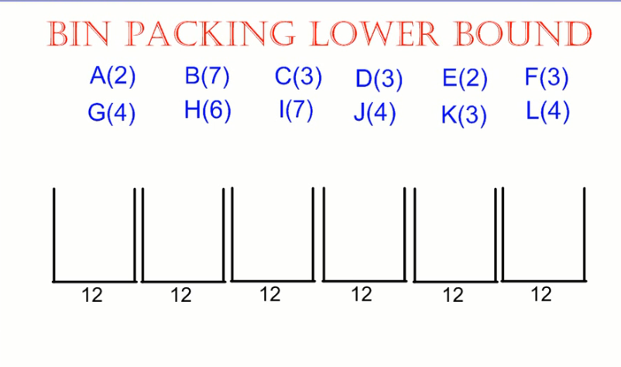
Exercise- 2
1. Find the lower bound.
2. Find how many bins are required to move these items using three algorithms.
3. Which is more efficient and why?
‹#›

Slide 34
Link
https://www.youtube.com/watch?v=kiMFyTWqLhc
‹#›

Slide 35

Thank you!
‹#›

