Slide 1
Airline Reservation Mobile App
Michael Munsey, Jonathan Veilleux
June 19, 2017
CLDAWS CP 230 A
System Operations for Amazon Web Services

Slide 2






Backend Tools
Mobile Hub
Cognito
DynamoDB
S3
Amazon S3
Amazon Cognito
IAM
Amazon DynamoDB
Notes:
Mobile Hub is a toolbox to help you connect the other components. It isn’t actually used at runtime.
Mobile Hub has support for API Gateway, Lambda, and other tools but we did not use them.
Public – Any app user can read and write to any item
Protected – Any app user can read, only owner can write to item
Private – Only the owner can read and write the item.

Slide 3
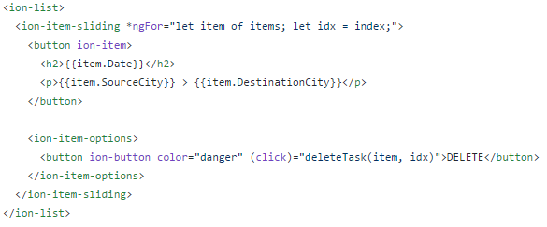
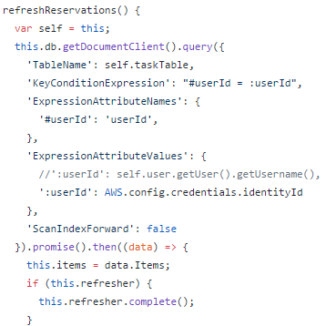
App tools
Cordova (hybrid apps)
Ionic Framework
Fully Cross-Platform*
TypeScript/Angular Framework
Notes:
(Michael)
Hybrid vs. Native
Hybrid – transpile to HTML, JS, and CSS instead of platform specific APIs
+easy to code, -larger binary, runs slower
Less features such as animations than in Swift, etc.
Cordova, PhoneGap
NativeScript
TypeScript – Components - OOP for JavaScript
Angular – data binding, dependency injection

Slide 4
Challenges
Both of us new to Angular
Debugging mobile apps can be hard
Did not get emulator working
Can use tethered device with Android Studio/Xcode
Most features can be tested in web
Did not get Visual Studio Code working on EC2 instance
Had difficulty with any QT/GTK application
Works on Ubuntu on EC2?
Used Cloud9 web IDE
Ionic not as well documented as we had hoped
Had trouble finding examples
As many classmates found, AWS was the easy part of the project

Slide 5
Demo
https://s3-us-west-2.amazonaws.com/230demo/android-debug.apk
http://230demo.s3-website-us-west-2.amazonaws.com/

