Slide 1
American International University-Bangladesh (AIUB)
Faculty of Engineering (FE) | Department of Electrical and Electronic Engineering (EEE)
Arduino-Based Gas Leakage and Fire Detection System With Prevention and Safety Mechanisms
Course:
Microprocessor and Embedded Systems(COE3104)
Semester:
Spring 2025-2026 |
Faculty:
Group #:
Capstone Project Presentation – COE3104 – AIUB

Slide 2
Team Members
01
Najiat Islam Rishad
ID: 23-55218-3 | BSc in CSE | AIUB
02
03
04
05
2

Slide 3
Introduction & Problem Statement
Gas Leakage Risk
77.7%
Gas leaks in homes, restaurants & labs cause explosions, fire, and loss of life.
Concerned about gas
leakage hazards
Delayed Detection
Conventional systems are expensive and often inaccessible to low-income households.
70.4%
Do NOT use any
detection device
Market Gap
70.4% of surveyed households use NO gas or fire detection device at all.
42.6%
Our Solution
Willing to pay
under 1500 BDT
A low-cost, real-time Arduino-based detector with automatic ventilation & shutoff.
3

Slide 4
Motivation & Societal Relevance
Frequent Accidents
Affordability Crisis
Domestic gas incidents are common in urban and semi-urban areas of Bangladesh due to negligence and lack of safety devices.
42.6% of users can only afford devices under 1500 BDT — far below most commercial detectors, creating a design constraint.
Immediate Alert Need
Automation Impact
38.9% of users prioritize a loud buzzer alert over remote IoT notifications, validating our local-first design approach.
Embedded systems with servo-motor gas shutoff and exhaust fan activation can actively prevent hazard escalation without human action.
4

Slide 5
Literature Review
Recent research (2022–2025) on embedded safety systems was reviewed to identify trends and gaps.
Identified Trends
Research Gaps Addressed
✔
Arduino & IoT adoption growing rapidly for gas/flame safety monitoring.
✖
Most systems are expensive and not accessible to common households.
✔
Dual-sensor (gas + flame) architecture improves hazard accuracy.
✖
Many rely on internet connectivity — unreliable in emergencies.
✔
MQ-series sensors validated as effective for combustible gas detection.
✖
Few include automated gas shutoff and ventilation as combined response.
✔
Edge-based processing reduces latency vs cloud-dependent systems.
✖
False alarm rates remain high without proper calibration strategies.
5

Slide 6
Literature Review — Comparative Summary
Citation | Technology Focus | Key Contribution
[1] Mustofa (2025) | NodeMCU, MQ-6, Blynk IoT | IoT system with 9.52% error; 500m smartphone alert range.
[2] Ghasemi et al. (2025) | Dual-Sensor VOC/Pellistor, BLE, LoRa | Reliability testing; dual-sensor strategy for power optimization.
[3] Baballe et al. (2022) | ESP Controller, MQ-5, Email/App | Fast messaging emphasis; mobile notification reliability.
[4] Alao et al. (2024) | ESP32, MQ-2, Flame, Servo Motor | Integrated sensors with servo motor for automatic gas shutoff.
[5] Arfianto et al. (2025) | Arduino Nano 33 BLE, TinyML Edge | Edge processing; reduced latency and power consumption.
Our system addresses gaps: affordable, local-alert-first, with automatic ventilation AND gas shutoff — all in one device.
6

Slide 7
Project Objectives
Main Aim
To design and implement a low-cost, Arduino-based embedded safety system that detects gas leakage and flame hazards in real time, and automatically activates ventilation and gas supply shutoff to prevent accidents.
①
Design a real-time gas & flame detection system using Arduino hardware with MQ-2 and flame sensor.
③
Implement automatic safety mechanisms: exhaust fan activation and servo-motor gas supply shutoff.
②
Generate immediate audio-visual alerts (buzzer, LED) and display system status on a 16×2 LCD.
④
Evaluate the system through experimental testing and validate against numerical simulation results.
7

Slide 8
System Components
Arduino Uno R3
MQ-2 Gas Sensor
Central microcontroller / processing unit
1 pc
Detects combustible gases (butane, LPG, smoke)
1 pc
Flame Sensor Module
Active Buzzer
1 pc
Immediate audio alert on hazard detection
1 pc
Detects infrared radiation from fire sources
Servo Motor
16×2 LCD Display
1 pc
1 pc
Automatically closes gas cylinder valve
Real-time status messages (SAFE / GAS / FLAME)
Red LED + Resistors
DC Exhaust Fan
Visual flashing alert indicator
1+2 pc
Ventilation activation via MOSFET switching
1 pc
Mosfet
Control Fan Power
1 pc
ESP-01 ESP8266
Send Data Over WiFi
1 pc
8

Slide 9
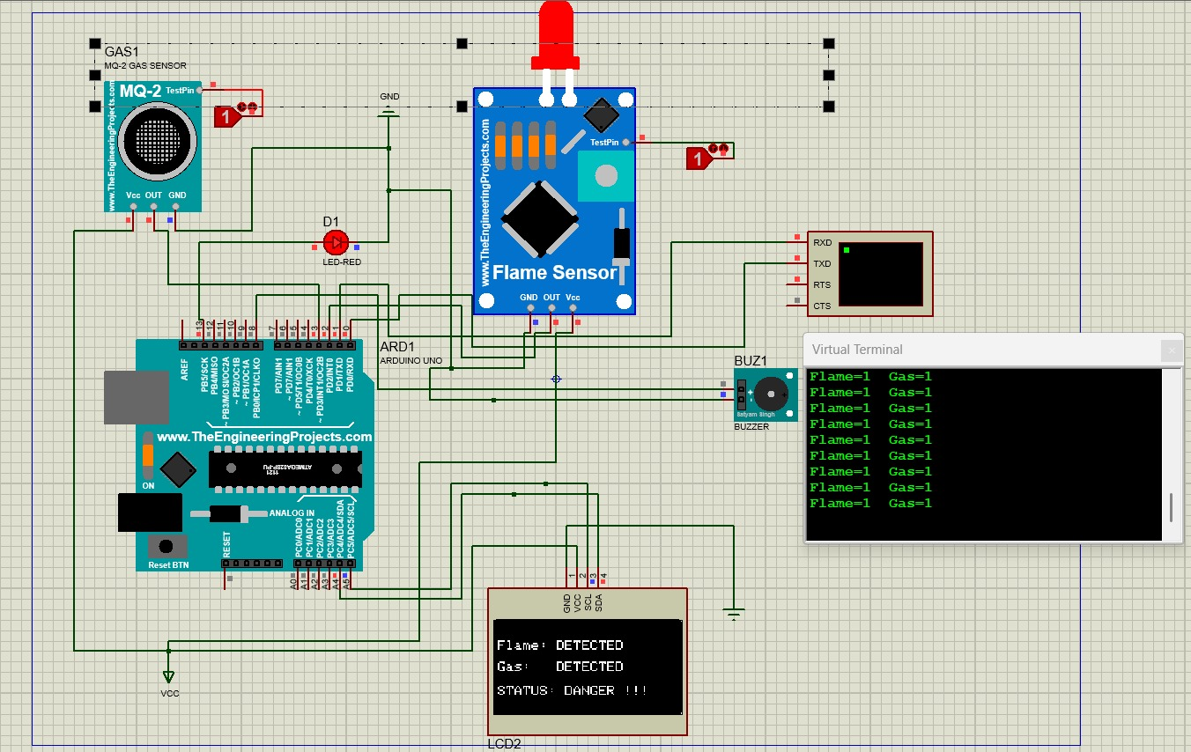
Project Simulation

Slide 10
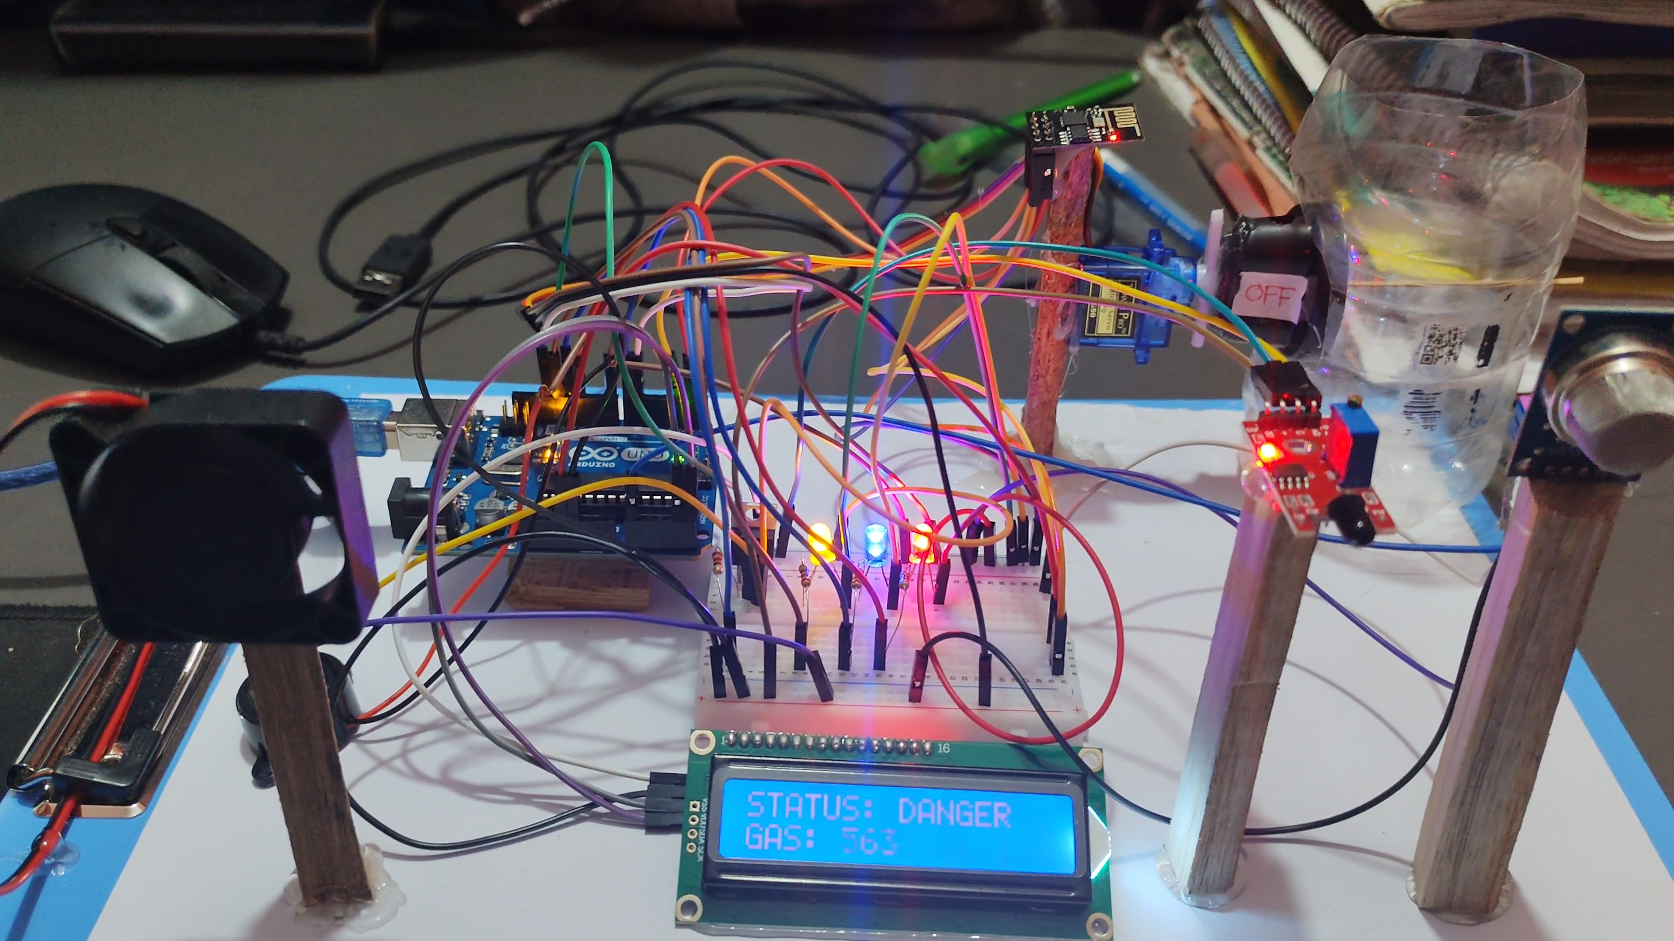
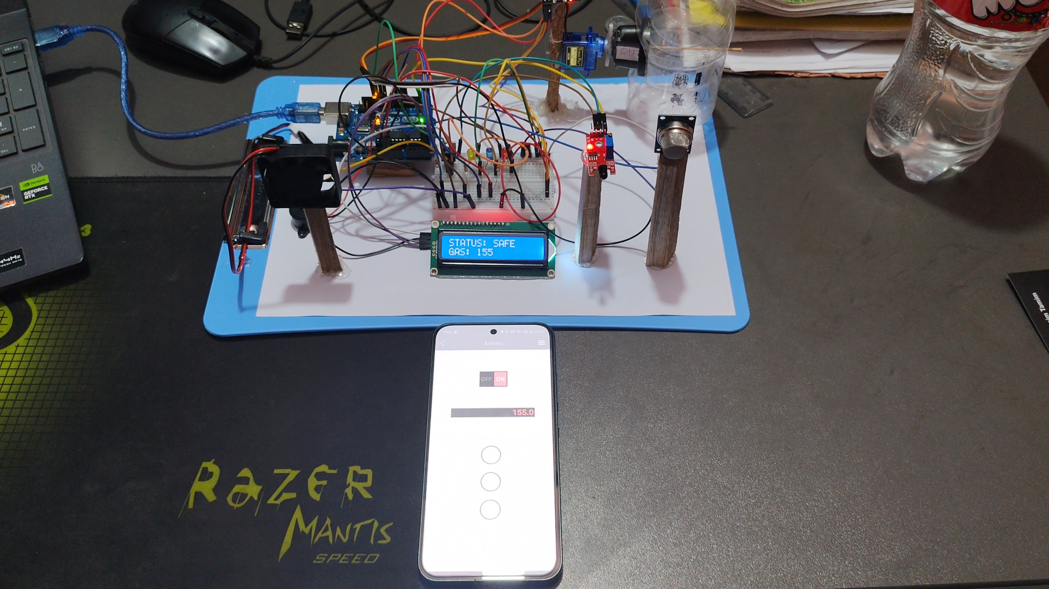
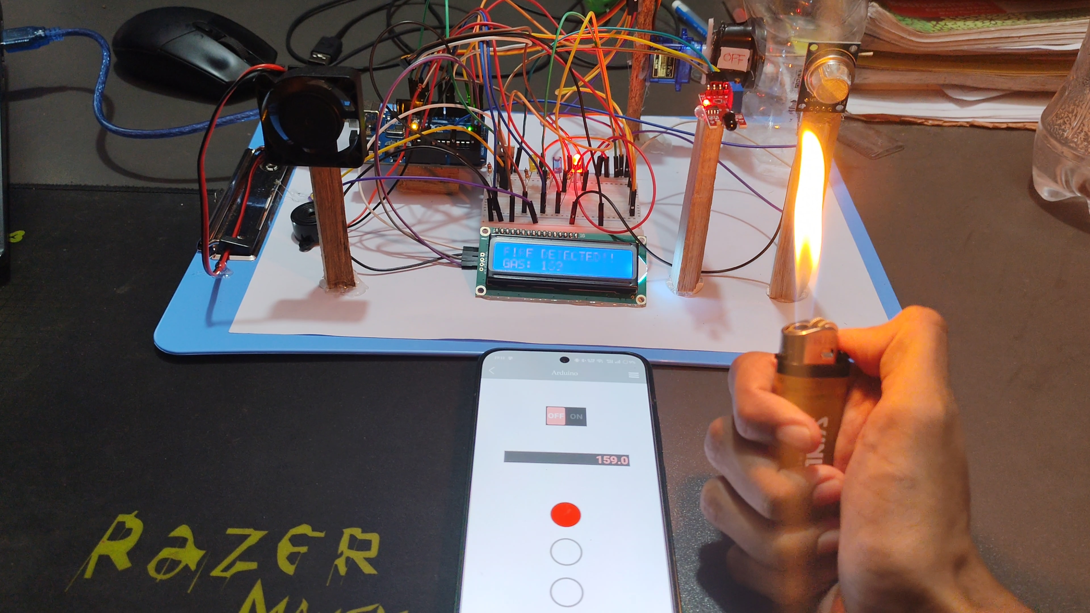
Experimental Results Under Different Conditions
Figure 2: Flame Detection and Alert Activation
Figure 3: Gas Leakage Detection with Fan Activation and Servo Shutoff
Figure 1: System in Normal Condition (Safe State)

Slide 11
Working Principle & System Architecture
The MQ-2 sensor continuously monitors gas concentration; the flame sensor detects infrared radiation. Arduino Uno reads both sensors, compares against thresholds, and triggers: audio-visual alerts, exhaust fan ventilation, and servo motor gas shutoff simultaneously.
Buzzer
+ LED
MQ-2 Gas
Sensor
Arduino
Uno R3
16×2 LCD
Display
Analog/Digital Signals
Control Outputs
Exhaust
Fan
Flame
Sensor
Servo Motor
(Gas Off)
ESP-01 → Android App
Buzzer Alarm
LED Alert
9

Slide 12
Methodology
01
Circuit Design
Designed the schematic linking Arduino Uno, MQ-2, flame sensor, buzzer, LCD, servo motor, MOSFET, and exhaust fan.
02
Sensor Calibration
MQ-2 sensor was tested and calibrated with ADC thresholds. Baseline range (320-360 ADC) and alarm threshold (>450 ADC) determined.
03
Arduino Programming
Threshold-based monitoring logic written in C++. System continuously polls sensors and executes alert & safety routines on threshold breach.
04
Simulation & Validation
System behavior numerically analyzed before physical build. Simulated gas leakage and flame conditions validated all output responses.
05
Hardware Testing
Prototype tested in lab: butane exposure simulated gas leak; lighter flame tested flame detection at multiple distances.
10

Slide 13
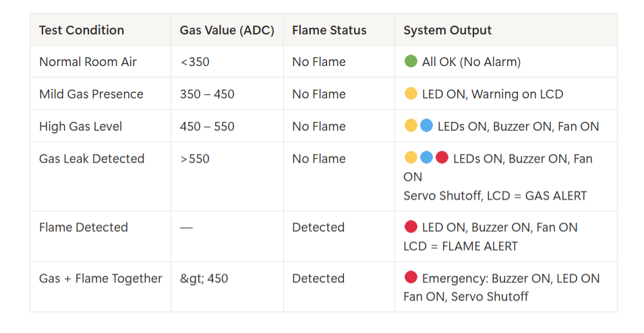
Experimental Test Results
Threshold-based logic confirmed: reliable hazard detection with consistent alert and automated safety response across all test conditions.
11

Slide 14
Performance Analysis & Cost Overview
Real-Time Detection
Cost Analysis
System responds within seconds of gas threshold breach or flame detection — no dependency on internet.
Arduino Uno R3
~450 BDT
Dual Sensor Coverage
MQ-2 Gas Sensor
~120 BDT
MQ-2 gas sensor + flame sensor together minimize false negatives and improve hazard coverage.
Flame Sensor
~80 BDT
Automatic Mitigation
EESP-01
~200 BDT
Exhaust fan + servo-controlled gas shutoff activate simultaneously — no user action required.
Servo Motor
~160 BDT
Stability Confirmed
Exhaust Fan+MOSFET
~130 BDT
Minimal false alarms after calibration; consistent behavior under repeated simulation and lab testing.
Misc (wires, LED, LCD, etc)
~250 BDT
Total Estimate
~1390 BDT
12

Slide 15
Survey Findings & User Research
Platform: Google Forms | Total Respondents: 54 | Focus Areas: Gas safety awareness, device usage, features, pricing
77.7%
70.4%
42.6%
38.9%
Concerned or Very
Concerned about gas hazards
Do NOT use any gas or
fire detection device at home
Would only pay less than
1500 BDT for a safety device
Prioritize LOUD BUZZER
as the #1 safety feature
Survey Metric | Result | Design Implication
Problem Demand | 77.7% concerned | Validates psychological need for the device.
Market Gap | 70.4% no device at home | Confirms massive untapped market opportunity.
Price Constraint | <1500 BDT preferred | Drives strict low-cost component selection.
Feature Priority | Loud buzzer (38.9%) | Justifies audio-visual local alert design.
13

Slide 16
Conclusion
The developed Automatic Gas Leakage and Fire Detection System successfully demonstrates a low-cost, reliable, and real-time safety monitoring solution suitable for households and small commercial environments.
✔
Reliable Hazard Detection
System accurately detects gas leakage (ADC >450) and flame presence in real time with consistent threshold-based response.
✔
Automatic Safety Response
Exhaust fan ventilation and servo-controlled gas shutoff activate immediately — no human intervention required.
✔
Affordable & Accessible
Total cost ~1300 BDT — well within the 1500 BDT price ceiling identified by 42.6% of survey respondents.
✔
Locally Operational
No internet connectivity required; system remains functional during power outages or network disruptions.
14

Slide 17
Future Scope & Enhancements
01 — IoT Remote Alerting
02 — Solenoid Valve Upgrade
Integrate Wi-Fi / GSM module to send mobile app or SMS alerts when users are away from home.
Replace servo motor with industrial solenoid valve for more powerful and fail-safe gas supply control.
03 — Battery Backup System
04 — Smart Home Integration
Add rechargeable power backup to ensure operation during power outages or emergencies.
Connect with home automation systems to trigger ventilation, appliances, and relay-based safety networks.
05 — Enhanced Sensor Calibration
06 — Cloud Data Logging
Implement filtering algorithms to reduce false alarms under variable humidity, airflow, and temperature.
Log sensor data to a cloud platform for pattern analysis, remote monitoring, and predictive safety alerts.
15

Slide 18
References
[1] S. Kumar and V. Patel, Low-Cost Fire Detection Using Microcontroller and Flame Sensor Network, IEEE Access, vol. 10, pp. 115230-115240, 2022.
[2] M. Uddin, R. Chowdhury, and K. Hossain, Smart Home Safety Monitoring System Using Arduino and IoT, IEEE ICCECE, 2024, pp. 556-561.
[3] H. Tanvir and N. Chowdhury, Embedded LPG and Methane Leakage Alert System for Domestic Applications, IEEE TENSYMP, 2023, pp. 102-107.
[4] R. Singh, M. Das, and P. Roy, Design of a Multi-Sensor Fire and Gas Detection System for Smart Buildings, IEEE IS, 2022, pp. 844-850.
[5] J. Park and J. Lee, Real-Time Fire Detection Using Flame Sensors and Edge Computing, IEEE IoT Journal, vol. 9, no. 12, pp. 9510-9521, 2022.
[6] A. Mustofa, Design an Internet of Things-Based LPG Gas Leak Detection System, 2025.
[7] S. M. Ghasemi et al., Reliability and Performance Evaluation of IoT-Based Gas Leakage Detection Systems, 2025.
[8] M. A. Baballe et al., A Comparative Study on Gas Alarm Detection System, 2022.
[9] P. O. Alao et al., Integrated Gas Leakage Detection and Automatic Shutoff System, 2024.
[10] R. Arfianto et al., Gas Leakage Detection Using Tiny Machine Learning (TinyML), 2025.
16

Slide 19
AIUB | Faculty of Engineering | EEE Department
Digital Logic and Circuits Lab — EEE3102
Thank You
Automatic Gas Leakage and Fire Detection System
Using Arduino with Ventilation and Safety Shutoff
Group 05 | Section S | Spring 2025–2026
Questions & Discussions Welcome
Faculty Advisor: S M Tanvir Hassan Shovon
AIUB | EEE3102 Capstone Project | Group 05

