Slide 1
Mazewar (Lab 2) Tutorial
ECE419

Slide 2
Agenda
Code Structure
what you need to do
Game Initialization
Game Play
Applying the Patch
Questions
Ali: Fault Tolerance

Slide 3
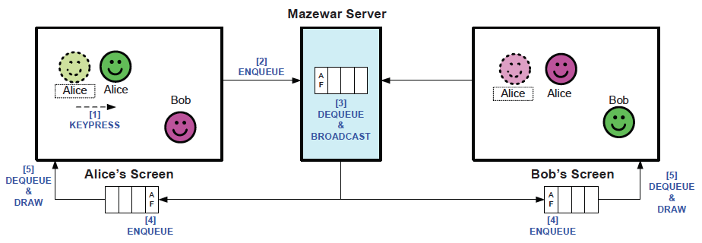
Game Overview

Slide 4
Architecture
Server (Need to create Files)
Client Files (Possibly need to modify):
Mazewar.java: Creates game
*Client.java: All the different clients
Maze.java
MazeImpl.java

Slide 5
Mazewar Server (High level)
public class MazewarServer{
//enqueue - multithreaded since
//many clients
//dequeue and broadcast
}

Slide 6
Server and Server Threads
Server
Server
Thread
Client 1
Server
Thread
Client 2

Slide 7
Mazewar Server
public class MazewarServer{
//Error checking
//Declare Data Structures
ServerSocket s = new ServerSocket(3000);
new MazewarBcastThread().start();
while(true)
//listens and enqueues
new MazewarThread(s.accept(),...).start();
}
Notes:
start with this class

Slide 8
Server Thread Class
public class MazewarThread extends Thread{
public MazewarThread(Socket s, <<other args>>){...}
public void run(){
while(true){
//read packet
//process
//enqueue packet
Notes:
High level description:
what are the threads doing, i.e. processing, listening, broadcasting

Slide 9
Alternative Thread Declaration
public class MazewarThread implements Runnable{
public void run(){
//
}
}

Slide 10
Client (High Level)
Send Events
2) Receive Events
while(true){
//readpacket
//enqueue-packet
//execute event on appropriate client
}

Slide 11
Game Overview
Initialization
Create players as required
Game Play
Event happens on client (e.g. Bob moves left)
Client sends events to server
Server broadcasts events
Client executes event
Notes:
add alice, bob figure

Slide 12
Player Creation
Players are instantiated in Mazewar.java
guiClient = new GUIClient(name);
maze.addClient(guiClient);
Creating Remote players:
RemoteClient r = new RemoteClient(“foo”);
maze.addClient(r);

Slide 13
Client Events
see GUIClient.java, function keypressed
public void keyPressed(KeyEvent e) {
...
// Up-arrow moves forward.
else if(e.getKeyCode() == KeyEvent.VK_UP) {
forward();
...

Slide 14
Sending Events to Server
GUIClient.java, function keypressed,is where keystrokes are recorded.
//Send them to the server here.
//Do not call action method e.g. forward().

Slide 15
Client-Server Comm: Serialization
Need to serialize data; create a packet class (MazewarPkt)
{...
public static final int UP = 1;
int event;
int player;
...}

Slide 16
Client-Server Comm: Sending Pckts
ObjectOutputStream sender = //initialize
...
MazewarPkt p = new MazewarPkt;
p.event = 1; //i.e. UP event
p.Player = 1; //i.e. Bob
sender.writeObject(p);

Slide 17
Client-Server Comm: Receiving Pckts
listens for incoming packets
ObjectInputStream receiver = //initialize
...
MazewarPkt p = new
=(MazewarPkt)receiver.readObject();

Slide 18
Receiving Events from Server
MazewarPkt p;
while (true){
p = new
=(MazewarPkt)receiver.readObject();
//enque packet
}

Slide 19
Moving Players
Both Remote and Local Client inherit from Client Class.
Client has forward(), backup(), turnLeft(), turnRight().
Call these methods when events are dequeued by client (this is what keypressed is doing too).

Slide 20
Known Issues
Glitch with player orientation- when player spawns, the orientation is displayed incorrectly key presses many times (left or right) will correct it
Do manually, or programmatically

Slide 21
Known Issues -2
Synchronization Issue with Missile:
-Missile movement is not atomic
-there can be interference from other events, leading to inconsistency
-i.e. the event queue and the missile action are not synchronized with each other, their interleaving can create inconsistency
Notes:
Explain what the patch is for
-missile displayed step by step, not atomic
-there can be interference from other player action -> leading to inconsistency
-queues are independent

Slide 22
A
QUEUE
1)A Left
A Left
1)A Left
A Left
1)A Left
2)B Right
2)B Right
2)B Right
SERVER
1)A Left
B Right
1)A Left
2)B Right
2)B Right
B Right
B

Slide 23
A
A
Since fire event not sent to server, there is no ordering.
B move event might happen before or after bullet reaches B.
A Fires
A Fires
B
B Moves
B
B Moves

Slide 24
Fix: Synchronize Missile Tick
Currently, Missile movement being controlled in MazeImpl.java, run method.
Client: Replace run with missileTick method that moves missile every fixed period (run does this) so that it is synchronized with the rest of the events.
Run: Modifies projectileMap, a map of projectiles and their positions
Server: Use a server separate thread that adds a “missile tick” event every 200ms
Notes:
put figure
-put some code from solution in slide

Slide 25
Mazewar Server
public class MazewarServer{
//Error checking
//Declare Data Structures
ServerSocket s = new ServerSocket(3000);
new MazewarBcastThread().start();
new MazewarTickerThread().start();
while(true)
new MazewarThread(s.accept(),...).start();
}
Notes:
MC 254: WED: 5-6
Go high level -> details
If patch not applied, -> inconsistency

Slide 26
Server: Ticker Thread
public class MazewarTickerThread()extends Thread{
public void run(){
//Enqueue tick event
try{
Thread.sleep(200);
}catch (InterruptedException e) {
e.printStackTrace();
}
}
}

Slide 27
Achieving Concurrency
Use concurrent data structures- Blocking Queue interface
Synchronization methods
Synchronized statements, i.e. with locks and semaphores.

Slide 28
Compiling and Running
-A Makefile is provided. Will need to modify Makefile and Makefile.dep when you add your own files.
-Modify: ${ECE419_HOME} and ${JAVA_HOME}) if testing at home.
-./run.sh

Slide 29
Tips
-working in groups of 2, so use version control (Bitbucket provides free private repos for Git)
-Understand how the code works, you’ll be able to debug better.
-Many parts of the code (queueing events) will be reused for Lab 3. Write your program so that it is easy to modify.

Slide 30
Tips
Lab 3, will be similar except p2p (can reuse client queuing code)
Ideally, no centralization
-lightweight centralization (penalty)
Bonus points for:
fault tolerance
dynamic joins
bots

