Slide 1
A SHORT OVERVIEW OF
LWM Management System

Slide 2

Front/Home Page
Signup module for
User registration
Login module for
User login

Slide 3
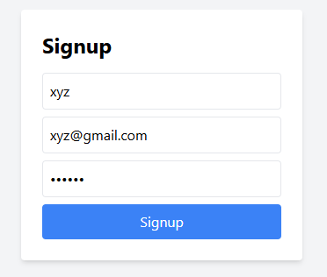
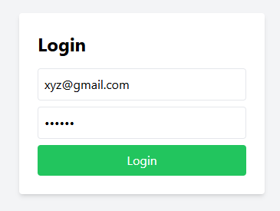
Sign in / Login
Redirect...
Users need to provide Name, Email and Password for signing in to the system
Users need to provide Email and Password for logging in to the system. Users will be redirected to the Dashboard after logging in.

Slide 4
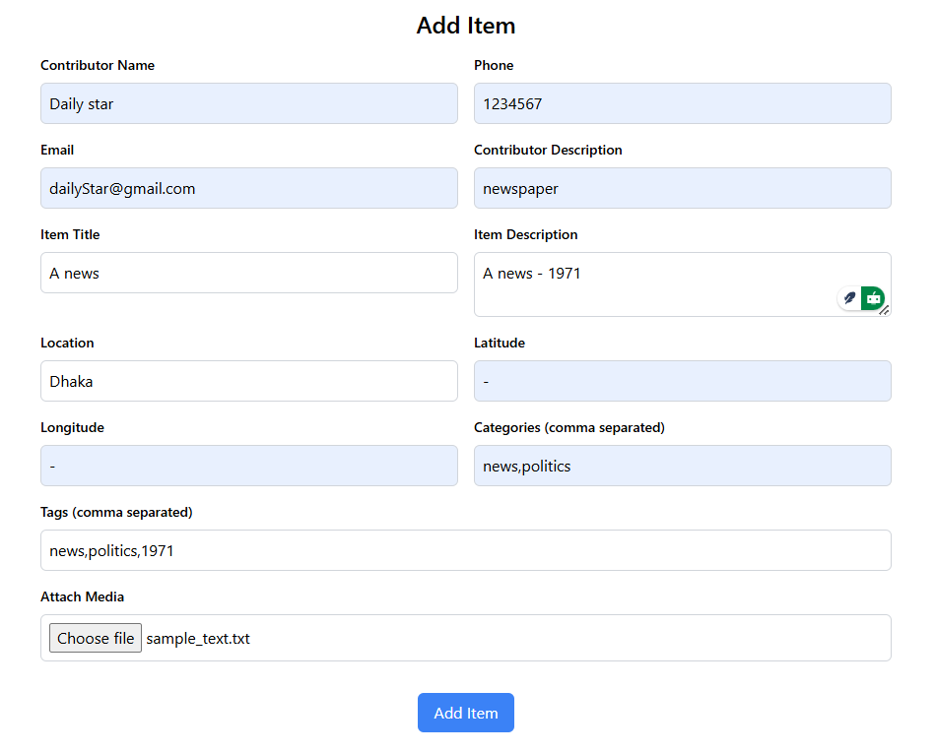
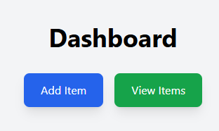


Add Item
Users need to fill up the boxes to add an item.
Users can attach media (jpg/png/txt/pdf) to store

Slide 5
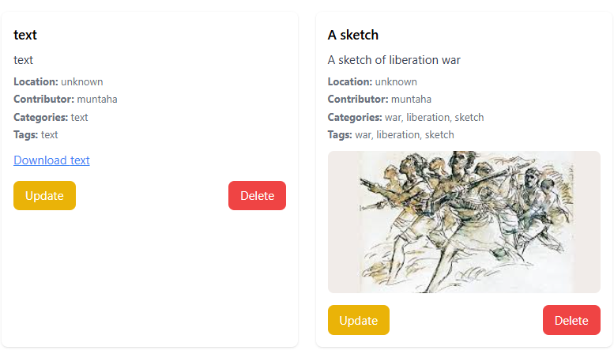


View Item
View items button navigates to the item display page
Users can also download the attachments

Slide 6
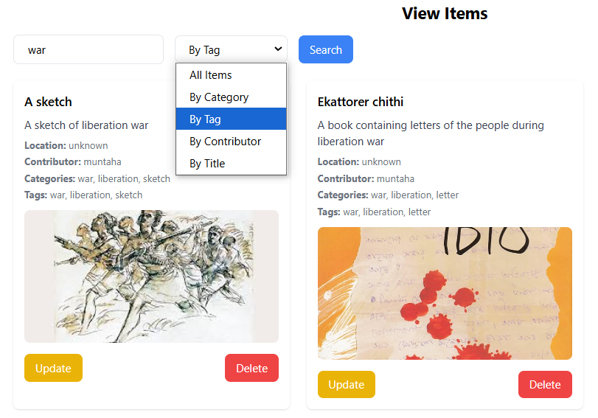

Search/filter Item
users can filter items according to the filter criteria

Slide 7
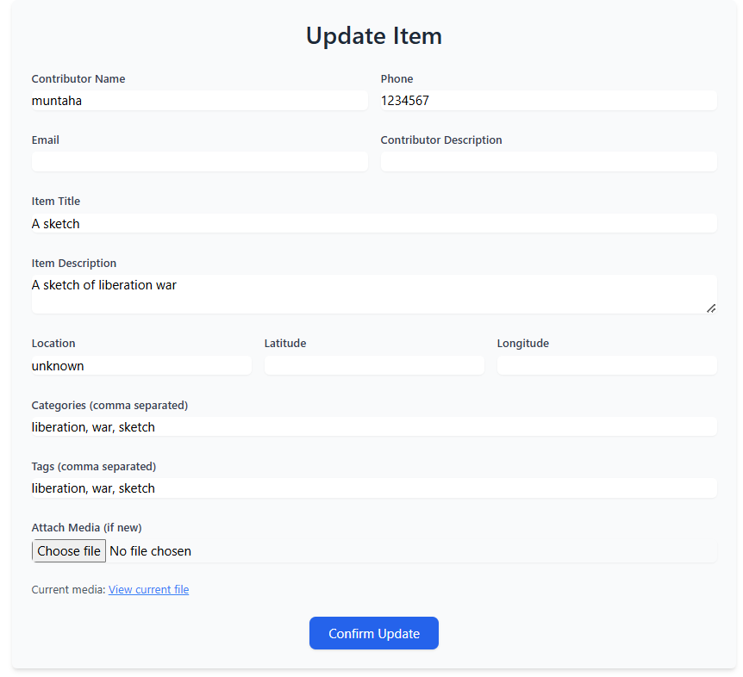
Update/delete Item
Users can update information with this button
Users can delete item with this button

