Slide 1

DX BALL
A PRESENTAION BY
MUNTAHA TASNIM(19)
AND MD. AZAHER UDDIN(31)

Slide 2

INTRODUCTION
THIS IS A CONSOLE BASED PC GAME NAMED “DX BALL”.
IT IS A SINGLE PLAYER GAME.

Slide 3
WE HAVE IMPLEMENTED THE GAME IN C LANGUAGE.
BESIDES,THE GRAPHICAL USER INTERFACE WAS IMPLEMENTED BY BGI LIBRARY.
CODE::BLOCKS WAS USED AS IDE.
BEHIND THE GAME

Slide 4
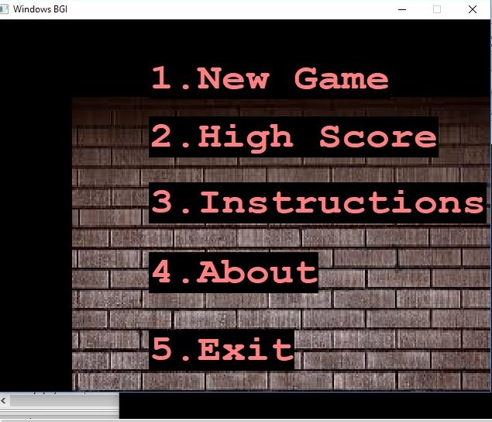
FFEATURES
THE GAME INCLUDES THESE FEATURES.
USING KEYBOARD TO CHOOSE OPTIONS AND GAMEPLAY.
PROVINDING PROPER INSTRUCTIONS IF CORRECT KEYS ARE NOT PRESSED.

Slide 5
GAMEPLAY
THIS IS A SINGLE PLAYER GAME WITH A MOVING BAR AND A DEFINITE AMOUNT OF COLORFUL BRICKS.
THE PLAYER HAS TO MOVE THE BAR WITH THE HELP OF ARROW KEYS AND REFLECT THE BALL.
THE BALL WILL COLLIDE WITH THE BRICKS AND BREAK THEM.

Slide 6
THE GAME HAS ACTUALLY TWO LEVELS.
1.EASY
2.HARD
IN THE EASY LEVEL OF THE GAME,THE BRICKS WILL BREAK JUST BY ONE COLLISION WITH THE BALL.
AND THE HARD LEVEL REQUIRES AT LEAST 2 COLLISIONS TO BREAK THE BRICKS.

Slide 7
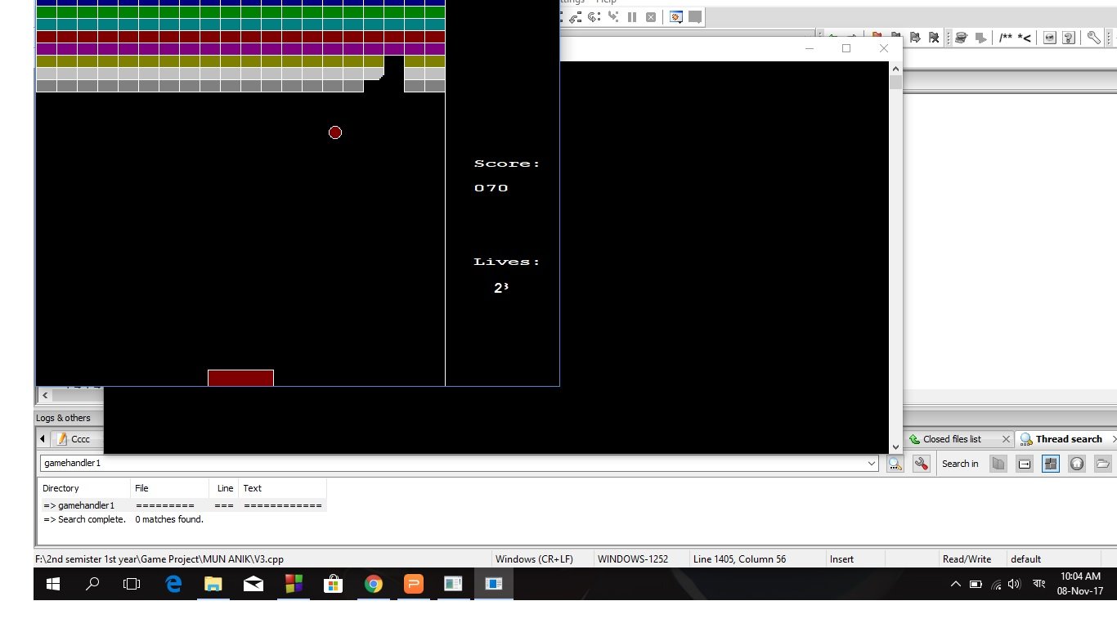
level 1(EASY)

Slide 8
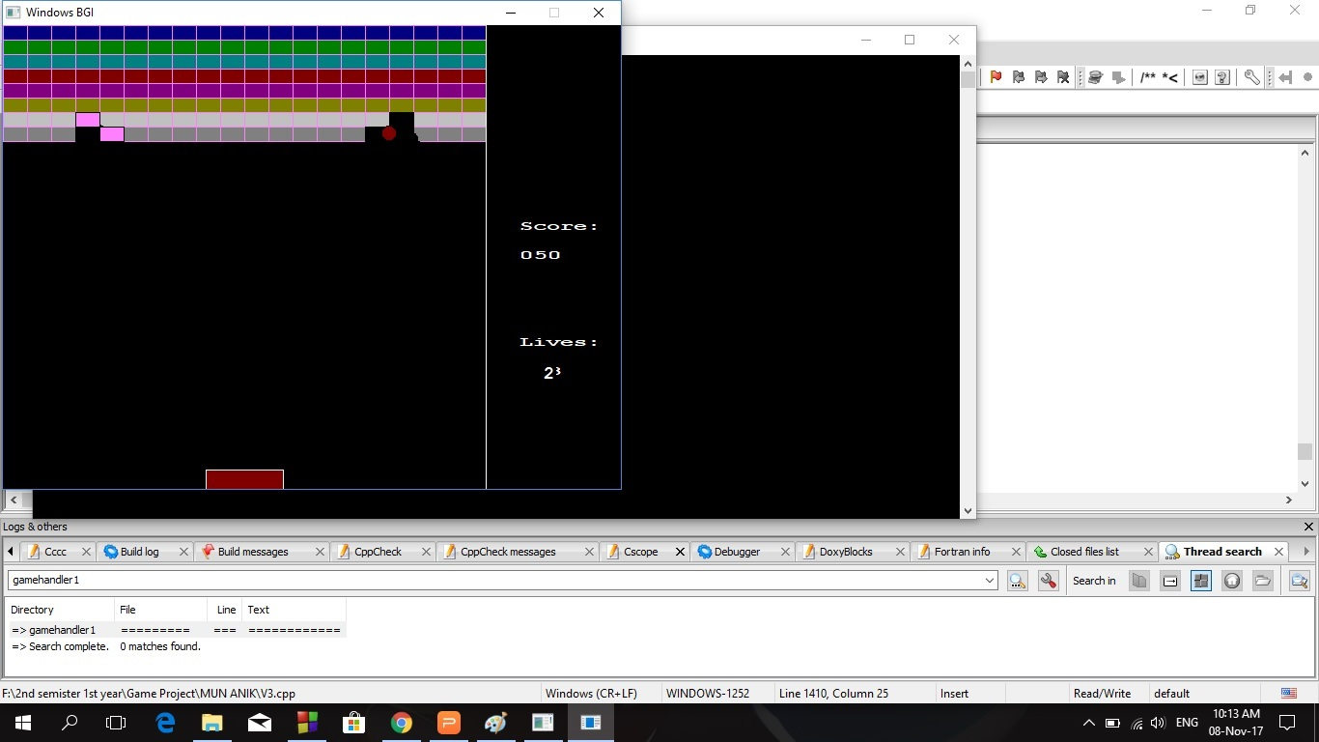
level 2(HARD)

Slide 9
SCORE
DISPLAYING UPDATED SCORES AND LIVES BESIDE THE GAMEPLAY WINDOW.
DISPLAYS HIGH SCORE IN CONSOLE.

Slide 10
SPECIAL FEATURES
PINPOINT COLLISION
SMOOTH GAMEPLAY(NO IMAGE IN GAME PLAY)
BALL HAS TO COLLIDE PERFECTLY TO DESTROY THE BRICKS.OTHERWISE THEY REBUILD.

Slide 11
POINTS
DIFFERENT BRICKS HAVE DIFFERENT SCORE POINTS.
THE BRICKS IN THE HIGHER ROWS HAVE HIGHER SCORES.
BRICKS IN ROW 1 WILL HAVE 10 POINTS PER BRICK FOR BREAKING
AND IF IT'S ROW 7 OR 8 IT WILL GRAB CONSECUTIVELY 70 AND 80 POINTS.

Slide 12
LIVES
IF THE BALL IS LOST, LIVES WILL DECREASE GRADUALLY FOR EACH LOOSING.

Slide 13
GAME STRUCTURE
IMPLEMENTING OBJECT ORIENTED PROGRAMMING.
IMPLEMENTED BAR/BALL/GAME FUNCTIONS IN THEIR OWN STRUCTURES.

Slide 14
THE GAMEPLAY IS CONSTRUCTED BY REMOVING AND REDRAWING OBJECTS TO SHOW ANIMATIONS.

Slide 15
THANK YOU :)

