Slide 1
More Applications of the Pumping Lemma

Slide 2









The Pumping Lemma:
Given a infinite regular language
there exists an integer (critical length)
for any string with length
we can write
with and
such that:

Slide 3
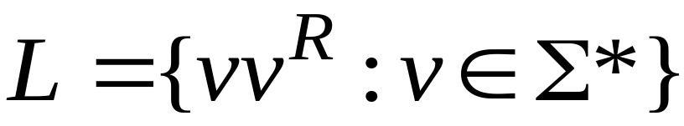
Non-regular languages
Regular languages

Slide 4

Theorem:
The language
is not regular
Proof:
Use the Pumping Lemma

Slide 5
Assume for contradiction
that is a regular language
Since is infinite
we can apply the Pumping Lemma

Slide 6



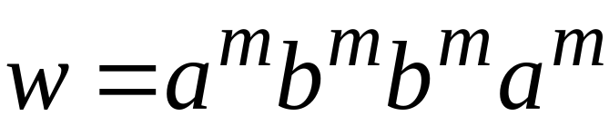
Let be the critical length for
Pick a string such that:
and
length
We pick

Slide 7
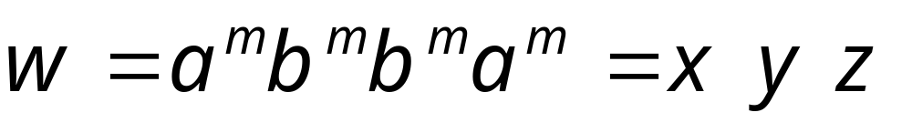

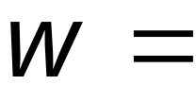



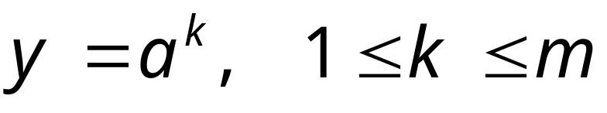
From the Pumping Lemma:
we can write:
with lengths:
Thus:

Slide 8
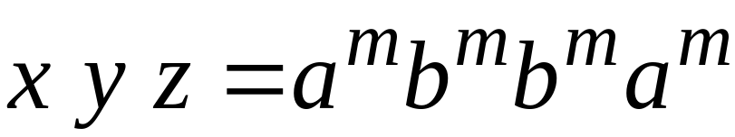

From the Pumping Lemma:
Thus:

Slide 9

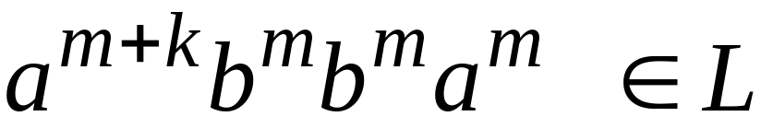
From the Pumping Lemma:
Thus:

Slide 10

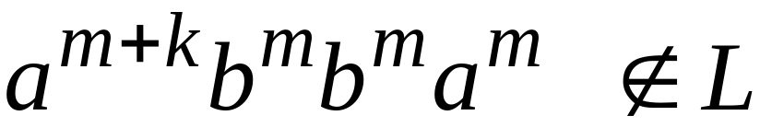
BUT:
CONTRADICTION!!!

Slide 11
Therefore:
Our assumption that
is a regular language is not true
Conclusion:
is not a regular language
END OF PROOF

Slide 12

Non-regular languages
Regular languages

Slide 13
Theorem:
The language
is not regular
Proof:
Use the Pumping Lemma

Slide 14
Assume for contradiction
that is a regular language
Since is infinite
we can apply the Pumping Lemma

Slide 15

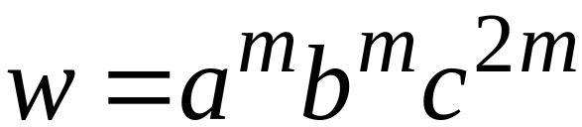
Let be the critical length of
Pick a string such that:
and
length
We pick

Slide 16
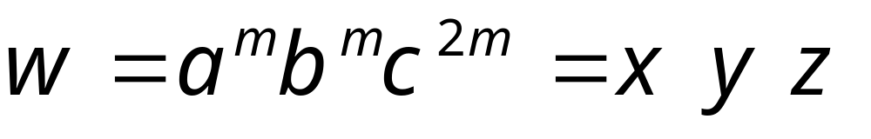


From the Pumping Lemma:
We can write
With lengths
Thus:

Slide 17
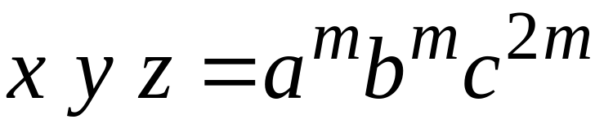
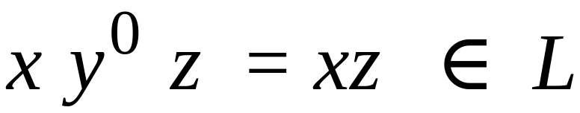
From the Pumping Lemma:
Thus:

Slide 18
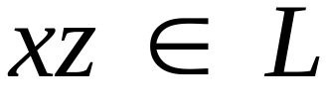

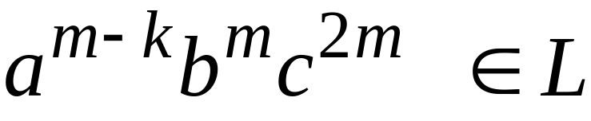
From the Pumping Lemma:
Thus:

Slide 19
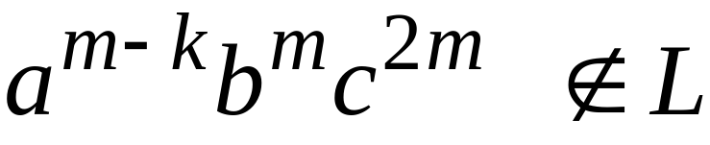
BUT:
CONTRADICTION!!!

Slide 20
Therefore:
Our assumption that
is a regular language is not true
Conclusion:
is not a regular language
END OF PROOF

Slide 21
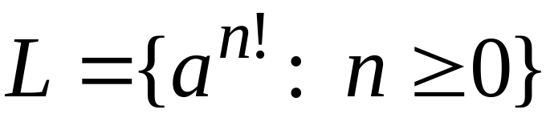
Non-regular languages
Regular languages

Slide 22
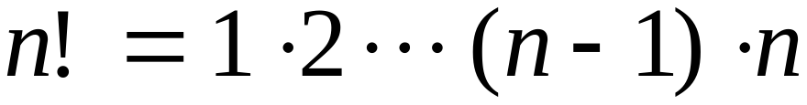
Theorem:
The language
is not regular
Proof:
Use the Pumping Lemma

Slide 23
Assume for contradiction
that is a regular language
Since is infinite
we can apply the Pumping Lemma

Slide 24
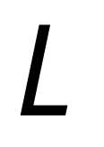
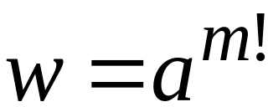
Let be the critical length of
Pick a string such that:
length
We pick

Slide 25
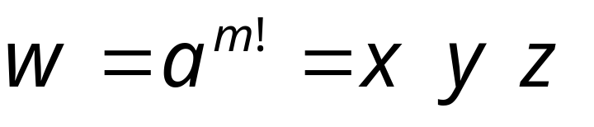

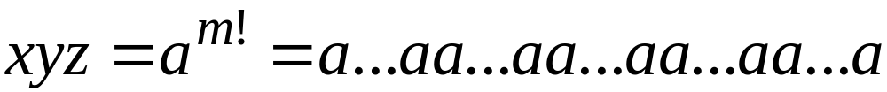
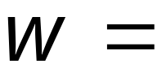
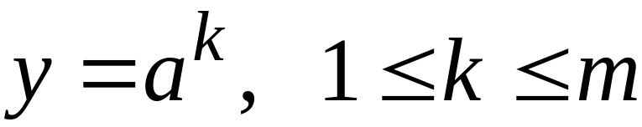
From the Pumping Lemma:
We can write
With lengths
Thus:

Slide 26
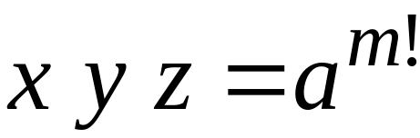
From the Pumping Lemma:
Thus:

Slide 27

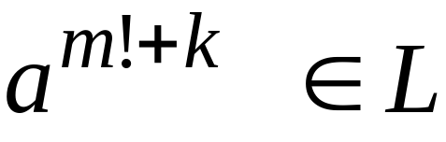
From the Pumping Lemma:
Thus:

Slide 28
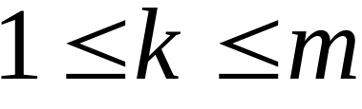

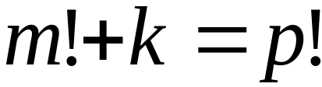
Since:
There must exist such that:

Slide 29

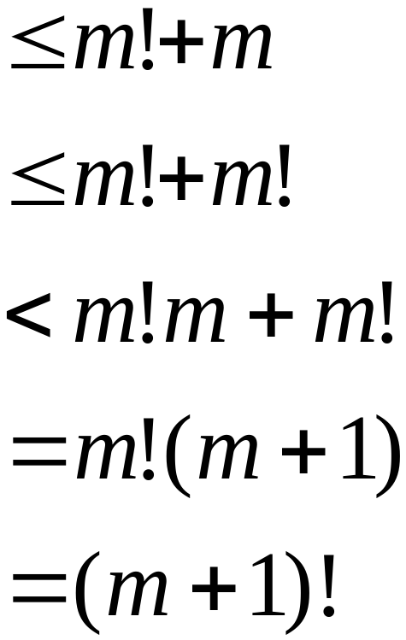

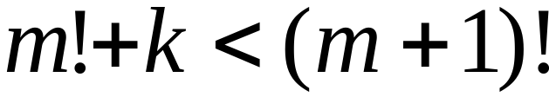
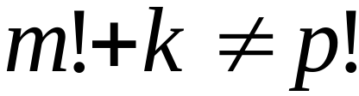
However:
for
for any

Slide 30
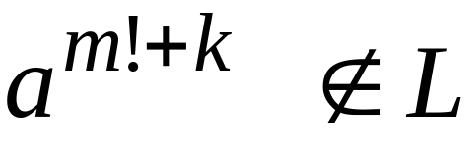
BUT:
CONTRADICTION!!!

Slide 31
Therefore:
Our assumption that
is a regular language is not true
Conclusion:
is not a regular language
END OF PROOF

