Slide 1
Theory of Computation
Access Code: KW2TP-9F9TP

Slide 2

Hello!
I am Meskat Jahan
I am here because I love to learn something with all of you …...
You can find me at:
Meskat.jahan@gmail.com

Slide 3
Reference Books
Introduction to the Theory of Computation. CENGAGE Learning, 3rd ed., 2012 - M. Sipser.
Introduction to Automata Theory, Languages, and Computation. Addison-Wesley Longman Publishing Co., Inc., 3rd ed., 2006 - J. E. Hopcroft, R. Motwani, and J. D. Ullman.

Slide 4
Theory of Computation
Lecture 01
Introduction

Slide 5
Course Outline
Finite automata: deterministic finite automata, nondeterministic finite automata, equivalence and conversion of deterministic and nondeterministic finite automata, pushdown automata;
Context free languages; Context free grammars; Pushdown automata;
Regualar languages: regular expressions, nonregular languages, the pumping lemma;
Turing Machines: basic machines, configuration, computing with Turing machines, combining Turing machines; Undecidability..

Slide 6
Assessment methods :
Category Marks %
Class Participation/ Observation 5
Class Attendance 10
Quizzes/class tests 15
Mid Term Examination (1.5 hours) 20
Final Examination (3 hours) 50
Total 100

Slide 7
Theory of Computation: area
Formal Language Theory
language = set of sentences (strings)
grammar = rules for generating strings
production/deduction systems
capabilities & limitations
application: programming language specification
Automata Theory (Abstract Machines)
models for the computing process with various resources
characterize ``computable”
capabilities & limitations
application: parsing algorithms
Complexity Theory
inherent difficulty of problems (upper and lower bounds)
time/space resources
intractable or unsolvable problems
application: algorithm design

Slide 8
Major Themes
Study models for
problems
machines
languages
Classify
machines by their use of memory
grammars and languages by type
languages by class hierarchies
problems by their use of resources (time, space, …)
Develop relationships between models
reduce solution of one problem to solution of another
simulate one machine by another
characterize grammar type by machine recognizer

Slide 9
Describing Problems
Problems described by functions
functions assign ouputs to inputs
described by tables, formulae, circuits, math logic, algorithms
Example: TRAVELLING SALESPERSON Problem
Input: n(n-1)/2 distances between n cities
Output: order to visit cities that gives shortest tour (or length of tour)
Problems described by languages
``yes/no’’ problems or decision problems
a language represents a problem or question
input strings in the language: answer is ``yes’’; else ``no”
Example: HALTING Problem
Input: a string w and a Turing Machine M
Output: ``yes” if ;``no” otherwise
equivalent to asking if string
where

Slide 10
Types of Machines
Logic circuit
memoryless; values combined using gates
c
s
<
Circuit size = 5
⊕
>
Circuit depth = 3
>
⊕
x
y
z

Slide 11
Types of Machines (cont.)
Finite-state automaton (FSA)
bounded number of memory states
step: input, current state determines next state & output
a
0
1
Mod 3 counter
state/ouput (Moore) machine
a
2
a
models programs with a finite number of bounded registers
reducible to 0 registers
b

Slide 12
Types of Machines (cont.)
Pushdown Automaton (PDA)
finite control and a single unbounded stack
a, A/AA
a, $/A$
b, A/ε
b, A/ε
#, $/ε
models finite program + one unbounded stack of bounded registers
top
$
b

Slide 13
Types of Machines (cont.)
Turing Machine (TM)
finite control & tape of bounded cells unbounded in # to R
current state, cell scanned determine next state & overprint symbol
control writes over symbol in cell and moves head 1 cell L or R
models simple ``sequential’’ memory; no addressability
fixed amount of information (b) per cell
•
•
•
b
□
Finite-
state
control

Slide 14
How Machines are Used
To specify functions or sets
Transducer - maps string to string
Acceptor - ``recognizes” or ``accepts’’ a set of strings
Generator - ``generates” a set of strings
M
w
f(w)
M
yes
w
no
M accepts strings which cause it to enter a final state
M
f(w)
M generates all values generated during computation

Slide 15
Outline of the course contents
Computation
CPU
memory

Slide 16
temporary memory
input
CPU
output
Program memory

Slide 17
Example:
temporary memory
input
CPU
output
Program memory
compute
compute

Slide 18
temporary memory
input
CPU
output
Program memory
compute
compute

Slide 19
temporary memory
input
CPU
output
Program memory
compute
compute

Slide 20
temporary memory
input
CPU
Program memory
output
compute
compute

Slide 21
Automaton
temporary memory
Automaton
input
CPU
output
Program memory

Slide 22
Automaton
temporary memory
Automaton
input
output
transition
state

Slide 23
Different Kinds of Automata
Automata are distinguished by the temporary memory
Finite Automata: no temporary memory
Pushdown Automata: stack
Turing Machines: random access memory

Slide 24
Finite Automaton
temporary memory
input
Finite Automaton
output
Example: Elevators, Vending Machines
(small computing power)

Slide 25
Pushdown Automaton
Temp.
memory
Stack
Push, Pop
input
Pushdown
Automaton
output
Example: Compilers for Programming Languages
(medium computing power)

Slide 26
Turing Machine
Temp.
memory
Random Access Memory
input
Turing
Machine
output
Examples: Any Algorithm
(highest computing power)

Slide 27
Power of Automata
Simple
problems
More complex
problems
Hardest
problems
Finite
Automata
Pushdown
Automata
Turing
Machine
Less power
More power
Solve more
computational problems

Slide 28
Turing Machine is the most powerful
computational model known
Question: Are there computational
problems that a Turing Machine
cannot solve?
Answer: Yes
(unsolvable problems)

Slide 29
Time Complexity of Computational Problems:
NP-complete problems
Believed to take exponential
time to be solved
P problems
Solved in polynomial time

Slide 30
What is Automata Theory?
Study of abstract computing devices, or “machines”
Automaton = an abstract computing device
Note: A “device” need not even be a physical hardware!
A fundamental question in computer science:
Find out what different models of machines can do and cannot do
The theory of computation
Computability vs. Complexity

Slide 31
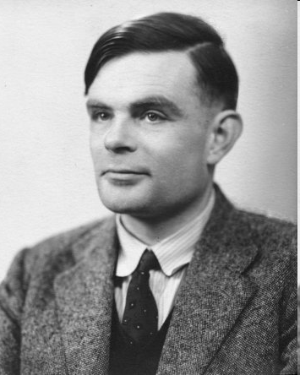
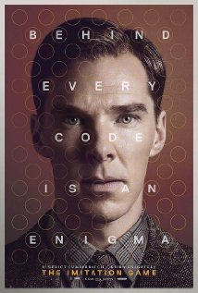
Alan Turing (1912-1954)
(A pioneer of automata theory)
Father of Modern Computer Science
English mathematician
Studied abstract machines called Turing machines even before computers existed
Heard of the Turing test?

Slide 32
Theory of Computation: A Historical Perspective
1930s
Alan Turing studies Turing machines
Decidability
Halting problem
1940-1950s
“Finite automata” machines studied
Noam Chomsky proposes the “Chomsky Hierarchy” for formal languages
1969
Cook introduces “intractable” problems or “NP-Hard” problems
1970-
Modern computer science: compilers, computational & complexity theory evolve

Slide 33
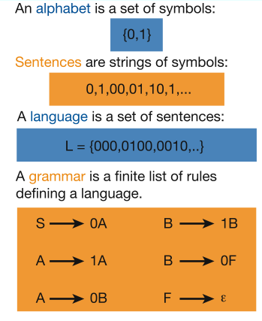
Languages & Grammars
Languages: “A language is a collection of sentences of finite length all constructed from a finite alphabet of symbols”
Grammars: “A grammar can be regarded as a device that enumerates the sentences of a language” - nothing more, nothing less
N. Chomsky, Information and Control, Vol 2, 1959
Or “words”
Image source: Nowak et al. Nature, vol 417, 2002

Slide 34
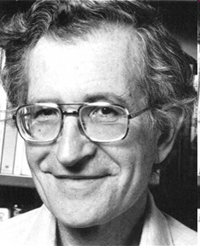
The Chomsky Hierachy
A containment hierarchy of classes of formal languages
Recursively- enumerable (TM)
Context- sensitive (LBA)
Context- free
(PDA)
Regular
(DFA)

Slide 35
The Central Concepts of Automata Theory

Slide 36
Alphabet
An alphabet is a finite, non-empty set of symbols
We use the symbol ∑ (sigma) to denote an alphabet
Examples:
Binary: ∑ = {0,1}
All lower case letters: ∑ = {a,b,c,..z}
Alphanumeric: ∑ = {a-z, A-Z, 0-9}
DNA molecule letters: ∑ = {a,c,g,t}
…

Slide 37
Strings
A string or word is a finite sequence of symbols chosen from ∑
Empty string is ε (or “epsilon”)
Length of a string w, denoted by “|w|”, is equal to the number of (non- ε) characters in the string
E.g., x = 010100 |x| = 6
x = 01 ε 0 ε 1 ε 00 ε |x| = ?
xy = concatentation of two strings x and y

Slide 38
Powers of an alphabet
Let ∑ be an alphabet.
∑^{k} = the set of all strings of length k
∑* = ∑⁰ U ∑¹ U ∑² U …
∑⁺ = ∑¹ U ∑² U ∑³ U …

Slide 39
Languages
L is a said to be a language over alphabet ∑, only if L ⊆ ∑*
➔ this is because ∑* is the set of all strings (of all possible length including 0) over the given alphabet ∑
Examples:
Let L be the language of all strings consisting of n 0’s followed by n 1’s: L = {ε, 01, 0011, 000111,…}
Let L be the language of all strings of with equal number of 0’s and 1’s:
L = {ε, 01, 10, 0011, 1100, 0101, 1010, 1001,…}
Definition: Ø denotes the Empty language
Let L = {ε}; Is L=Ø?
Canonical ordering of strings in the language
NO

Slide 40
The Membership Problem
Given a string w ∈∑*and a language L over ∑, decide whether or not w ∈L.
Example:
Let w = 100011
Q) Is w ∈ the language of strings with equal number of 0s and 1s?

Slide 41
Finite Automata
Some Applications
Software for designing and checking the behavior of digital circuits
Lexical analyzer of a typical compiler
Software for scanning large bodies of text (e.g., web pages) for pattern finding
Software for verifying systems of all types that have a finite number of states (e.g., stock market transaction, communication/network protocol)

Slide 42
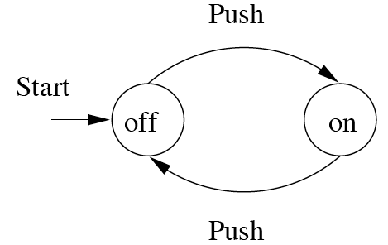
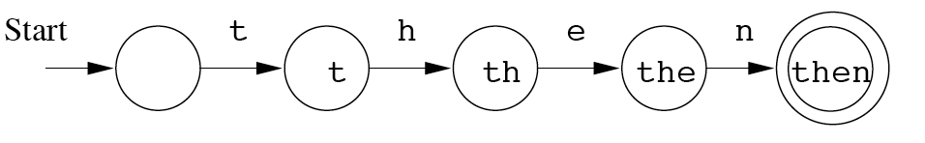
Finite Automata : Examples
action
On/Off switch
Modeling recognition of the word “then”
state
Start state
Transition
Intermediate state
Final state

Slide 43
Structural expressions
Grammars
Regular expressions
E.g., unix style to capture city names such as “Palo Alto CA”:
[A-Z][a-z]*([ ][A-Z][a-z]*)*[ ][A-Z][A-Z]
Start with a letter
A string of other letters (possibly empty)
Should end w/ 2-letter state code
Other space delimited words (part of city name)

Slide 44
Formal Proofs

Slide 45
Obtaining Results
Use definitions, theorems and lemmas, with proofs
Proofs use construction, induction, reduction,
contradiction
Construction: design an algorithm for a problem, or to build a machine from a grammar, etc.
Induction: a base case and an induction step imply a conclusion about the general case. Main tool for showing algorithms or constructions are correct.
Reduction: solve a new problem by using the solution to an old problem + some additional operations or transformations
Contradiction: make an assumption, show that an absurd conclusion follows; conclude the negation of the assumption holds (“reductio ad absurdum”)

Slide 46
Class of all languages
Reg
●
●
CF
CS
● L
●
Decidable
Computably Enumerable
●
Non-Computably Enumerable
●

Slide 47
Deductive Proofs
From the given statement(s) to a conclusion statement (what we want to prove)
Logical progression by direct implications
Example for parsing a statement:
“If y≥4, then 2^{y}≥y².”
(there are other ways of writing this).
given
conclusion

Slide 48
Example: Deductive proof
Let Claim 1: If y≥4, then 2^{y}≥y².
Let x be any number which is obtained by adding the squares of 4 positive integers.
Claim 2:
Given x and assuming that Claim 1 is true, prove that 2^{x}≥x²
Proof:
Given: x = a² + b² + c² + d²
Given: a≥1, b≥1, c≥1, d≥1
➔ a²≥1, b²≥1, c²≥1, d²≥1 (by 2)
➔ x ≥ 4 (by 1 & 3)
➔ 2^{x} ≥ x² (by 4 and Claim 1)
“implies” or “follows”

Slide 49
On Theorems, Lemmas and Corollaries
We typically refer to:
A major result as a “theorem”
An intermediate result that we show to prove a larger result as a “lemma”
A result that follows from an already proven result as a “corollary”
An example:
Theorem: The height of an n-node binary tree is at least floor(lg n)
Lemma: Level i of a perfect binary tree has 2^{i} nodes.
Corollary: A perfect binary tree of height h has 2^{h+1}-1 nodes.

Slide 50
Quantifiers
“For all” or “For every”
Universal proofs
Notation=
“There exists”
Used in existential proofs
Notation=
Implication is denoted by =>
E.g., “IF A THEN B” can also be written as “A=>B”

Slide 51
Proving techniques
By contradiction
Start with the statement contradictory to the given statement
E.g., To prove (A => B), we start with:
(A and ~B)
… and then show that could never happen What if you want to prove that “(A and B => C or D)”?
By induction
(3 steps) Basis, inductive hypothesis, inductive step
By contrapositive statement
If A then B ≡ If ~B then ~A

Slide 52
Proving techniques…
By counter-example
Show an example that disproves the claim
Note: There is no such thing called a “proof by example”!
So when asked to prove a claim, an example that satisfied that claim is not a proof

Slide 53
Different ways of saying the same thing
“If H then C”:
H implies C
H => C
C if H
H only if C
Whenever H holds, C follows

Slide 54
“If-and-Only-If” statements
“A if and only if B” (A <==> B)
(if part) if B then A ( <= )
(only if part) A only if B ( => ) (same as “if A then B”)
“If and only if” is abbreviated as “iff”
i.e., “A iff B”
Example:
Theorem: Let x be a real number. Then floor of x = ceiling of x if and only if x is an integer.
Proofs for iff have two parts
One for the “if part” & another for the “only if part”

Slide 55
Why Study Automata Theory and Formal Languages?
A survey of Stanford grads 5 years out asked which of their courses did they use in their job.
Basics like Programming took the top spots, of course.
But among optional courses, Automata Theory stood remarkably high.
3X the score for AI, for example.

Slide 56
Why Finite Automata and Regular Expressions?
Regular expressions (REs) are used in many systems.
E.g., UNIX, Linux, OS X,… a.*b.
E.g., Document Type Definitions describe XML tags with a RE format like person (name, addr, child*).
Finite automata model protocols, electronic circuits.
Theory is used in model-checking.

Slide 57
Why Context-Free Grammars?
Context-free grammars (CFGs) are used to describe the syntax of essentially every modern programming language.
Every modern complier uses CFG concepts to parse programs
Not to forget their important role in describing natural languages.
And Document Type Definitions are really CFG’s.

Slide 58
Why Turing Machines?
When developing solutions to real problems, we often confront the limitations of what software can do.
Undecidable things – no program can do it 100% of the time with 100% accuracy.
Intractable things – there are programs, but no fast programs.
A course on Automata Theory and Formal Languages gives you the tools.

Slide 59
Other Good Stuff
We’ll learn how to deal formally with discrete systems.
Proofs: You never really prove a program correct, but you need to be thinking of why a tricky technique really works.
You’ll gain experience with abstract models and constructions.
Models layered software architectures.

Slide 60
Summary: Theory of Computation
Models of the computing process
circuits
finite state automata
pushdown automata
Turing machines
capabilities and limitations
Notion of ``effectively computable procedure’’
universality of the notion
Church’s Thesis
what is algorithmically computable
Limitations of the algorithmic process
unsolvability (undecidability) & reducibility
Inherent complexity of computational problems
upper and lower bounds: classification by resource use
NP-completeness & reducibility

Slide 61
Summary
Automata theory & a historical perspective
Chomsky hierarchy
Finite automata
Alphabets, strings/words/sentences, languages
Membership problem
Proofs:
Deductive, induction, contrapositive, contradiction, counterexample
If and only if
Read chapter 1 for more examples and exercises

