Slide 1
MRISim Project • SDLC Mid-Journey Deck
Slide 1 of 9
MID-JOURNEY PROJECT PRESENTATION • SLIDE 1 OF 9
● MID-JOURNEY STATUS: 55% COMPLETE
MRI Simulator Platform — SDLC Mid-Journey Review
Stage Completion: 55%
Tracking how much our current project has completed across the 7 sequential SDLC stages and our roadmap ahead.
6 / 6 Pages
521 Lines
15 Assets
Stage 4 & 5
HTML Routes Built & Committed
Unified Dark CSS3 Stylesheet
Clinical MRI Scans & SVG Logo
Current Position in 7-Stage SDLC
THE 7 SEQUENTIAL STAGES OF OUR SDLC & CURRENT COMPLETION
STAGE 1
STAGE 2
STAGE 3
STAGE 4
STAGE 5
STAGE 6
STAGE 7
Planning &
Feasibility
Requirements
Analysis
System
Design (SDD)
Development
(Coding)
Testing &
QA
Production
Deployment
Maintenance
& Support
100% Done
100% Done
100% Done
65% Active
35% Active
20% Prep
Future Goal
✔ COMPLETED SO FAR (FIRST HALF OF JOURNEY)
🚀 UPCOMING GOALS (SECOND HALF OF JOURNEY)
Completed 100% of Planning, Requirements (SRS), System Design (SDD), all 6 HTML page layouts (Home, Courses, Course, Quiz, Quize, Reference), 521-line CSS stylesheet, 15 clinical MRI scan images, and 6 clean Git commits.
Add client-side JavaScript interactivity (live quiz grading, dynamic question navigation, real-time reference search), execute mobile/cross-browser QA testing, deploy live to cloud hosting, and expand interactive physics tools.
MRI Simulator Platform (fable-5) | Software Development Life Cycle (SDLC) Review

Slide 2
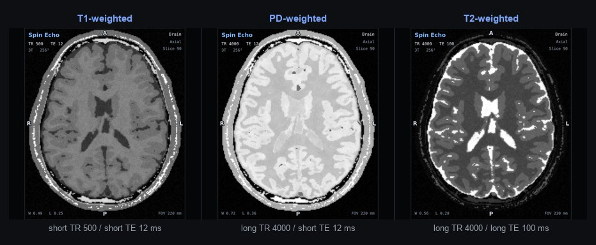
MRISim Project • SDLC Mid-Journey Deck
Slide 2 of 9
SDLC STAGE 01 OF 07 • FOUNDATION PHASE
✓ STAGE STATUS: 100% COMPLETED
1. Planning & Feasibility
Stage Completion: 100%
"Define project goals, scope, and assess whether the project is technically and financially viable."
🎯 Project Goals & Scope Defined
⚙️ Technical, Financial & Schedule Feasibility
✔ Core Educational Goal: Create an intuitive web-based learning platform for MRI physics, T1/T2/PD contrast weighting, clinical scan interpretation, and MR safety.
✔ Target Users: Medical students, radiology trainees, and imaging technologists seeking structured visual MRI fundamentals.
✔ 4-Module Project Scope: (1) Home Overview & Contrast Table, (2) Guided Courses Syllabus, (3) Read-the-Scan Quiz, and (4) Reference Library.
✔ Version Control Plan: Designed a strict 6-commit incremental Git strategy on the main branch so each page and its CSS design is tracked cleanly.
● Technical Viability (100%): Selected semantic HTML5 + custom CSS3 (style.css) with zero external framework overhead for 100% browser reliability.
● Financial Viability ($0 Cost): Zero licensing or server costs; uses curated educational MRI scan imagery and free static cloud hosting.
● Schedule Viability: Split into Milestone 1 (Static UI, Content & Pages — Done) and Milestone 2 (JS Logic, QA & Cloud Release).
Stage 1 Outcome: Approved
All 15 clinical MRI scan assets and the 6-page site scope were finalized prior to development.
MRI Simulator Platform (fable-5) | Software Development Life Cycle (SDLC) Review

Slide 3
MRISim Project • SDLC Mid-Journey Deck
Slide 3 of 9
SDLC STAGE 02 OF 07 • SPECIFICATION PHASE (SRS)
✓ STAGE STATUS: 100% COMPLETED
2. Requirements Analysis
Stage Completion: 100%
"Gather and document functional and non-functional requirements (compiled into an SRS blueprint)."
FR-01: Home Module
FR-02: Guided Courses
FR-03: Scan Quiz
FR-04: Reference
index.html
courses.html / course.html
quiz.html / quize.html
reference.html
✔ Hero section with T1, PD & T2 clinical scan
✔ Key stats row (13 sequences, 6 anatomies, 1.5T/3T)
✔ 4 learning path cards with scan previews
✔ Brain, Spine & Knee imaging plane showcase
✔ 5-tissue T1/T2/PD contrast quick-guide table
✔ Curriculum summary (4 modules, 14 lessons)
✔ Featured Lesson 1.2 side-by-side T1 vs T2 visual
✔ Clinical Takeaway Rule box (CSF fluid dark vs bright)
✔ Full 4-module syllabus with lesson thumbnails
✔ 7 topic filter chips (Sequences, Artifacts, Safety)
✔ Clinical scan display with TR/TE parameters
✔ 4-option radio form + Check Answer & Next buttons
✔ Detailed clinical explanation box + practice queue
✔ 2-column layout (260px sidebar + main content)
✔ 6 category navigation links in sticky sidebar
✔ Keyword search input box (.search-box)
✔ 8 illustrated reference cards with keypoint bullets
🛡️ Non-Functional Requirements (NFR) Specified
📌 SRS Traceability: Phase 1 (Done) vs Phase 2 (Next)
● Dark Diagnostic UI (#0b1120): Reduces eye fatigue and enhances grayscale MRI scan contrast.
● Responsive Flexbox Layout: Fluid wrapping cards (max-width: 1100px) + route redundancy (course/courses, quiz/quize).
⚡ Phase 1 UI & Content Requirements: 100% implemented across all 6 HTML files and style.css.
⚡ Phase 2 Dynamic Requirements: JavaScript event handling for quiz scoring & live search scheduled next.
MRI Simulator Platform (fable-5) | Software Development Life Cycle (SDLC) Review

Slide 4
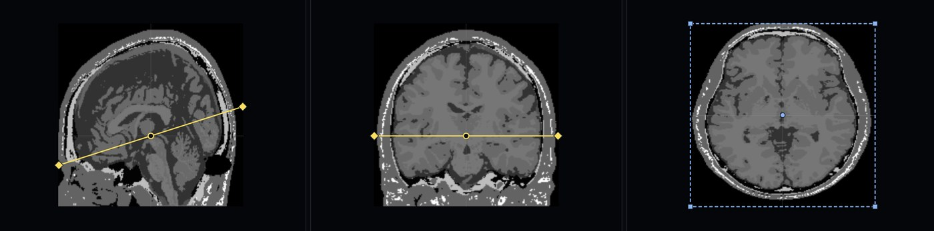
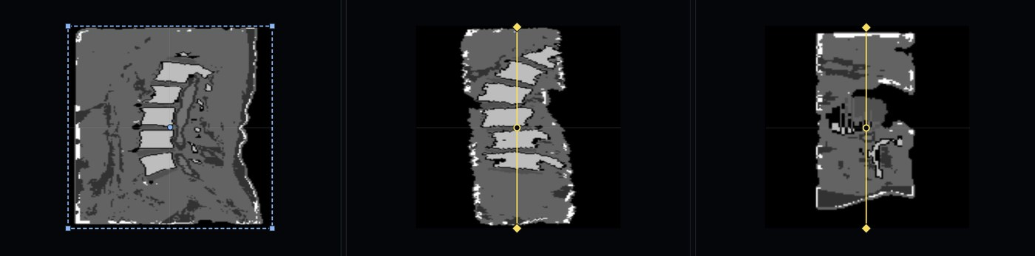
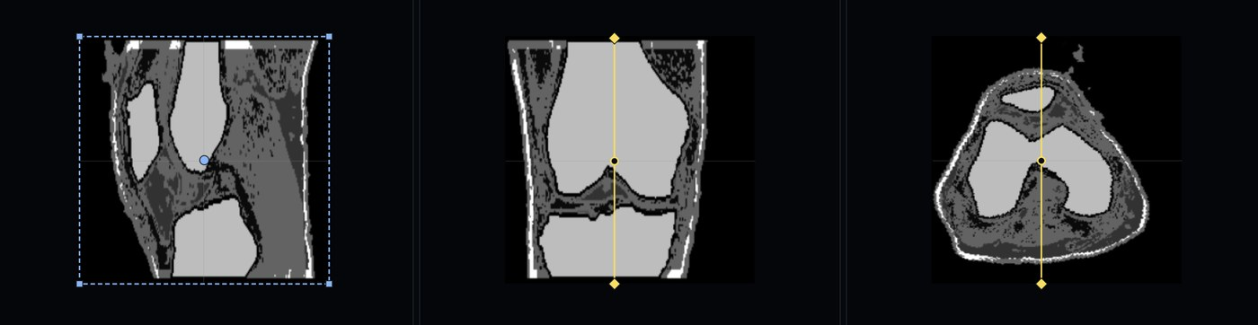
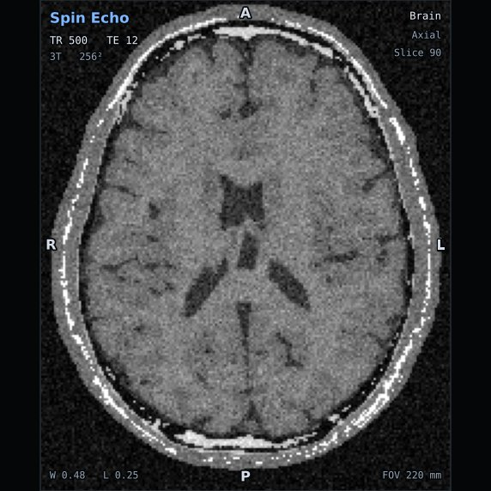
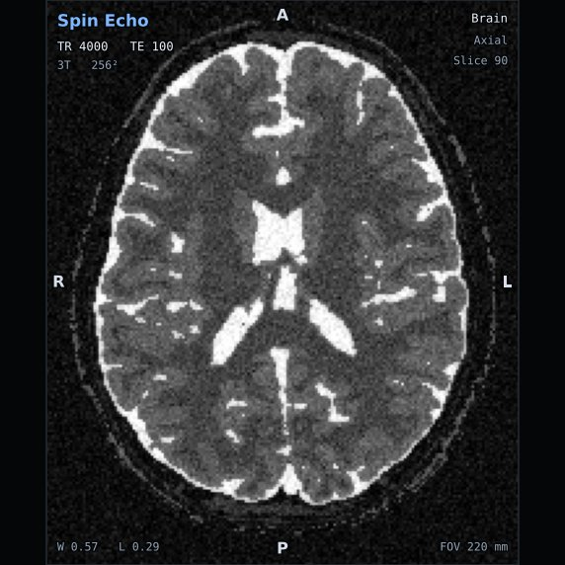
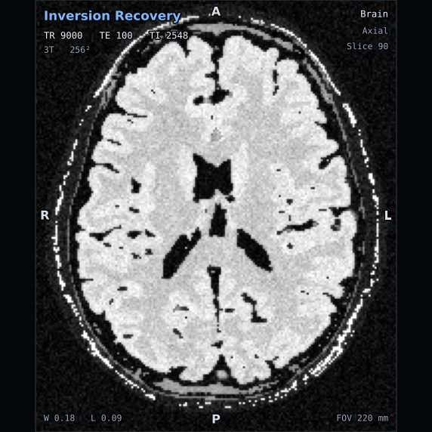
MRISim Project • SDLC Mid-Journey Deck
Slide 4 of 9
SDLC STAGE 03 OF 07 • ARCHITECTURE & DESIGN BLUEPRINT
✓ STAGE STATUS: 100% COMPLETED
3. System Design (SDD)
Stage Completion: 100%
"Translate requirements into a technical blueprint, UI/UX design system, and directory architecture (SDD)."
🎨 UI/UX Color Tokens & Component System (style.css)
🗺️ System File & Routing Blueprint
▸ index.html (219 lines): Landing page, hero showcase, 4 module cards, 3 anatomy planes & contrast table.
▸ courses.html & course.html (235 lines each): Guided MRI syllabus, T1 vs T2 visual comparison & 4 module lesson lists.
▸ quiz.html & quize.html (196 lines each): Read-the-Scan diagnostic quiz, topic chips, radio form & answer explanations.
▸ reference.html (215 lines): Sticky sidebar index, search filter box & 8 illustrated reference cards.
▸ style.css (521 lines): Single unified stylesheet shared across all 6 HTML routes.
▸ img/ (15 files): 14 clinical JPEG scans + 1 vector logo.svg.
#0B1120
#1E293B
#0F172A
#38BDF8
#0284C7
Body Canvas
Card Surface
Inset Box
Medical Cyan
Primary Button
Reusable CSS Architecture: .header-container, .hero-grid, .stats-row, .card, .quiz-box, .lesson-compare-grid, .topic-chips, and .ref-layout (521 total lines).
🖼️ Clinical MRI Scan Asset Library (img/ — 15 Files)
Includes Axial Brain, Sagittal Spine, Sagittal Knee, T1/T2/PD comparisons, FLAIR, DWI, Gadolinium & Motion/Chemical-Shift artifacts.
MRI Simulator Platform (fable-5) | Software Development Life Cycle (SDLC) Review

Slide 5
MRISim Project • SDLC Mid-Journey Deck
Slide 5 of 9
SDLC STAGE 04 OF 07 • ACTIVE MID-JOURNEY STAGE
⚡ STAGE STATUS: 65% COMPLETED
4. Development (Coding)
Stage Completion: 65%
"Write and compile the source code based on the approved design." — Our current mid-journey position!
✅ Completed Coding: 6 Modular Git Commits (100% UI)
⏳ Remaining Phase 2 Coding Goals (35% Pending)
a791c41
feat: home page design complete
⚡ Interactive Quiz Engine (quiz.js): Connect Check Answer & Next Question buttons, evaluate selected radio options, and update Current Score dynamically.
⚡ Live Reference Search (reference.js): Filter the 8 reference cards in real time as users type in .search-box or click sidebar categories.
⚡ Course Lesson Modal (courses.js): Enable Read Lesson → buttons to open interactive lesson content and mark lessons complete.
index.html + Base/Hero/Table CSS + 7 images
c2b0057
feat: courses page complete
courses.html + Lesson/Module CSS + 8 images
8ac943c
feat: create quiz page
quiz.html + Quiz scan, options & chip CSS
7f22fc0
feat: reference page design complete
reference.html + Sidebar & card CSS
f2201b9
feat: course page design complete
📈 Codebase Delivered at Mid-Journey
course.html singular route alias
1,296 Lines
521 Lines
6 Commits
c5afbac
feat: create quize page
quize.html alternate quiz route
Semantic HTML5
Modular CSS3
Clean Git History
MRI Simulator Platform (fable-5) | Software Development Life Cycle (SDLC) Review

Slide 6
MRISim Project • SDLC Mid-Journey Deck
Slide 6 of 9
SDLC STAGE 05 OF 07 • VERIFICATION & QUALITY PHASE
🔍 STAGE STATUS: 35% COMPLETED
5. Testing & Quality Assurance
Stage Completion: 35%
"Verify that the software meets requirements, functions properly, and is free of defects."
✅ Completed Verification (Mid-Journey QA)
🧪 Upcoming Phase 2 QA Plan (65% Remaining)
✔ HTML/CSS Rendering Verification: Verified all 6 pages render cleanly with consistent dark theme, flexbox cards, and typography.
✔ Cross-Page Navigation Audit: Tested all header and footer links across Home, Courses, Quiz, and Reference routes.
✔ Asset Integrity Check (15/15 Passed): Confirmed zero broken image paths and proper aspect-ratio scaling across all clinical scans.
✔ Clinical Data Accuracy: Reviewed T1/T2/PD contrast table and TR/TE acquisition parameters.
◈ Functional JS Unit Testing: Validate quiz radio selection grading, score counter math, and topic chip filtering.
◈ Search Input Edge-Case Testing: Verify case-insensitive keyword matching and empty-search fallback states in Reference.
◈ Responsive Viewport Testing: Test layout wrapping across mobile phones (375px), tablets (768px), and wide desktops.
◈ Accessibility & Lighthouse Audit: Verify keyboard tab navigation, form labels, and contrast ratios.
Static UI & CSS QA
Image & Link Audit
Responsive Mobile QA
Dynamic JS Functional QA
100% Passed
15 / 15 Verified
In Progress
Scheduled Phase 2
MRI Simulator Platform (fable-5) | Software Development Life Cycle (SDLC) Review

Slide 7
MRISim Project • SDLC Mid-Journey Deck
Slide 7 of 9
SDLC STAGE 06 OF 07 • PRODUCTION RELEASE PHASE
🚀 STAGE STATUS: 20% PREPARED
6. Deployment
Stage Completion: 20%
"Release the finished software application to production for end-users."
✅ Completed Deployment Preparation (20%)
🌐 Upcoming Production Deployment Plan (80%)
✔ Git Version Control Established: All 6 modular page commits are cleanly structured on the main branch and pushed to origin/main.
✔ Portable Relative File Paths: All stylesheet (style.css) and image (img/...) references use relative paths, ready for any cloud host.
✔ Zero Build-Step Architecture: Static bundle deploys directly to any global CDN without complex server dependencies.
◈ Cloud Hosting (GitHub Pages / Vercel): Connect the main branch to automatic CI/CD deployment upon completing Phase 2 JS scripts.
◈ Asset Compression & Caching: Optimize the 14 clinical JPEG scans and enable browser cache headers for instant page loads.
◈ Public Live URL & SSL: Publish HTTPS production link for students and classroom demonstrations.
🔄 4-STEP RELEASE PIPELINE ROADMAP
STEP 1 • DONE
STEP 2 • DONE
STEP 3 • NEXT
STEP 4 • TARGET
6 Atomic Git Commits
Remote Branch Synced
Phase 2 JS & Final QA
Live Public CDN Release
MRI Simulator Platform (fable-5) | Software Development Life Cycle (SDLC) Review

Slide 8
MRISim Project • SDLC Mid-Journey Deck
Slide 8 of 9
SDLC STAGE 07 OF 07 • LONG-TERM EVOLUTION
🔮 STAGE STATUS: FUTURE ROADMAP
7. Maintenance & Support
Stage Completion: 15%
"Provide ongoing updates, bug fixes, and performance monitoring." — Future goals for our project.
🛠️ Corrective & Adaptive Care
🎛️ Interactive Simulator Upgrades
📚 Clinical Curriculum Expansion
◈ Ongoing Bug Fixes: Monitor and resolve layout or script issues across browser updates.
◈ Performance Monitoring: Track page load speed and clinical image rendering performance.
◈ Mobile UX Enhancements: Refine touch targets for quiz radio buttons and reference tables on phones.
◈ Live TR / TE Contrast Sliders: Let students drag TR and TE sliders to watch T1/T2 brain contrast shift dynamically.
◈ 3-Plane Slice Prescriber: Interactive canvas to practice positioning slices on Axial, Sagittal & Coronal scouts.
◈ Browser Progress Saving: Save completed lessons and quiz high scores in localStorage.
◈ 30+ Scan Quiz Question Bank: Expand from 4 static scan questions to 30+ randomized clinical cases.
◈ New Anatomy Modules: Add Cardiac MRI, Liver contrast phases, and MR Angiography (MRA) lessons.
◈ MR Safety Updates: Keep ACR Zone I–IV safety guidelines and 1.5T/3T protocols up to date.
💡 WHY OUR CURRENT CODEBASE IS BUILT FOR EASY MAINTENANCE
Because our HTML pages and style.css classes (.card, .quiz-box, .ref-item, .lesson-row) are modular and cleanly structured, adding new lessons, quiz scans, or reference terms takes minutes.
MRI Simulator Platform (fable-5) | Software Development Life Cycle (SDLC) Review

Slide 9
MRISim Project • SDLC Mid-Journey Deck
Slide 9 of 9
CONCLUSION & FINAL SCORECARD • SLIDE 9 OF 9
★ MID-JOURNEY MILESTONE ACHIEVED
Mid-Journey Summary & Path to Completion
Stage Completion: 100%
Complete overview of what our project has achieved today and our immediate next milestones to finish the SDLC.
📊 7-Stage SDLC Completion Scorecard
🏆 Mid-Journey Takeaways & Next Sprint
1. Planning & Feasibility
100% Done
✔ Foundation 100% Complete: All 6 HTML pages, 521-line CSS design system, and 15 clinical MRI scan assets are built and committed.
✔ Next Immediate Goal: Implement Phase 2 JavaScript interactivity (quiz grading & live reference search).
✔ Final Release Goal: Complete responsive QA testing and deploy live on GitHub Pages / Vercel.
2. Requirements Analysis (SRS)
100% Done
3. System Design (SDD)
100% Done
4. Development (Coding)
65% (UI Done)
5. Testing & Quality Assurance
35% (Static QA)
6. Production Deployment
20% (Git Ready)
Thank You!
7. Maintenance & Support
Future Roadmap
Questions & Mid-Journey Project Discussion
MRI Simulator Learning Platform • fable-5 Repository
MRI Simulator Platform (fable-5) | Software Development Life Cycle (SDLC) Review

