Slide 1
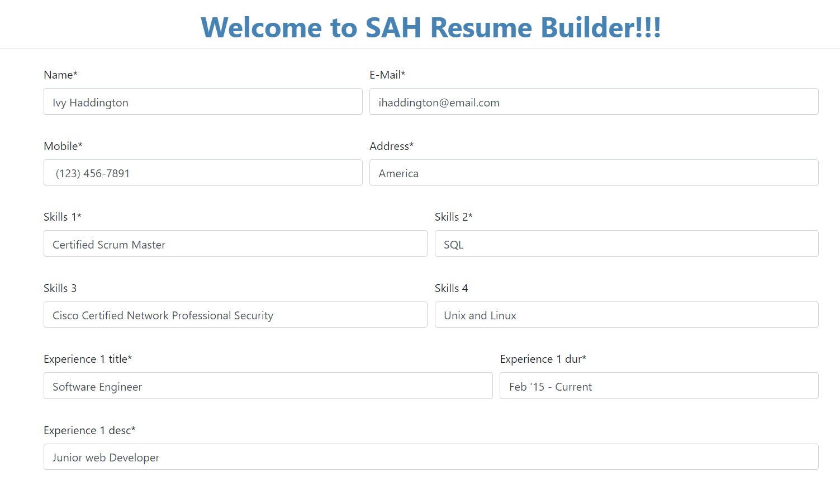
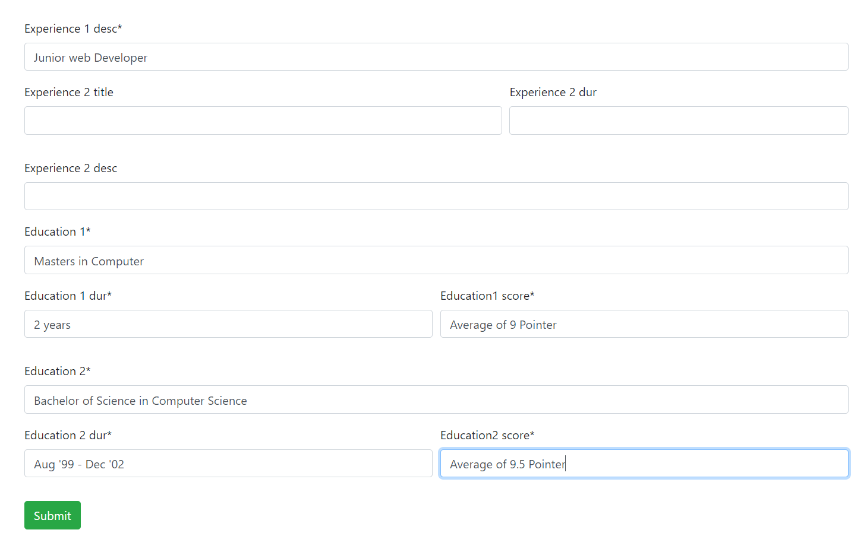
Screenshots:
Form to take the information of the candidate applying :
Resume generated :

