Slide 1

QUICK PHISHER
A PHISHING DETECTION SYSTEM
(Minor Project)
Presented By :
Sakib Rahman
ADTU/2020-24/BTech(CTIS)/001
Simran Malakar
ADTU/2020-24/BTech(CTIS)/011
Btech CTIS – 7th Semester
Under the Guidance of :
Mr. Nazrul Islam
Assistant Professor,
Faculty of Engineering and Technology
Assam Downtown University
Panikhaiti, Guwahati – 781026, Assam, India
Session: August – January, 2024

Slide 2
Contents
Introduction
Objective
Problem Statement
Existing System
Functions Used
Dataset Collection
Use Case Diagram
Tools And Technology Used
Conclusion
Reference

Slide 3
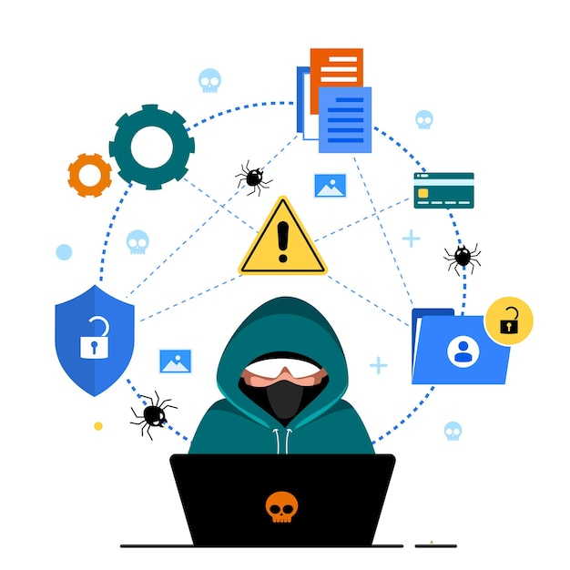
What is phishing?
Phishing is a form of cybercrime in which a target is contacted via email, telephone, or text message by an attacker disguising as a reputable entity or person. The attacker then lures individuals to counterfeit websites to trick recipients into providing sensitive data.
The purpose of this project is to help individuals identify these phishing URLs in order to provide safer practices online.

Slide 4

Types of Phishing Tactics
Email
96% of phishing attacks arrive by email.
Telephone
3% of phishing attacks is done over the telephone. This is also known as vishing.
Text
Message
1% of phishing attacks is done via text message. This is also known as smishing.

Slide 5
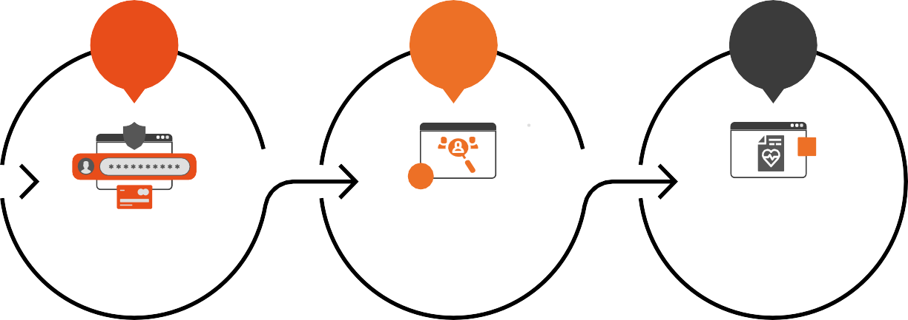



Top Three Types of Data
Passwords, usernames, pin numbers, credit card information
Name, address, email address
Treatment information, insurance claims
CREDENTIALS
PERSONAL
DATA
MEDICAL

Slide 6
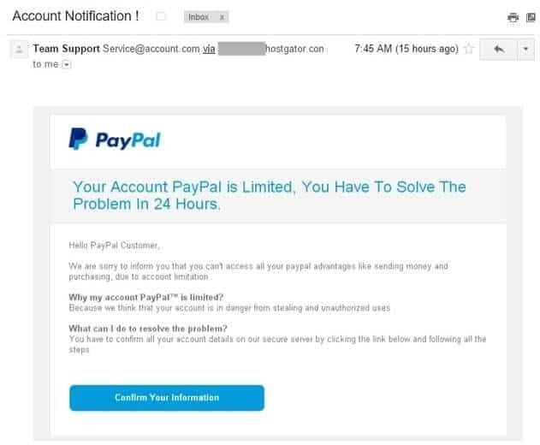
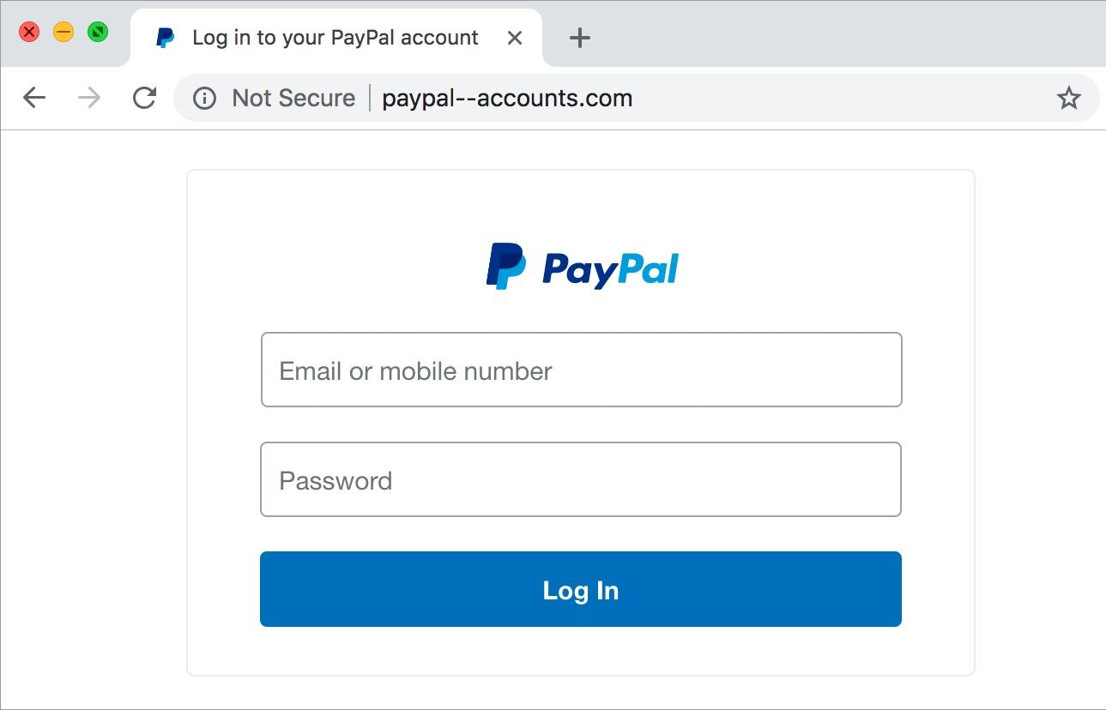

Paypal

Slide 7

2023 Phishing Statistics
30% of phishing emails are opened by users, and 12% of these targeted users click on the malicious link or attachment.
97% of the users are unable to recognize a sophisticated phishing email.

Slide 8

Objective
Enhance Online Security
The primary goal is to bolster online security measures through the implementation of advanced technologies. It will mitigate the risk of successful phishing attacks, safeguarding sensitive data and maintaining the integrity of digital platforms.
Empower Users With Knowledge
Equipping users with the necessary knowledge and awareness is essential in the fight against phishing. Through education initiatives and training programs, individuals can learn to recognize phishing attempts, understand evolving tactics, and adopt secure online practices

Slide 9

Problem statement
Lack Of Knowledge
Users unknowingly share sensitive information due to unfamiliarity with phishing tactics, like clicking on deceptive links.
Variety Of Attacks
The surge in diverse phishing methods, from basic email scams to sophisticated spear-phishing, complicates cybersecurity defense.
Limited Awareness
Insufficient understanding of phishing risks results in a lack of vigilance, making individuals more susceptible to deceptive tactics.
Traditional Security Measures
Relying solely on standard security tools may be insufficient against evolving phishing techniques, emphasizing the need for more proactive measures.

Slide 10
Existing System
Url Void
https://www.urlvoid.com/
Scan Url
https://www.urlscan.io/
Norton Safe Web
https://www.safeweb.norton.com/
Criminal Ip
https://www.criminalip.io/
Google Transparency Report
https://www.transparencyreport.google.com/

Slide 11
Comparison
Phishing Detection System
DNS Report
View Source code
Preview Site
Quick Phisher
URL VOID
Norton safe web
Google transparency report

Slide 12
Some Features
These are the features provided by quick phisher to its users
Quick Phisher is easy to use, with a simple interface that anyone can navigate.
Users can see the preview of the website without actually visiting it.
Quick Phisher gives a trust score to the url, which will provide the user an understanding of the trustability and authenticity of the domain.
The url is checked with a phish database (PhishTank) to see whether it is a reported phishing link.

Slide 13
Functions Used
Validate_url(url): checks if the given URL is active by making an HTTP request and returning the status code or false if it cannot be reached.
Whois_data(domain): collects whois data for the domain, including creation date, and returns it in a structured format.
Url_redirects(url): checks if the URL performs redirects and returns a list of redirected url if they exist.
Phishtank_search(url): searches phishtank for the given url to check if it's a known phishing site.
Get_certificate_details(domain): collects ssl/tls certificate details for the domain, including issuer, validity, cipher suite, and more.
Calculate_trust_score(current_score, case, value): calculates and adjusts the trust score based on specific criteria and their weights.

Slide 14
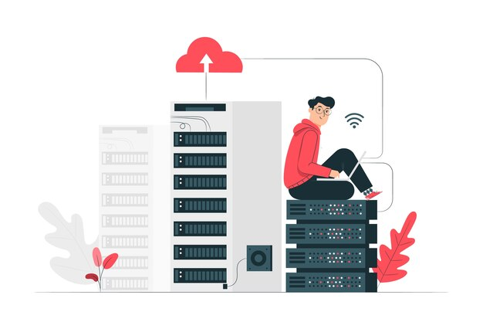
DATaset Collection
Legitimate urls are collected from the dataset provided by university of new brunswick, https://www.Unb.Ca/cic/datasets/url-2016.Html
Phishing urls are collected from opensource service called phishtank . this service provide a set of phishing urls in multiple formats like csv, json etc. That gets updated hourly.

Slide 15
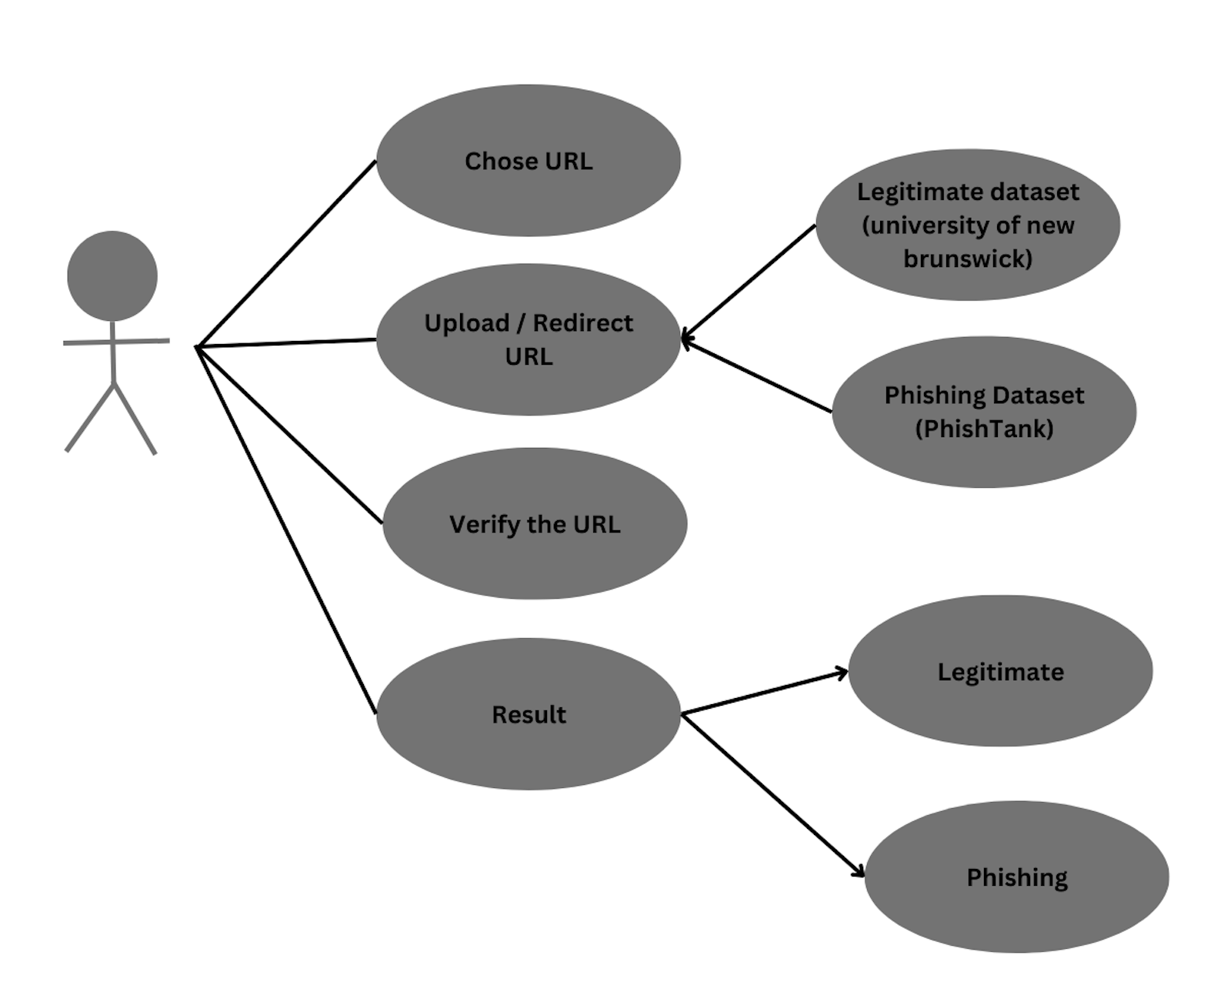
USE Case Diagram

Slide 16
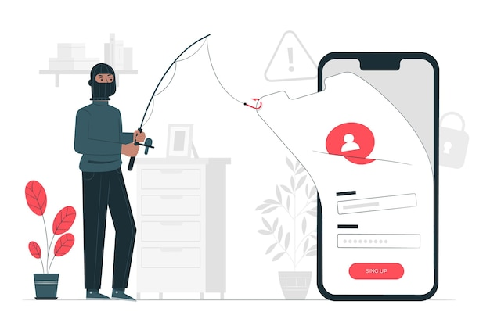
Tools & Technology used
Frontend Development: HTML, CSS, JavaScript
Backend Development: Python
Integrated Development Environment (IDE): VS Code, PYCHARM
Version Control: Git & GitHub

Slide 17

How to Avoid Phishing Attacks
1
STAY INFORMED
Learn about new phishing techniques that are being developed to avoid falling prey to one.
2
THINK BEFORE YOU CLICK
Never click on hyperlinks without examining the hidden URL.
3
UTILIZE ‘QUICK PHISHER’
When in doubt, use the ‘QUICK PHISHER’ to verify the authenticity of a website.

Slide 18
CONCLUSIONS
In summary, phishing poses a persistent and evolving threat, exploiting human vulnerabilities through deceptive tactics. Understanding the varied attack types, objectives, and functions is crucial for crafting effective defense strategies. The comparison between Quick Phisher and other tools underscores the need for advanced detection measures. Dataset collection is vital for training proactive machine learning models, and the use case diagram provides insights into attack lifecycles. Embracing cutting-edge tools and technologies is paramount to staying ahead in the relentless battle against phishing threats. A comprehensive approach, combining technology, education, and vigilance, is key to mitigating risks and enhancing cybersecurity posture.

Slide 19

Thank you!
Any questions?

Slide 20
References
Proofpoint. (2022, August 19). "The 2022 Ponemon Cost of Phishing Study: Proofpoint US." www.proofpoint.com/us/resources/analyst-reports/ponemon-cost-of-phishing-study
Tessian. (2022, May 17). "Phishing Statistics (Updated 2022): 50+ Important Phishing Stats." www.tessian.com/blog/phishing-statistics-2022/
Verizon Business. "2022 DBIR Master's Guide." [Online] Available: www.verizon.com/business/resources/reports/dbir/2022/masters-guide/
KnowBe4. "What Is Phishing www.phishing.org/what-is-phishing
Cofense. (2022, May 28). "History of Phishing." www.cofense.com/knowledge-center/history-of-phishing/
Python Software Foundation. (2023). "Python 3.12.7 Documentation." www.docs.python.org/3/

