Slide 1
Sales Prediction
Big Mart

Slide 2
Introduction
To understand and visualize the sales predictions of a company.
Model Used:
Linear Regression Model
Decision Tree (Simple) Model
Bagged Tree Model
Random Forest Model

Slide 3
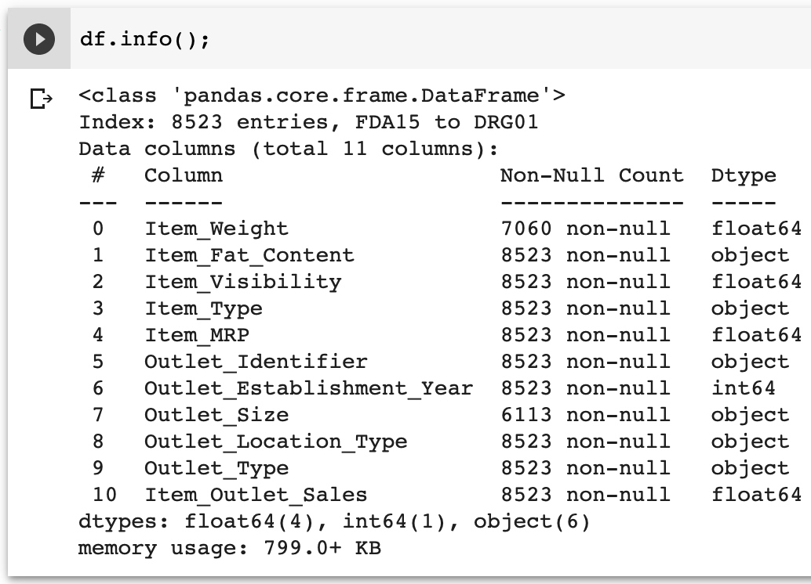
Part 1: Exploring Data
Item_Weight is missing values and filled data with ‘bfill’
Outlet_Size is missing values and filled data with ‘bfill’

Slide 4
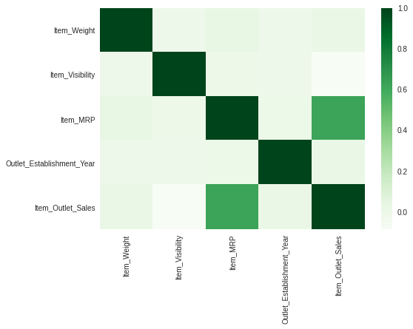
HEAT Map

Slide 5
Part 2: Exploring the Regression Model
Linear Regression Model:
Train_score = 0.49894180306217045
Test_Score = 0.52884105908702
R_square = 0.4989418030621704

Slide 6
Decision Tree Regression Model
Train_score = 1.0
Test_Score = 0.0817468837963321
R_square = 1.0

Slide 7
Bagged Tree Regression Model
Train_score = 0.899301358460872
Test_Score = 0.47103380030628994
R_Square = 0.7882033216220955

Slide 8
Random Forest Regression Model
Train_score = 0.9254109024057993
Test_Score = 0.5044866359708848
R_Square = 0.8162143771738168

Slide 9
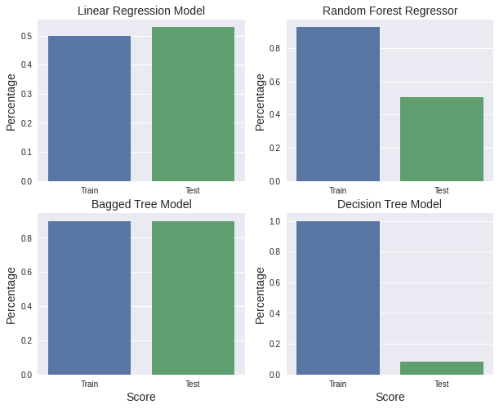
Plot for Train and Test Score

Slide 10
Conclusion:
Based on the value predicted Bagged Tree has the better train and test score.
Other models like Linear Regression, Decision Tree and Random Forester are good too but not as good as Bagged Tree based on the prediction.

