Slide 1
COMPUTER VISION PROJECT
Helmet and No-Helmet
Rider Detection Using YOLOv8
Helmet status · licence plates · road images

Slide 2



MOTIVATION
Road-safety monitoring needs a faster visual signal
Manual monitoring
Computer vision
Project focus
Time-consuming and difficult to scale across road imagery.
Automates visual inspection with object detection.
Identify riders with helmets, riders without helmets, and licence plates.
02

Slide 3
DETECTION TARGETS
One detector, three target classes
With Helmet
Without Helmet
licence
The goal is a complete pipeline from annotated images to evaluation on unseen test data.
03

Slide 4
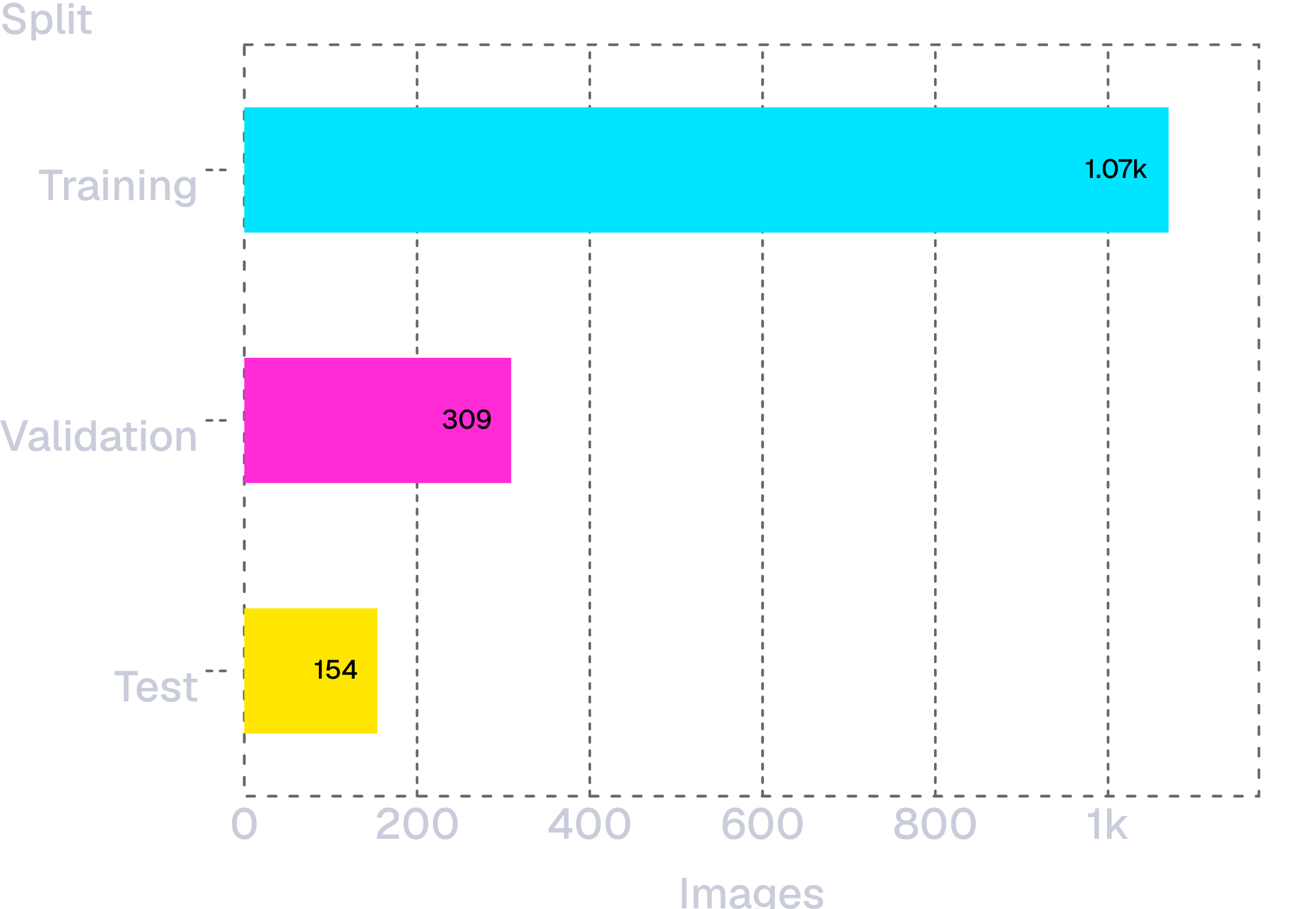
DATASET · YOLO FORMAT
The dataset contains 1,533 annotated road images
1,533
annotated road images
Roboflow dataset in YOLO format, extracted in Google Colab.
04

Slide 5
END-TO-END WORKFLOW
The workflow connects data, training, evaluation, and inference
01
02
03
04
Prepare
Train
Evaluate
Infer
Download and extract the annotated YOLO dataset.
Fine-tune YOLOv8n for the three classes.
Measure precision, recall, mAP, confusion matrix, and curves.
Run the trained model on unseen images and inspect detections.
05

Slide 6
TRAINING CONFIGURATION
YOLOv8n was trained for 50 epochs on a Tesla T4
MODEL
IMAGE SIZE
YOLOv8n
640 × 640
From Ultralytics
BATCH SIZE
HARDWARE
16
NVIDIA Tesla T4 GPU
50 EPOCHS · OUTPUT: best.pt
06

Slide 7
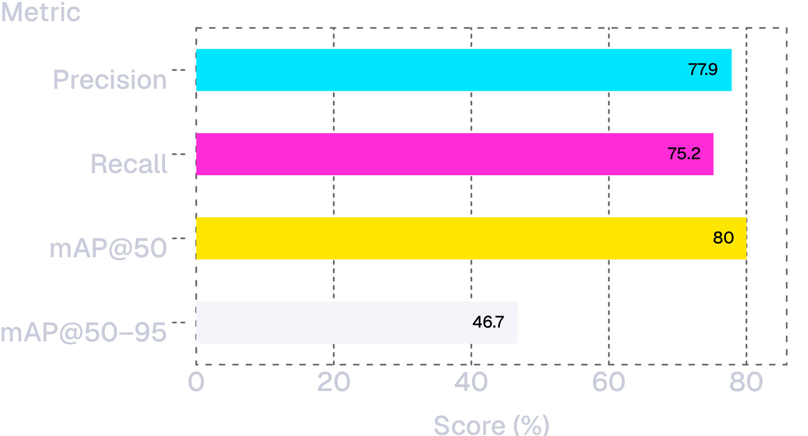
UNSEEN TEST IMAGES · 154 IMAGES · 237 ANNOTATED OBJECTS
The model reached 80.00% mAP@50 on unseen test images
80.00%
mAP@50
Precision: 77.85% · Recall: 75.21%
mAP@50–95: 46.74%
07

Slide 8
PER-CLASS EVALUATION · %
Licence detection was strongest; helmet status was harder
Class | Precision | Recall | mAP@50 | mAP@50–95
With Helmet | 75.10 | 76.40 | 76.90 | 45.80
Without Helmet | 66.70 | 65.80 | 72.60 | 34.30
licence | 91.80 | 83.50 | 90.50 | 60.10
Compare the three classes across precision, recall, mAP@50, and mAP@50–95.
08

Slide 9
EVALUATION VIEWS
Evaluation curves explain where the detector succeeds and misses
FIGURE PANEL 01
FIGURE PANEL 02
Confusion matrix
Normalized confusion matrix
Placeholder · inspect class-level confusions.
Placeholder · compare error patterns by class.
FIGURE PANEL 03
FIGURE PANEL 04
Precision–Recall
Precision · Recall · F1
Placeholder · threshold-sensitive behavior.
Placeholder · threshold-sensitive behavior.
Actual Google Colab graphs were not supplied; no graph values are shown.
09

Slide 10
INFERENCE · PROJECT PREDICTIONS
Inference turns predictions into inspectable road-image evidence
Bounding boxes show the detected object class and location.
LICENCE / PLATE · 01
LICENCE / PLATE · 02
LICENCE / PLATE · 03
Prediction image unavailable
Prediction image unavailable
Prediction image unavailable
HELMET-RELATED · 01
HELMET-RELATED · 02
Prediction image unavailable
Prediction image unavailable
Five project prediction images were not supplied; these panels are placeholders, not model outputs.
10

