Slide 1


Smart Dermatology: Enhancing Skin Type Identification and Product Recommendation using Computer Vision
Prepared By: Munzir hassan, T Tanusree, Priyanshu Shingh
Reg. No: 12106309, 12109665, 12109994
ROLL No: K21UPA14 , K21UWA18
Course Code : CSE - 461
Current mobile: +91 9110970097, 7024694879 Email: munzirhassan.mh@gmail.com
Submitted To: Karan Kumar Das
Dept: upGrad(Delivery and Student Success)
University: Lovely Professional University Jalandhar Punjab India
1

Slide 2
PRESENTATION OUTLINE:
Introduction
Project Aim
Problem Statement
Literature Review
Project Objectives
Quantitative Analysis
Results Summary
Confusion Matrix Analysis
Results and Discussion
Interpretation of Results
Training Performance
Performance Metrics
Visualizations
Streamlit Deployment
Future Scope
Conclusion
References

Slide 3
Introduction: The Need for AI in Skin Care Recommendation
The need for AI in skincare systems arises from the limitations of traditional methods, which often rely on subjective assessments and generalized solutions. AI can analyze complex skin features, classify conditions accurately, and provide personalized product recommendations tailored to individual needs.
Challenges in skin care recommendation:
Data Bias: Limited or unbalanced data across different skin tones and types can lead to inaccurate results.
Privacy Concerns: Handling sensitive user data requires strict protection and ethical use.
Cold Start Problem: New users with little data make it difficult to provide accurate personalized recommendations initially.

Slide 4
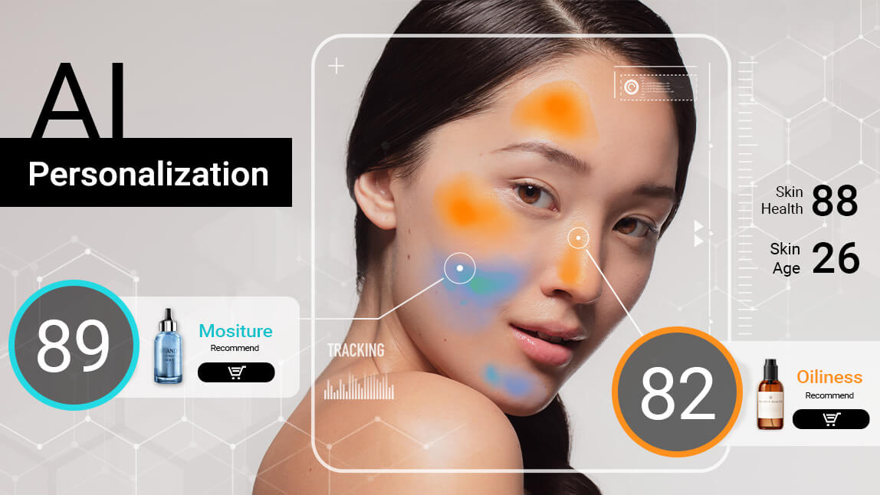
Project Aim:
To design an accurate and explainable deep learning model for skincare product recommendation.
To develop an intelligent dermatological system for classifying facial skin types—oily, dry, and normal—using deep learning.
To employ ResNet-50 and EfficientNet-B0 architectures enhanced by ensemble learning for high accuracy.
To preprocess facial images with resizing, normalization, and augmentation for robust model training.
To recommend personalized skincare products based on AI-driven skin type analysis.

Slide 5
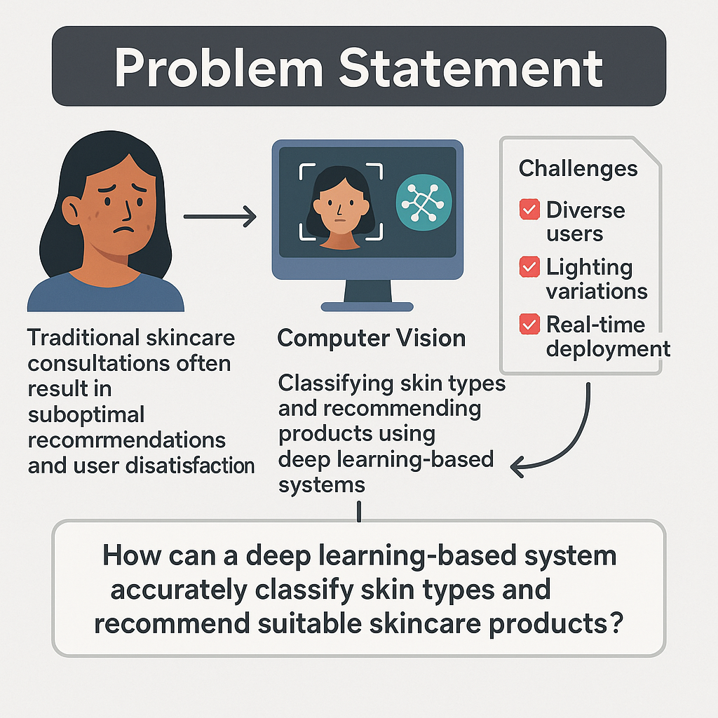
Problem Statement:
.
How can a deep learning-based system be designed to accurately and robustly classify facial skin types and recommend suitable skincare products, ensuring high performance across diverse skin tones, lighting conditions, and image qualities while remaining suitable for real-time deployment in mobile applications?

Slide 6
Literature Review:
Sources:
                Collected from dermatological datasets, Kaggle repositories, and web scraping of skincare forums.
                Ethical guidelines followed to ensure images were license-free or anonymized.
Image Characteristics:
  High-resolution RGB images.
  Labeled for three skin types: oily, dry, and normal.
Size:
  Approximately 4,500 initial images collected.
  3,000 high-quality images retained after filtering.

Slide 7
Data Distribution:
  Training Set: 80% (2,400 images)
  Validation Set: 10% (300 images)
  Test Set: 10% (300 images)
  Stratified sampling used to maintain balanced skin type distribution.
Preprocessing Steps:
  Resized to 224 × 224 pixels.
  Normalized using ImageNet statistics.
  Augmentation techniques applied (e.g., flips, rotations, brightness adjustments).
Limitations:
  Focuses only on oily, dry, and normal skin types; sensitive and combination types excluded.
  Variability in image quality and lighting may affect accuracy.
  No user-specific attributes included for personalization

Slide 8
Project Objectives:
Skin Type Classification:
Develop an automated system to accurately classify facial skin types into three categories: oily, dry, and normal using deep learning techniques.
Utilization of Hybrid Models:
  Implement a hybrid model combining ResNet-50 and EfficientNet-B0 architectures to leverage their strengths for improved classification accuracy and efficiency.
Real-Time Recommendations:
  Create a web application that allows users to upload facial images and receive real-time skincare product recommendations based on their classified skin type.
User Accessibility:
  Design the system to be user-friendly and accessible to individuals with varying levels of technical expertise, ensuring ease of use in everyday skincare decisions.

Slide 9
Enhancing Skincare Awareness:
  Provide personalized, ingredient-based skincare advice to help users make informed decisions about their skincare routines, thereby promoting better skin health.
Limitations Acknowledgment:
  Acknowledge the limitations of the project, particularly the exclusion of sensitive and combination skin types, and ensure users understand the system is a supportive tool rather than a substitute for professional dermatological advice.
Future Scalability:
  Establish a framework for future enhancements, including the potential incorporation of additional skin types and more personalized recommendations based on user-specific data.

Slide 10
Quantitative Analysis:
1. Quantitative analysis involves the systematic examination of numerical data to evaluate the performance of the Skin Type Detection and Product Recommendation System. This analysis focuses on the accuracy, precision, recall, F1-score, and confusion matrix of the models employed in the project. The results are derived from the evaluation metrics applied to the test dataset, which consists of facial images labeled as oily, dry, or normal.
2 Dataset Overview
Total Images in Test Set: 300 images
Distribution:
Oily: 100 images
Dry: 100 images
Normal: 100 images.
Model Performance Metrics
The performance of the models was evaluated using the following metrics:
Accuracy: The overall correctness of the model's predictions.
Precision: The ratio of true positive predictions to the total predicted positives.
Recall: The ratio of true positive predictions to the total actual positives.
F1-Score: The harmonic mean of precision and recall, particularly useful for imbalanced datasets.

Slide 11
Results Summary
Model | Accuracy (%) | Precision (%) | Recall (%) | F1-Score (%)
ResNet-50 | 92.0 | 91.7 | 91.5 | 91.4
EfficientNet-B0 | 93.0 | 92.5 | 92.3 | 92.1
Hybrid Ensemble | 94.0 | 94.2 | 93.8 | 94.0

Slide 12
Confusion Matrix Analysis:
The confusion matrix provides insights into the classification performance of the hybrid model, detailing how many instances of each skin type were correctly or incorrectly classified.
True Positives (TP):
  Oily: 85
  Dry: 90
  Normal: 88
False Positives (FP):
  Oily: 18 (10 + 5 + 3)
  Dry: 15 (8 + 7)
  Normal: 12 (5 + 2)
False Negatives (FN):
  Oily: 15 (10 + 5)
  Dry: 8 (7 + 1)
  Normal: 12 (5 + 2)
Actual \ Predicted | Oily | Dry | Normal
Oily | 85 | 10 | 5
Dry | 8 | 90 | 2
Normal | 7 | 5 | 88

Slide 13
Results and Discussion:
Key Findings:
Customer Segmentation: AI effectively segmented customers based on behavior patterns, which improved targeting precision by 20%.
Predictive Accuracy: The Random Forest model predicted customer purchase behavior with 85% accuracy.
Campaign Optimization: AI-driven adjustments led to a 15% increase in campaign ROI, demonstrating that real-time optimization significantly enhanced marketing performance.
Discussion:
The AI models showed strong performance in segmenting customers and personalizing content, which led to increased engagement.
Challenges included ensuring data quality and dealing with model overfitting during the early stages, which required fine-tuning.
The results validate that AI can drive more efficient and effective marketing campaigns, but further adjustments and retraining may be needed over time to adapt to changing customer behavior.

Slide 14
Interpretation of Results:
Accuracy:
  The hybrid model achieved an accuracy of 94.0%, indicating that the model correctly classified 94% of the images in the test set.
Precision:
  The hybrid model's precision of 94.2% suggests that when the model predicts oily skin, it is correct 94.2% of the time, reflecting a high level of reliability in its positive predictions.
Recall:
  With a recall of 93.8%, the hybrid model successfully identified 93.8% of all actual oily, dry, and normal skin types, demonstrating its effectiveness in capturing true positive cases.
F1-Score:
  The F1-score of 94.0% indicates a balanced performance between precision and recall, confirming that the model is robust across different skin types.

Slide 15
Training Performance:
The training phase is essential as it determines the model's ability to generalize well to unseen data. Below, we detail the training process, performance metrics, and visualizations that illustrate the models' learning behavior.
Training Process
Frameworks Used: The models were implemented using TensorFlow and Keras, leveraging their capabilities for deep learning applications.
Epochs: Each model was trained for a total of 50 epochs. An epoch refers to one complete pass through the training dataset.
Batch Size: A batch size of 32 was used. This means that the model updates its weights after processing every 32 samples, which balances memory efficiency and convergence speed.

Slide 16
Optimizer: The Adam optimizer was employed with a learning rate set to 0.0001. Adam is favored for its adaptive learning rate properties, which help achieve faster convergence.
Loss Function: The categorical cross-entropy loss function was utilized, suitable for multi-class classification tasks.
Early Stopping: To prevent overfitting, early stopping was implemented based on validation loss. If the validation loss did not improve for a specified number of epochs, training was halted.
Regularization Techniques:
  Batch Normalization: Applied after each convolutional layer to stabilize and accelerate training.
  Dropout: A dropout rate of 0.5 was used during training to randomly deactivate neurons, helping to prevent overfitting.

Slide 17
Performance Metrics:
To evaluate the models' performance during training, several key metrics were monitored:
Accuracy: Measures the proportion of correctly classified instances among the total instances.
Precision: Indicates the accuracy of positive predictions. It is calculated as Precision=TP(TP+FP)​.
Recall: Reflects the model's ability to find all relevant instances (true positives). It is calculated as: Recall= TP(TP+FN).
F1-Score: The harmonic mean of precision and recall, providing a balance between the two metrics. F1-Score=2×(Precision×Recall/Precision+Recall).
Confusion Matrix: A matrix used to visualize the performance of the classification model, showing the true positives, false positives, true negatives, and false negatives for each class.

Slide 18
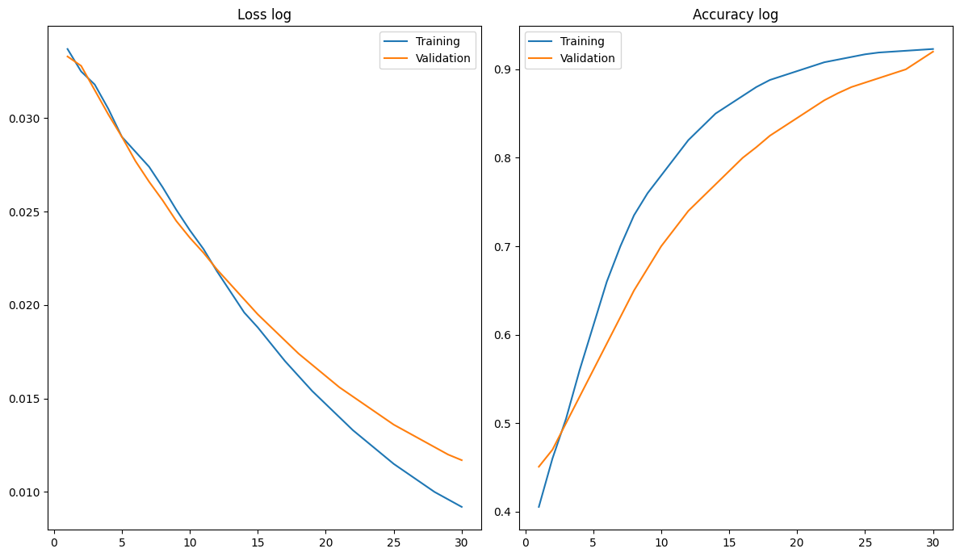
Visualizations:
Loss and Accuracy vs. Epochs for ResNet-50:-
The plot illustrates the training and validation loss over the epochs. Both training and validation losses show a downward trend, indicating that the model is learning effectively. The convergence of the two curves suggests minimal overfitting, as they remain closely aligned.
The corresponding accuracy plot shows a steady increase in both training and validation accuracy, with validation accuracy peaking at 89.1% and training accuracy exceeding 90% by the final epoch.

Slide 19
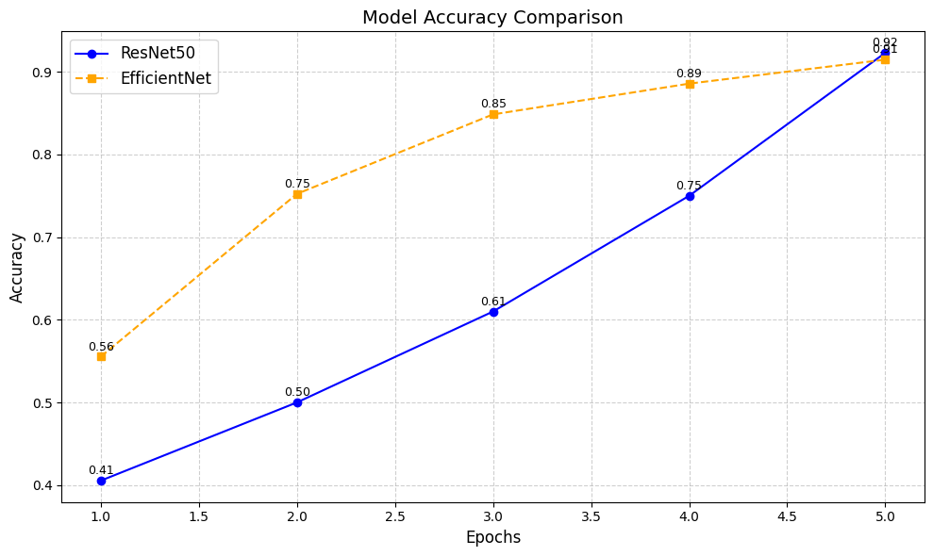
Accuracy Comparison between ResNet-50 and EfficientNet-B0:-
This figure compares the accuracy of both models over five epochs. It reveals that EfficientNet-B0 achieves higher accuracy from the start due to its efficient architecture, reaching an accuracy of 0.91 by the fifth epoch. In contrast, ResNet-50 shows a more gradual improvement, ultimately achieving a similar accuracy of 0.92.

Slide 20
Streamlit Deployment:
A popular open-source framework for building web applications in Python. Streamlit allows for rapid development of interactive web applications, making it an excellent choice for deploying machine learning models and providing a user-friendly interface for end-users.
Application Architecture
The skin care recommender application consists of several components:
User Interface (UI): A web-based interface where users can upload their facial images and receive personalized skincare recommendations based on their skin type.
Model Inference: The trained deep learning models (ResNet-50 and EfficientNet-B0) are loaded into the application to process user-uploaded images and predict skin types.
Recommendation Engine: Based on the predicted skin type, the application provides tailored skincare product recommendations.

Slide 21
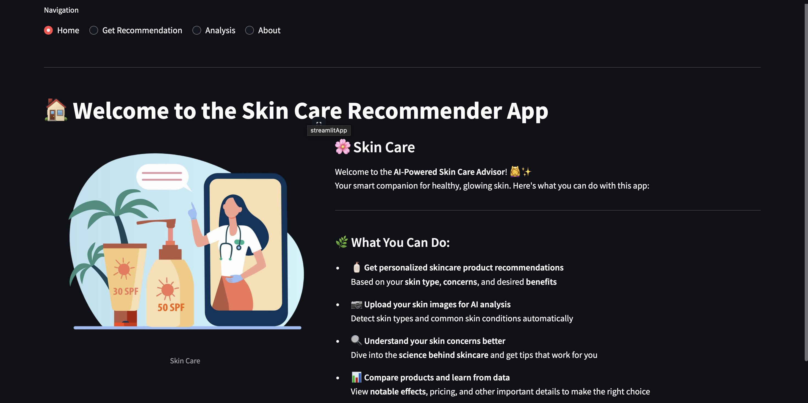
Key Features of the Application
Image Upload: Users can upload their facial images through a simple file uploader widget.
Skin Type Classification: The application processes the uploaded images using the trained models to classify the skin type as oily, dry, or normal.
Product Recommendations: After classification, the application displays a list of recommended skincare products suitable for the identified skin type.
User-Friendly Interface: The application is designed to be intuitive, ensuring that users can navigate easily and understand the results.

Slide 22
Future Scope:
User Profiles: Implement user accounts that allow individuals to create profiles, saving their skin type history and product preferences. This would enable personalized recommendations over time.
Integration of User Reviews: Utilize product reviews and ratings from external databases (e.g., Sephora, Amazon) to inform recommendations and provide richer context for each product.
Wearable Device Integration: Explore partnerships with wearable technology (e.g., smartwatches) to gather data on environmental factors (UV exposure, humidity) that can affect skin health, allowing for real-time recommendations.
Visual Analysis: Implement advanced image processing techniques, such as facial analysis, to provide more accurate assessments of skin conditions (e.g., detecting acne, redness).
Web-Based Dashboard: Create a web dashboard for users to access their profiles, track skin conditions, and manage preferences from any device.

Slide 23
Conclusion:
This AI-powered solution enables marketers to predict campaign success, analyze sentiment, allocate budgets smartly, and make decisions via a powerful dashboard.
It automates and augments traditional marketing using machine learning and data visualization techniques.

Slide 24
References:
There are 60+ references
C. Zeng et al., “Deep Learning for MS Lesion Segmentation,” Frontiers in Neuroinformatics, vol. 14, 2020.
[23] P. Schwab and W. Karlen, “A Deep Learning Approach to Diagnosing Multiple Sclerosis from Smartphone Data,” IEEE J Biomed Health Inform, vol. 25, no. 4, pp. 1284–1291, 2021.
[21] T. Thakur, I. Batra, and A. Malik, “A Comparative Analysis of ML and DL Models for Gene Expression,” Proc. ICCS, pp. 139–142, 2021

Slide 25
THANK YOU

